Slide 1
Quality Controlled Continuously Formed NCF-Preforms
Arne Stahl, Henrik Borgwardt
German Aerospace Center (DLR e.V.)
Institute of Composite Structures and Adaptive Systems Braunschweig

Slide 2
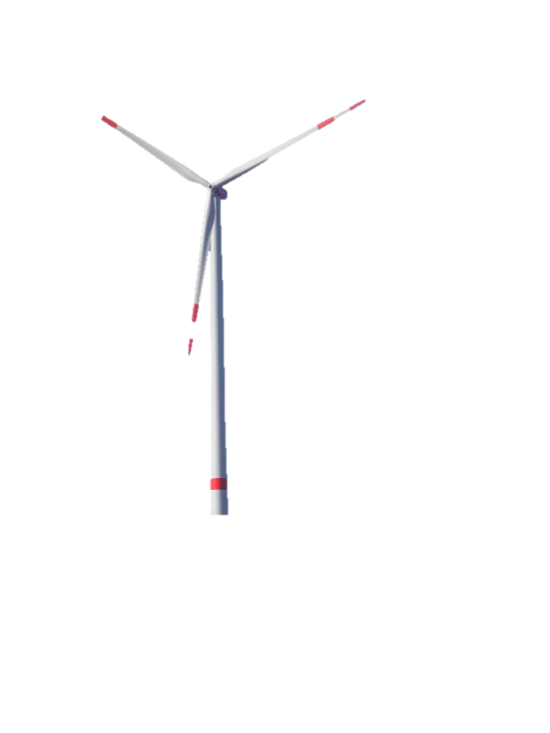
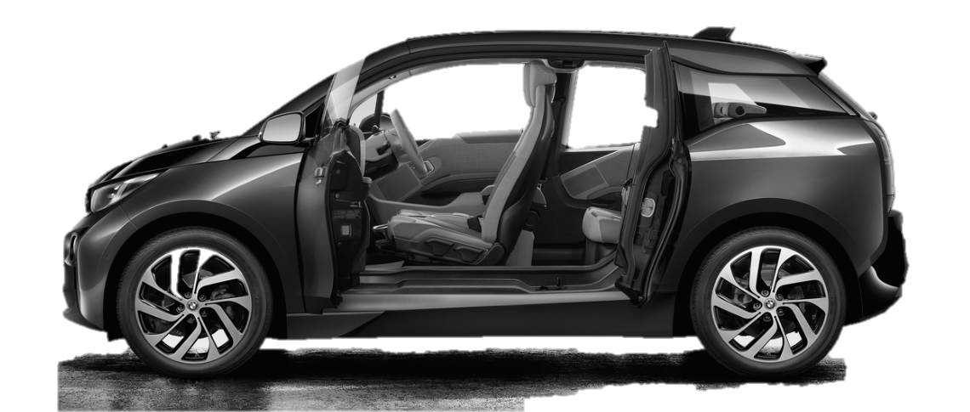
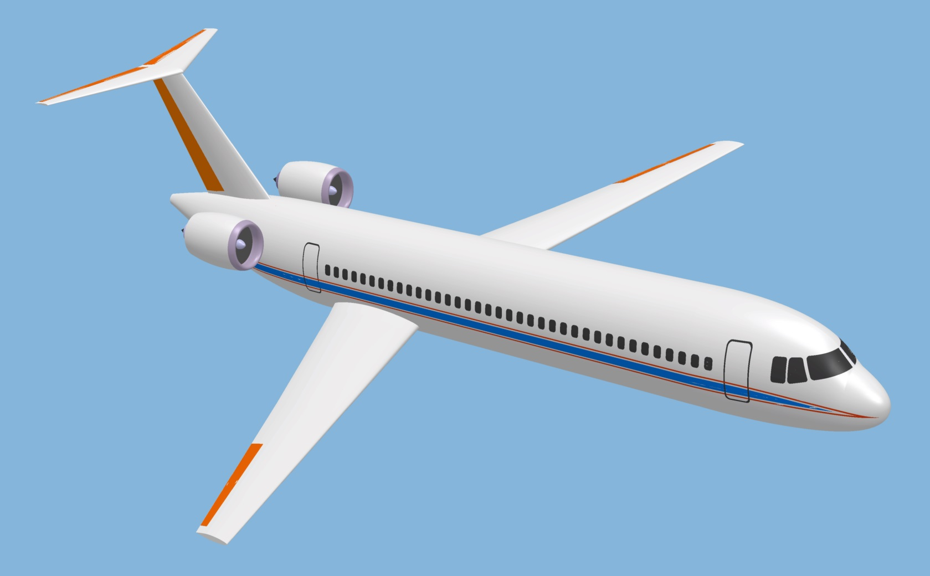
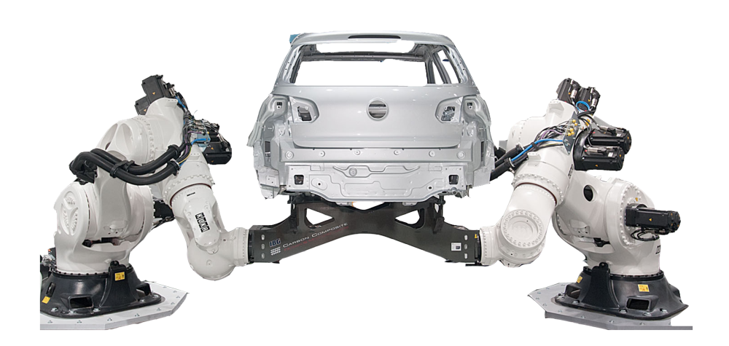
Motivation
Source: BMW
Source: Nordex
Source: Goeke Group
Lightweight composite design can contribute to achieve more efficient travelling and more efficient manufacturing and energy recovery
Composites as lightweight material require specialized manufacturing technologies for high quality and high quantity
Notes:
Many advantages through lightweight composite design
Different application markets: for example aeronautics, automotive, energy and industry

Slide 3
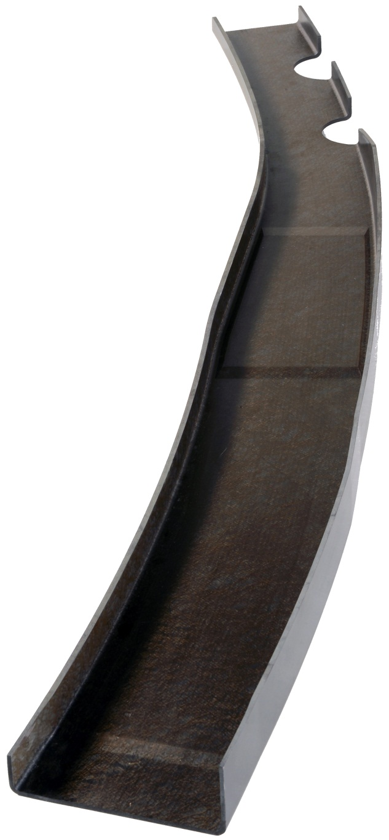
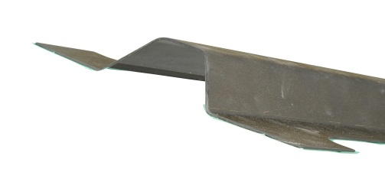
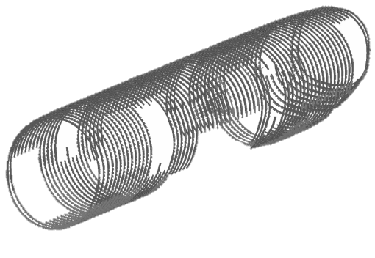
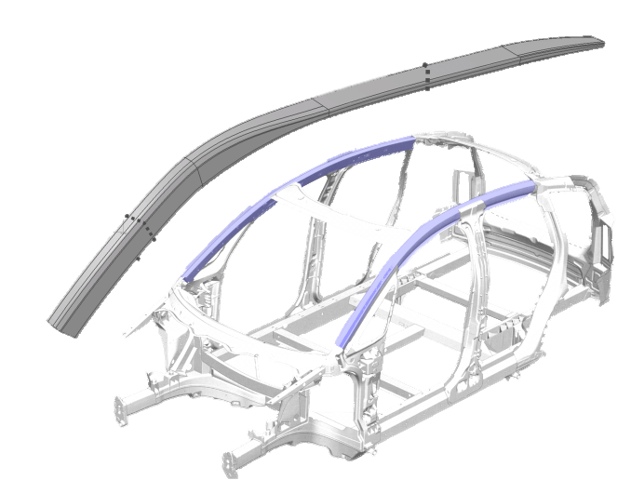
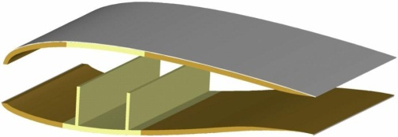
Motivation
Focus on Aircraft
Fuselage Frames
Quality
Source: Audi
Source: Nordex
Quantity
Notes:
Numbers for aircraft sector:
40-50 a/c per month
200 frames per fuselage
120.000 frames per year
Aircraft frame:
Multiple curvature
Variable cross section
Variable thickness
Biaxial and triaxial NCF plus seperate 0°-UD-layers

Slide 4
Automated RTM for high quantity and high quality
Roll Handling | Cutting | Ply Transfer | Gripping
Fine Trimming | Consolidation | Quality Assurance | Draping
Preform Insertion | Injection | Curing | Demoulding
Notes:
Fully automated RTM with 2D-NCF for high quality and high quantities and cost-effective manufacturing

Slide 5
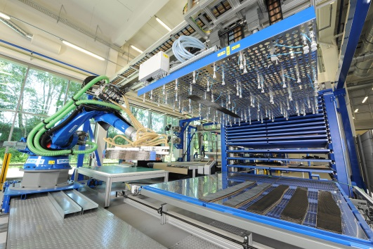
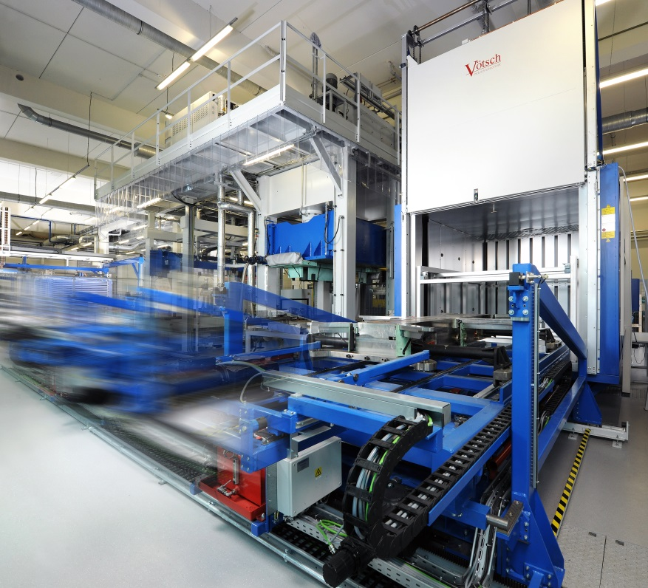
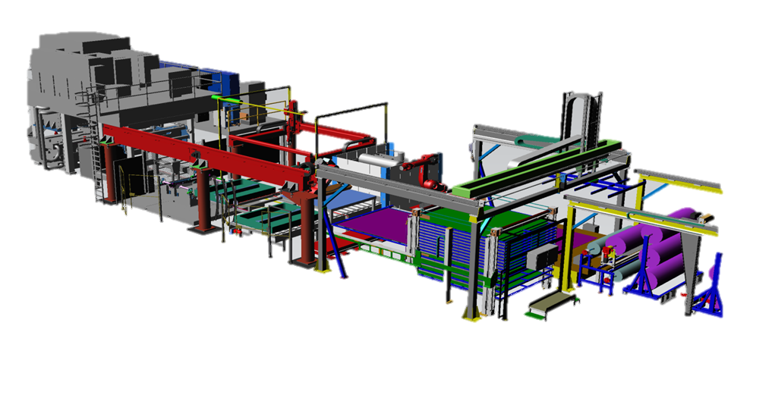
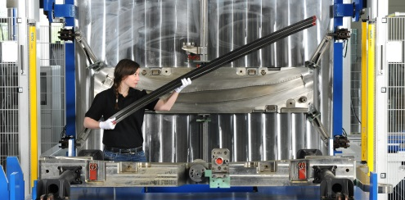
Automated RTM for high quantity and high quality
Research RTM-line installed at Institute
Notes:
2 seperate Preforming process variations:
sequential
continuous

Slide 6
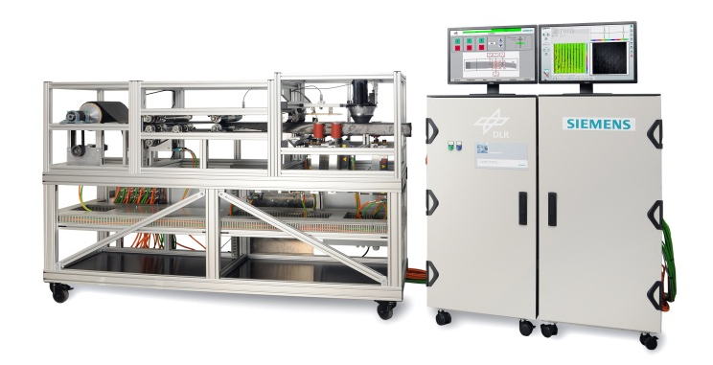
Continuous Preforming Process Part of RTM-line
Roll Handling | Cutting | Ply Transfer | Gripping | Draping | Quality Assurance
Continuous Preforming Process
Notes:
Consolidation of six sequential preforming steps in one continuous preforming process

Slide 7
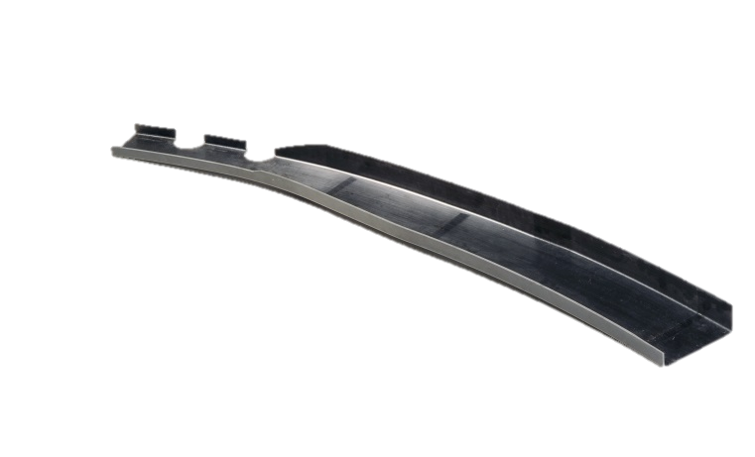
Continuous Preforming Process Overview
Process based on metallic roll forming
Constant fiber orientation along the whole part length
less edge effects while draping
Variable curvature
Geometric flexibility for various cross sections
NCF for fast lay-up rates
Notes:
Single layer preforming due to interleaved 0° layers in lay-up followed by robotic stacking process
Full quality controll of whole stack

Slide 8
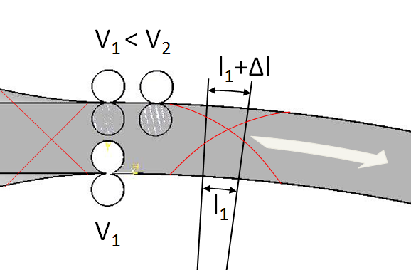
Continuous Preforming Process Roll Forming Principle
v₂
NCF +/- 45°/(90°) needs to be sheared and lengthened in the outer flange
Speed difference between roller pairs at outer flange “stretches” NCF
Inner flange is undeformed
Variable adjustable speeds v₁ and v₂ allow variable curvature
v₁
v₁
φ_{a}
φ_{i}
b
Patents (DE102012101706A1; EP000002633965A2 )
Notes:
Direct correlation between speed difference, stretch, fiber angle and curvature for a given profile width

Slide 9
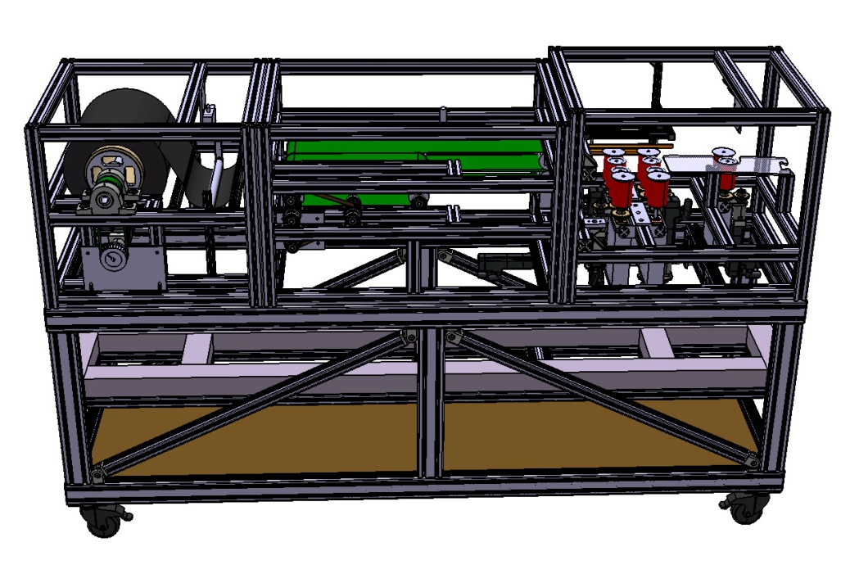
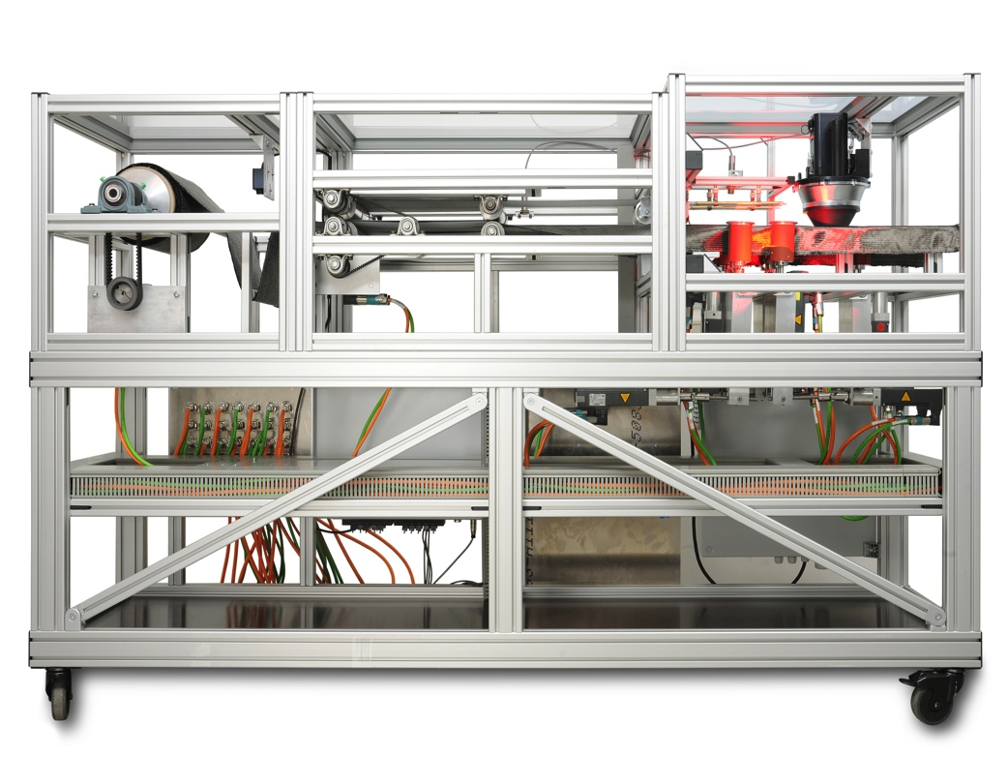
Continuous Preforming Process Configuration of Forming Facility
Prototypic facility for process validation and proof of industrialization
Modular design for expandability and additional functions
Industrial motion and controll systems for individual controll of all drives
Quality assurance by fiber orientation measurement
storage
transport
heating forming
Notes:
Based on forming principle prototypic facility was developed for process validation and a proof of industrialization of a preforming process

Slide 10
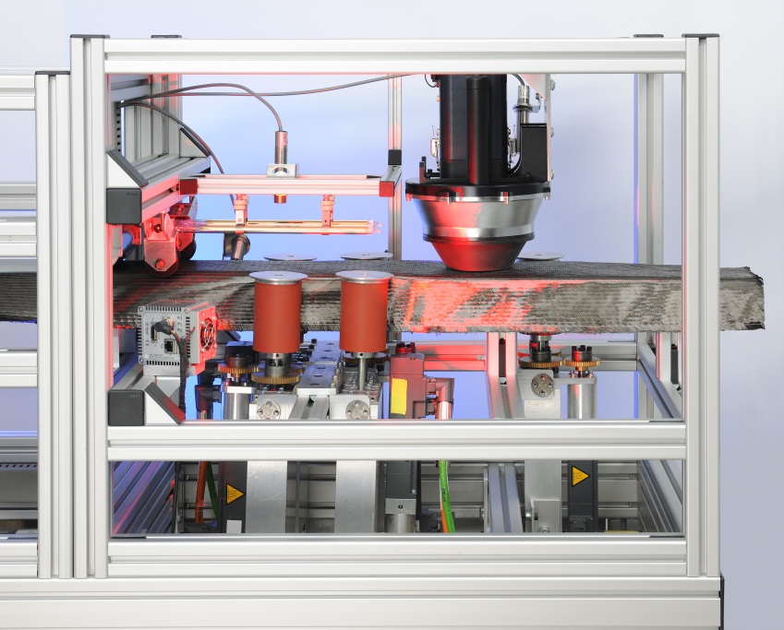
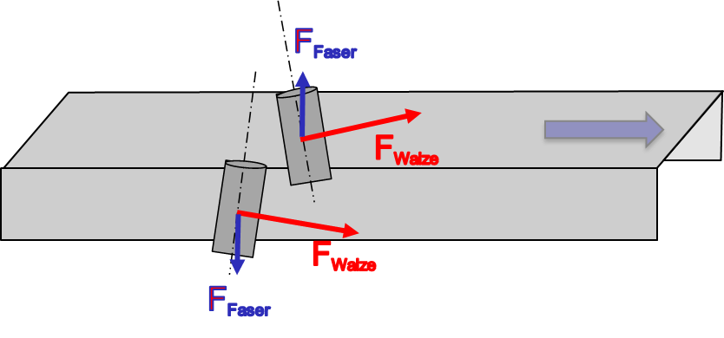
Continuous Preforming Process Configuration of Forming Facility
Five individual driven roller-pairs
Infrared heating elements for binder activation
pivoting forming unit to controll sideway movement of NCF
storage
transport
heating forming
Notes:
Induction Ströhlein

Slide 11
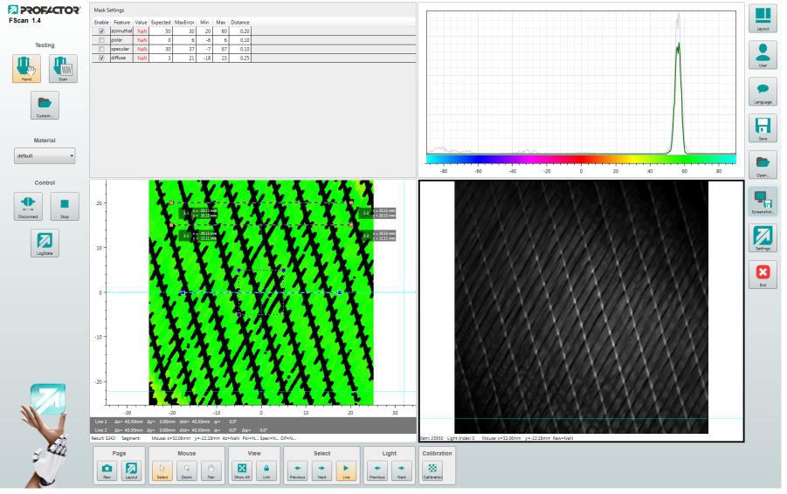
Quality Assurance Fiber Orientation Measurement
Optical FScan sensor based on Fiber Reflection Analysis*
Orientation can be calculated without time consuming image processing
Very fast method suitable for scanning with 1 m/s
Scan of whole part can be transformed to FEA mesh for as-built-simulation
* Palfinger, W., Tumfarth, S. & Eitzinger, C. “Photometric stereo on carbon fiber surfaces.” 35th Workshop of the Austrian Association for Pattern Recognition, Graz; 26.11.2011

Slide 12
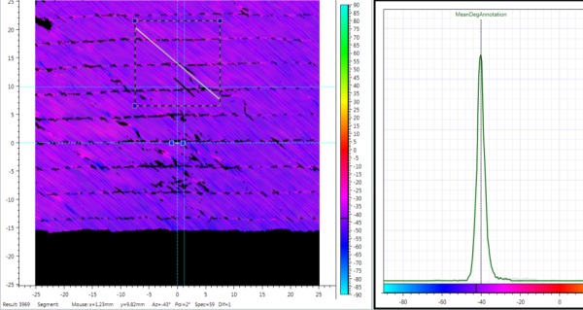
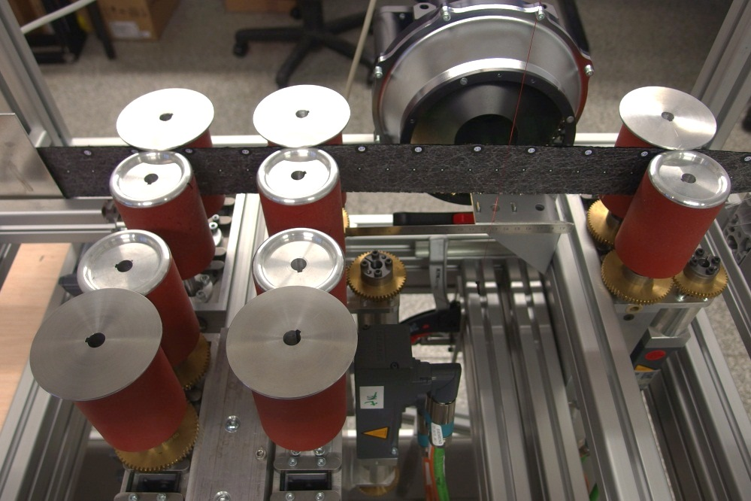
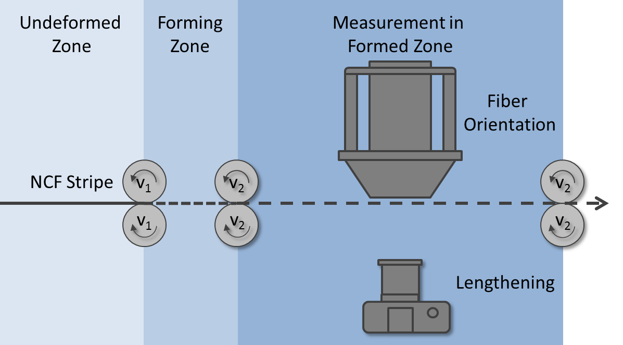
Validation of Process Fiber Orientation and Elongation Measurement
Shear and elongation of a biaxial NCF strip as a degree for the deformation and curvature of profile
Elongation for validation of forming principle
Fiber orientation for validation of correspondence between elongation and shear

Slide 13
Validation of Process Fiber Orientation and Elongation Measurement
running-in interval
forming interval
Asymptotic behaviour of fiber angle change and elongation towards theoretical values
Variations in fiber angle change due to initial material-inherent variation of +/-1°
Deviations because of slippage and assumptions for theoretical values
Average deviation of +/-1° is well within requirements
Basically matching curves of elongation and fiber angle change show correlation
Off-set speed is adjusted to compensate deviations

Slide 14
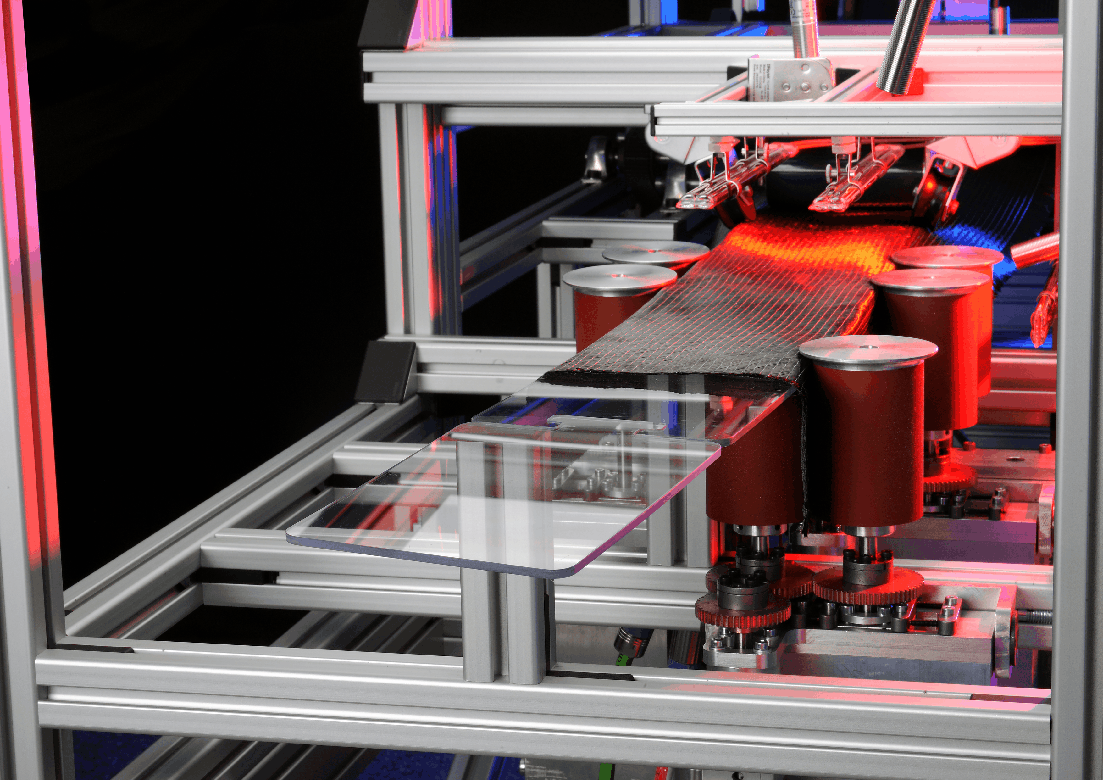
Summary and Outlook
Summary
Outlook
Novel preforming mechanism for NCF profiles is developed and proven
Correlation between shear, elongation and frame curvature is determined
Quality assurance system is adapted and integrated for fiber orientation measurement as a measure of the degree of curvature
Development and of cross-sectional variation
Integration of additional UD layers
Camera-based sensor system for controll of side-way NCF movement

Slide 15
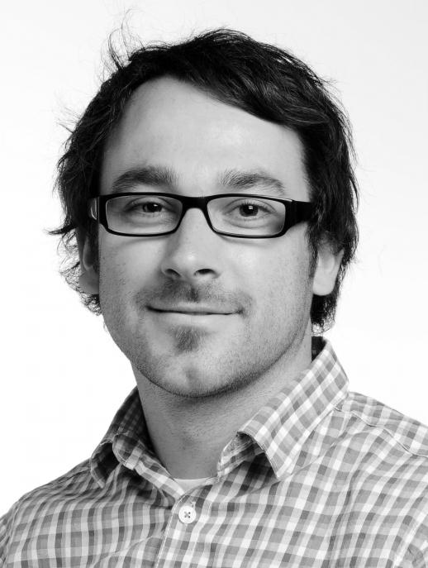
Thank you very much!
Dipl.-Ing. Arne Stahl
arne.stahl@dlr.de
Deutsches Zentrum für Luft- und Raumfahrt e.V. (DLR)
German Aerospace Center
Institute of Composite Structures and Adaptive Systems Composite Design
Lilienthalplatz 7
38108 Braunschweig
Germany
www.DLR.de/FA

