Slide 1
New multispectrum fitting software used at DLR for analysis of laboratory Fourier-Transform molecular spectra
Joep Loos, Manfred Birk, Georg Wagner
German Aerospace Center, Remote Sensing Technology Institute

Slide 2
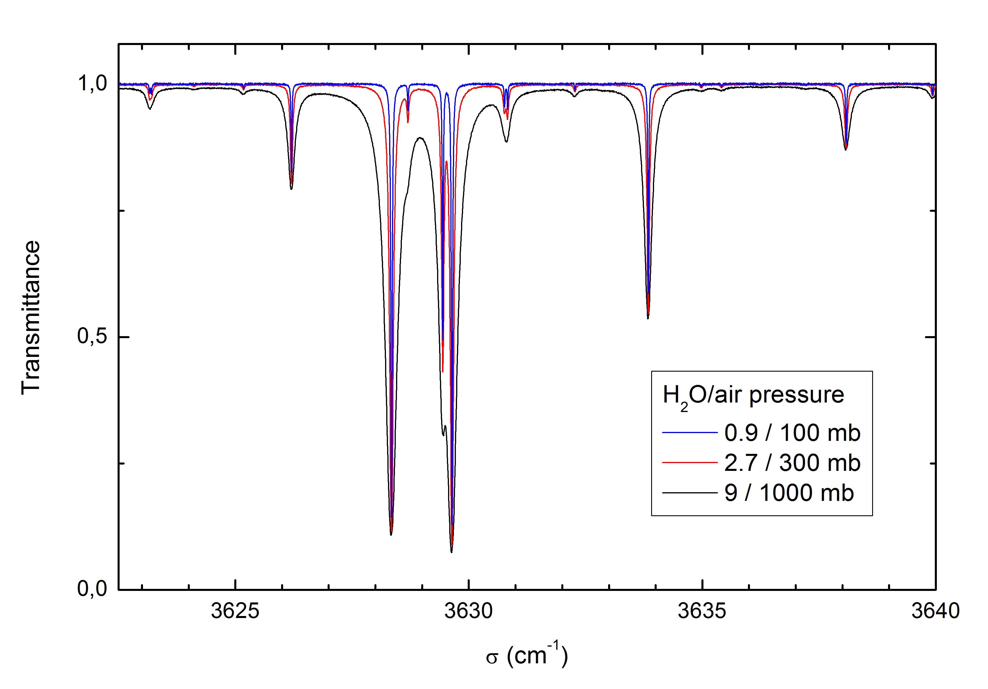
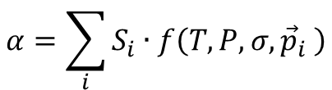

Absorption cross sections or line-by-line data?
$$α=\sum_{i}{S_{i}∙f\left(T,P,σ,{\vec{p}}_{i} \right)}$$
$$t=\text{exp}\left[−α\left(T,P,σ\right)∙l∙N\right]$$
High measurement effort
Higher resolution necessary
Low analysis effort
Only interpolation
➔ e.g. HFCs, CFCs
Baseline less critical
Less measurements needed
Extrapolation possible (to some extent)
Low line density
Error parametrization accessible
➔ e.g. CO, NO, H2O
Notes:
Szenario: ACS mit zu geringer Auflösung gemessen.

Slide 3
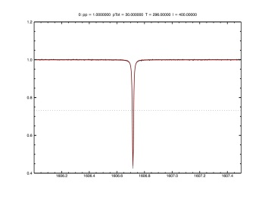
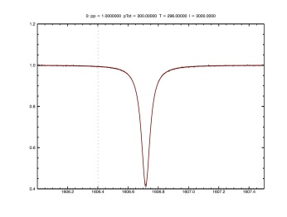
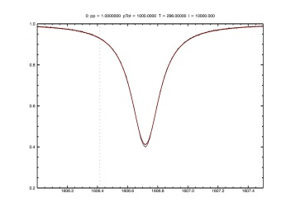





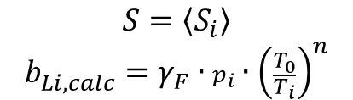

Why multispectral fitting?
„Classical“ analysis: single spectrum fitting
FitMAS, LINEFIT, tool by MB/GW, …
Multispectral analysis
$$S=\left\langle S_{i}\right\rangle$$
$$b_{Li, calc}^{}=γ_{F}∙p_{i}∙{\left(\frac{T_{0}}{T_{i}}\right)}^{n}$$
$$S_{1}$$
$$b_{L1}$$
$$T_{i}=f\left(S,γ_{F},n ,p_{i},T_{i}\right)$$
$$S,γ_{F},n$$
$$S_{2}$$
$$b_{L2}$$
$$S,γ_{F},n$$
Computationally extensive
Quality assessment difficult: only spectral residuals
Data reduction model has to be known
decorrelates various parameters
opaque and blended lines can be fitted
Computationally inexpensive
Quality assessment accessible:
  Chi-Test, filecuts
Test of data reduction model possible
Error covariances lost
$$S_{3}$$
$$b_{L3}$$
Notes:
alles well known
Ausdruch „data reduction model“ erklären

Slide 4
Multispectrum vs single spectrum fitting
Single spectrum fitting + consecutive data reduction = sound method for generation of spectroscopic data
Complexity and computation time requirements restrict multispectral fit to small spectral intervals
Temperature and number density fit requires large spectral range ➔ restricted to single spectrum fits
Multispectrum fit yields higher precision in many cases
Multispectrum fit can give higher accuracy in some cases
Multispectrum fit enables fitting of parameters not accessible to single spectral analysis
e.g. speed-dependence
➔ Fusion of multispectrum and single spectrum fit to combine advantages
Notes:
higher precision: in single spectrum fits kann nur „fitbare“ Linie gefittet werden
higher accuracy: covariances lost -> eg correlation between baseline parameter and line strength of weak lines

Slide 5
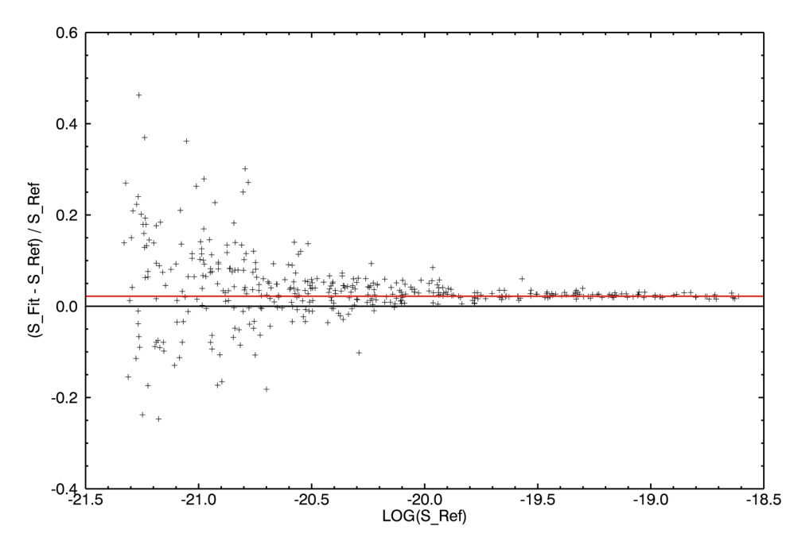
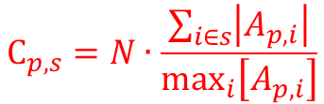

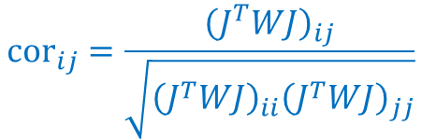
What can the new software do?
Line models
  Voigt
  Speed-dependent Voigt (C. Boone)
  Speed-dependent Galatry + LM (F. Hase)
  pCqSDHC + LM (Ngo, Tran)
  Humlicek by Kuntz & Ruyten for Boone and Tran
Versatile interactive mode
  Choice of line model, fitparameters
  ILS, calibration factors, baseline, channelling, …
Automatic mode
  Microwindow-, spectra-, fitparameter selection (Voigt)
  Chi-test of spectral residuals
  Residua analysis similar to MIPAS/ENVISAT REC analsis
  by Anu Dudhia planned
Single spectrum fitting
Temperature/number density fit
Filecuts (results of single-spectra-fits vs. ms-fit)
  Identification of systematic spectrum-specific errors
Identification/prevention of correlation between fitted parameters
Identification of source of information
Filecut
$${\text{cor}}_{ij}=\frac{{\left(J^{T}WJ\right)}_{ij}}{\sqrt{{\left(J^{T}WJ\right)}_{ii}{\left(J^{T}WJ\right)}_{jj}}}$$
$${A=\left(J^{T}WJ\right)}^{−1}\left(J^{T}W\right)$$
$${\text{C}}_{p,s}=N∙\frac{\sum_{i∈s}{\left|A_{p,i}\right|}}{{\text{max}}_{i}\left[A_{p,i}\right]}$$

Slide 6
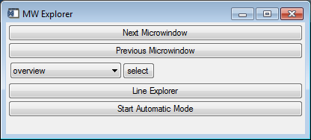
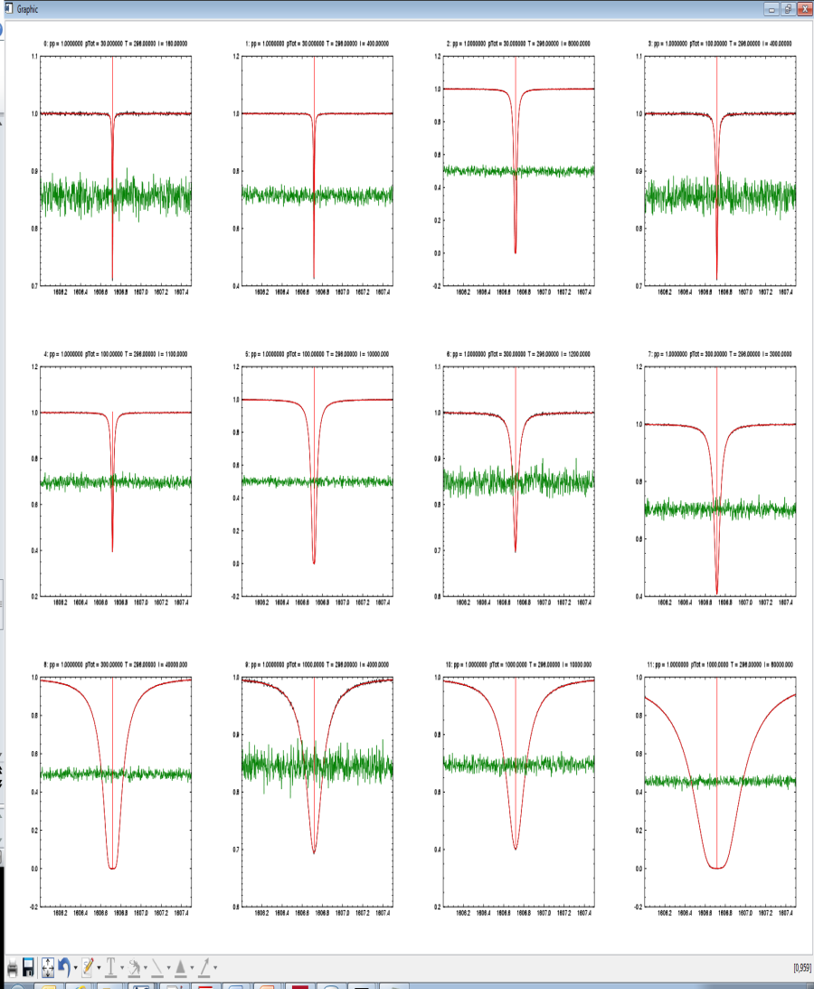
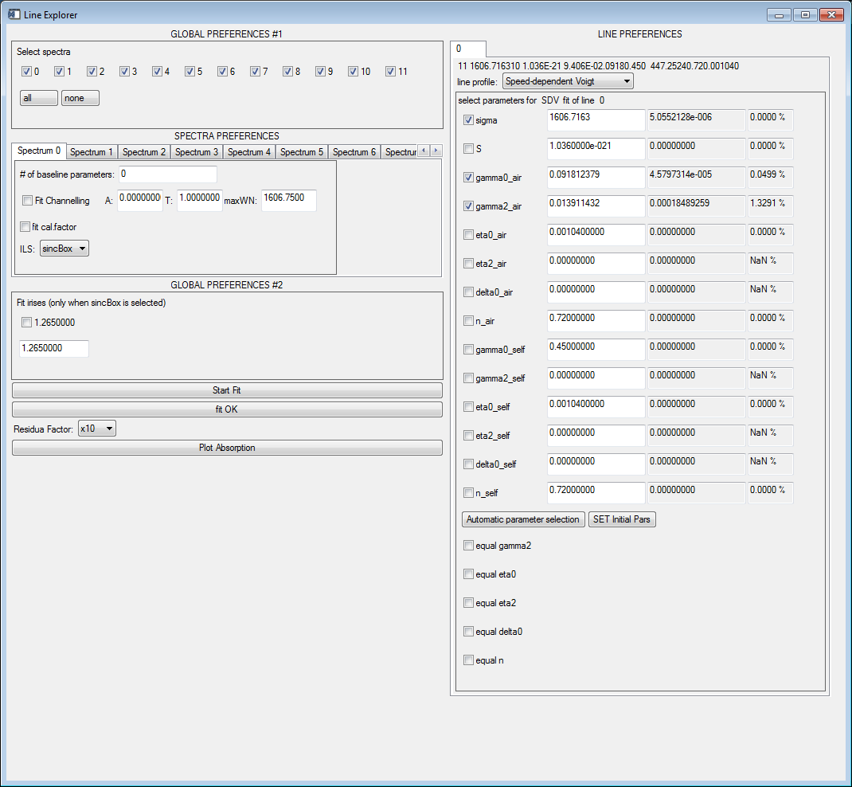
How does it look like?

Slide 7
Example: Speed-dependent analysis of H₂O ν₂ band

Slide 8
Example: Speed-dependent analysis of H₂O ν₂ band
Voigt: w-shaped residuals for non-opaque lines
Voigt: line-wing residuals for opaque lines
Fitted broadening parameters systemitically larger when fitted with SDV
 ➔ Opaque lines are modelled too narrow
Influence of narrowing larger when broadening parameter lower (higher J)

Slide 9
Example: Line mixing of N₂O ν₃ band

Slide 10
Example: Line mixing of N₂O ν₃ band

Slide 11
Concluding remarks
Multispectral analysis essential when using line profiles of high complexity and various parameters
IDL fitting tool combining advantages of single and multispectrum fit has been developed
  Several line models
  Interactive and automatic mode
  Additional information for quality assessment
  (parameter correlation matrix, information content, filecuts)
H₂O ν₂ band reanalyzed
  Speed-dependence of broadening parameter has to be considered
  Opaque and non-opaque lines fitted simultaneously
  Systematically larger broadening parameters than HITRAN
N₂O ν₃ band
  High SNR measurements
  Speed-dependence and line mixing have to be considered

