Slide 1
Collaborative Research into Exascale Systemware, Tools and Applications
Gregor Matura, German Aerospace Center (DLR)
Achim Basermann, Fang Chen, Markus Flatken, Andreas Gerndt (DLR)
James Hetherington, Timm Krüger, Rupert Nash (UCL)

Slide 2
PPStee
A Pre-Processing Interface for Steering Exascale
Simulations by Intermediate Result Analysis
through In-Situ Post-Processing

Slide 3
Motivation
pre
Initialisation
main
post
Result analysis
Visualisation
Simulation core
Data manipulation
Rendering
?
Partitioner:
Load balance
?

Slide 4
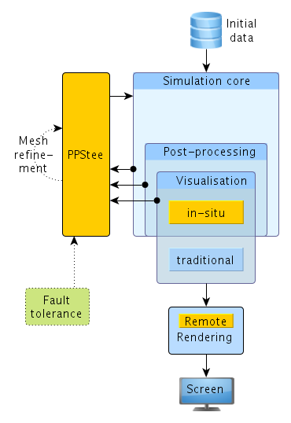
PPStee data flow: overview

Slide 5
Assumptions
The simulation uses a partitioner
There is some sort of mesh
The mesh is there (= in memory): an initial (=bad) read-in happens
The simulation has more than one stage
E.g.: an in-situ data analysis or visualisation is integrated

Slide 6
Properties
Swappable external partitioning tool
Flexible data format
Incorporates different simulation stages like computation and visualization
Easily adjustable to
new partitioning tools
different kinds of stages
fault tolerance
(more/any) mesh refinement

Slide 7
PPStee data flow: revisited

Slide 8
Advantages
Offers standardised partitioner access
Relies on established external partitioning tools (however own ones can be integrated as well)
Little overhead: if partitioning is already implemented required interface input is present in some (similar) form
Small memory requirements

Slide 9
Disadvantages
Individual routines of external partitioning tools covering special functionalities have to be implemented separately (yet this is possible)
Another software layer

Slide 10
Basic usage: example
Old call to ParMETIS:
ParMETIS_V3_PartKway(
vtxdist, xadj, adjncy,
vwgt, adjwgt,
wgtflag, numflag, ncon, nparts,
tpwgts, ubvec, options, edgecut,
part,
comm);

Slide 11
Basic usage: example
Call to PPStee:
// get interface
PPStee ppstee;
// submit graph
ppstee.submitGraph(pgraph);
// submit weights
ppstee.submitNewStage(wgtCmp, PPSTEE_STAGE_COMPUTATION);
ppstee.submitNewStage(wgtVis, PPSTEE_STAGE_VISUALISATION);
// calculate partitioning
PPSteePart* ppart;
ppstee.getPartitioning(&ppart);

Slide 12
Basic usage: example
Build graph:
// get graph (as ParMETIS type)
PPSteeGraph pgraph = PPSteeGraphParmetis(MPI_COMM_WORLD, vtxdist, xadj, adjncy);
Build weights:
// construct and set weights for computation
PPSteeWeights wgtCmp(&pgraph);
wgtCmp.setWeightsData(vwgt_c, adjwgt_c);
// construct and set weights for visualisation
PPSteeWeights wgtVis(&pgraph);
wgtVis.setWeightsData(vwgt_v, adjwgt_v);

Slide 13
Future work
Integration into HemeLB
Performance measurements with HemeLB
Further tests with other applications
Revision of architecture
Comparison with other frameworks (some of them cover features of PPStee, e.g. ITAPS)

Slide 14
Preliminary results
HemeLB test runs on HemeLB test data sets (R15-L45 and R15-L450)
PPStee using ParMETIS vs. PPStee using PTScotch vs. plain HemeLB code (ParMETIS)

Slide 15
Thank you
for your attention!

