Slide 1
Lightweight Design: The Vanguard of Automotive Engineering Strategies for Materials and Construction Methods
Prof. Dr.-Ing. Horst E. Friedrich
Dipl.-Ing. Gundolf Kopp
Dipl.-Ing. Marco Münster

Slide 2
Agenda
1. Growing importance of lightweight construction
2. Methodical approach in the development process
3. Lightweight construction strategies
4. Challenge: lightweight construction in the volume segment
5. Concepts for current and future cars
6. Trends in materials and structures yesterday, today and tomorrow

Slide 3
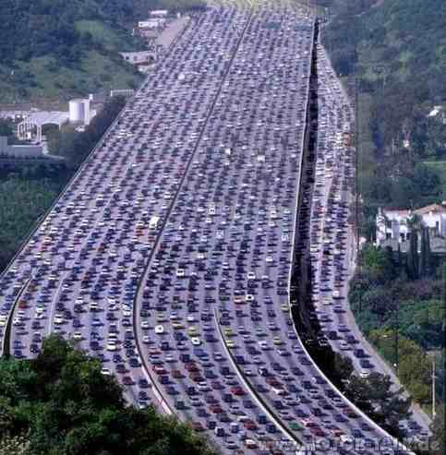
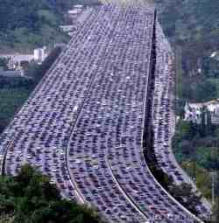
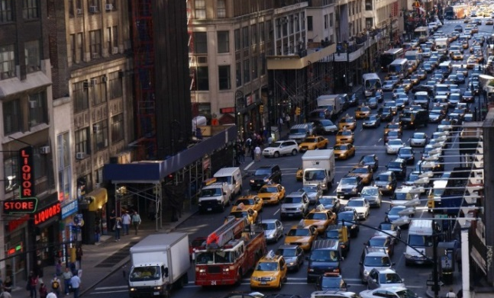
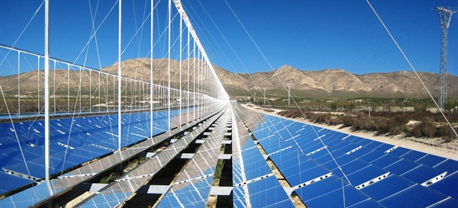
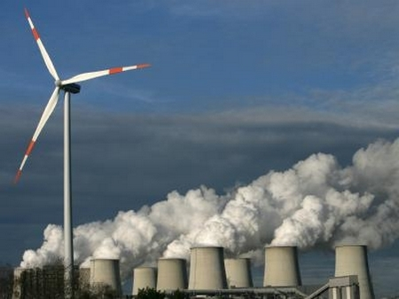
Megatrends
We are reaching the limits of oil extraction
Climate change is taking place
Growing population, concentrated in big cities and conurbations
Demographic trend
Source: http://www.fotocommunity.de/pc/pc/mypics/1438338/display/18369424
Source: DLR
Vehicle concepts
Lower energy consumption
Reduced CO₂ emissions
Alternative and regenerative energy sources
Automated driving / connectivity
…
Source: versust.blogsport

Slide 4
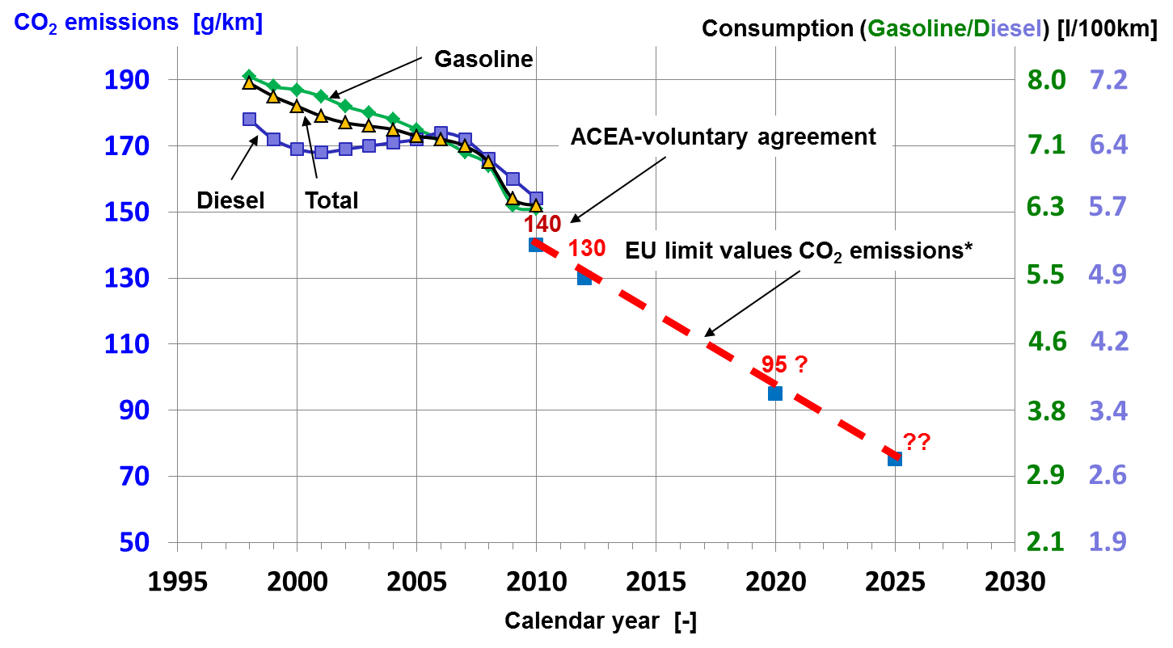
CO₂ emissions in new vehicles in Germany and EU CO₂ limits
* Mass-dependent
Source: KBA; DLR

Slide 5
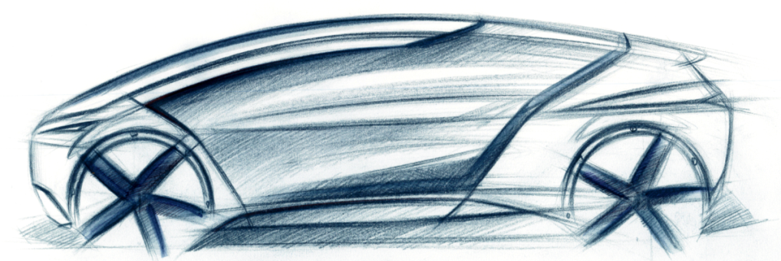
Total of normal resistances and consumption
$${∑ F}_{w}=b∙(m_{g}+∑ m_{rot})+m_{g}∙g∙f_{R}∙cos(α)+m_{g}∙g∙\sin\left(α\right)+ \frac{ρ}{2}∙c_{w}∙A∙v^{2}$$
F_{B}
F_{R}
F_{St}
F_{L}
urban
combined
highway
F_{L}
$$B_{e}=\int{b_{e}∙\frac{1}{η_{Antrieb}}∙{∑F}_{w}}∙\frac{v∙dt}{\int{v∙dt}}$$
Consumption per 100 kg/ (l/100 km)
0,39
0,32
F_{B}
F_{R}
0,15
F_{St}
i adjust NEFZ
vh adjust NEFZ
Normal resistances
Differential consumption factors for 100 kg weight reduction in a vehicle with spark-ignition engine
Source: DLR; Rohde-Brandenburger, Volkswagen AG

Slide 6
Extension of range with small electric vehicles
Artemis Urban (with recuperation)
Artemis Urban (without recuperation)
NEFZ (with recuperation)
NEFZ (without recuperation)
Increase in range [%]
28 %
25 %
Mass reduction [%]
Source: DLR

Slide 7
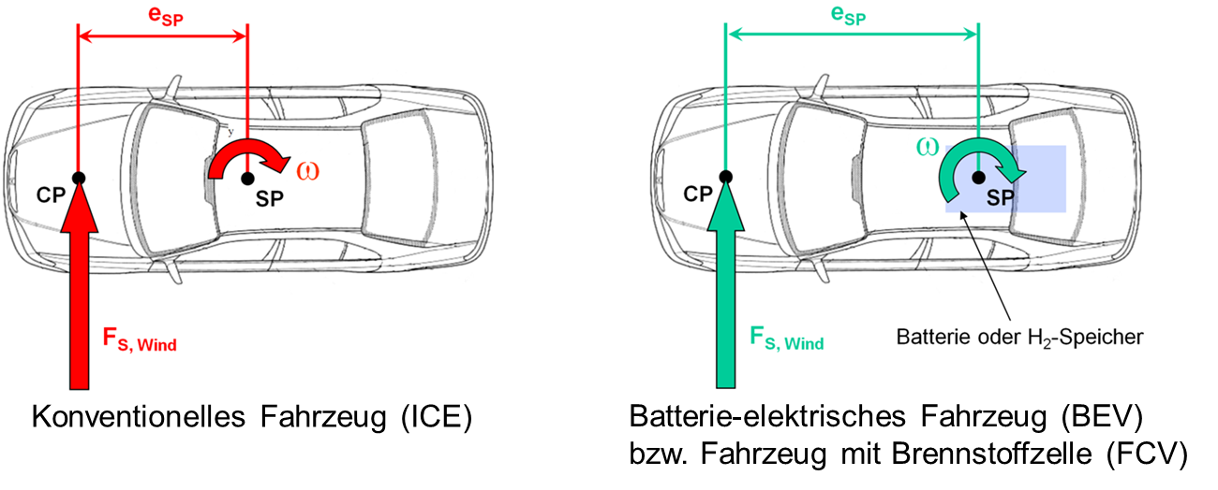
Lightweight construction, vehicle dynamics and electromobility
- Running resistances
Lateral dynamics dependent on CG (SP)
- Unsprung mass
- Secondary effects
- Crosswinds
- Road transverse gradient
- Ruts, stochastic
unevenness
- More sensitive to
weight
Influence of lightweight construction on vehicle dynamics
- Position of battery → Roll behavior
- Wheel hub drive → Yaw behavior
Opportunity for electromobility
battery or fuel cell tank
Lightweight design measures required
conventional vehicle (ICE)
battery electric vehicle (BEV) or fuel cell vehicle (FCV)
Source: IVK Stuttgart, DLR
Notes:
Logitudinal motions
Lateral motions

Slide 8
Potential to minimize CO₂ emissions
Lightweight
CO₂ emissions in the production of materials
(kg CO₂ eq./kg raw material)
CO₂ reduction cost and potential
(Example: medium sized car with 140 g CO₂/km)
ICE efficiency
Electric powertrain
Range
High strength steel
Weight reduction of 250 kg
Carbon fiber structures
Weight reduction of 490 kg
333
Steel
Hybrid structures
(aluminum, magnesium, plastics)
Weight reduction of 420 kg
128
133
Range extended electric
vehicle
Hybrid electric
vehicle
Range extended electric
vehicle
Hybrid electric
vehicle
Cost of CO₂ reduction (EUR/g)
95
Battery electric
vehicle
CFRP
Battery electric
vehicle
45
50
50
57
37
18
13
24
31
31
140
50
84
36
CO₂ reduction potential (g/km)
Source: McKinsey, Ecoinvent, EEA, DLR

Slide 9
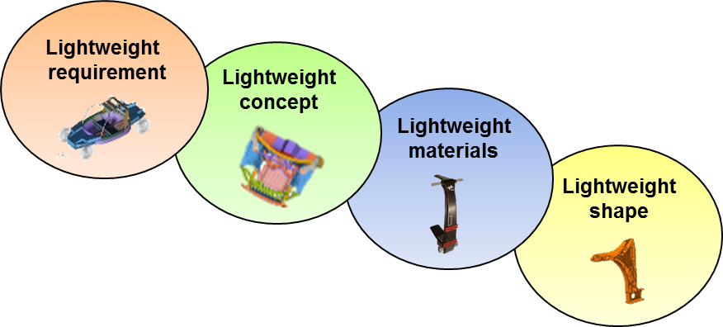
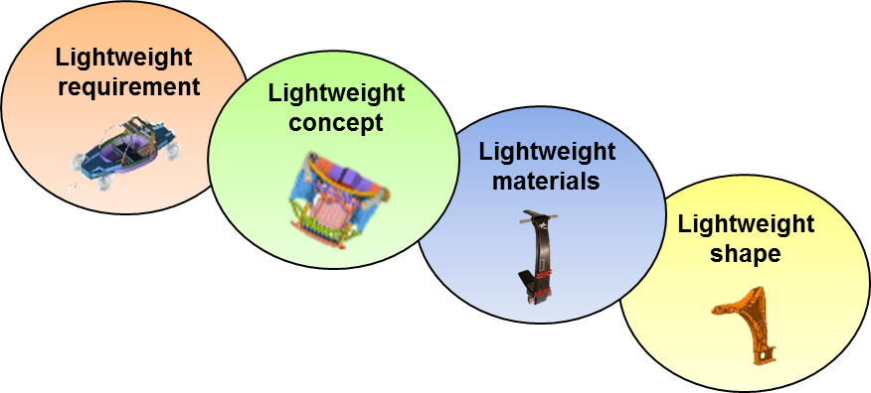
From the chain of effects of the traffic system to the methodical development process
Demand for mobility
- CO₂
- Legislation
- Energy prices
- …
Transport system
- Requirements
- Target function
- …
Vehicle concepts and architecture
- Simulation
- Optimization
- …
Technology
- Structural components
- Crash components
- Energy converters
- …
Quelle: DLR

Slide 10
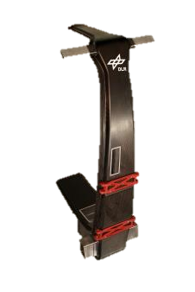
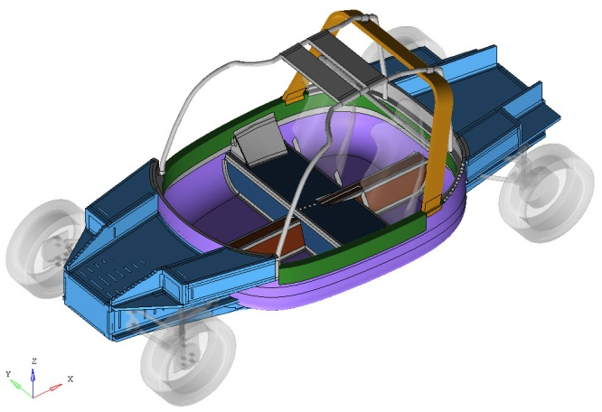
Lightweight
requirement
Lightweight requirement
Lightweight concept
Lightweight materials
Objective:
light vehicle with high crash performance (L7e)
Solution:
Body structure in sandwich architecture
Skin layers aluminum alloy
Foam core polyurethane
Joining process
Crash-stable structural adhesive
Welded parts
Lightweight shape
BIW < approx. 80 kg
Euro-NCAP frontal crash → intrusion approx. 102 mm
Source: DLR

Slide 11
Lightweight
requirement
Lightweight design concept
Lightweight concept
Lightweight materials
Objective:
- Crash modular, adaptable vehicle front
Lightweight shape
Solution:
Energy absorbed through cutting
- Three-dimensional, reinforced light
front vehicle structure
- Peeling pipes for adjustment of energy
Approx. 20% lighter than steel reference structure
Source: DLR
„weak“
„medium“
„strong“

Slide 12
Lightweight
requirement
Lightweight concept
Lightweight material design
Lightweight materials
Objective:
- Light CFRP B-pillar
Lightweight shape
Solution:
Layer structure (0/90/$±$45)
Manufacture using VARI procedure
Internal reinforcement with additional Omega profile
Source: DLR

Slide 13
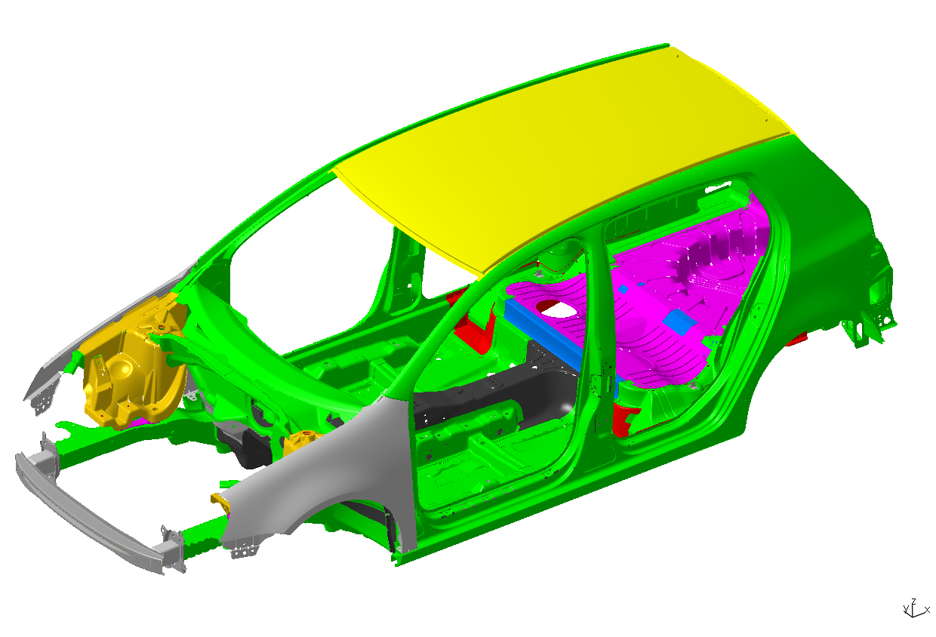
Lightweight
requirement
Lightweight concept
Lightweight material design
Lightweight materials
Objective:
- BIW weight reduction ≥ 85 kg (≥ 30%)
- Lightweight construction costs (cost of parts) ≤ 5 €/kg
Lightweight shape
Materials
Aluminium sheet
Aluminium cast
Aluminium extrusion
Steel
Hot-formed steel
Magnesium sheet
Magnesium diecasting
Glasfibre thermoplastic
Percent by weight
Aluminium 96kg (53%)
Steel 66 kg (36%)
Magnesium 11 kg (7%)
Plastics 7 kg (4%)
Solution:
Body in white 100 kg lighter than reference (approx. 35%)
Complete CAD model of the BIW
Validation of structure (crash, static etc.)
Specification of joining and production processes
Life cycle analysis for MMD concept
Source: VW, DLR

Slide 14
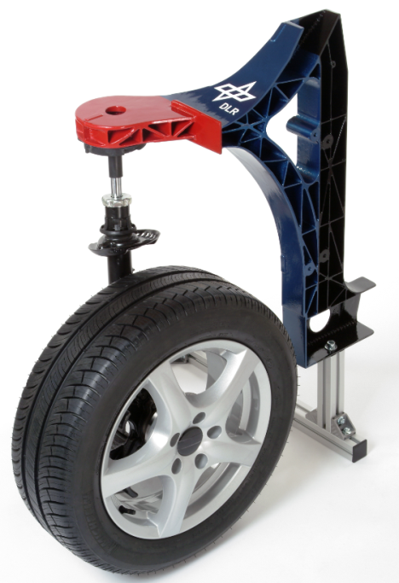
Lightweight
requirement
Lightweight concept
Lightweight shape
Lightweight materials
Objective:
A-pillar cast node lighter and more cost-attractive
Lightweight shape
Solution:
New design with magnesium alloy
Integration of suspension strut slot and A-pillar
Weight saving approx. 50 %
Source: DLR

Slide 15
Challenge: lightweight construction in the volume segment
FRP-
intensive
- CFRP; GFRP
Multi-
Material-
Design
Light metal-
Intensive
- Al; Mg
t
Lightweight construction potential
Steel-intensive
- ductile; high-strength and
highest-strength steel
Adjusting lever for lightweight construction:
Materials
Concepts
Production technology
etc.
…
Series size
Weight
Safety
NVH
etc.
Source: VW; Daimler; DLR

Slide 16
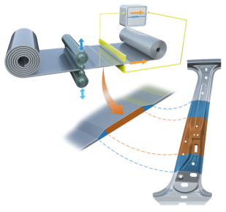
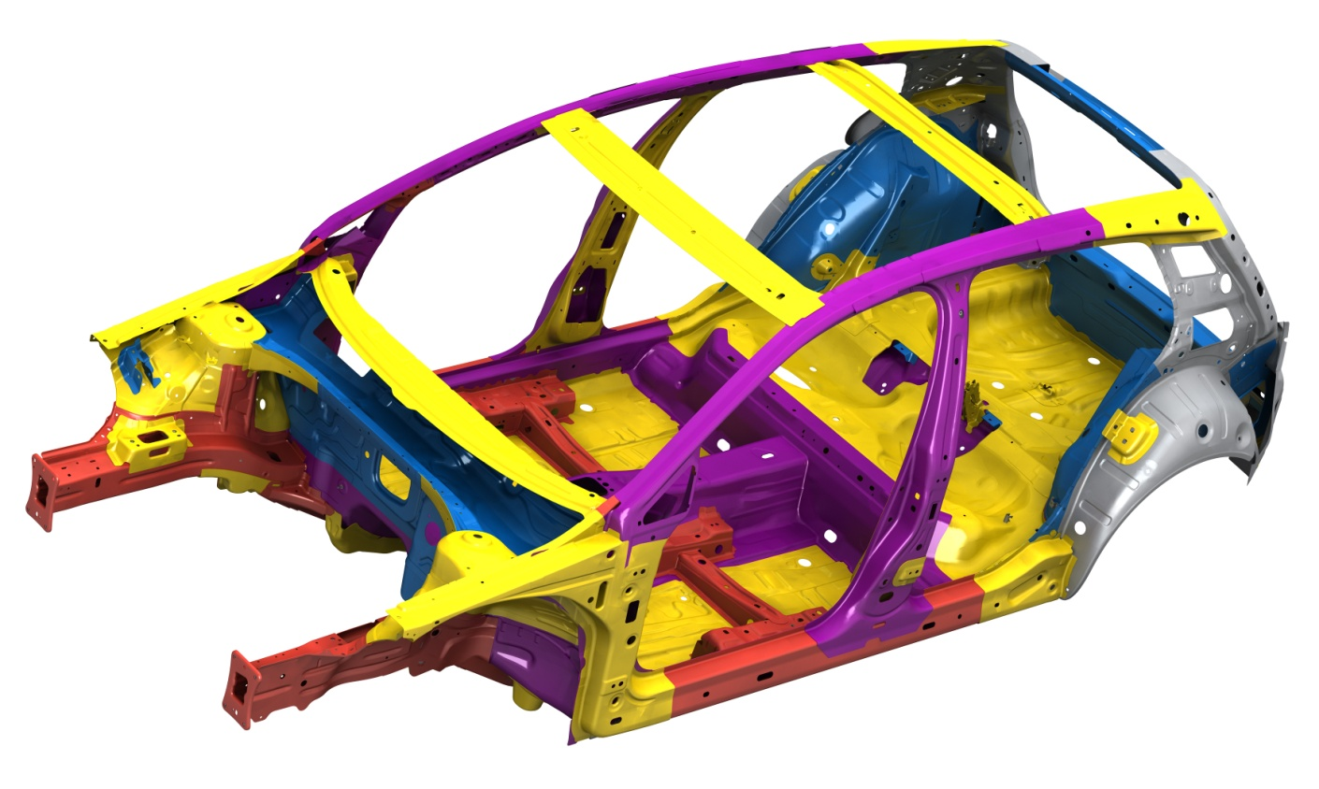
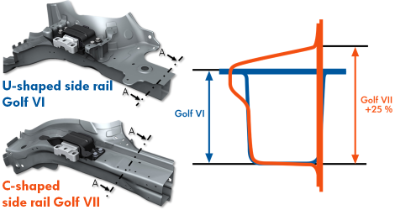
Concept: steel-intensive Example: Golf VII
Weight saving:
structural weight reduced by about 100 kg
Electrics - 6 kg
Drive train - 40 kg
Chassis - 26 kg
Body - 37 kg
Lightweight design measures:
High-strength and higher-strength types of steel, reduced sheet thickness (TRB)
Only using material where it is needed
Optimal geometry of profiles and surfaces
28%
20%
11%
9%
32%
Mild Steel
High-Strength Steel
Highest-Strength Steel
Advanced-High-Strength Steel
Ultra-High-Strength Steel, hot formed
Source: VW

Slide 17
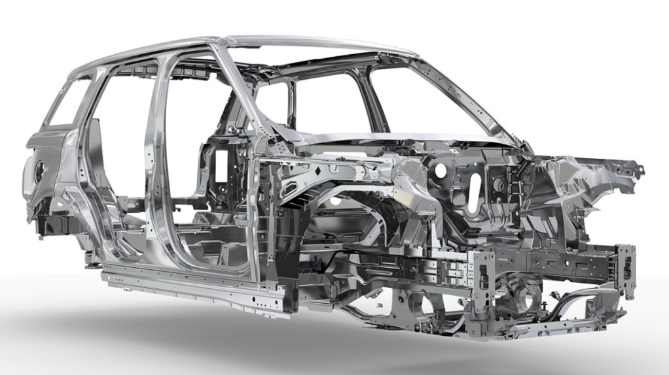
Concept: Aluminum-intensive Example: Range Rover V
Weight saving:
Vehicle about 420 kg lighter than its predecessor
Weight saved in basic shell approx. 39% (almost 180 kg)
Lightweight design measures:
External skin panels between 0.9 and 1.5 mm
All body joints riveted or bonded
Side parts compressed in a single aluminum component
→ Fewer body joints
High-strength Al AC300 for the crash structure
Source: ATZ; www.carsuk.net

Slide 18
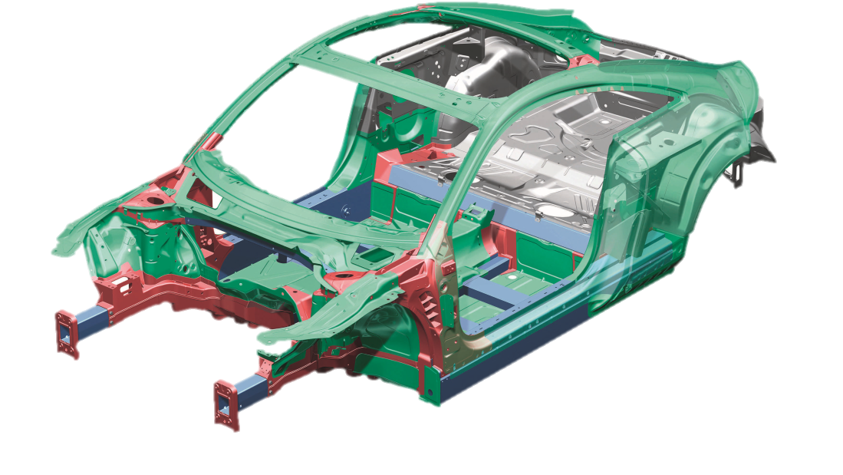
Concept: Aluminum-/steel-intensive hybrid design
Example: Audi TT 2nd generation
Weight saving:
Weight of body: 206 kg
Reference body in steel would be 48% heavier
Pure Al body would be 12% lighter
Lightweight design measures :
Multi-material-desgin
Shell and space frame structure combined
Aluminum 69%
Sheet metal 63 kg
Cast components 45 kg
Extruded profiles 32 kg
Sheet 31%
Sheet metal 66 kg
Source: Audi

Slide 19
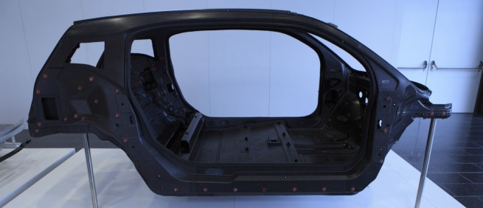
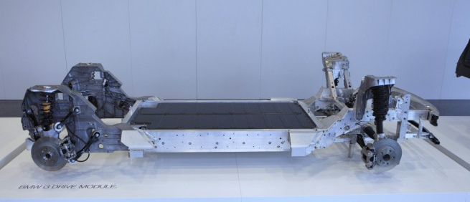
Concept: Bi-module (CFRP-Al-intensive) Example: BMW i3
Weight saving:
Vehicle total weight approx. 1195 kg with battery
Approx. 300 kg saved through new material and purpose-built design
Lightweight design measures:
Material combination CFC + aluminum
Bi-modular design
"Life" module - CFC monocoque body
"Drive" module - crash and structural components, Al chassis
Source: www.bimmertoday.de
Source: www.bimmertoday.de
CFRP "Life" module
Aluminum “Drive" module
Source: BMW

Slide 20
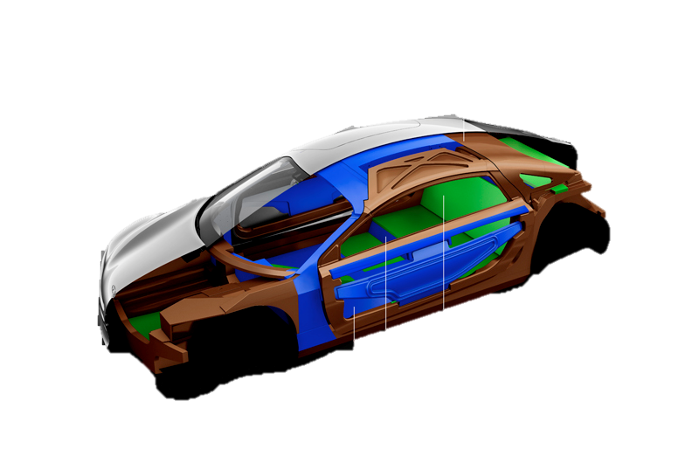
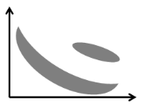
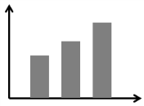
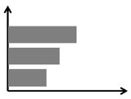
Concept: CFRP-intensive Example: F125!
CFC
Weight saving:
CFRP-intensive design approx. 250 kg lighter than current reference
Front curved and support structures designed as load-bearing assembly unit in CFRP sandwich hybrid design
CFC sandwich
Metal-plastic hybrid
Correctly use the good material characteristics of Steel, Aluminum, Composites
Lightweight design measures:
Ultra-light fiber composite body
Structure-integrated hydrogen storage
Function integration through CFRP e.g. safety belt integrated into seat structure
A
C
S
S
S
A
A
C
strain/ tensile strength
Energy absorption
Thickness
Source: Daimler

Slide 21
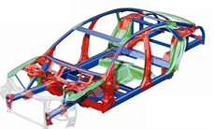
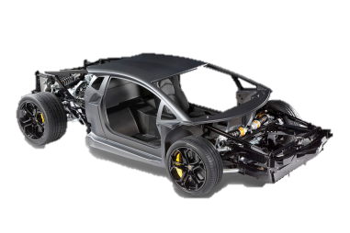
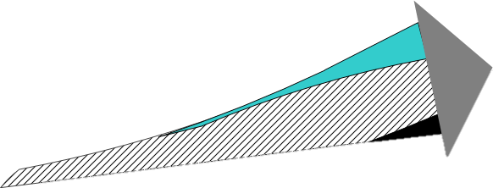
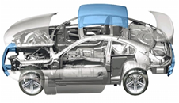
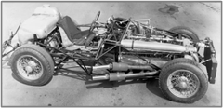
Trends in materials & structures yesterday, today
Audi A8
Al Space Frame
Steel
Light metal
FRP
Skeleton/
Space Frame
Lamborghini Aventador
CFRP- monocoque
Monocoque
BMW M6
St- Shell + AL & CFRP
Shell construction
Space Frame/
frame structure
Mercesdes-Benz W196
frame structure
Source: Audi; VW; Daimler

Slide 22
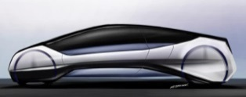
Trends in materials & structures yesterday,today,tomorrow
Audi A8
Al Space Frame
Steel
Light metal
FRP
Bi-modular
Desgin
Skeleton/
Space Frame
Lamborghini Aventador
CFRP- Monocoque
?
Monocoque
BMW M6
St- Shell + AL & CFRP
Shell construction
Hybrid
Desgin
Space Frame /
frame structure
Mercesdes-Benz W196
frame structure
Source: Audi; VW; Daimler

Slide 23
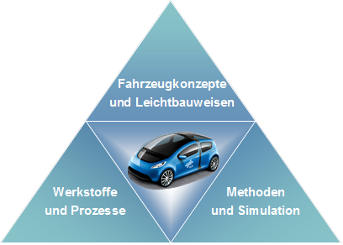
Summary
CO₂ limits are driving forward lightweight construction in vehicle design
Gradual electrification is reinforcing the trend towards lightweight construction
Compensation for extra weight of new components
Further development of construction methods:
Increase in MMD in volume-intensive production sector
Focus for research and development:
Consideration overall, methodical approach in the product development process
Vehicle concepts and lightweight design
Materials and processes
Methods and simulation
Source: DLR

Slide 24
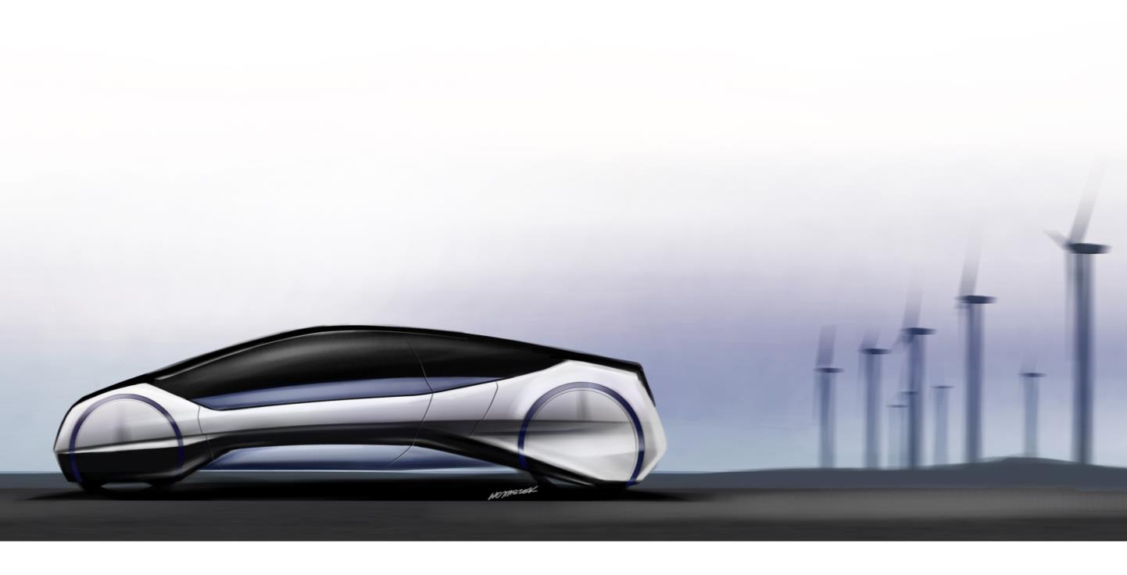
Thank you for your attention!

