Slide 1
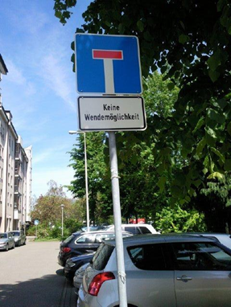
The New Paradigma: Social Dimensions and Indicators of Social Scenarios Uwe Pfenning, DLR Stuttgart

Slide 2
Biography of Energy Systems
Comparing historical contexts of energy supply systems: a) many changes before in technology (exchanging primary energy resources from fossile to fossile) (implementation of nuclear power within same administration path) (driven by political acts and development (f.e. oil crisis 1972) b) few changes in political structures (generating state controll for private investigations and investment) (implementation of market designs and economical liberalisation (EU)) c) no changes in societal contexts (ownership, participation, responsibility and involvement a.s.o.)

Slide 3
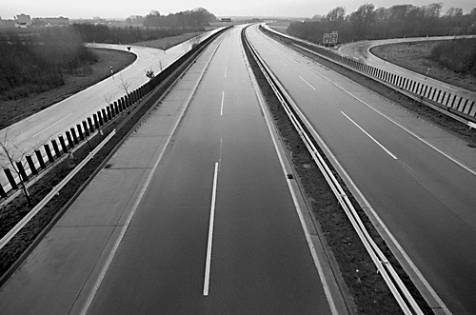
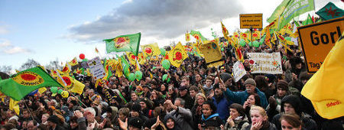
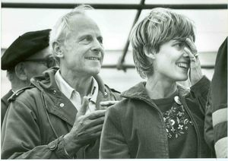
Drivers of Changes and (partly) Innovations
Political-economical aims for security of energy supply and decreasing dependency of oil (1972)
Ecological issues getting public attention (limits of growth, sustainability)
Social Movements (Anti-AKW partly peace movement) which also
changing the parlamentary system and therefore bringing in recursive functions to change the political structure

Slide 4
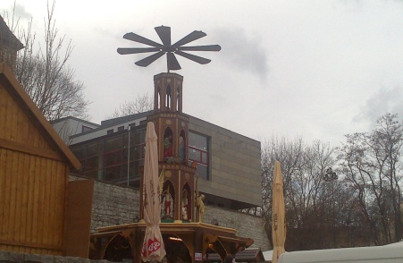
Focus of Definitions
Energiewende means Renewables becomes the dominating technologies in the entire energy supply system (power and heating)
The energy supply system(s) has to be defined in social issues concerning involved actors, collective decision making processes, and science as moderator

Slide 5
The paradigma of renewables I: Decentralisation and ownership
Technological options for individual power generating (PV)
Technological options for collective power generating (Wind)
Technological options for local autonomy & independency for energy supply (power + heat)
for the first time use of extraterrestrial resources for energy (solar energy)
Possible societal changes in ownership and investments for decentral power stations, and also partly for central power „parks“ (wind parks).
New images and myths toward infinite resources for energy supply (f.e. contradictional for better energy efficiency)

Slide 6
The paradigma of renewables II: Forcing new communication structures for administration
Need for new systemical approaches to combine power generation („transformation“), storage (because of volatity and fluctuation), and technical distribution of power between regions a) saving the security of distribution to avoid technical blackouts b) make sure sufficient power capacity for consumption peaks c) coordinating the three technological systems (need-triad)
Technical needs forced new communication structures for coordinating the relevant actors in all three sectors, i.e. new economical administration bodies to deal with capacities of production, storages and net-distritbution

Slide 7
The Paradigma for Renewable III: External pressures from science and economics
Scientifically knowledge and literacy a) local eco-systems can be affected by human interventions (climate, acid rain a.s.o.) leading to ask for and discuss individual responsibility for environmental protection b) media effects for agenda setting ot topics affects validity of mass surveys and public discussion
Economical integration and market design a) saving fossile resources for better purposes for economics b) critical mass of Renewables Energy inside the power market system (i.e. 27%) c) implementating own renewable lobby by impacts of employment, ratio of investments, stocks a.s.o.

Slide 8
All Electric society
Actors
Social Arena
Systems
coordination
Collectiv‘s & Society
Individuals
f(x) market
E-Mobility
Government &
States
Heating
f(x) control
Geothermie
Household
EVUs, & companies
Railway Traffic
Biomasse
Economy
Solar
CSP
Groups and Lobbys
Wind
Offshore
Public lightening
Atom
Exit
Researchers
Wasser
Öl
Gas
BHKW
Kohle
CES
1880 1900 1920 1940 1960 1980 2000 2020

Slide 9
Social Scenarios
Social Scenarios means … a) to apply communication paths to work out a common sense with participation of different interest groups (i.e. a social arena) b) simulating different decision paths of the different actors for congruent or discongruent effects to the common sense model c) apply mathematical and statistical procedures for empirical tendencies of the different decision (i.e. Meta-Analyses, Structural Equation Modeling, CIB and Expert-Delphi, Social Surveys and Discourse formats)

Slide 10
Overwiew about dimensions and scientific disciplines
Dimensions of Energy Transition | Disciplines of Social Scenarios
 | Philosophy | Sociology | Technology | Economy
Understanding | Sense | Knowledge | Innovation | Willingness to pay
Consumption | Needs | Life Styles | Usability | Budget
Involvement | Interest | Roles | Professions | Subjective benefit
Literacy | Enlightment | Norms & values | Use | Financial impacts
Legitimation | Democratisation | Research and funding | Societal use | Funding / Expenses
Power | Goals / aims | Influence | Decentralisation | Risks and benefits
Value orientation | Sustainability | Socialisation | Conventions, industrial norms | Balancing costs and benefits
Participation | Discourses | Acceptance | Realisation | Individual costs

Slide 11
Communication Paths
innovation of Renewables are being placed by politicy and politics
Strong tendencies to establish own lobby for reasons of high competition
Politics reacts as a collection of also interest groups by different positions of parties,
informal convention after Fukushima by federal parliament decisions, informal political coalition
The scene is dominated by many lobby groups without any common forum for conventions
Politics deliver task of generating common conventions to science, but there are different codes of legitimating conventions (knowledge based versus majority terms)

Slide 12
Need for Legitimation
Introducing renewables in the system need individual legitimation.
Forms of legitimation are acceptance, tolerance, use, and participation a) acceptance = belief in the „good“ sense b) tolerance = convinced by majority decision c) use = believe in sense and practice d) participation = process of generating beliefs

Slide 13
Conferences as a Social Arena
Thanks to you for your attention and patience for listening

