Slide 1
Thunderstorm nowcasting, short-range forecasting, and warning for aviation
by Dennis Stich,
C. Forster, A. Tafferner, M. Köhler, I. Sölch, and T. Gerz
13th EMS Annual Meeting & 11th ECAM
Reading, United Kingdom, 9 - 13 September 2013

Slide 2
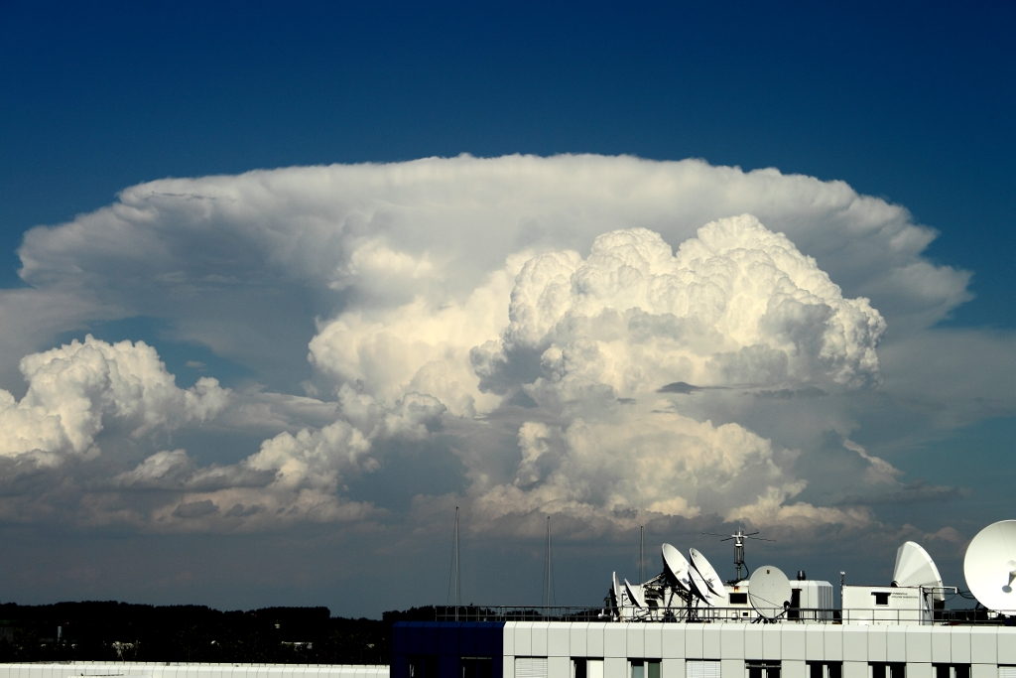

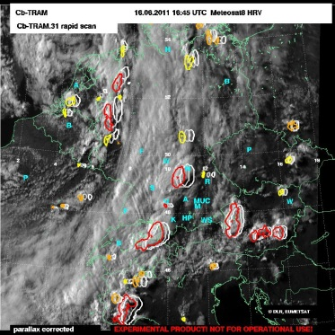
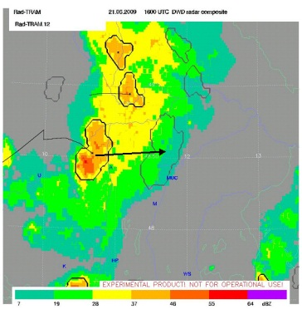
Thunderstorms as weatherobjects with multiple object attributes
Cb top:
conv. turbulence,
lightning activity, etc.
detected by satellite
(Cb-TRAM)
Cb bottom:
hail, icing, lightning, heavy rain, turbulence, etc.
detected by radar
(Rad-TRAM)
Picture by Martin Köhler, DLR
Vortrag > Autor > Dokumentname > Datum

Slide 3

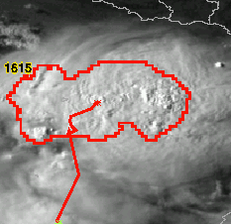
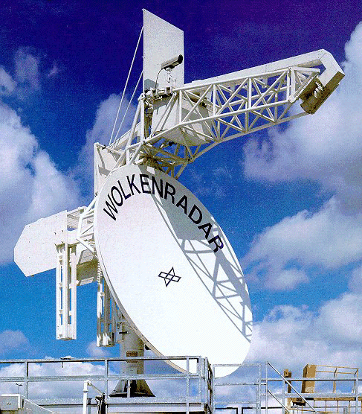
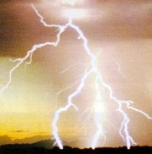

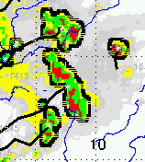

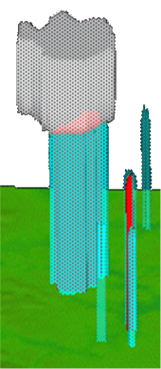
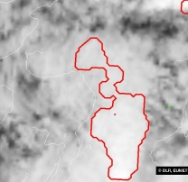
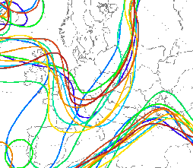
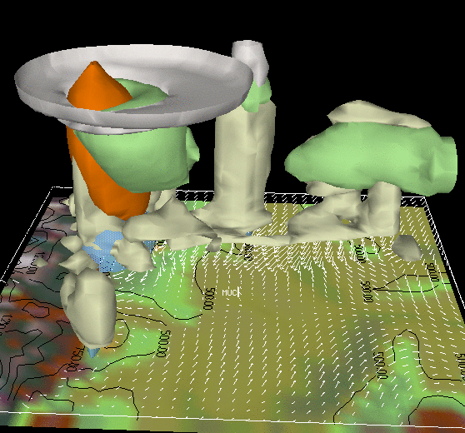
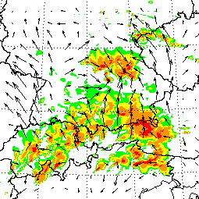
Weather Forecast User-oriented System Including Object Nowcasting
Cloud tracker
POLDIRAD
Lightning
Surface Analysis
Radar tracker
Combination of data sources through fuzzy logic:
Decision finding technique allowing for parameter ranges
instead of fixed thresholds
Takes into account the meteorological experience and concepts
as well as local effects
weather object
specification
oriented at user
requirements
Initiation
Track
Nowcast
Forecast
forecast validation
forecast validation
Object
Comparison
SYNSAT
Object
Comparison
COSMO-DE
& Ensemble
Local
forecasting
SYNRAD

Slide 4
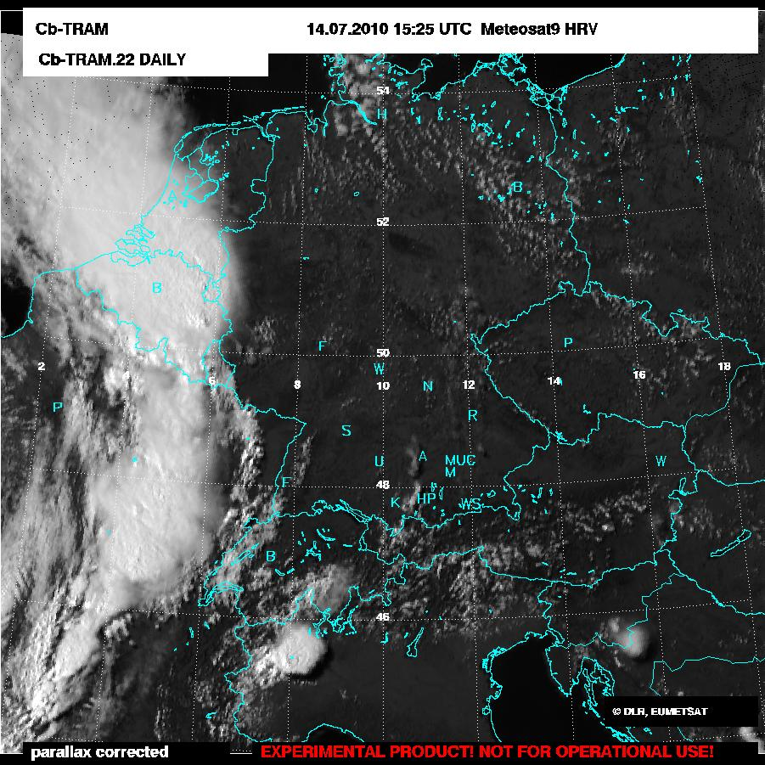
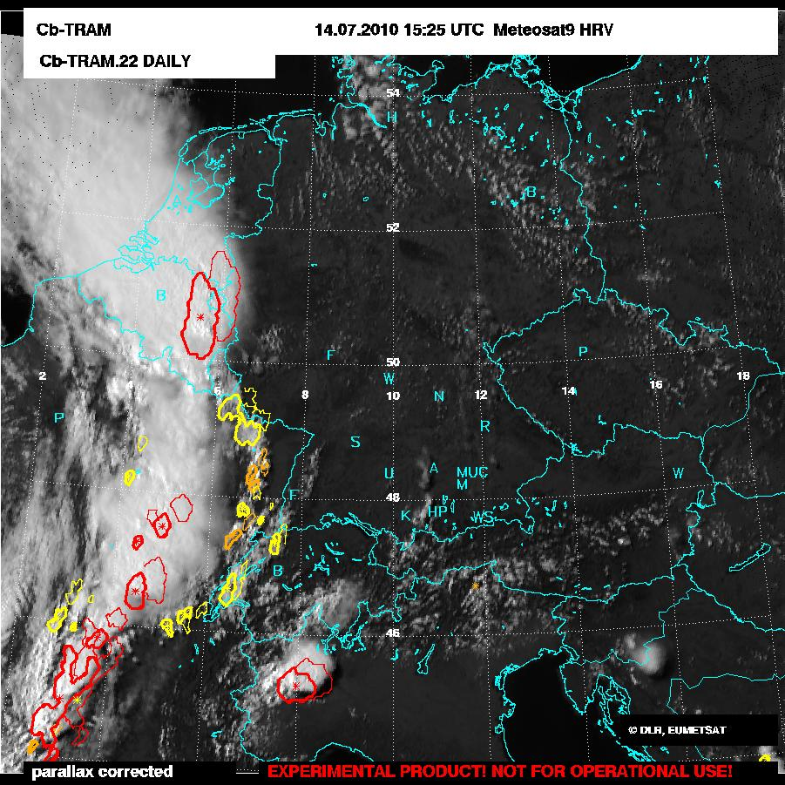
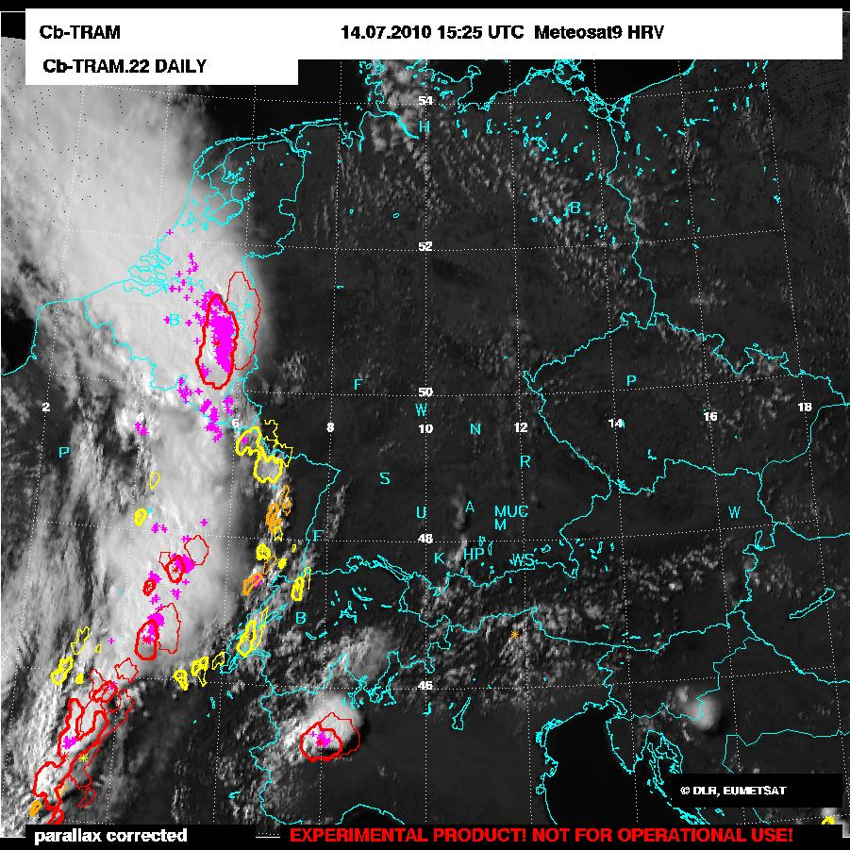
Cb-TRAM - Cumulonimbus TRacking And Monitoring
Used MSG (rapidscan) data:
WV 6.2 IR 10.8
IR 12.0 HRV
Detection stages:
1: Convection Initiation (CI)
development in HRV
IR 10.8 cooling
2: Rapid development
WV 6.2 rapid cooling
(> 1K/15min)
3: Mature storms
T 6.2 - T 10.8
HRV texture
Extrapolation up to 60 min
(here 30 minute nowcast plotted)
Description: Zinner et al., 2008,09 & 13
Detection stages:
1: Convection Initiation (CI)
development in HRV
IR 10.8 cooling
2: Rapid development
WV 6.2 rapid cooling
(> 1K/15min)
3: Mature storms
T 6.2 - T 10.8
HRV texture
Lightning (LINET)
Extrapolation up to 60 min
(here 30 minute nowcast plotted)
Description: Zinner et al., 2008,09 & 13

Slide 5




CI postprocessing with additional data
LINET data & ingredients describing moisture, instability, and lift:
equivalent potential temperature θ_{e}
KO-Index
vertical motion ω in 500 hPA
Generation of a CI forcing value for each CI detection with
fuzzy logic
CI forcing values can be translated into a statistical
probability of further development
Lowest probabilities can be filtered
The probability of further development is an additional information which can be treated as a kind of confidence level assigned to the CI detection

Slide 6
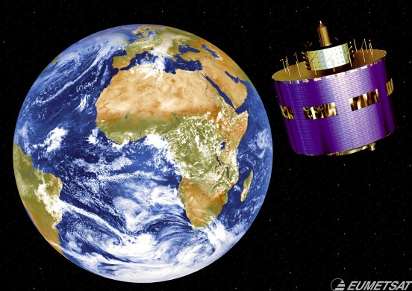
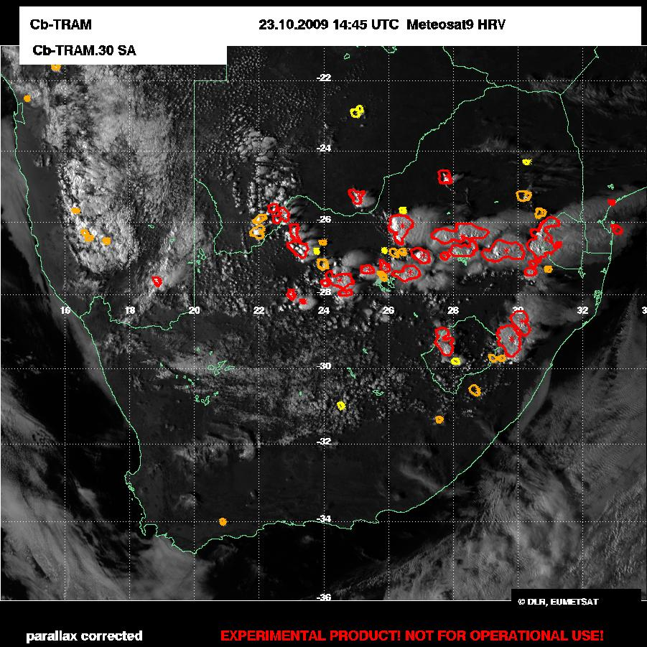
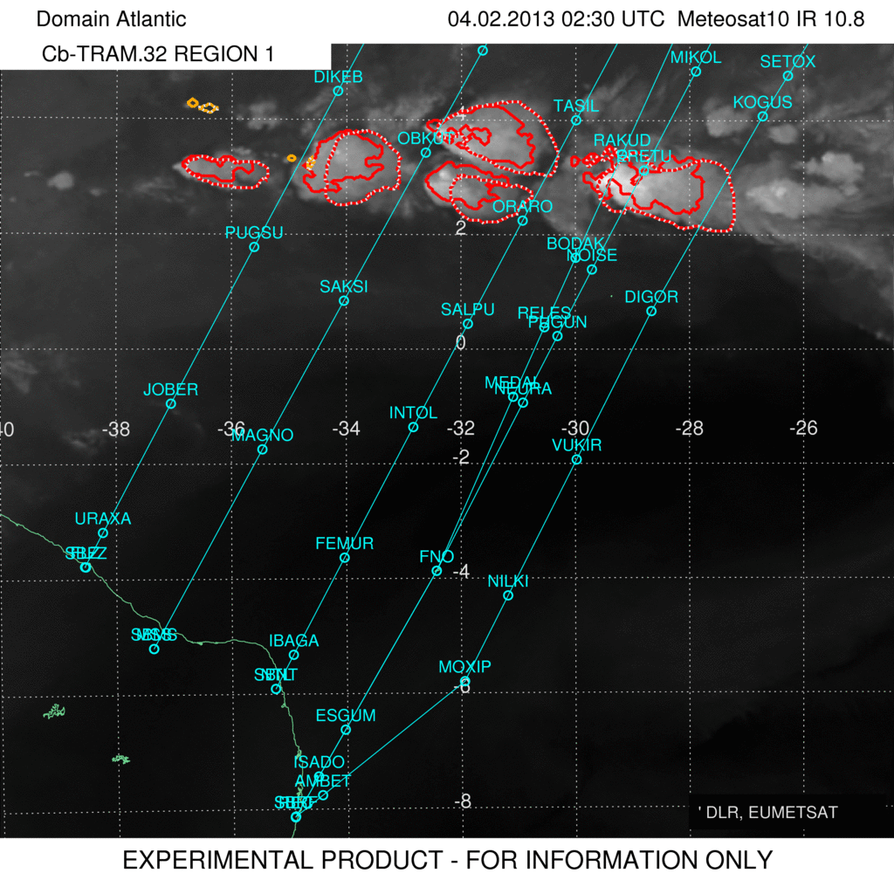
Cb-TRAM: area of application

Slide 7
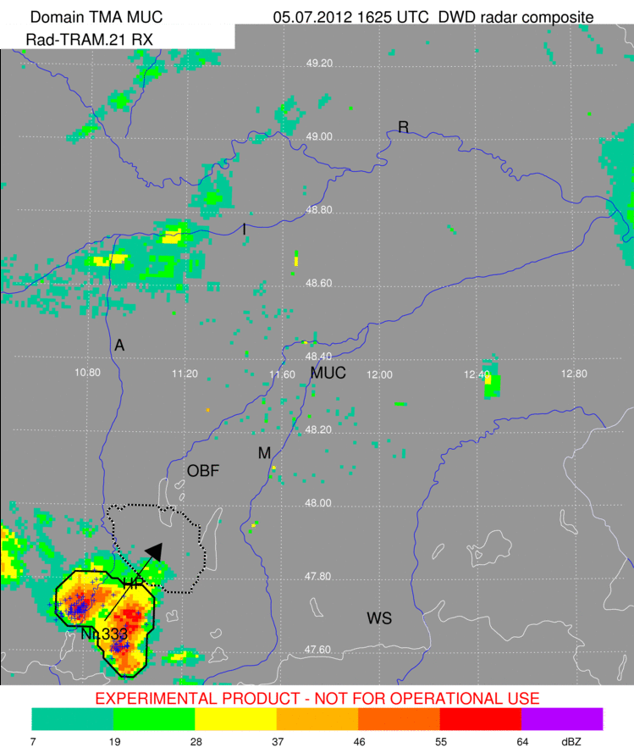
Rad-TRAM - Radar Tracking and Monitoring
Based on DWD radar data:
RX and EURADCOM
Black contours:
areas > 37 dBZ
Dotted contours:
60 min nowcast
Tracking and nowcasting
based on pyramidal
matching like in Cb-TRAM
Available every 5th minute

Slide 8
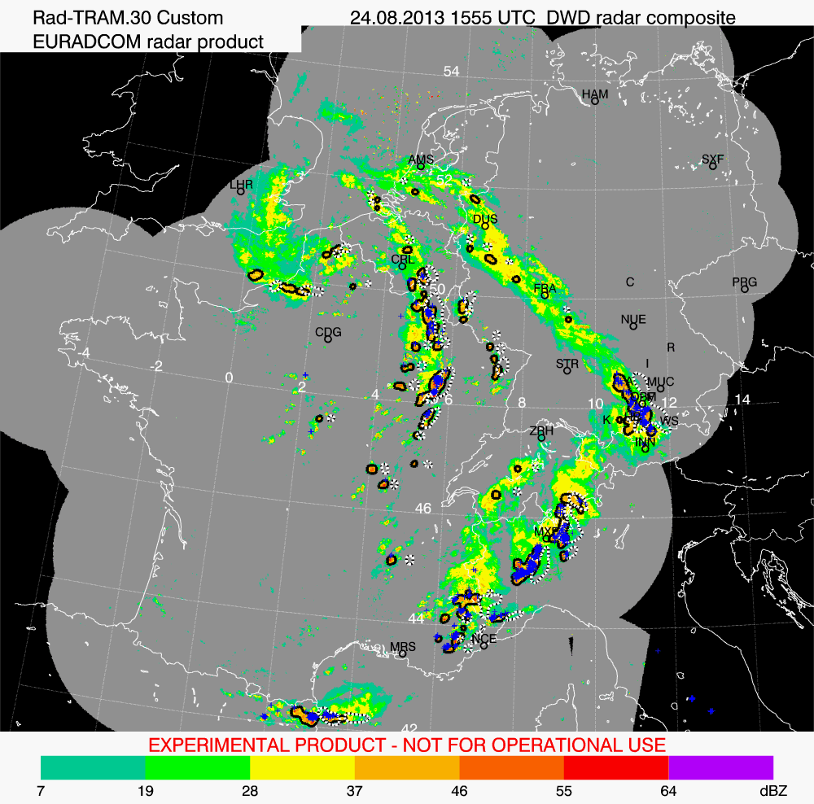
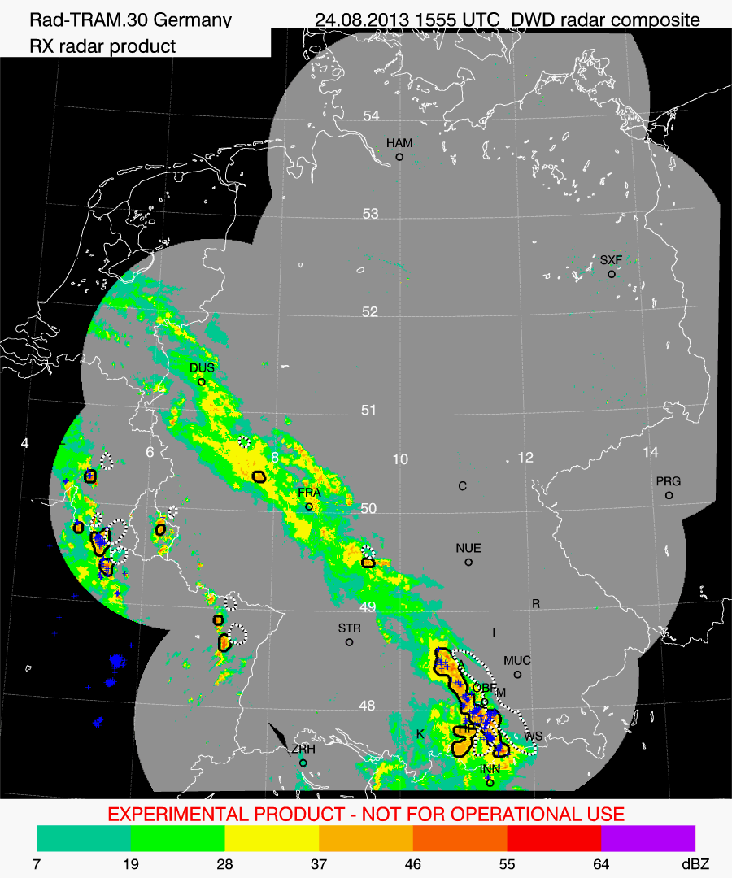
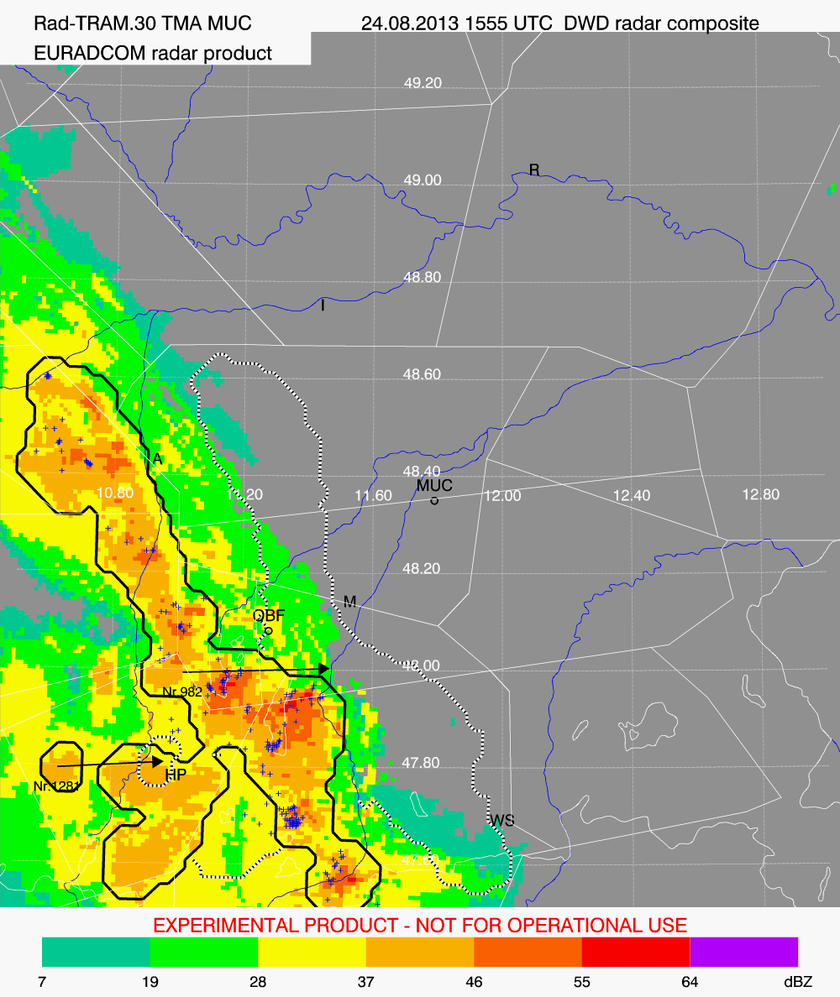
Rad-TRAM: area of application
Rad-TRAM EURADCOM for FABEC
(Functional Airspace Block European Central)
Rad-TRAM RX for Germany
Rad-TRAM EURADCOM for TMA MUC

Slide 9
Automated thunderstorm warnings (AutoAlert)
Aims:
Raise situational awareness
Presentation of the same information to describe the current
situation to all stakeholders at an airport to support CDM
Automated generation of text with attachment of the current
Rad-TRAM-image for the TMA – 24/7 availability
~ 120 users at Airport MUC at
DFS, FMG, Lufthansa, DWD, TUIfly, AirBerlin, All Nippon Airways…
Applicable not only at MUC, but for each airport where Rad-TRAM and lightning measurement data are available

Slide 10
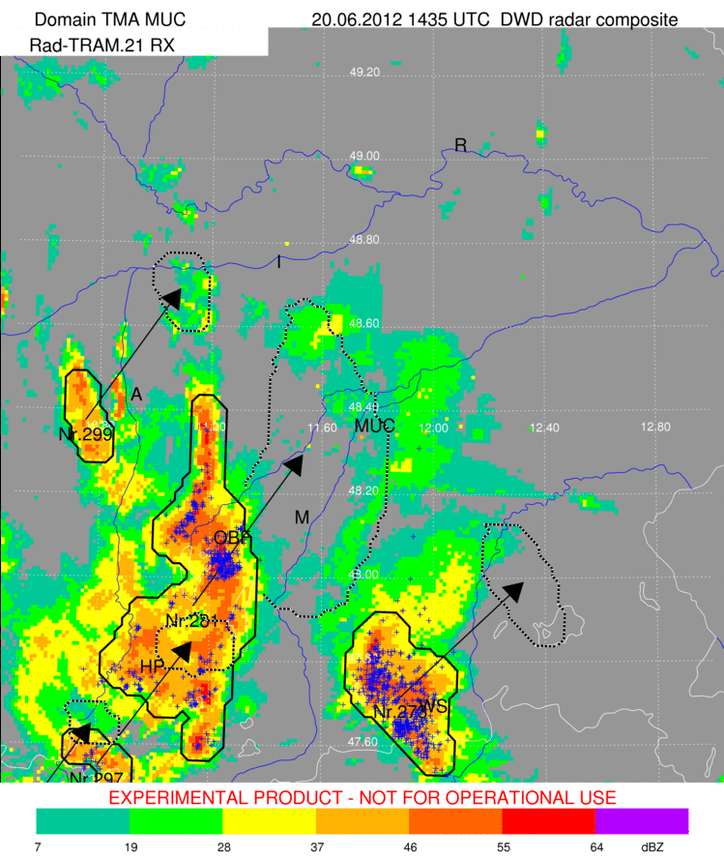
AutoAlert example with additional information interactively edited (in red)
DLR Oberpfaffenhofen, 20 June 2012, Gewitterwarnhinweis um 14:40 UTC
*********************************************************
Es wurden Gewittertops bis ca. 14 km Höhe und länger anhaltender Hagel beobachtet.
Gewitterzelle Nr. 281 etwa 31 km von MUC entfernt wird laut Prognose in 50 Min. den Flughafen MUC treffen.
Weitere Gewitterzellen weniger als 100 km von MUC entfernt. Betroffene Bereiche: NW, SW, SE
Mittlere Zugrichtung aller Zellen: nord-oestlich
Zur Erläuterung:
Gewitterzellen sind schwarz umrandet (Bereich mit Starkniederschlag).
Die Verlagerung nach 60 Minuten ist mit einem Pfeil
und einer schwarz-weiß gestrichelten Linie markiert.
Blitze (LINET) sind mit blauen Kreuzen markiert.
Weitere Informationen:
Siehe Anhang, MetFROG und http://www.pa.op.dlr.de/nowcasting/
(User: nowcasting, Passwd: drizzle)
Mit freundlichen Grüßen,
das Gewitterteam des DLR Instituts für Physik der Atmosphäre
Feedback, Fragen und Anregungen bitte an
cb-team@dlr.de Tel.: 08153 28 3174 oder 01853 28 1218

Slide 11
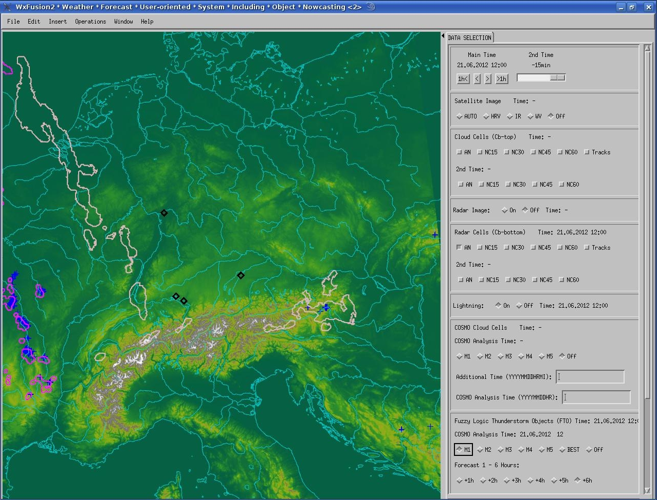
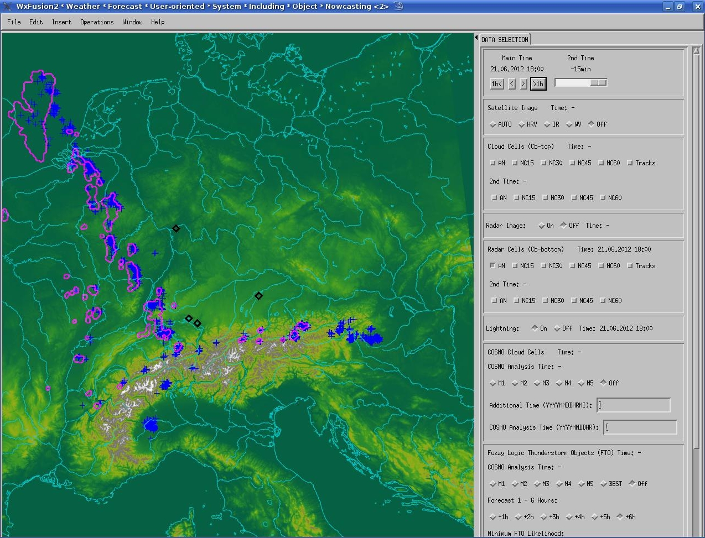
Cb indicator forecasts up to 6 hrs (Cblike)
Fuzzy logic combination of CAPE, 500 hPa vertical velocity, synthetic satellite and radar data from the DWD COSMO-DE model
Cb observation 21 June 2012 18:00 UTC
Cblike 6 hrs forecast for 21 June 2012 18:00 UTC
White contours:
Cblike indicator exceeding
a certain threshold
Pink contours:
Rad-TRAM cells
Blue crosses:
Lightning data (LINET)

Slide 12
Short-range limited area NWP (COSMO-MUC)
For seemless prediction of airtraffic relevant phenomena
Nowcasting
COSMO-MUC
COSMO-DE
Forecast skill
(60 min) (30 min - 4h) (3h +)
Theory
Nowcast
NWP
Forecast lead time

Slide 13
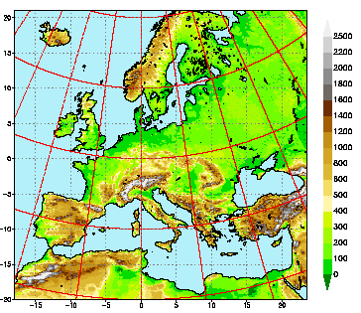
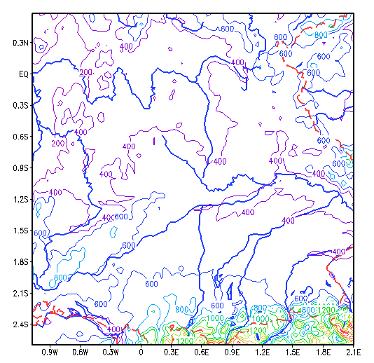
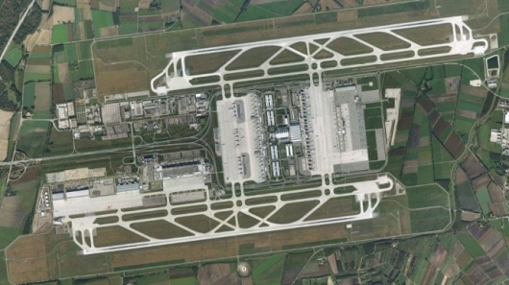
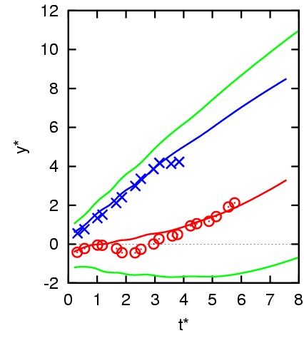
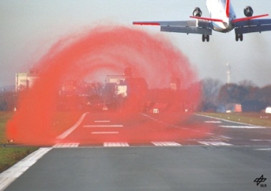
Experience in the framework of Wetter & Fliegen
COSMO-EU
COSMO-MUC
MUC
Glide path
P2P
~360 km
Height [m]
Glide path positions (GPP)

Slide 14
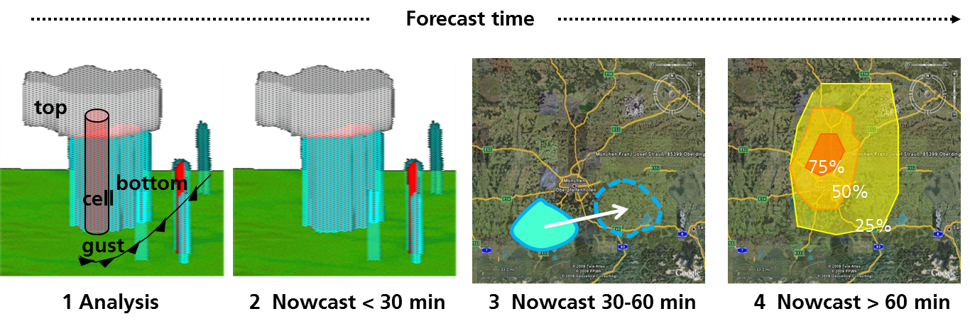
Thank you for your attention!
contact: dennis.stich@dlr.de
Decrease of information detail over forecast time (Tafferner et al., 2012)
Best possible Cb description
through 3D-polarimetric radar,
lightning, satellite, LLWAS;
Fuzzy logic: convective
initiation, intensity, life cycle
Output: Cb object 3D with
attributes.
Extrapolation including trend
in 3 dimensions by fuzzy logic
Combination.
Output: Cb object 3D with
attributes.
Extrapolation 2-D only,
no vertical extent, no trend,
indication of severity.
Output:Cb object 2 D with
attributes
Calculation of probability of
occurrence of Cb with certain
intensity by fuzzy logic combination
of extrapolation and model forecast
75%
50%
25%

