Slide 1

HYDROGEN now?
Dr. Christian Sattler
Christian.sattler@dlr.de

Slide 2
Hydrogen – Present Situation
Hydrogen is a mass product in industry mainly produced onsite and mainly used for fuel and fertilizer production
Hydrogen becomes more and more important because:
  Growing demand of fuels and fertilizers
  raw materials need even more H₂ to be processed into useful fuels e.g.:
    Heavy crudes
    Oil sands
    Biomass
    CO₂
  it is a very efficient storage for renewable energy especially wind – large utility companies like E.on and Vattenfall step in
Transportation is developping in niche markets like fork-lifts
Car manufacturers are anouncing market introduction
Infrastructure develops especially in Europe (Germany, Scandinavia), Asia (Japan, Korea), USA (California, South Carolina)

Slide 3

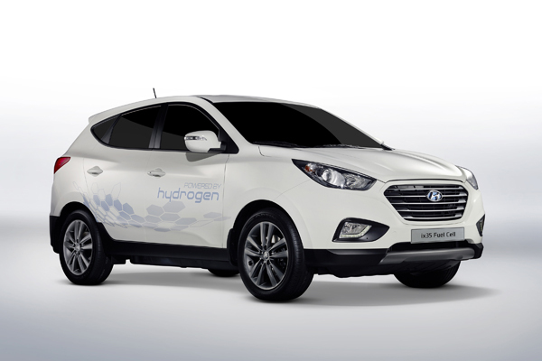
Hydrogen for Mobile Applications - Hyundai
In early 2012, a Hyundai ix35 Fuel Cell set a range record for hydrogen cars by driving from Oslo to Monaco using only existing fuelling stations
Production of the Hyundai ix35 Fuel Cell began in January 2013, making Hyundai the first automaker to begin commercial production of a hydrogen-powered vehicle.
Hyundai plans to manufacture 1.000 units of the hydrogen-powered ix35 Fuel Cell vehicles by 2015, targeted predominantly at public sector and private fleets, with limited mass production of 10.000 units beyond 2015.

Slide 4

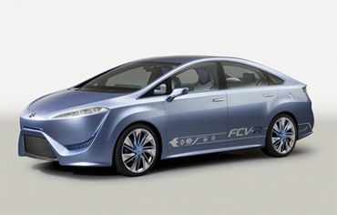
Toyota
Successful startup: -30° Celsius
Extended cruising range: 830km
(JC08 mode) without refueling
A sedan-type next-generation fuel-cell concept is planned for launch in about 2015.
Toyota says it will be among the first manufacturers to bring hydrogen-powered vehicles to the European market in 2015. The company has also said it will start selling fuel cell vehicles in the US in 2015, first in California.

Slide 5
More information: www.fch-ju.eu

Slide 6
Massive High Temperature H₂ production Global R&D Roadmap
INNOHYP-CA EU FP6 Project continued in the IEA HIA Task 25 (CSIRO was partner in both exercises)
Three groups of processes depending on deployment maturity and market opportunities

Slide 7
The cross-cutting actions Roadmap

Slide 8

Thank you very much for your attention!

