Slide 1
ONLINE DISCRIMINATION OF CHEMICAL SUBSTANCES
USING STANDOFF LASER INDUCED FLUORESCENCE SIGNALS
XVII CHEMOMETRICS IN ANALYTICAL CHEMISTRY
2018, Halifax, Canada
Marian Kraus, Florian Gebert, Carsten Pargmann,
Arne Walter and Frank Duschek
German Aerospace Center (DLR)
Institute of Technical Physics
Lampoldshausen, Germany

Slide 2
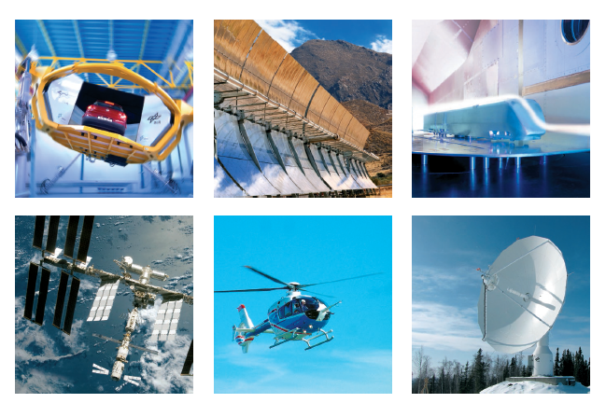
German Aerospace Center (DLR)
RESEARCH AREAS
e n e r g y
t r a n s p o r t
s p a c e
a e r o n a u t i c s
s e c u r i t y
d i g i t i z a t i o n

Slide 3
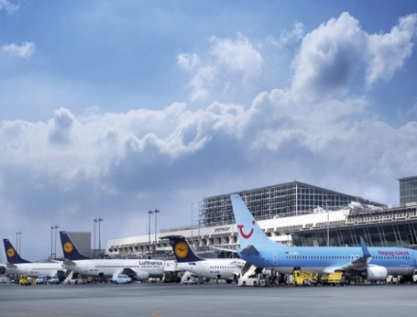

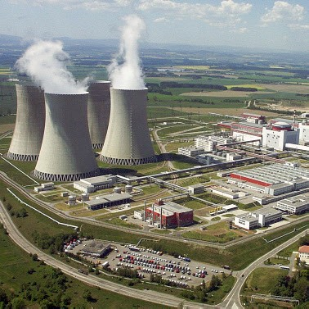
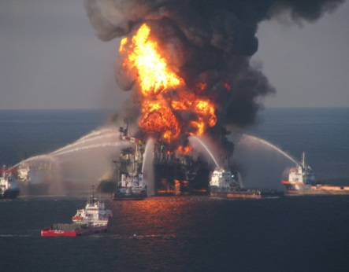

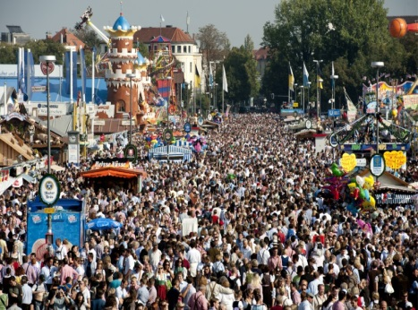
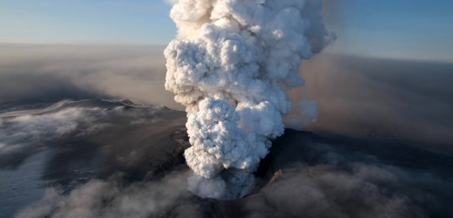
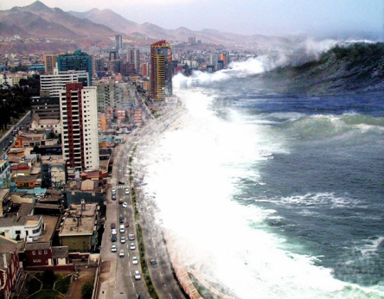
Security risk scenarios
Fast detection and early identification of hazardous substances
with low risk for people and low false alarm rates are essential!
intended output
accidental output
www.deutschkollegstuttgart.wordpress.com
www.br.de
www.abschnitt-mitte.blogspot.com
www.sueddeutsche.de
www.tsn.ca
www.sueddeutsche.de
www.spiegel.de
www.ghadry.com

Slide 4
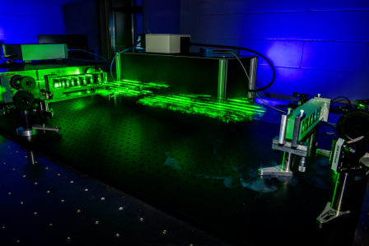
CBE detection techniques
Standoff detection?
LIF
„LIF+“
GC-MS
Sensitivity
Biochips
IR
Raman
Fluorescence
NMR
Selectivity

Slide 5
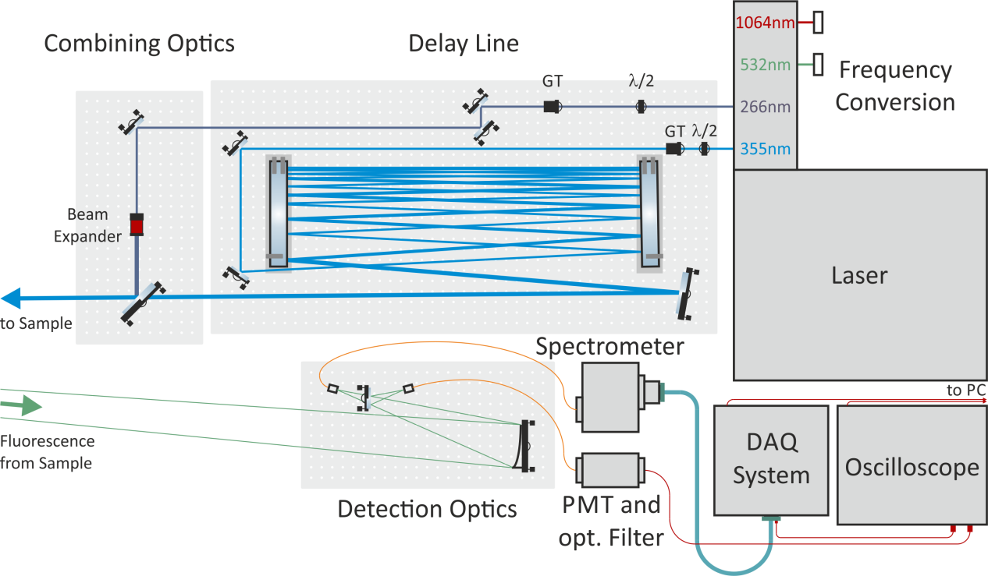
Laser induced fluorescence (LIF)
Gebert F. et al., Novel standoff detection system for the classification of chemical and biological hazardous substances combining temporal and spectral laser induced ﬂuorescence techniques, SICC 2017, Rome, Italy
Setup features:
32 spectral channels + up to 4 temporal channels
100 Hz data acquisition rate (complete spectral and temporal dataset excited by laser pulses with two different excitation wavelengths)

Slide 6
Substances
Chemicals
Fuels
Lubricants
Pesticides
Solvents
Fuel | Lubricant | Pesticide | Solvent
Diesel | Anderol555 | Imidacloprid(w) | Benzaldehyd
Jet fuel | Motor oil | Isoproturon(d) | Cyclopentan
Kerosene |  | Malathion(w) | Ethyl acetate
Paraffin |  | Oxyfluorfen(d) | Isopropyl alcohol
 |  | Permethrin(d) | Losin100
 |  | Terbuthylazine(d) | p-Xylol
 |  | Piperine(w) | Turpentine substitute
pure liquid substances, pesticides dissolved in water (w) or diethyl ether (d)

Slide 7
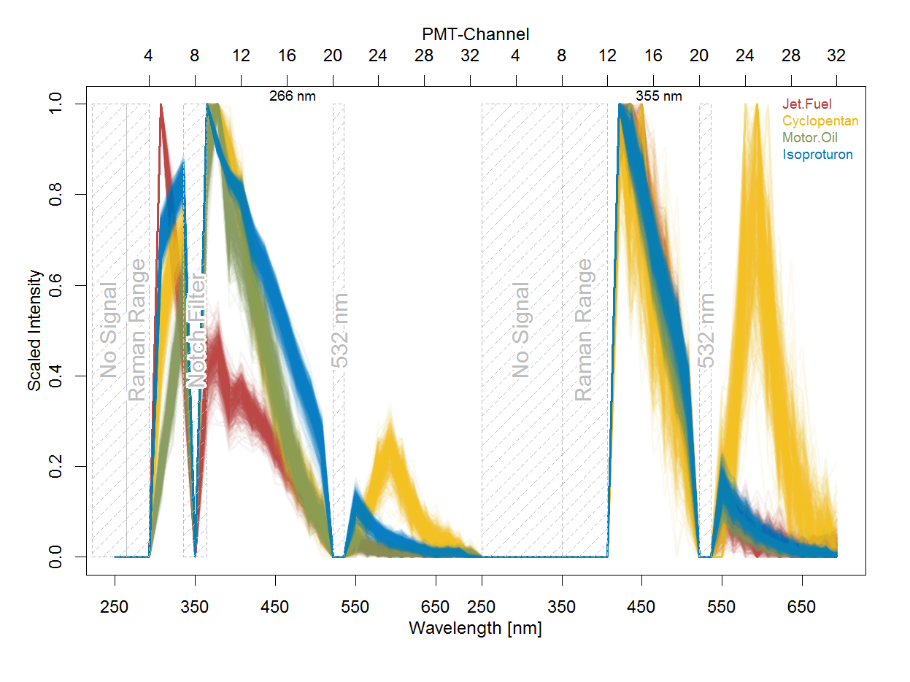
Data
Raw data:
2 x 32 channels per spectrum
100 spectra per measurement
5 measurements per substance
20 substances
Preprocess:
elimination of 21 channels
  beyond excitation wavelengths (2+8)
  in Raman range (2+4)
  at notch filter (1)
  around 532 nm (2+2)
scaling from 0 to 1
  10000 spectra with 43 features for classification procedure

Slide 8

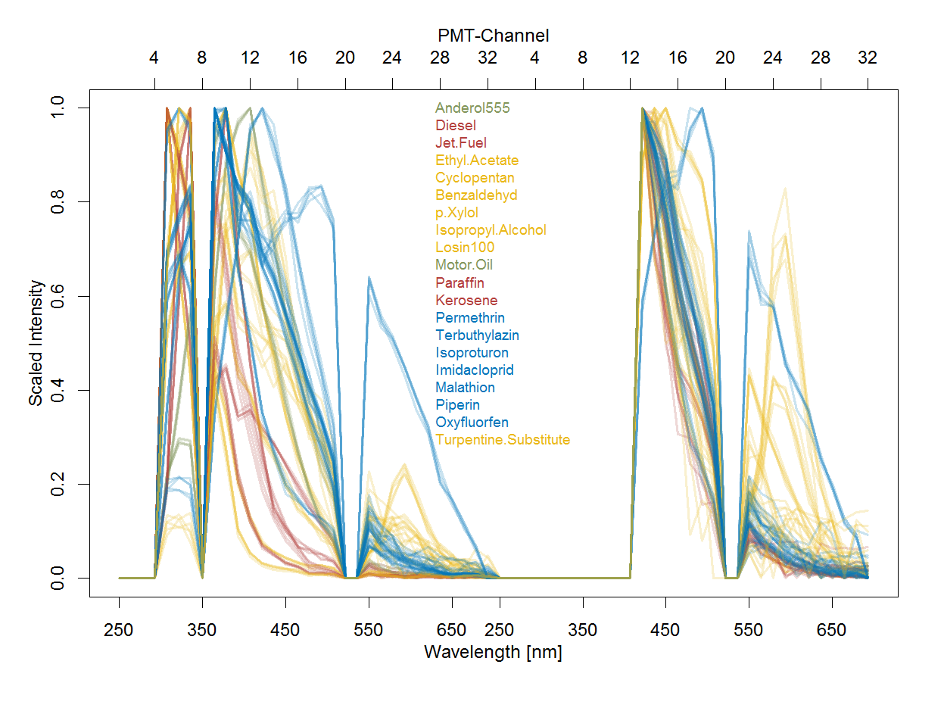


Classification
Software
  R, RStudio
  package: caret
10000 spectra with 43 features for classification procedure
Split data in two sets:
  75 % to train the algorithms
  25 % to test the classification models
Resampling
  Bootstrapping
  Cross-validation

Slide 9
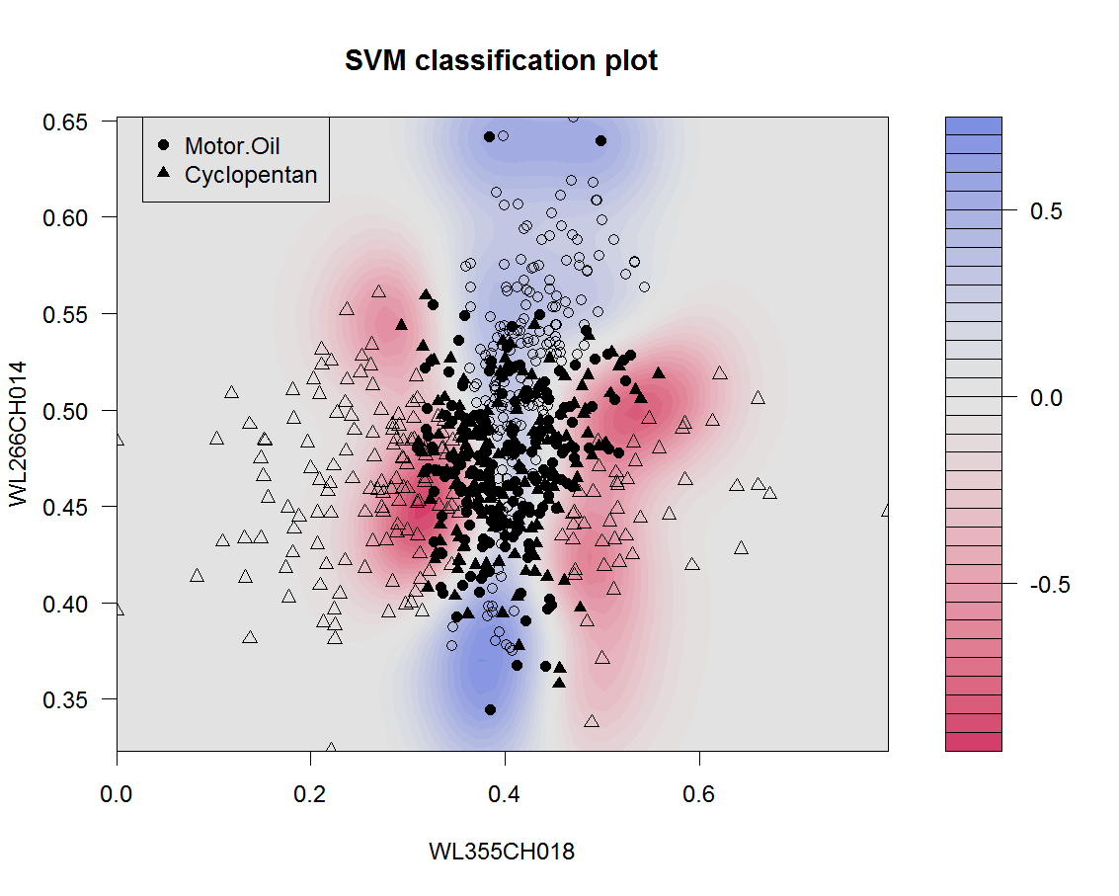
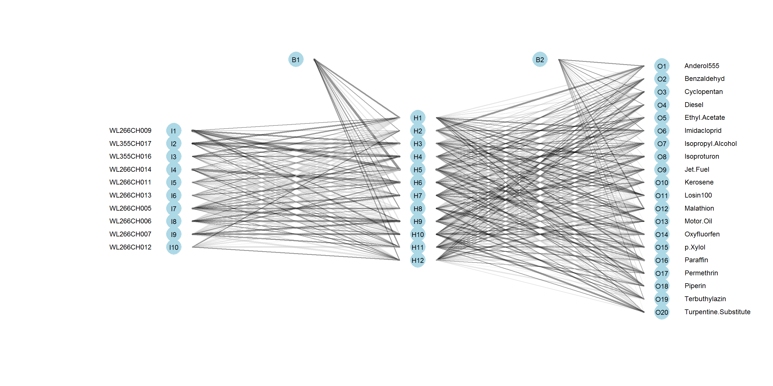
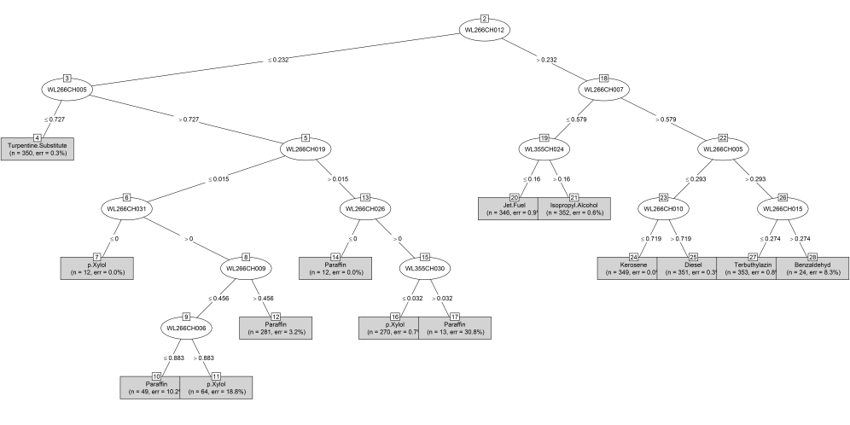
Algorithms
Specs | Decision Tree C5.0 | Support Vector Machine | Neural Network
classification | linear | nonlinear | nonlinear
computation | numerical | analytical | numerical
principle | if ... then statements | transformation with kernel function linear separation in hyperspace | combination of input and hidden units backpropagation converging weights
no overfitting | global pruning | smooth borders | averaging and early stopping

Slide 10
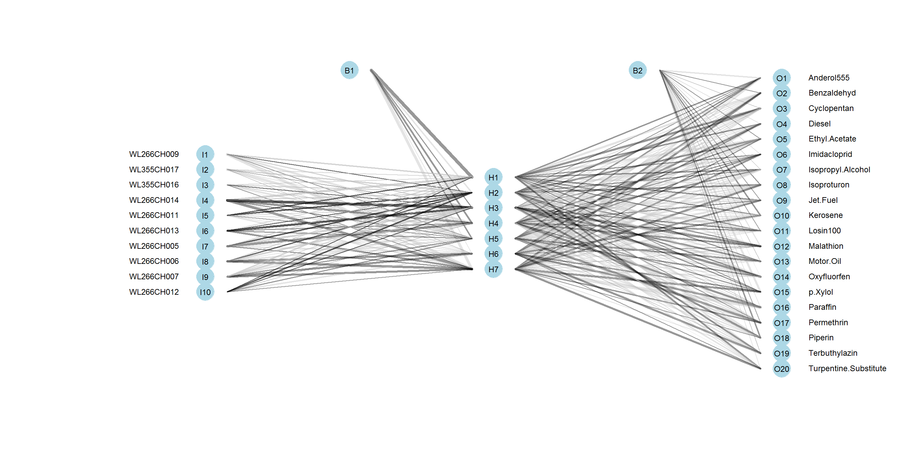
Algorithms
Details | Decision Tree C5.0 | Support Vector Machine | Neural Network
R packages | C50, plyr | kernlab | nnet
resampling | bootstrap | bootstrap | bootstrap
feature selection | no | no | PCA
parameters | 25 trees | kernel: radial basis function | 1 layer with 12 hidden units activation function: sigmoid

Slide 11
Algorithms
Results | Decision Tree C5.0 | Support Vector Machine | Neural Network
modeling | 2 min | 2 min | 10 min
errors | 21 (max. 3 per 100 spectra) | 31 (max. 4 per 100 spectra) | 17 (max. 3 per 100 spectra)
accuracy | 99.16 % | 98.76 % | 99.32
Kappa | 0.9912 | 0.9869 | 0.9928
execution | < 10 sec | < 10 sec | < 10 sec

Slide 12
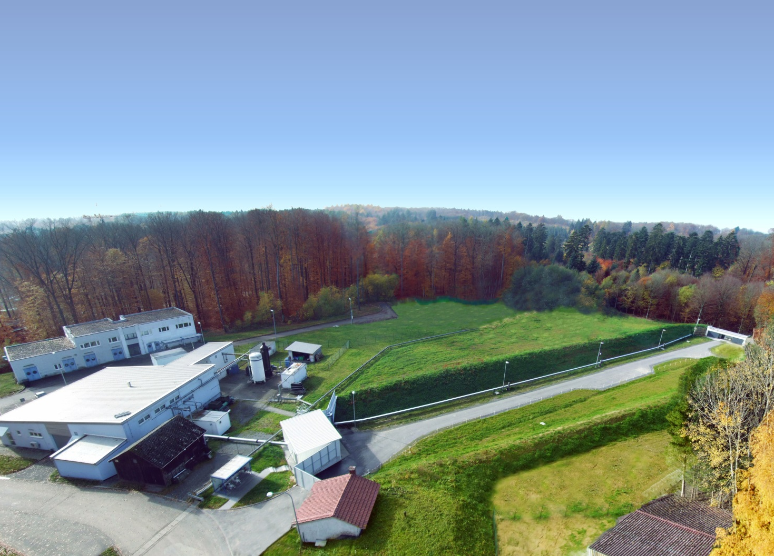
Future tasks
outdoor measurements
distances up to 120 m on our test range
model evaluation on new data
other algorithms
different concentrations
mixtures
mobile design

Slide 13


Thanks to the audience
More details:
Gebert F. et al., Novel standoff detection system for the classifcation of chemical and biological hazardous substances combining temporal and spectral laser induced ﬂuorescence techniques. SICC2017, Rome, Italy (2018).
Kraus M. et al., Comparison of Classifcation methods for Spectral Data of Laser Induced Fluorescence. SICC2017, Rome, Italy (2018).
Duschek F. et al., Standoff Detection and Classifcation of Bacteria by Multispectral Laser Induced Fluorescence. Advanced Optical Technologies 6: 75-83 (2017).

