Slide 1
Time-variant, non-stationary Vehicle-to-Vehicle Channel Model
Date: 2018-05-09
Authors:

Slide 2

Introduction V2X Channel Models
Realistic and efficient channel models needed for performance evaluation of Next Generation V2X in IEEE NGV SG [1],[2]
Small-scale fading models
Acosta-Marum channel model [3]
Channel models from the ETSI Plugtests™ 2013 [4],[5],[6]
Stochastic channel models: Wide-sense stationary uncorrelated scattering (WSSUS)
Vehicular channel [6],[7]: Highly time-variant, correlated scatterers
Geometry-based stochastic channel models (GSCMs)
Computational complexity
GSCM with analytic delay-dependent Doppler spectra [7],[8],[9],[10]

Slide 3
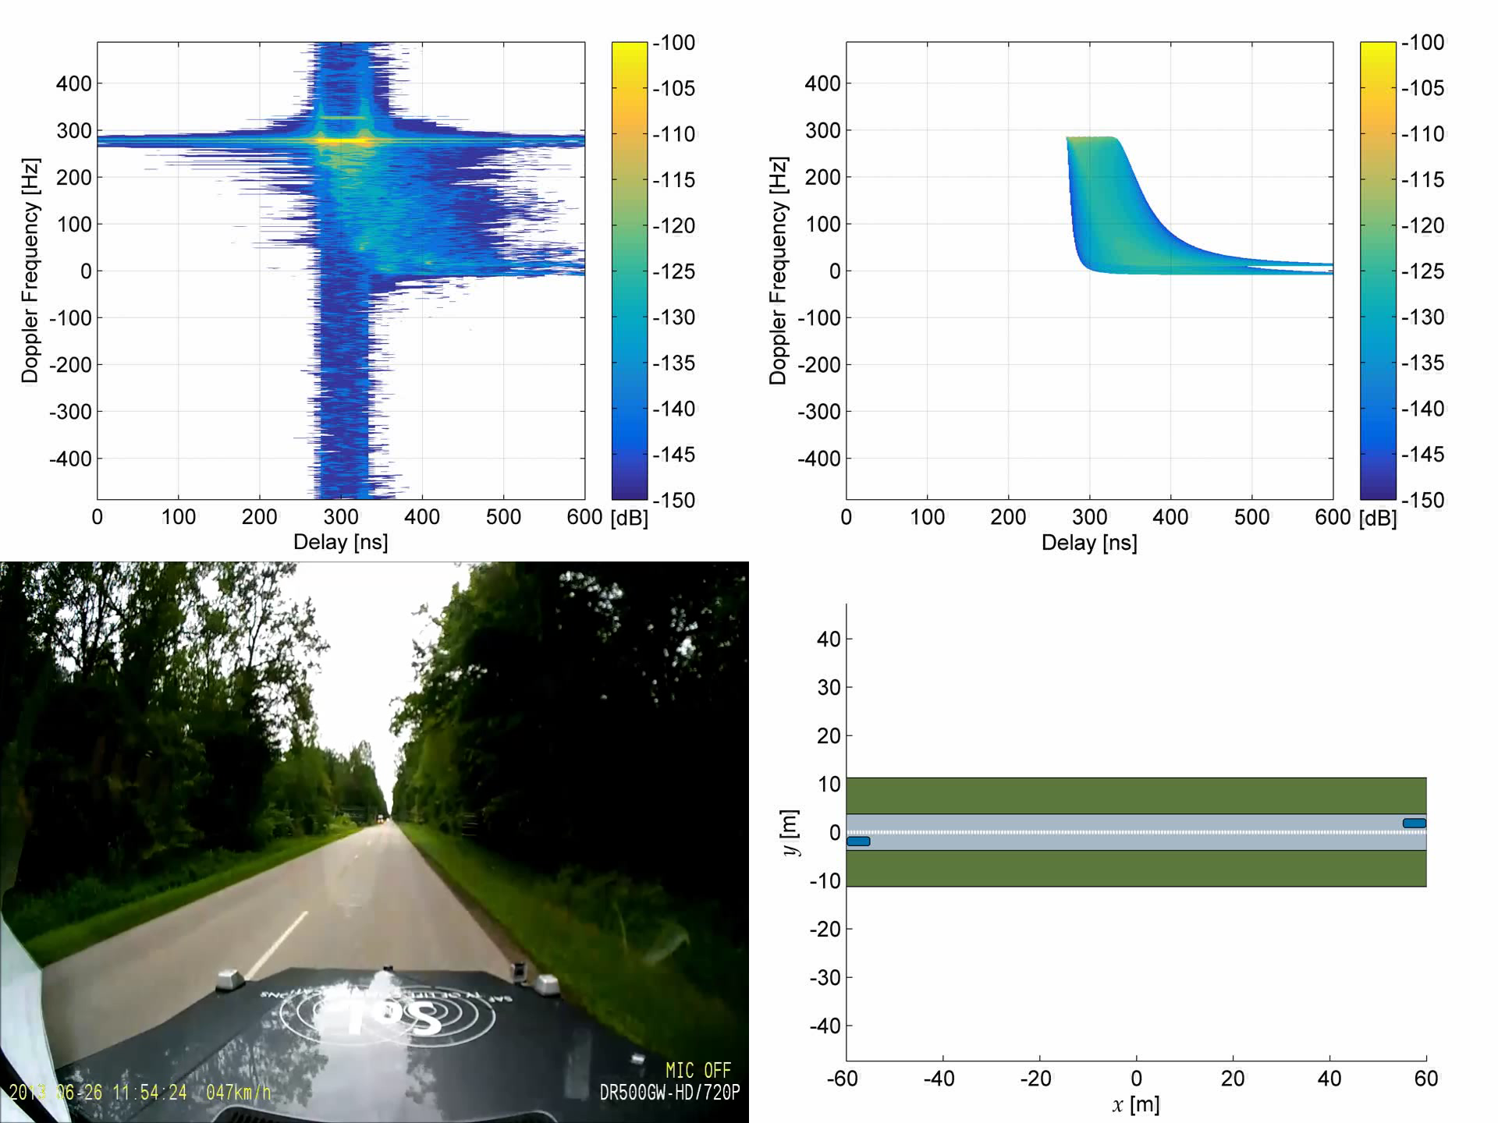

Slide 4

V2V-Channel: Driving in Opposite Directions
RX
TX
100 m

Slide 5
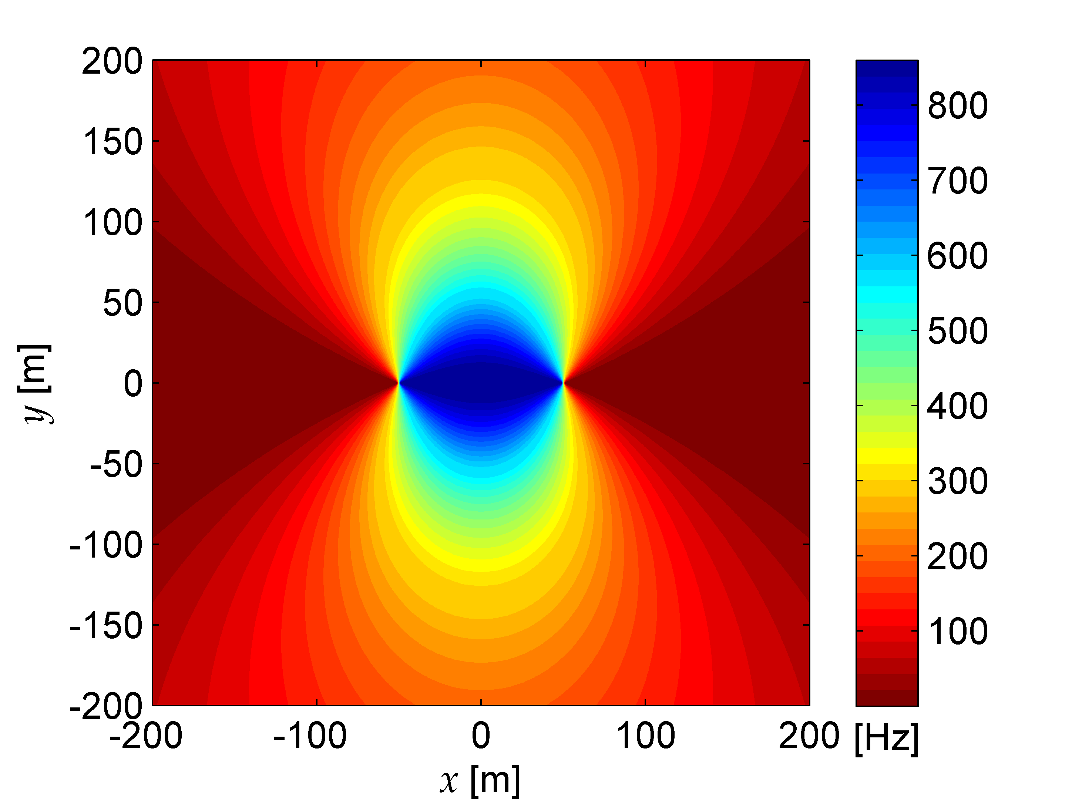

V2V-Channel: Driving in Opposite Directions
RX
TX
$$f_{c}=\text{5.2 }\text{GHz}$$
90 km/h
90 km/h
RX
TX
100 m

Slide 6
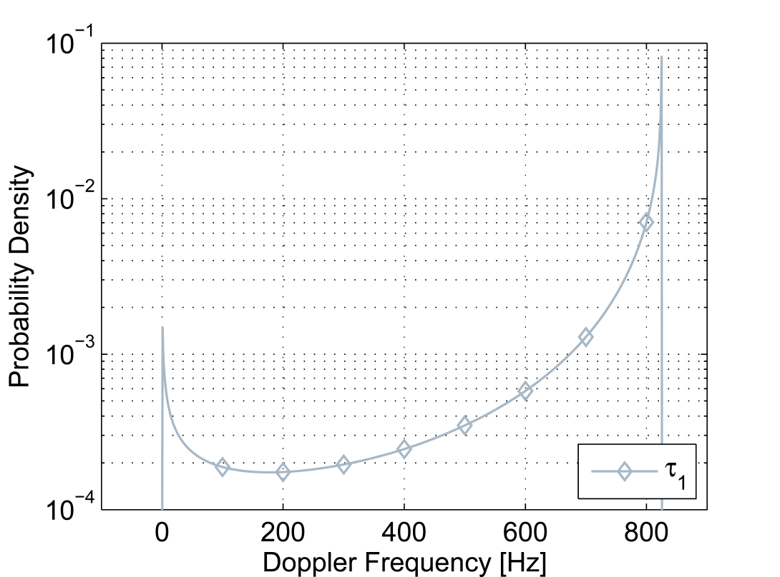
V2V-Channel: Driving in Opposite Directions
RX
TX
$$f_{c}=\text{5.2 }\text{GHz}$$
90 km/h
90 km/h
RX
TX
100 m

Slide 7
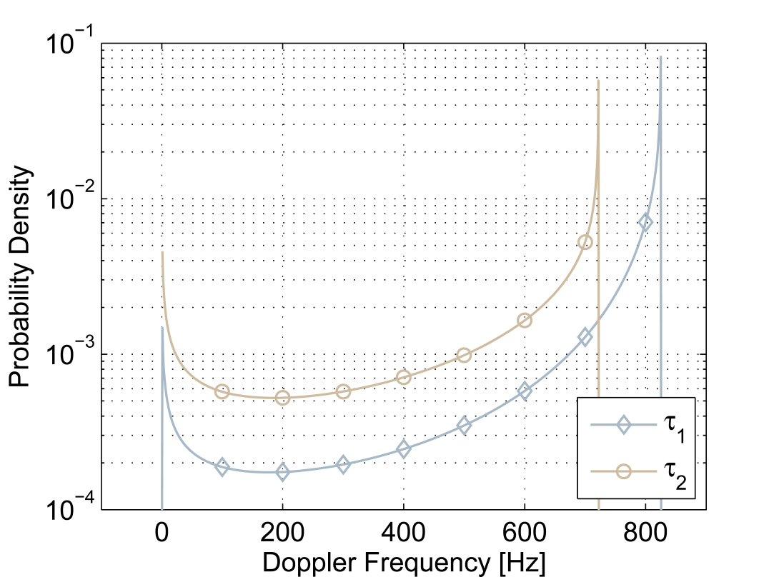
V2V-Channel: Driving in Opposite Directions
RX
TX
$$f_{c}=\text{5.2 }\text{GHz}$$
90 km/h
90 km/h
RX
TX
100 m

Slide 8
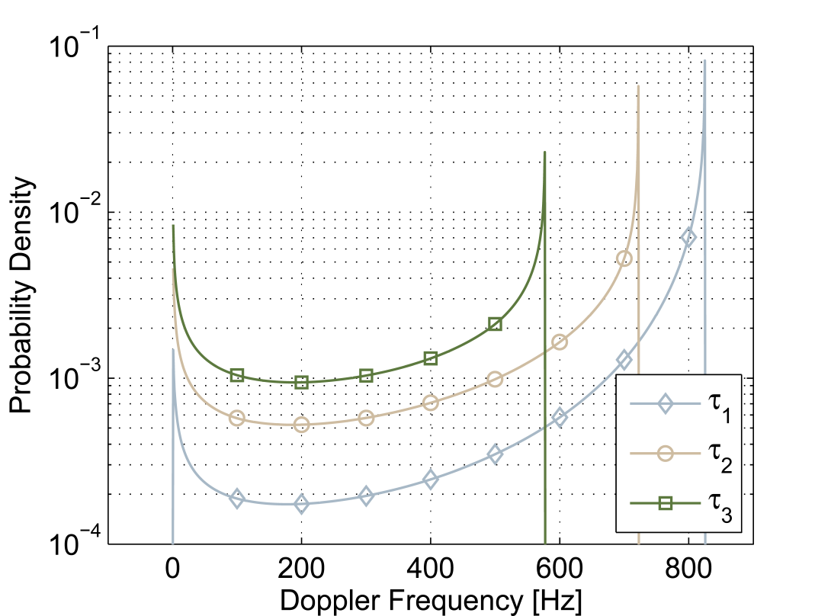
V2V-Channel: Driving in Opposite Directions
RX
TX
$$f_{c}=\text{5.2 }\text{GHz}$$
90 km/h
90 km/h
RX
TX
100 m

Slide 9
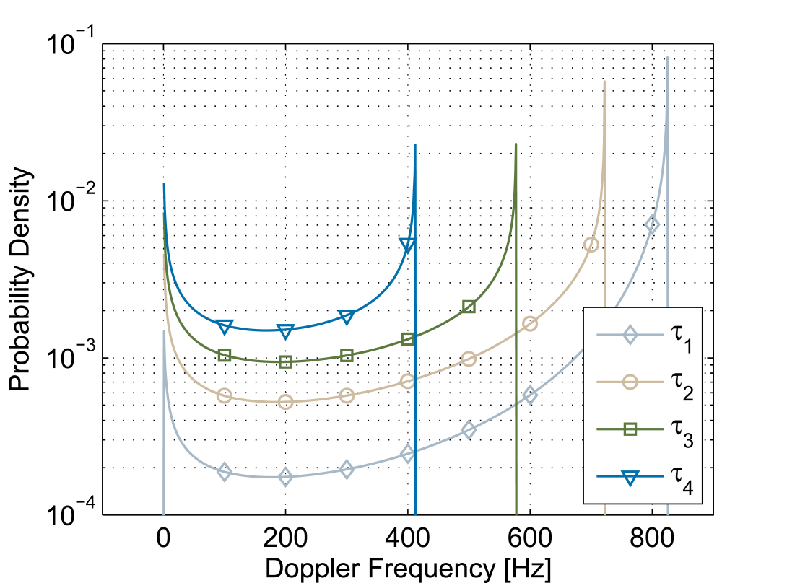
V2V-Channel: Driving in Opposite Directions
RX
TX
$$f_{c}=\text{5.2 }\text{GHz}$$
90 km/h
90 km/h
RX
TX
100 m

Slide 10
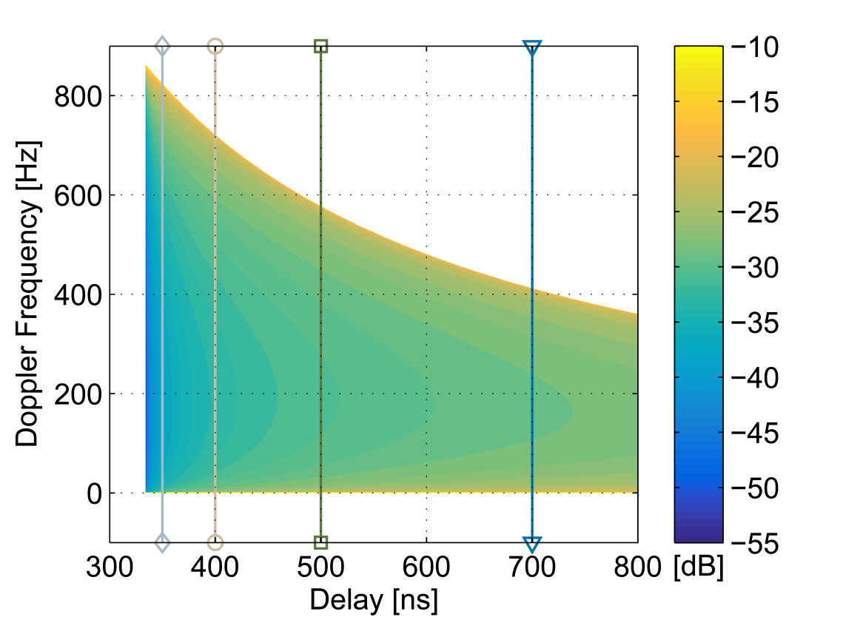
V2V-Channel: Driving in Opposite Directions
RX
TX
$$f_{c}=\text{5.2 }\text{GHz}$$
90 km/h
90 km/h
RX
TX
100 m

Slide 11
V2V-Channel: Driving in Opposite Directions
RX
TX
$$f_{c}=\text{5.2 }\text{GHz}$$
90 km/h
90 km/h
Doppler spectrum depends
on delay, velocity vectors, and Tx-Rx distance
RX
TX
100 m

Slide 12
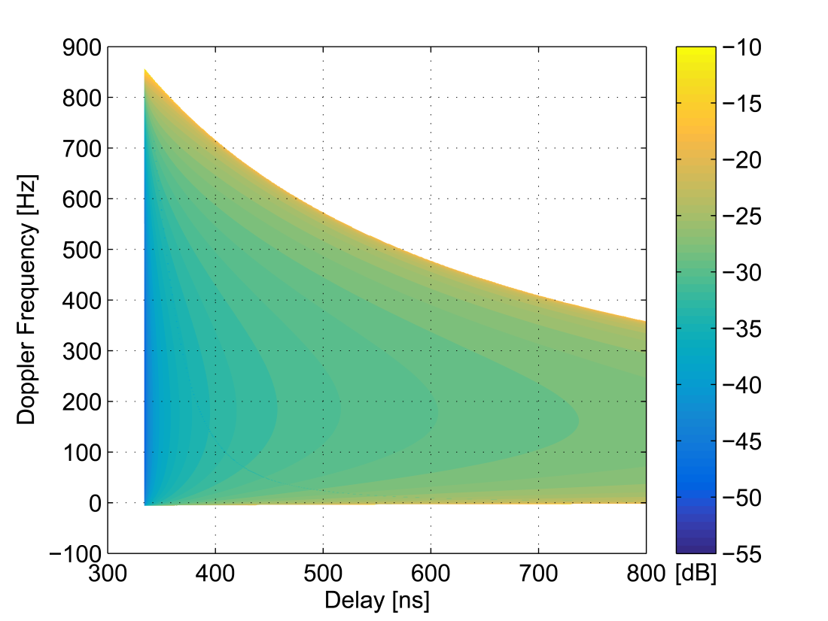

V2V-Channel: Influence of Finite Scattering Areas
100 m
90 km/h
TX
RX
90 km/h

Slide 13
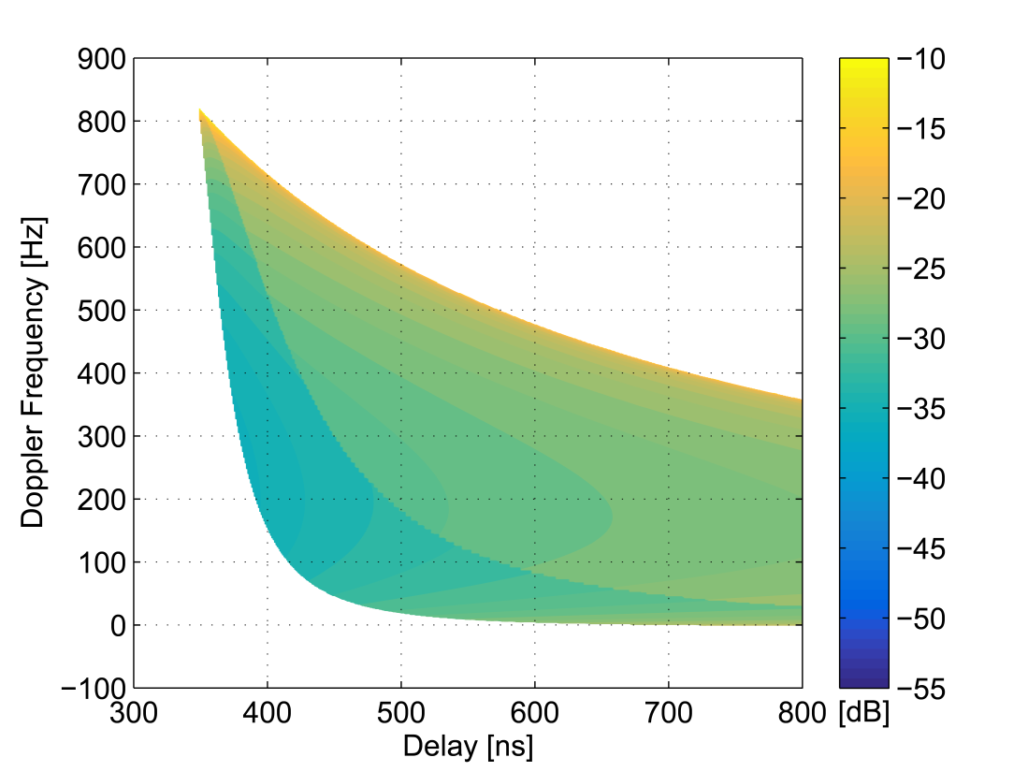
V2V-Channel: Influence of Finite Scattering Areas
100 m
90 km/h
TX
RX
90 km/h

Slide 14
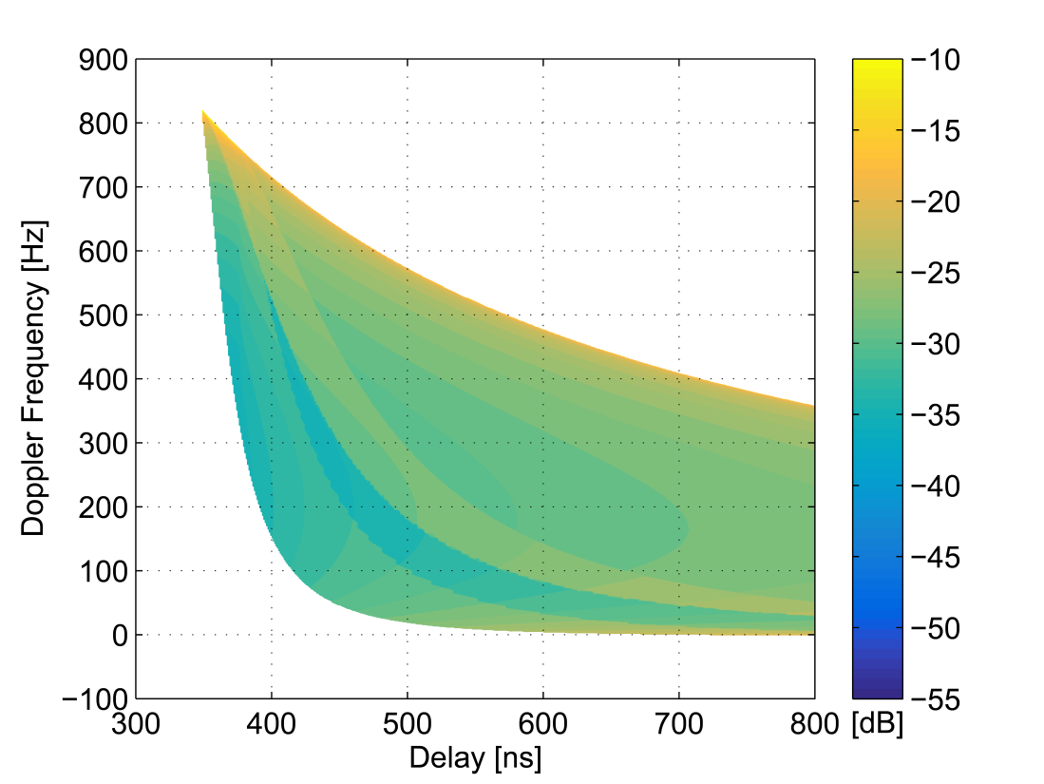
V2V-Channel: Influence of Finite Scattering Areas
100 m
90 km/h
TX
RX
90 km/h

Slide 15
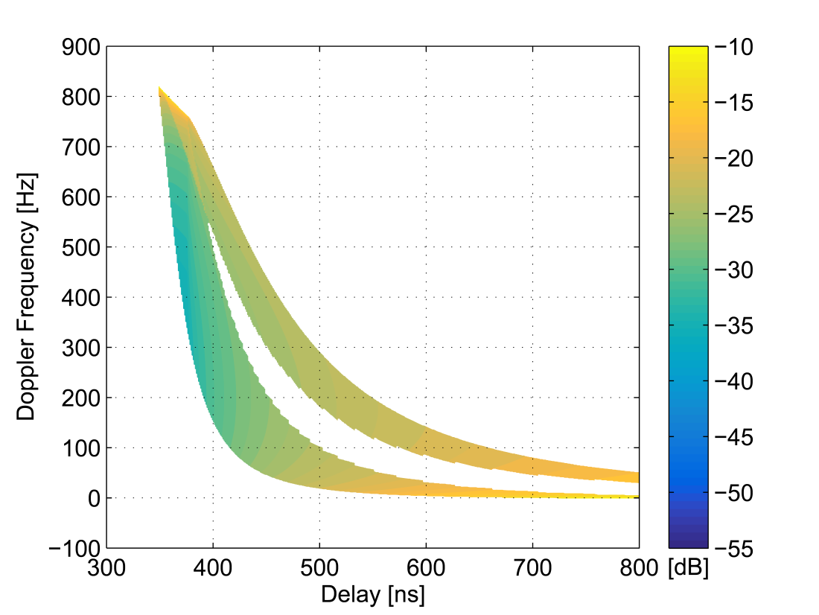
V2V-Channel: Influence of Finite Scattering Areas
100 m
90 km/h
TX
RX
90 km/h

Slide 16
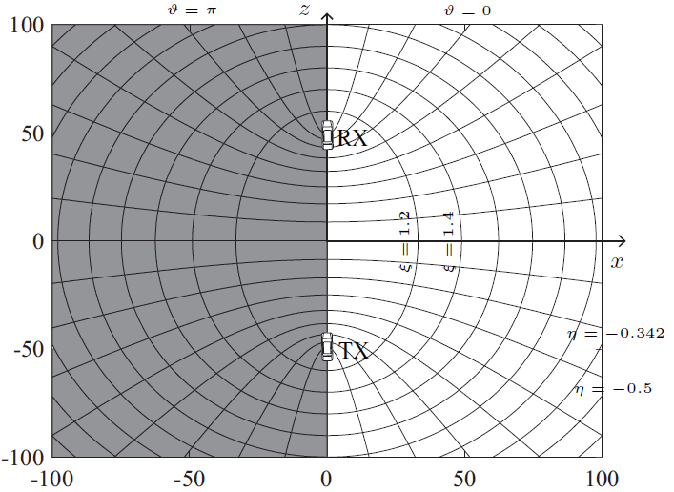
V2V-Channel: Theoretical GSCM based on Prolate Spheroidal Coordinate System
Exploit symmetry of problem by using adequate coordinate system
Separate coordinate ξ to describe constant delay resulting in ellipses
Allows a delay-dependent description of the Doppler frequency
No trigonometric functions
Algebraic analysis is possible!
[10] M. Walter, D. Shutin and A. Dammann, "Algebraic Analysis of the Poles in the Doppler Spectrum for Vehicle-to-Vehicle Channels," in IEEE Wireless Communications Letters, vol. PP, no. 99, pp. 1-1.

Slide 17
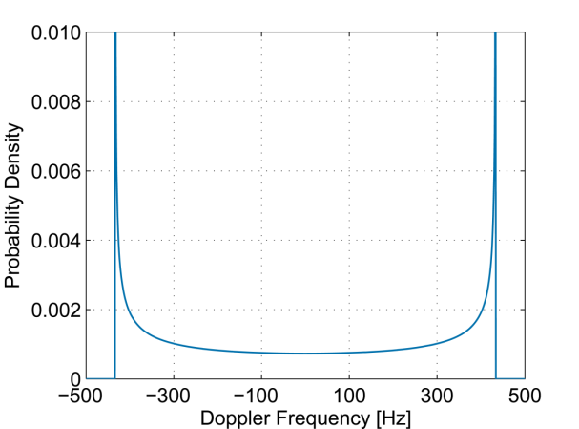
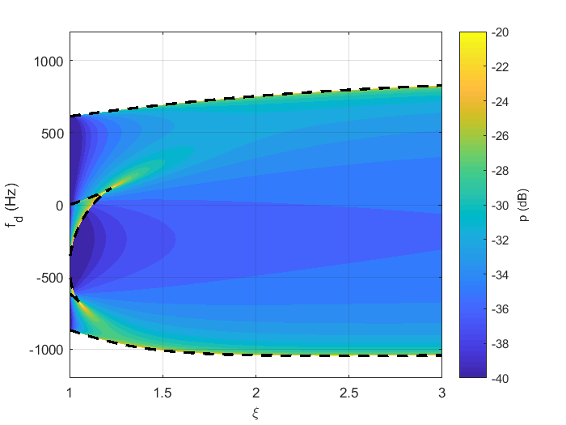
V2V-Channel: Theoretical GSCM based on Prolate Spheroidal Coordinate System
Algebraic Analysis of Poles in the Doppler Spectrum:
Poles determine the limiting frequencies of the spectrum
Theorem: In V2V channels the Doppler spectrum caused by single-bounce scattering can possess up to six distinct real poles.
Polynomial of degree 6 to resolve for the spectrum poles

Slide 18
V2V-Channel: Theoretical GSCM based on Prolate Spheroidal Coordinate System
Algebraic Analysis of Poles in the Doppler Spectrum:
Poles determine the limiting frequencies of the spectrum
Theorem: In V2V channels the Doppler spectrum caused by single-bounce scattering can possess up to six distinct real poles.
Polynomial of degree 6 to resolve for the spectrum poles

Slide 19

V2V-Channel: Theoretical GSCM based on Prolate Spheroidal Coordinate System
More realistic compared to (over-)simplifying models
time-variant (geometry-dependent) and delay-dependent Doppler spectrum
Computational efficient
Easily applicable for
simulation and emulation (PHY, MAC,…)
performance evaluation for NGV
Usable?
Geometric-Stochastic V2V-Model
Velocity vectors
time-variant, delay-dependent Doppler-pdf
Ego-coordinates

Slide 20
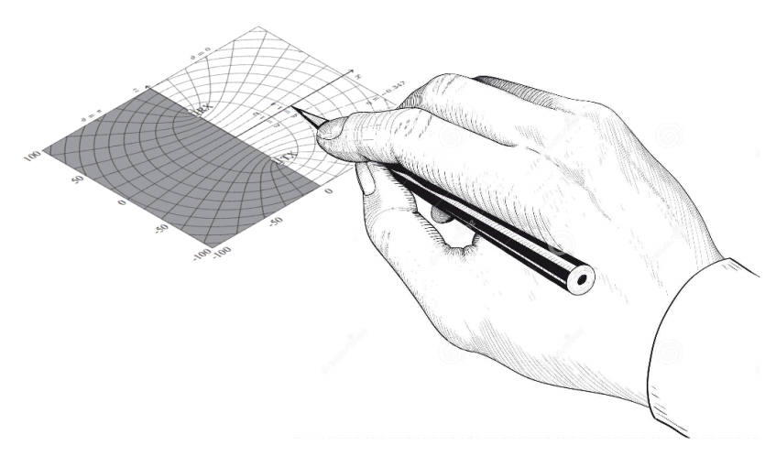
Summing up…
Precise theoretical geometric-stochastic channel model for non-stationary vehicle-to-vehicle channels
Applicable for simulations and (enhanced) performance evaluation
Suitable software is under construction…

Slide 21
References
[1] Hongyuan Zhang et al., “802.11 For Next Generation V2X Communications”, IEEE 802.11-18/0513r2.
[2] Jianhan Liu and Hognyuan Zhang, “ON NGV Channel Models”, IEEE 802.11-0821r0.
[3] G. Acosta-Marum and M. A. Ingram, “Six time- and frequency- selective empirical channel models for vehicular wireless LANs,“ in IEEE Vehicular Technology Magazine, vol. 2, nr. 4, p. 4-11, December 2007.
[4] I. Tan, W. Tang, K. Labertaux, and A. Bahai, ”Measurement and analysis of wireless channel impairments in DSRC vehicular communications,” in Proc. Of International Conference on Communications (ICC ’08), Beijing, China, May 2008, pp. 4882-4888.
[5] P. Alexander, D. Haley, and A. Grant, ”Cooperative intelligent transport systems: 5.9 GHz field trials,” in Proceedings of the IEEE, vol. 99, no. 7, pp. 1213-1235, July 2011.

Slide 22
References
[6] L. Bernado, T. Zemen, F. Tufvesson, A. F. Molisch, and C. F. Mecklenbräuker, ”Delay and Doppler spreads of non-stationary vehicular channels for safety relevant scenarios,” in IEEE Transactions on Vehicular Technology, vol. 63, no. 1, pp. 82-93, January 2014.
[7] M. Walter, D. Shutin and U. C. Fiebig, "Delay-Dependent Doppler Probability Density Functions for Vehicle-to-Vehicle Scatter Channels," in IEEE Transactions on Antennas and Propagation, vol. 62, no. 4, pp. 2238-2249, April 2014.
[8] M. Walter, D. Shutin and U. C. Fiebig, "Prolate Spheroidal Coordinates for Modeling Mobile-to-Mobile Channels," in IEEE Antennas and Wireless Propagation Letters, vol. 14, pp. 155-158, 2015.
[9] M. Walter, D. Shutin and A. Dammann, "Time-Variant Doppler PDFs and Characteristic Functions for the Vehicle-to-Vehicle Channel," in IEEE Transactions on Vehicular Technology, vol. 66, no. 12, pp. 10748-10763, Dec. 2017.

Slide 23
References
[10] M. Walter, D. Shutin and A. Dammann, "Algebraic Analysis of the Poles in the Doppler Spectrum for Vehicle-to-Vehicle Channels," in IEEE Wireless Communications Letters, vol. PP, no. 99, pp. 1-1.

