Slide 1
Injection seeded ns-pulsed Nd:YAG laser at 1116 nm for Fe-Lidar
Alexander Fischer¹, Peter Mahnke¹, Daniel Sauder¹, Matthias Damm¹, Hans Christian Büdenbender² , Jochen Speiser¹
¹DLR Stuttgart Institute for Technical Physics
²DLR Oberpfaffenhofen Institute for Atmospherical Physics

Slide 2
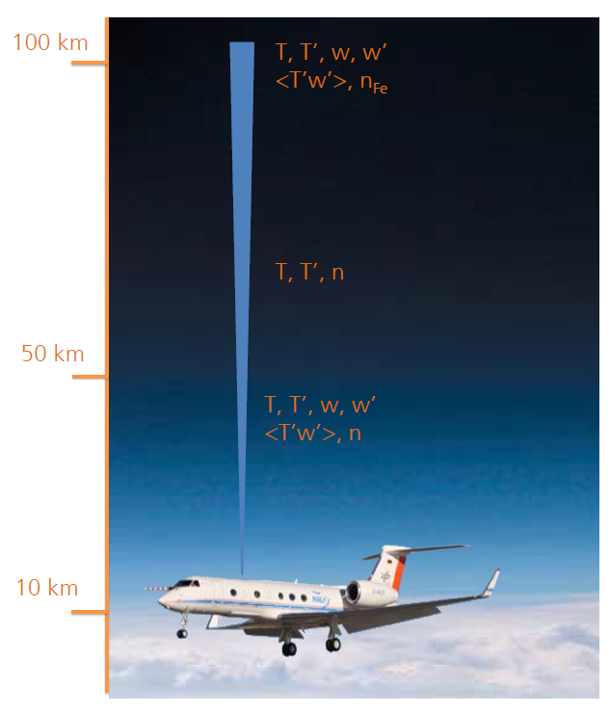
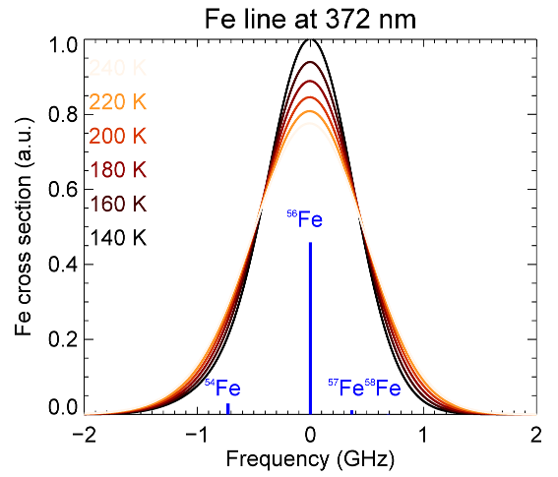
Motivation
Alima: Airborne Lidar for studying the
middle atmosphere
Cooperation with DLR Oberpfaffenhofen PA-LID
Iron in the upper atmosphere (50-100 km)
Fluorescence line of 372 nm suitable for
resonance Lidar
Analysis of the line gives information about
air velocity, temperature, gravity waves
Goal: compact, airborne
system
Gelbwachs J., Appl. Opt. 33, 7151 (1994)
Gardner et al, Geophys. Res. Lett. 27, 1199 (2001)
Chu et al, Appl. Opt. 41, 4400 (2002)
Kaifler et al. ;New Lidar Systems at the German Aerospace Center, LPMR 2015

Slide 3
Generation of 372 nm: existing system
100 mJ
~60 ns
34 Hz
3 W
744 nm
2ω
372 nm
Alexandrite laser
single frequency
Chu et al., Appl. Opt. 21, 4400 (2002)
developed by the NCAR
Disadvantage: small emission cross section, needs heating
strong pumping source needed

Slide 4
Generation of 372 nm: OPO
532 nm
1116 nm
558 nm
1064 nm
2ω
2ω
3ω
372 nm
single frequency Nd:YAG
1 J, 100 Hz, 10 ns
commercially available
OPO
>50 mJ
disadvantages: not very efficient
danger of damage of optics due to high pulse energies

Slide 5
Generation of 372 nm: resonator at 1116 nm
1116 nm
2ω
3ω
single frequency
>15 mJ, 100 Hz, <100 ns
amplifier system
>150 mJ
372 nm, >50 mJ
can be realized very compact
avoids very high pulse energies
small cooling system required

Slide 6
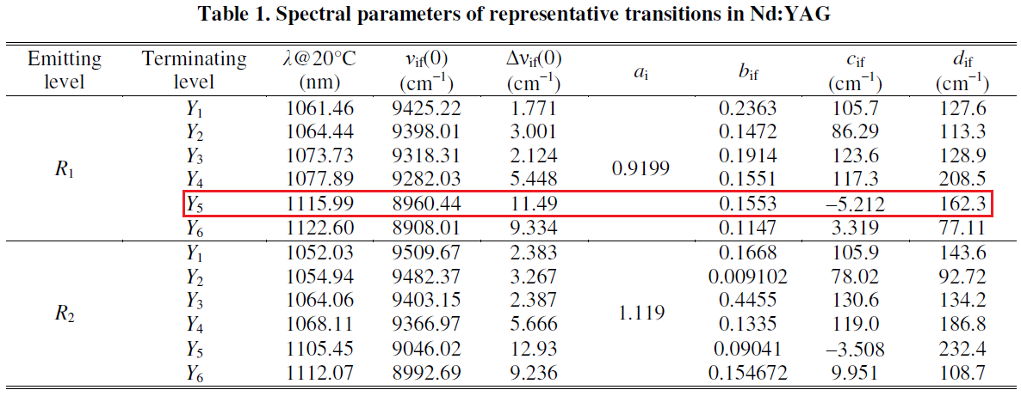
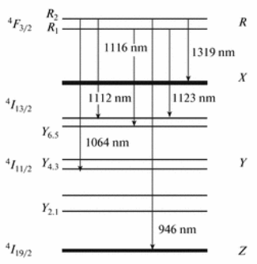
Nd:YAG laser line at 1116 nm
emission cross sections:
challenges with 1116 nm:
~7 times lower amplification than with 1064 nm
supression of 1064 nm
σ₁₀₆₄ = 2,8*10⁻¹⁹ cm²
σ₁₁₁₆ = 0,42*10⁻¹⁹ cm²
Alexandrite σ₇₄₄ = 0,07*10⁻¹⁹ cm² (295 K)
and 0,30*10⁻¹⁹ cm² (463 K)
Marling, IEEE J. Quant. Electron, 14, 56 (1978)
Wang et al.; Appl. Phys B (2011) 104:45–52
Huan et al.; Chin. Phys. B Vol. 21, No. 10 (2012) 104208
Zhang et al.; CHIN. PHYS. LETT. Vol. 30, No. 10 (2013) 104202

Slide 7
Realisation of the resonator
to experiment/
frequency conversion
etalon
λ/4 plate
λ/4 plate
TFP
end mirror
Pockels cell
end mirror
pump chamber
with Nd:YAG crystal
seed laser
diode laser @ 1116 nm
cw, 5 mW, single frequency
side pumped setup
injection seeded
resonator length ~110 cm
pump duration 300 µs @ 100 Hz

Slide 8
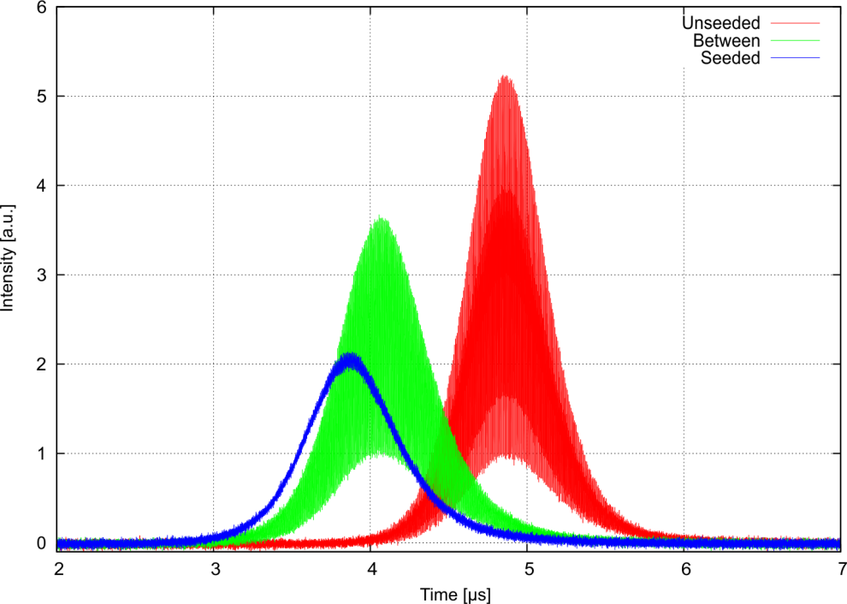
Injection Seeding
etalon
λ/4 plate
λ/4 plate
TFP
end mirror
Pockels cell
end mirror
pump chamber
with Nd:YAG crystal
seed laser
no stabilization
(bad parameters)
(2 modes)
Need for stabilization of the resonator length
to get proper seeding
single frequency

Slide 9
Feedback-looped Stabilzation
end mirror
with piezo
λ/4 plate
λ/4 plate
photodiode
TFP
pump chamber
with Nd:YAG crystal
seed laser
Build-up-time
feedback control
Folie mit vorher kombinieren

Slide 10
Output power and beam quality
M² ~ 1,1
maximum pulse energy ~14.3 mJ @ 1116 nm
4.9 mJ @ 372 nm (max. efficiency 35%)
output coupling ~10%
pulse length 80 ns

Slide 11
Further Work
implementation of a end pumped resonator

