Slide 1
COTS in (Deep) Space
Hans-Juergen Sedlmayr (hans-juergen.sedlmayr@dlr.de)
DLR (German Aerospace Centre), Robotic and Mechatronic Centre,
82234 Wessling
Germany
SERESSA 2017, October 16th – 19th , Munich (Garching)

Slide 2
Agenda
Introduction to DLR-RM
Usage of COTS – a short overview
Radiation testing
Some test results of motor driver solutions
Challenge COTS
Conclusion

Slide 3
Agenda
Introduction to DLR-RM
Usage of COTS – a short overview
Radiation testing
Some test results of motor driver solutions
Challenge COTS
Conclusion

Slide 4
German Aerospace Center (DLR) / Robotics and Mechatronics Center (RMC)
DLR is the national aeronautics and space research center of the Federal Republic of Germany.
8000 employees at 20 locations in Germany and also in Brussels, Paris, Tokyo, Washington D.C.
Main sectors: Research and development work in Aeronautics, Space, Energy, Transport, …
The Robotics and Mechatronics Center (RMC) is a cluster and DLR’s competence center for research and development in the areas of robotics, mechatronics and optical systems. It is formed by three institutes with key research areas for inter-institutional cooperation.
The institutes are:
  Institute of Robotics and Mechatronics (Director Dr. Alin Albu-Schäffer), Wessling
  Institute of System Dynamics and Control (Director Dr. Johann Bals), Wessling
  Institute for Optical Sensor Systems (Director Prof. Dr. Heinz-Wilhelm Hübers), Berlin

Slide 5
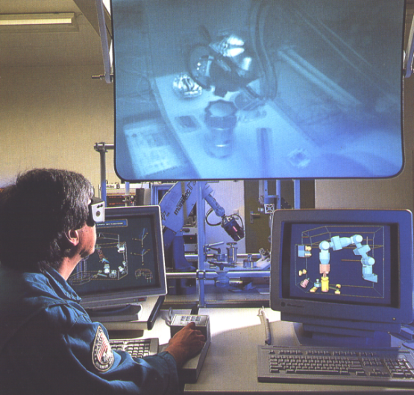
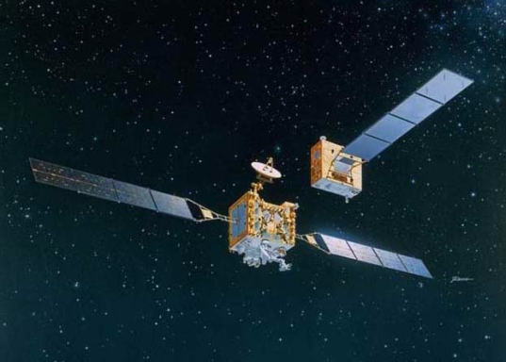
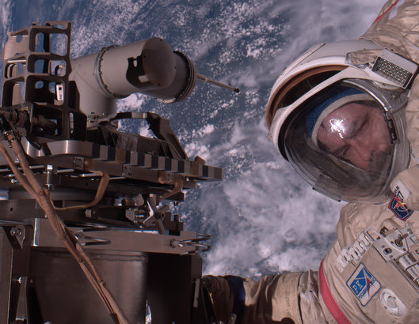
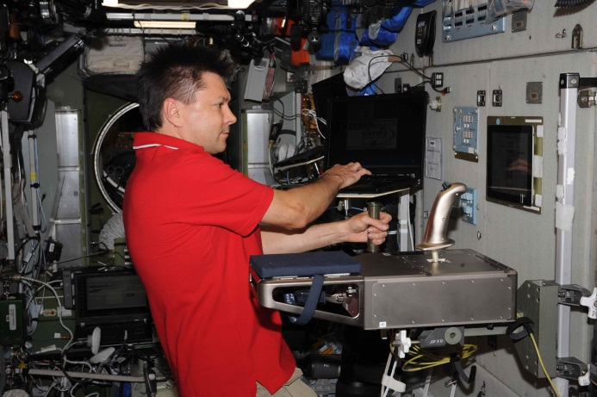
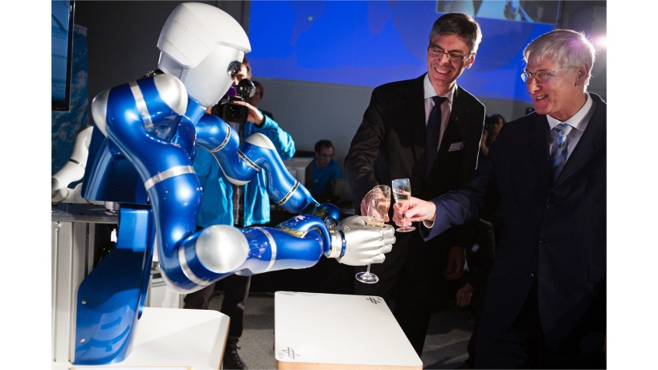
DLR-RM: Activities in Space Robotics - a short overview
  ROTEX (1993): The first remotely controlled robot in Space (D2 mission)
  GETEX / ETS-VII (1999): Video sensor controlled pick and place operations
  ROKVISS (2005 – 2010): Robot at the outside of the ISS based on LWR technology
  MASCOT (Now ongoing): Contribution with the Mobility unit
  KONTUR-2 (Now ongoing): Telepresence experiments (ISS ←→ Earth)
  CAESAR: Robotic arm for On-Orbit-Servicing (in Preparation)
  Spacehand: Robotic hand for On-Orbit-Servicing (in Preparation)
  LRU-2: Field research on Mount Etna succeeded within ROBEX framework

Slide 6
Agenda
Introduction to DLR-RM
Usage of COTS – a short overview
Radiation testing
Some test results of motor driver solutions
Challenge COTS
Conclusion

Slide 7
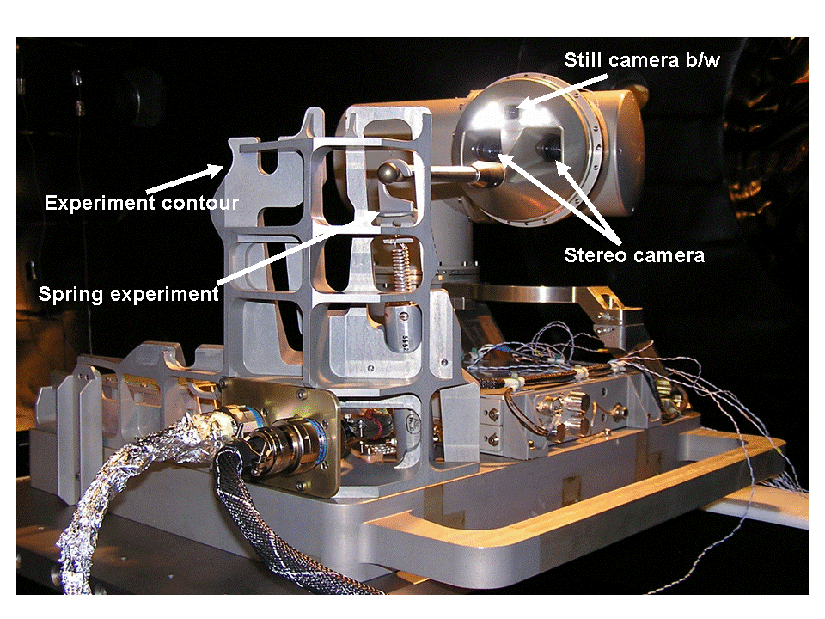
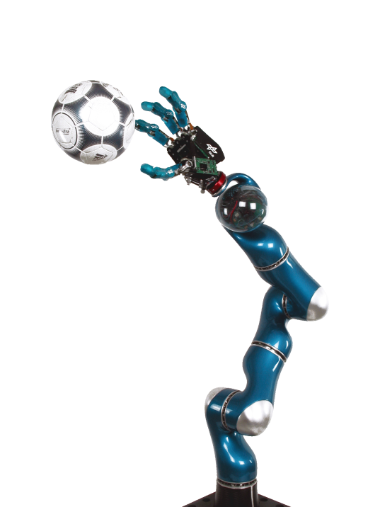
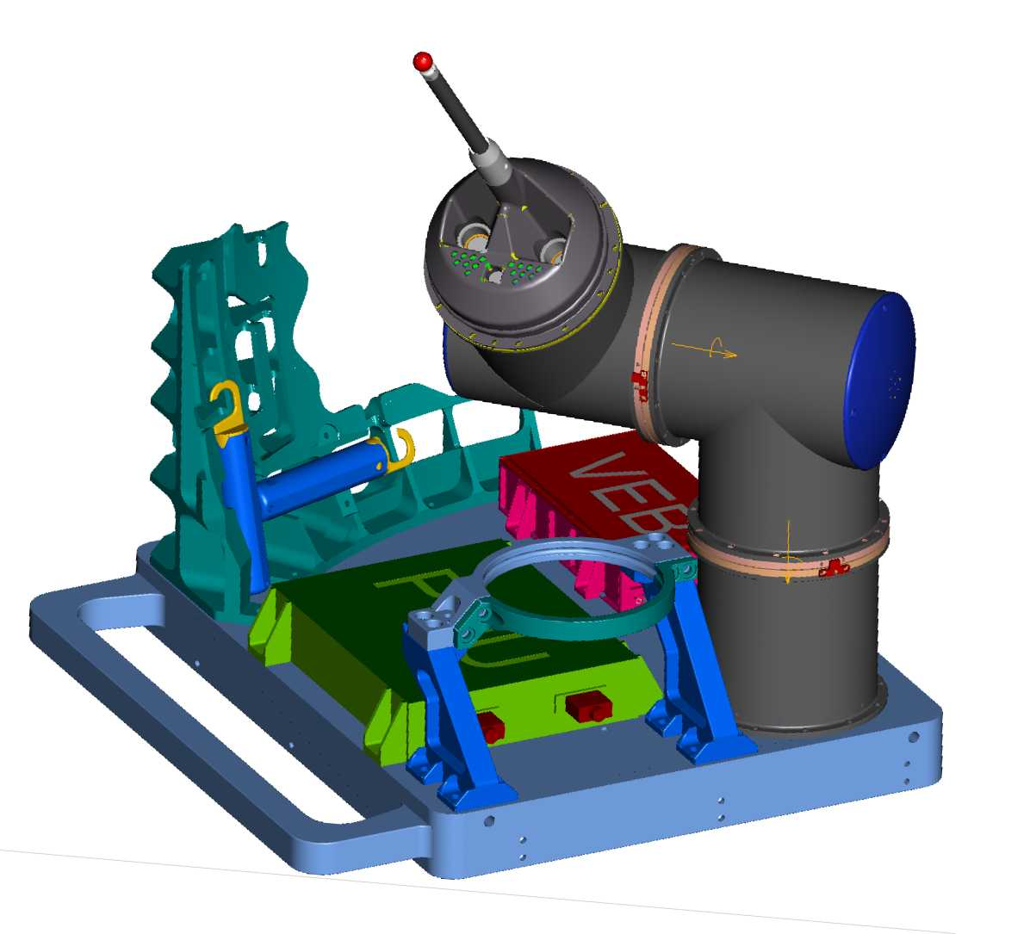
ROKVISS - Robotic Component Verification on the ISS
March 22, 2005 – November 2, 2010 at the outside of the Swesda Module of the ISS based on DLR-RM LWR technology
Experiments:
  Telepresence operation from Oberpfaffenhofen (direct link)
  Fully automatic operation
  Verification of new hardware (COTS and rad tolerant) and robot control concepts

Slide 8
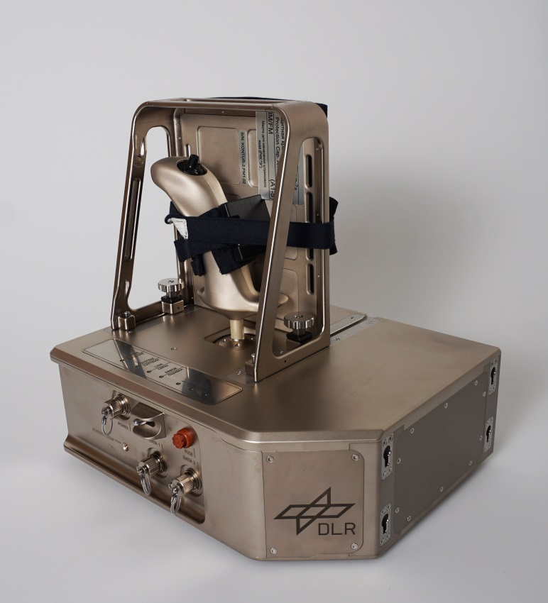
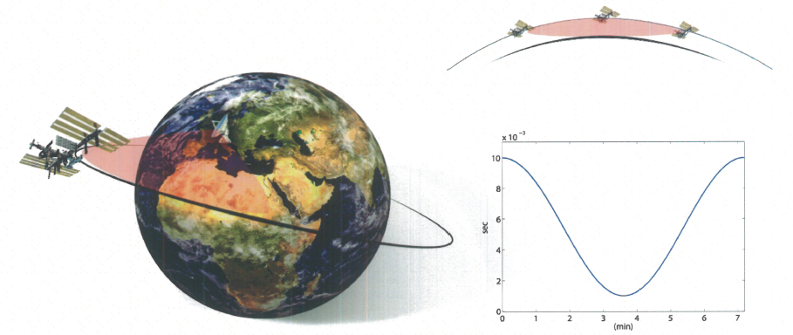
Kontur-2
Time Delay
Overflight Time
Remote control of Justin’s arm on earth from the ISS
Tele-handshake with humans
Telepresence experiment with Ball ISS - St.Petersburg - Oberpfaffenhofen
Development of a force feedback joystick for ISS

Slide 9
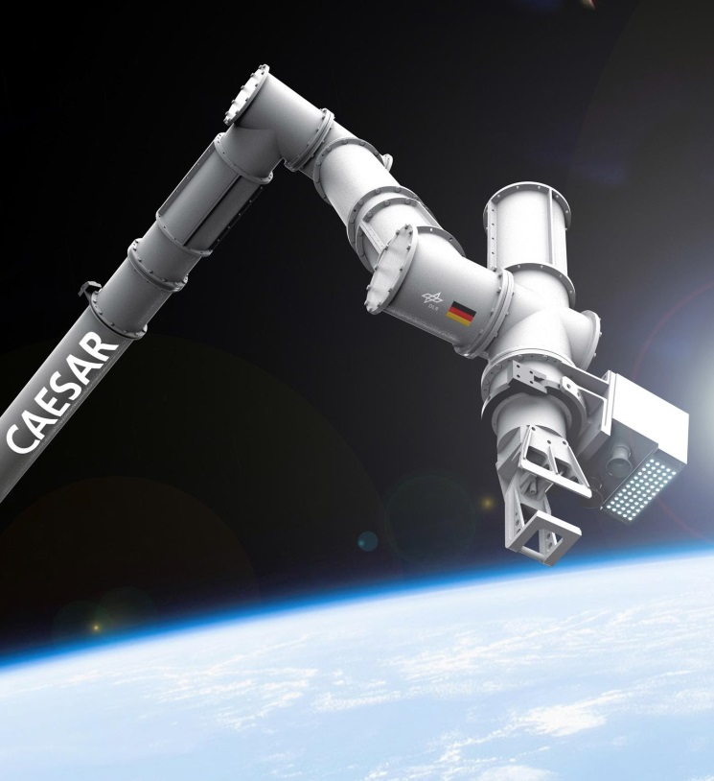
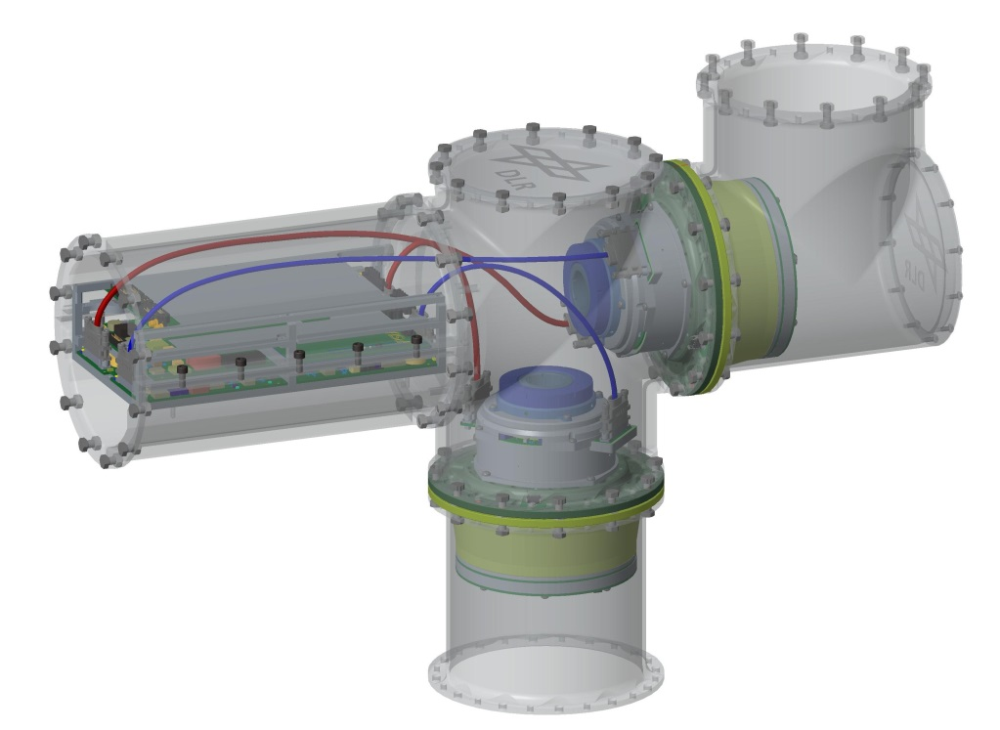
CAESAR
On-Orbit servicing missions in GEO
Based on DLR-RM LWR technology and on ROKVISS
7 Joints
Approx. 3m length in total
Real time bus EtherCat
Lessons learned from ROKVISS
New parts due to obsolescence and radiation

Slide 10
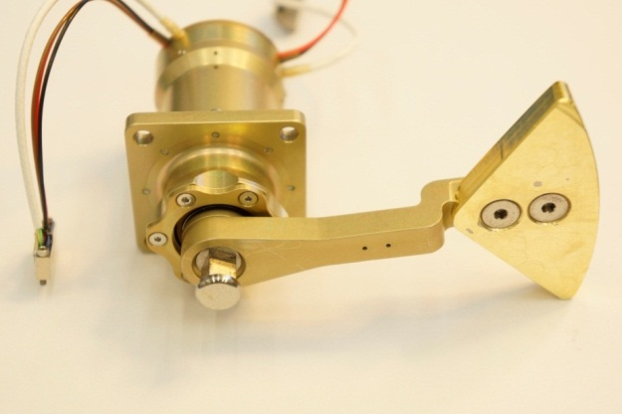
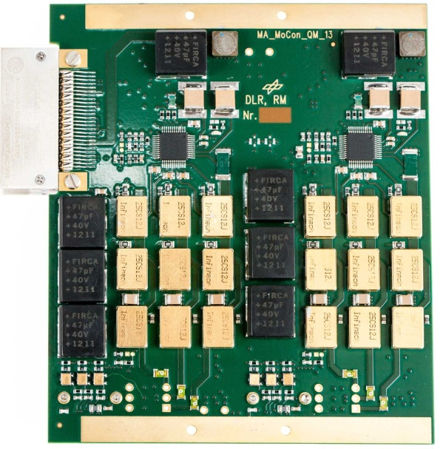
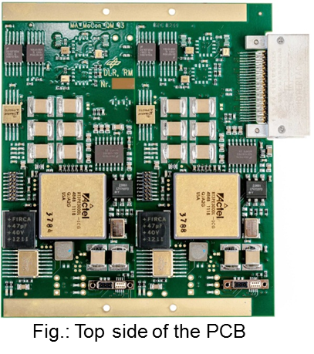
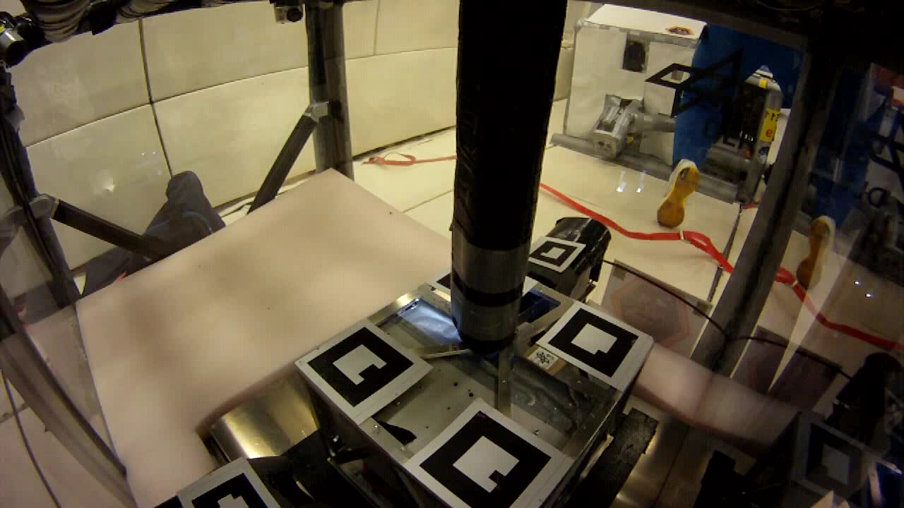
MASCOT - Mobility
10 kg Lander (30 x 30 x 20 cm)
Part of the Hayabusa II Sample Return Mission of JAXA
Asteroid Ryugu (1999JU3)s
Launch was in December 2014; Arrival at Target: 2018
Multiple Science Instruments on board
New innovative hopping / up righting mechanism for Lander
(gravity ~ 17e-6 g)

Slide 11
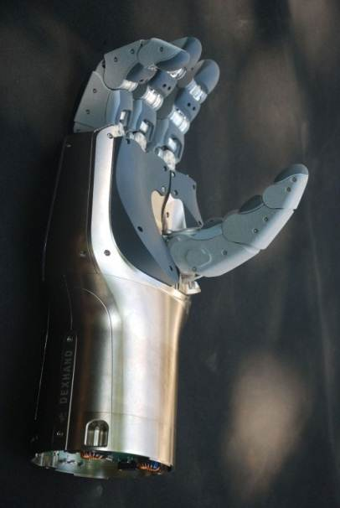
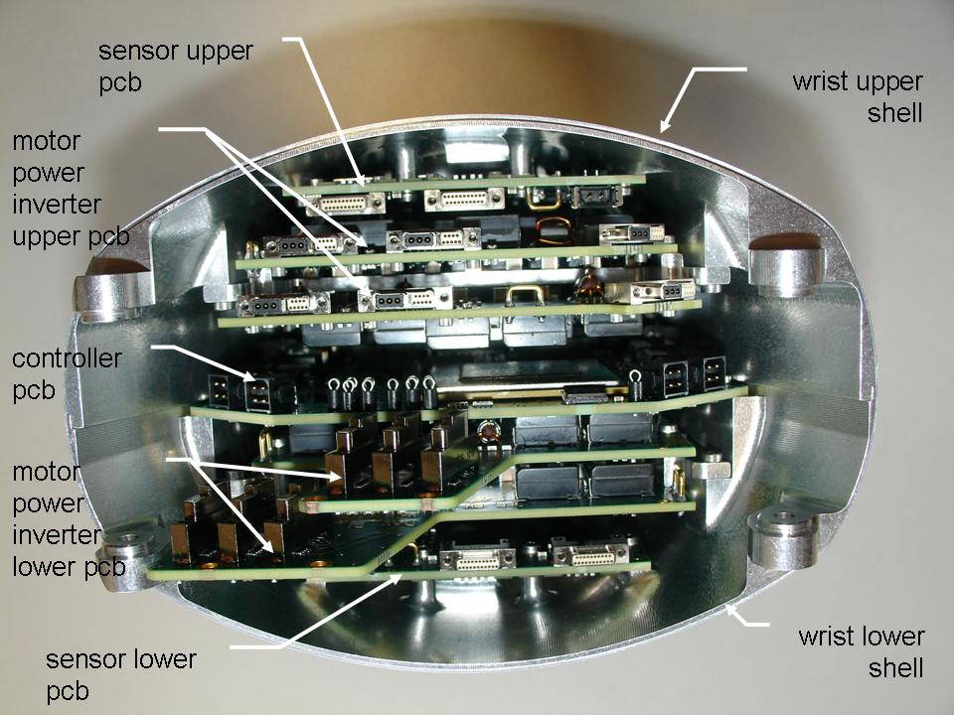
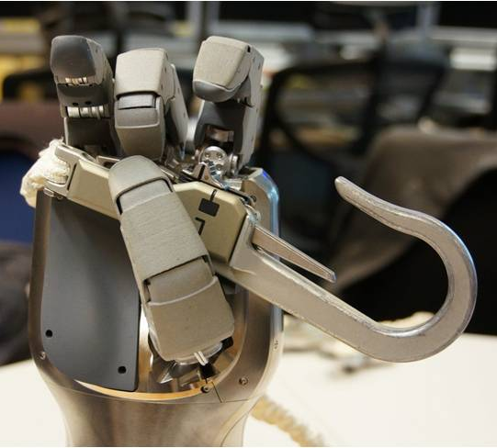
DEXHAND - Dexterous Robotic Hand (ESA Contract No. 21929/08/NL/EM)
Technology demonstration of an anthropomorphic four fingered, torque controlled robot hand
Size of an EVA glove
Survive 6 months in external ISS environment
Autonomous and tele-manipulation operation
Tasks are computed on the DEXHAND itself

Slide 12
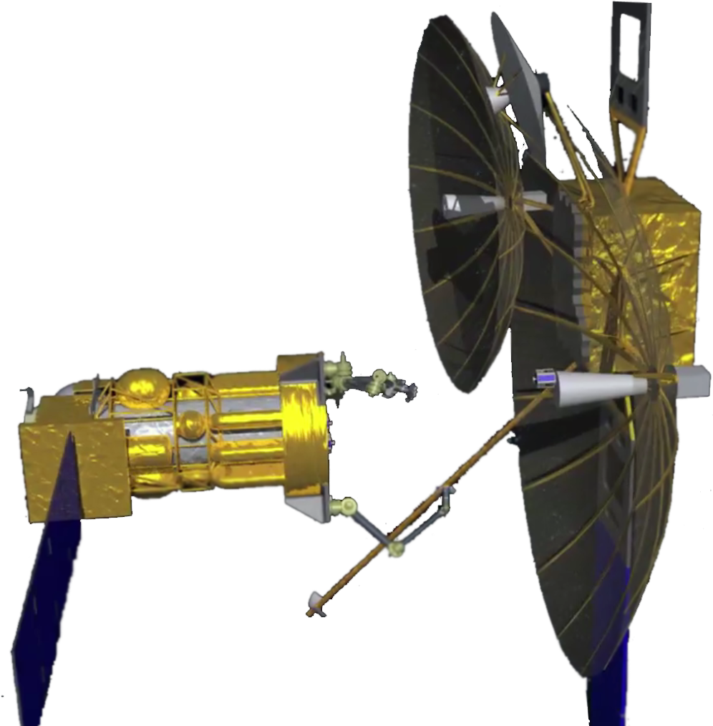
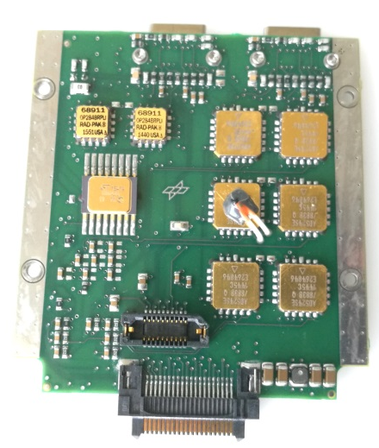
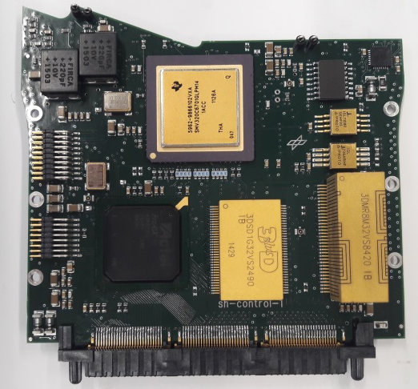
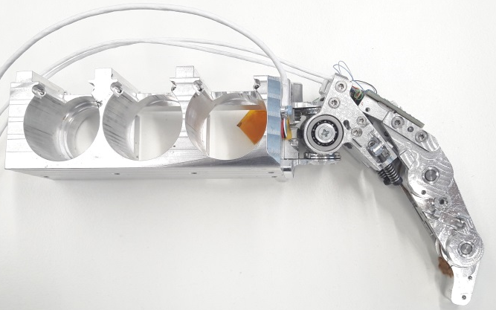
Spacehand (based on DEXHAND)
Size of an EVA glove
Multiple year operation in GEO orbit for orbital servicing tasks
Autonomous and tele-manipulation operation
Tasks are computed on the Spacehand itself
Part of the RSGS mission of DARPA, NRL and SSL

Slide 13
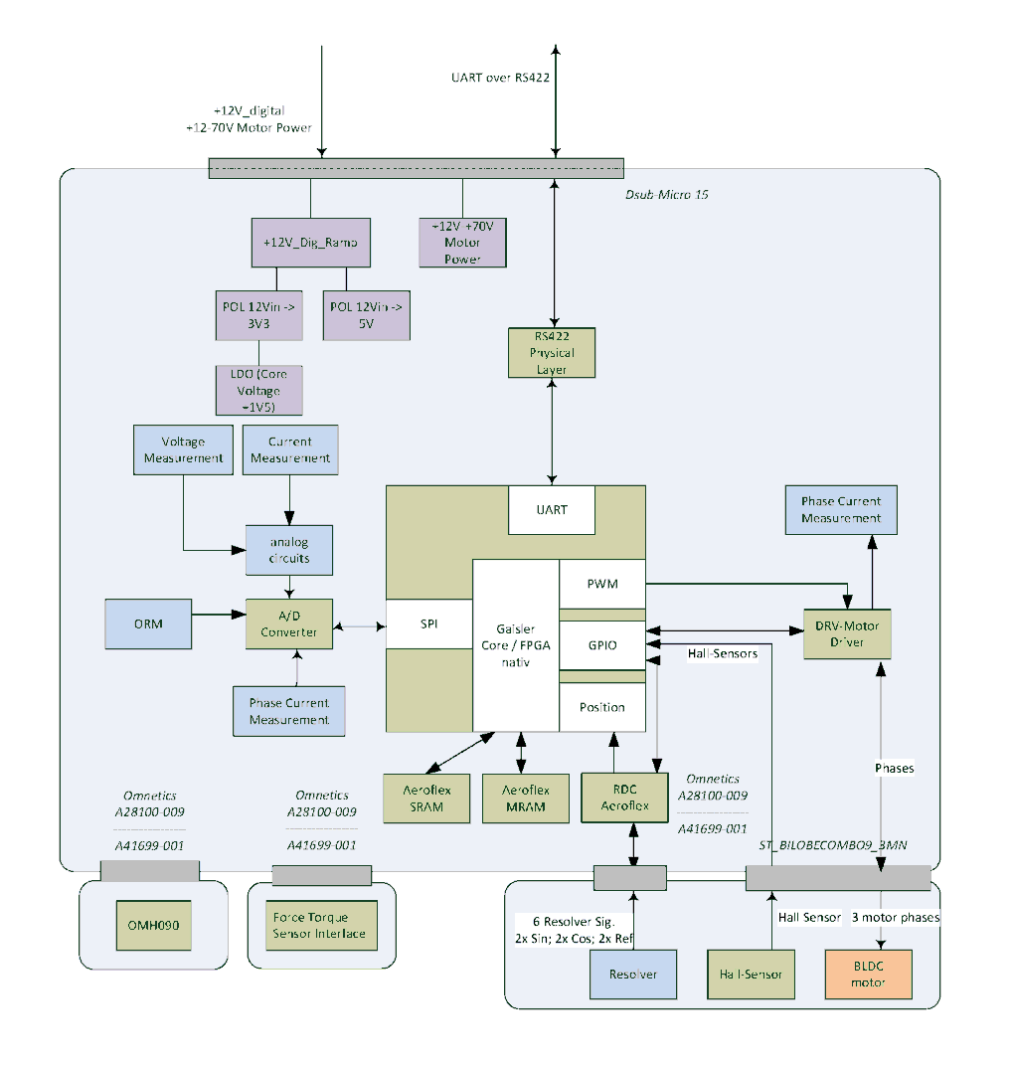
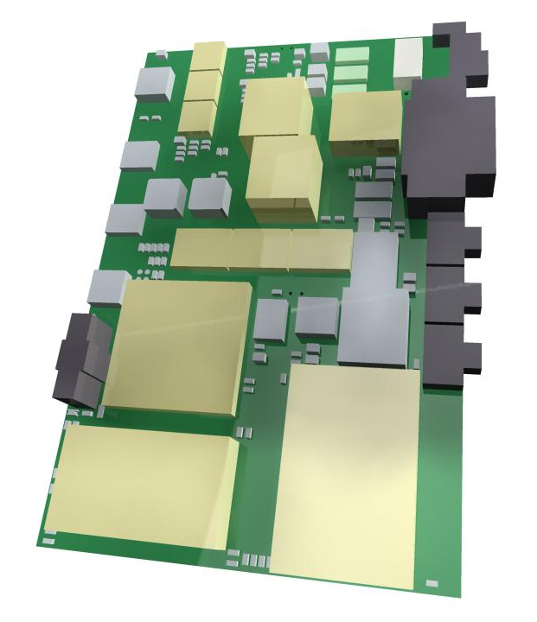
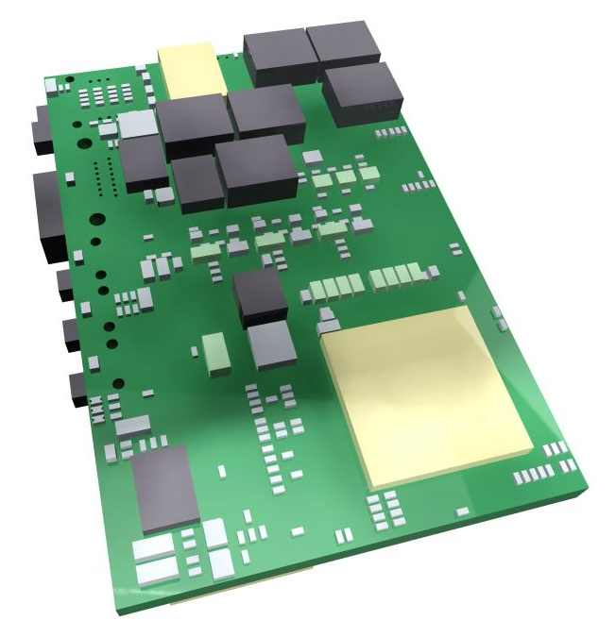
Highly integrated radiation tolerant Motion Controller
Size: 65 x 105 mm
Single digital 12V power supply
Motor power between 12 and 70V ; up to 300 W
Three phase current measurement in parallel
Multiple communication buses possible (one out of EtherCAT, SpaceWire, RS422)

Slide 14
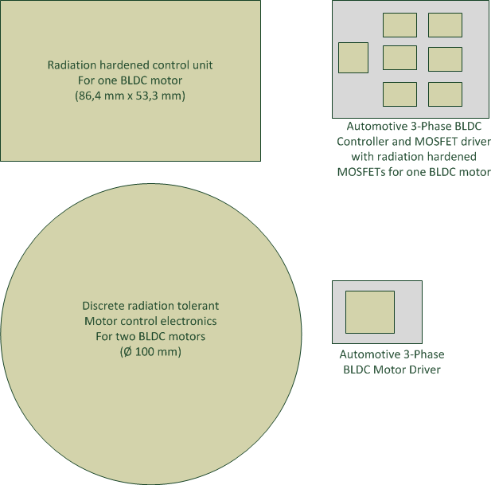
Reasons for using COTS
Size of available radiation tolerant parts
Performance of radiation tolerant parts
Automotive rated parts:
  Storage ~ -55°C up to +150°C
  Operating ~ -40°C up to +150°C
Type of mission helps for using COTS

Slide 15
Agenda
Introduction to DLR-RM
Usage of COTS – a short overview
Radiation testing
Some test results of motor driver solutions
Challenge COTS
Conclusion

Slide 16
Standards for radiation testing (most important)
ESCC Basic Specification 25100 (single event)
ESCC Basic Specification 22900 (total ionizing dose)
ESCC Basic Specification 23100 (evaluation and procurement)
ECSS Standard ECSS-Q-ST-60-13C (Commercial EEE components)

Slide 17
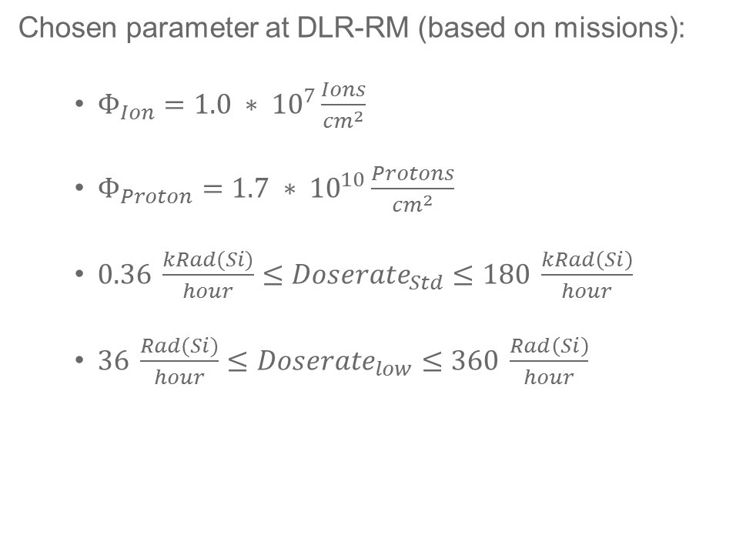
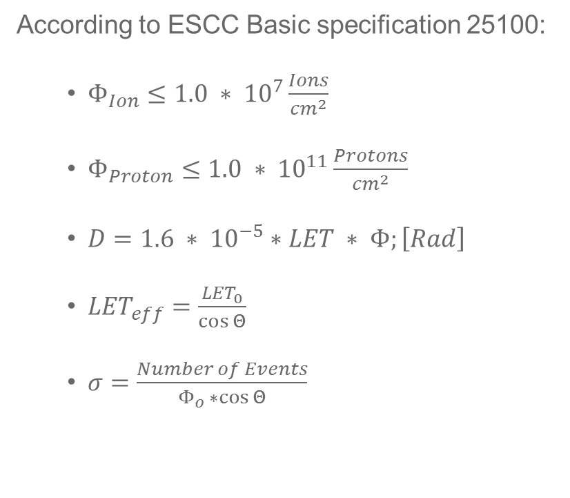
Fluence, Dose, LET and cross section
According to ESCC Basic specification 25100:
  $Φ_{Ion}≤1.0 ∗ {10}^{7}\frac{Ions}{{cm}^{2}}$
  $Φ_{Proton}≤1.0 ∗ {10}^{11}\frac{Protons}{{cm}^{2}}$
  $D=1.6 ∗ {10}^{−5}∗LET ∗ Φ;\left[Rad\right]$
  ${LET}_{eff}=\frac{{LET}_{0}}{\cos{Θ}}$
  $σ=\frac{Number of Events}{Φ_{o} ∗\cos{Θ}}$
Chosen parameter at DLR-RM (based on missions):
  $Φ_{Ion}=1.0 ∗ {10}^{7}\frac{Ions}{{cm}^{2}}$
  $Φ_{Proton}=1.7 ∗ {10}^{10}\frac{Protons}{{cm}^{2}}$
  $0.36 \frac{kRad(Si)}{hour}≤{Doserate}_{Std}≤180 \frac{kRad\left(Si\right)}{hour}$
  $36 \frac{Rad(Si)}{hour}≤{Doserate}_{low}≤360 \frac{Rad\left(Si\right)}{hour}$

Slide 18
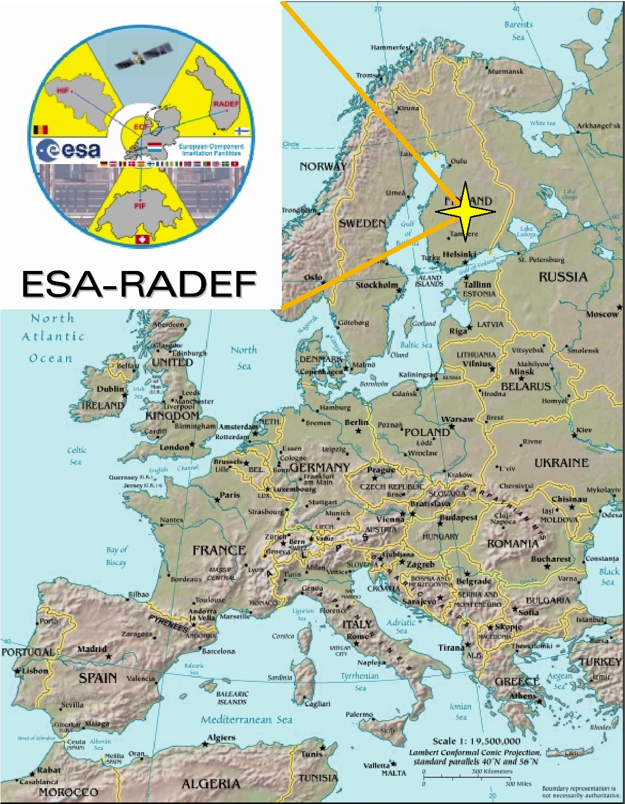
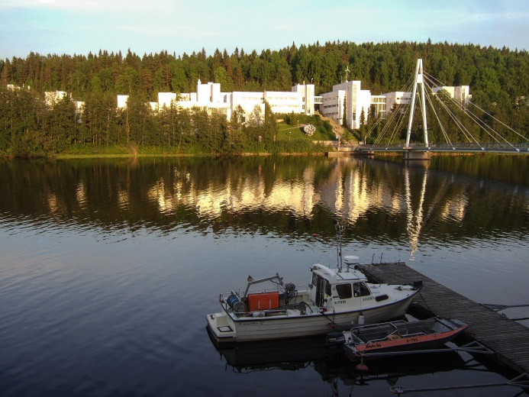
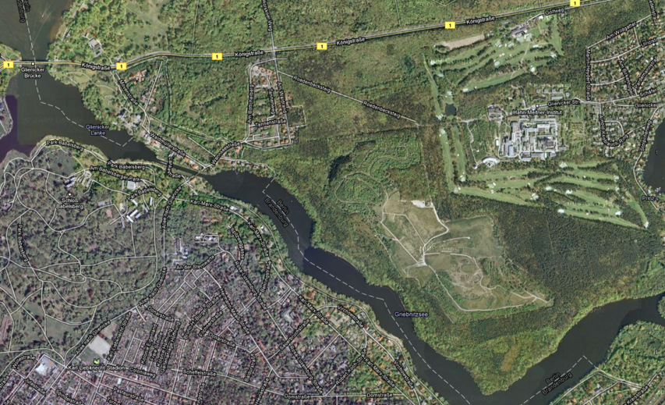
Test Facilities
Helmholtz-Zentrum Berlin Wannsee; Cobalt-60 source and proton therapy
RADiation Effects Facility of the University of Jyväskylä
Heavy-Ions
Total Dose (Co60) and Protons
Courtesy by google

Slide 19
Agenda
Introduction to DLR-RM
Usage of COTS – a short overview
Radiation testing
Some test results of motor driver solutions
Challenge COTS
Conclusion

Slide 20
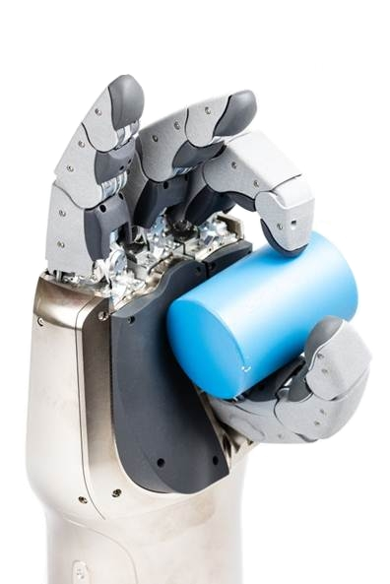
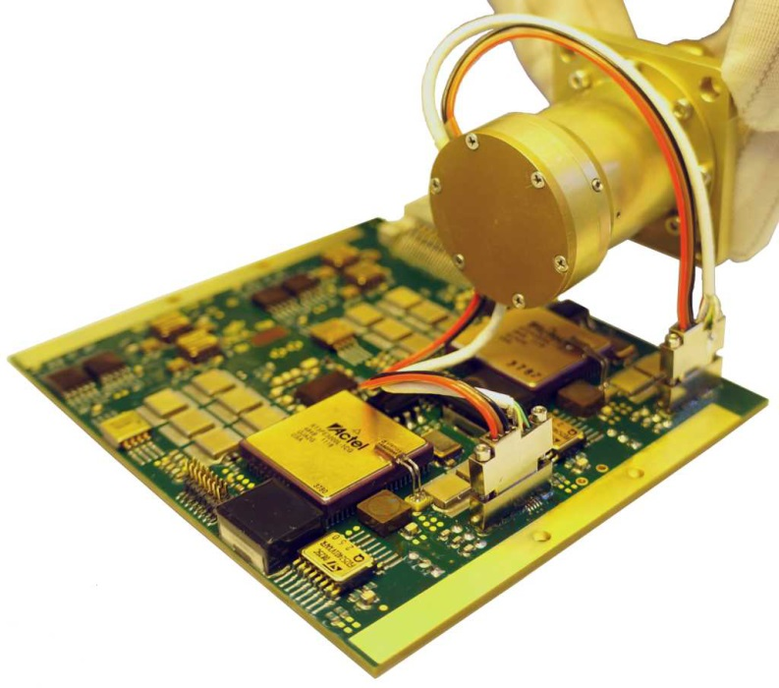
3-Phase BLDC Controller and MOSFET-Driver
COTS controller for two systems
  DEXHAND: TID = 10 kRad
  MASCOT: TID = 4.2 kRad (Electronic Box)
LQFP package (9 mm x 9 mm)
Charge pump allows for 100% PWM
Multiple security features integrated
Needs external power MOSFETs

Slide 21
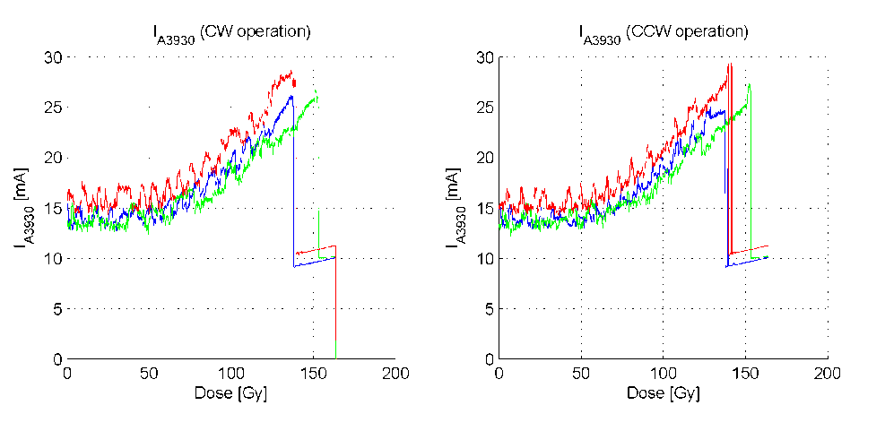
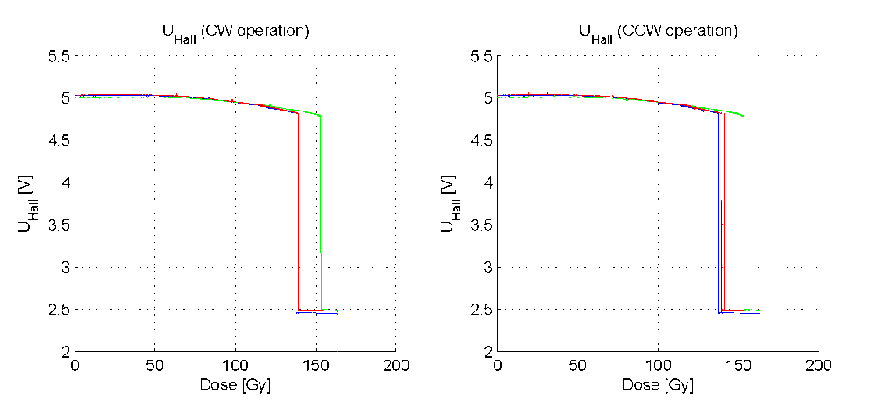
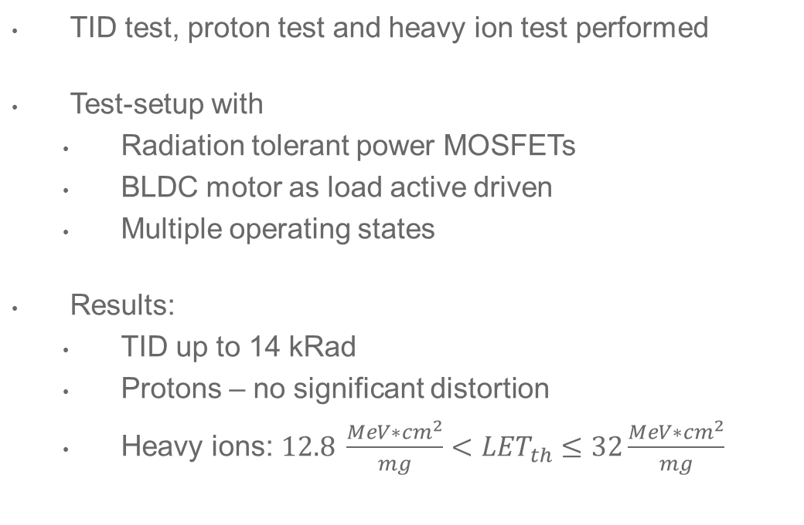
3-Phase BLDC Controller and MOSFET-Driver
TID test, proton test and heavy ion test performed
Test-setup with
  Radiation tolerant power MOSFETs
  BLDC motor as load active driven
  Multiple operating states
Results:
  TID up to 14 kRad
  Protons – no significant distortion
  Heavy ions:$12.8 \frac{MeV∗{cm}^{2}}{mg}<{LET}_{th}≤32\frac{MeV∗{cm}^{2}}{mg}$

Slide 22
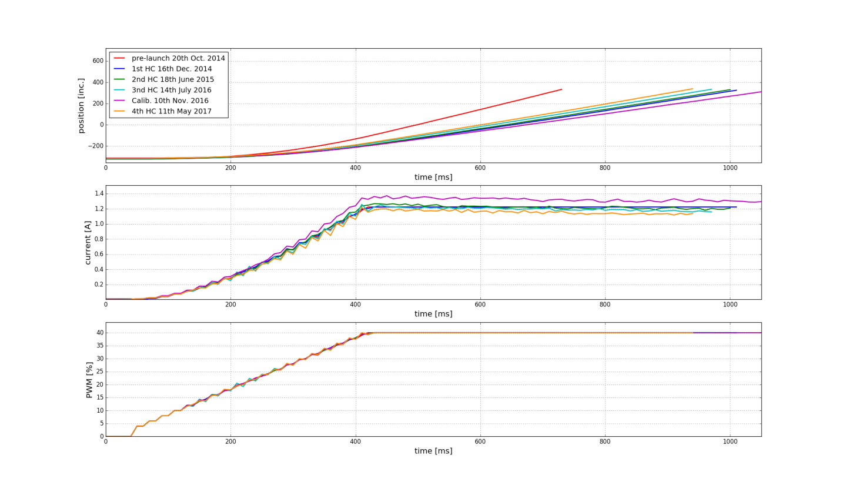
3-Phase BLDC Controller and MOSFET-Driver
DEXHAND → ISS Environment
MASCOT → Statistics of usage:
  Launch in 2014; Arrival in 2018
  Permanently unpowered despite checkouts during cruise phase
  Checkout lasts ~2 Minutes each
  Mission (uprighting / hopping ) lasts ~ 2 Minutes each
  6 Checkouts succeeded inbetween

Slide 23
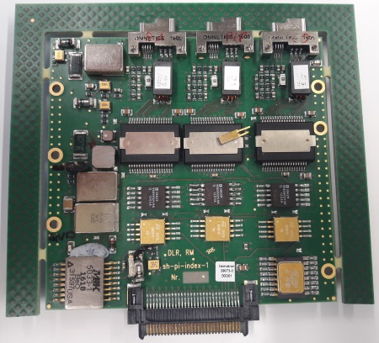
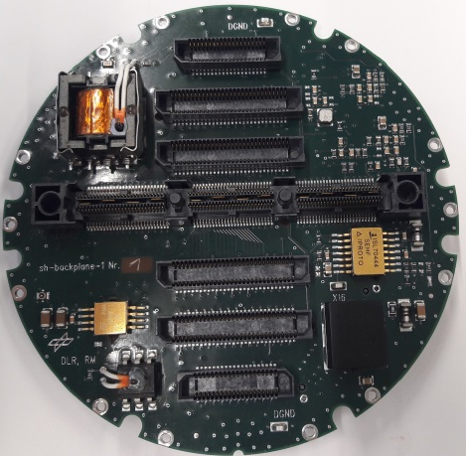
3-Phase BLDC Motor Driver
COTS controller for two systems
  Spacehand: multiple year GEO mission
  Flex. Motor driver board: medium radiation level
Internal power MOSFETs
Multiple security features integrated
Needs external logic for motor commutation; e.g. FPGA

Slide 24
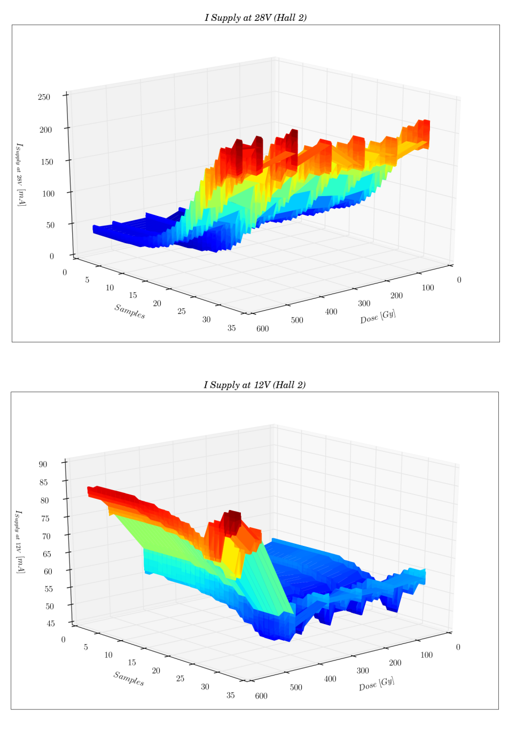
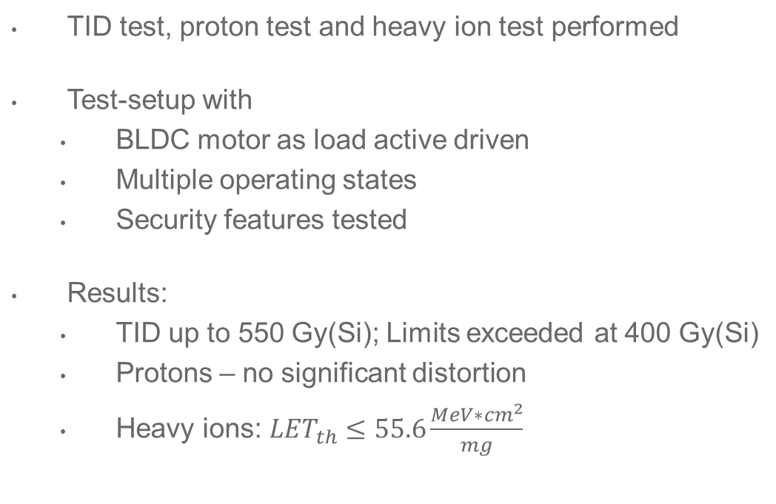
3-Phase BLDC Motor Driver
TID test, proton test and heavy ion test performed
Test-setup with
  BLDC motor as load active driven
  Multiple operating states
  Security features tested
Results:
  TID up to 550 Gy(Si); Limits exceeded at 400 Gy(Si)
  Protons – no significant distortion
  Heavy ions:${LET}_{th}≤55.6\frac{MeV∗{cm}^{2}}{mg}$

Slide 25
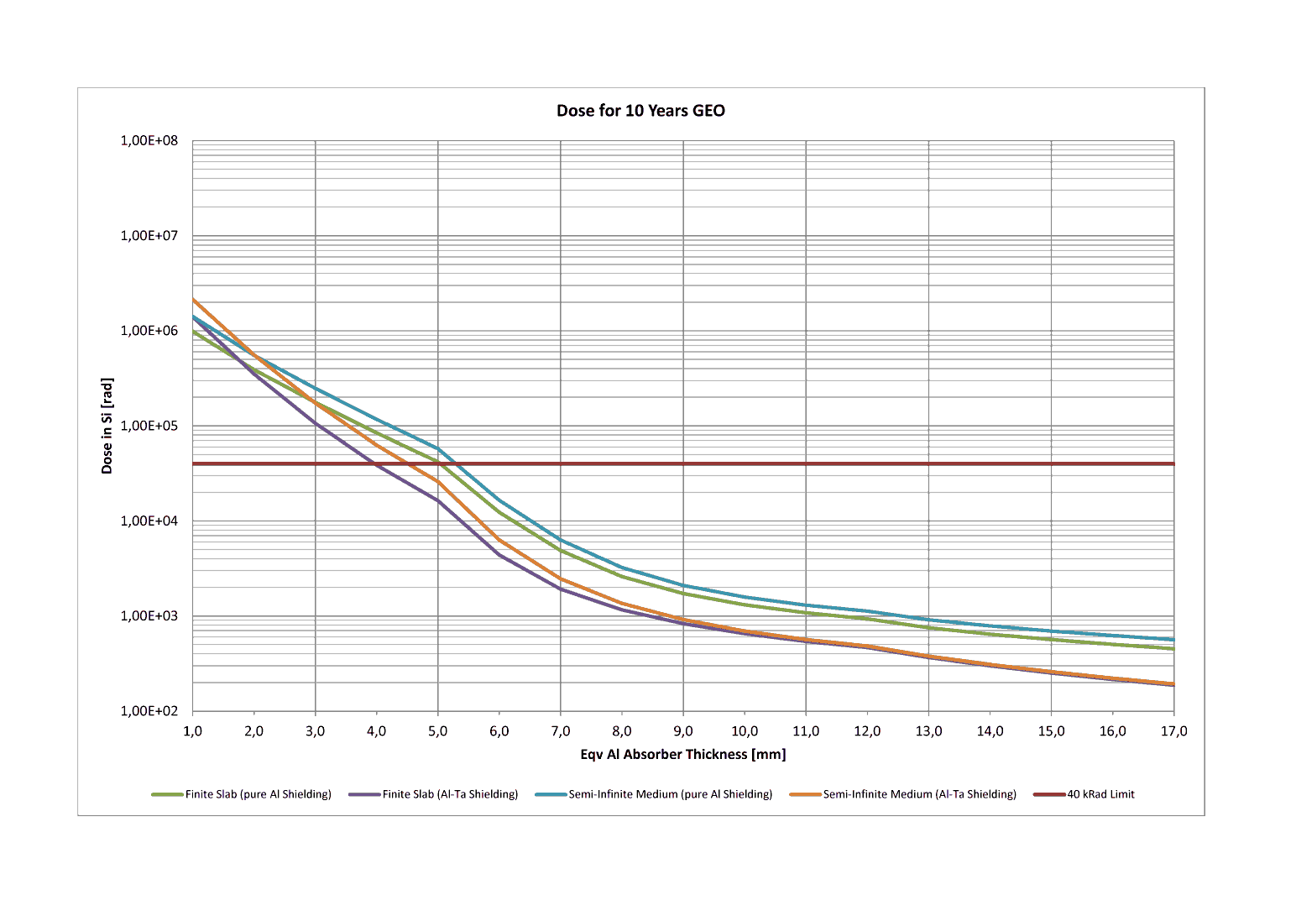
3-Phase BLDC Motor Driver
Environment-Simulation with SPENVIS:
  Geostationary Orbit, 10 years
  AP9 and AE9, SHILEDOSE-2Q (Finite slab and Semifinite slab shielding)
  Pure Al and Al-Ta compound
  → ≥4 mm equiv. Al Shielding necessary
Verification with MULASSIS
  → ~3 mm equiv. Al Shielding necessary
Spacehand electronics located behind palm
Spacehand stored in transport box

Slide 26
Agenda
Introduction to DLR-RM
Usage of COTS – a short overview
Radiation testing
Some test results of motor driver solutions
Challenge COTS
Conclusion

Slide 27
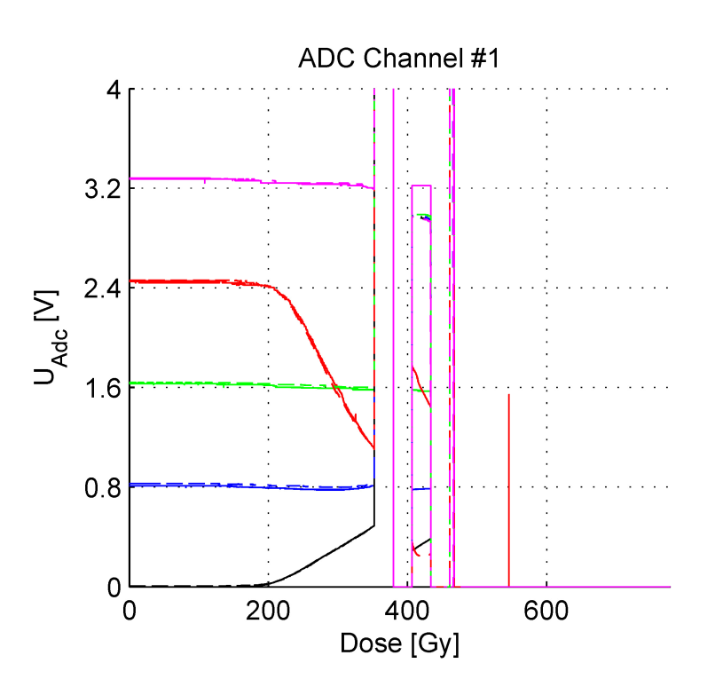
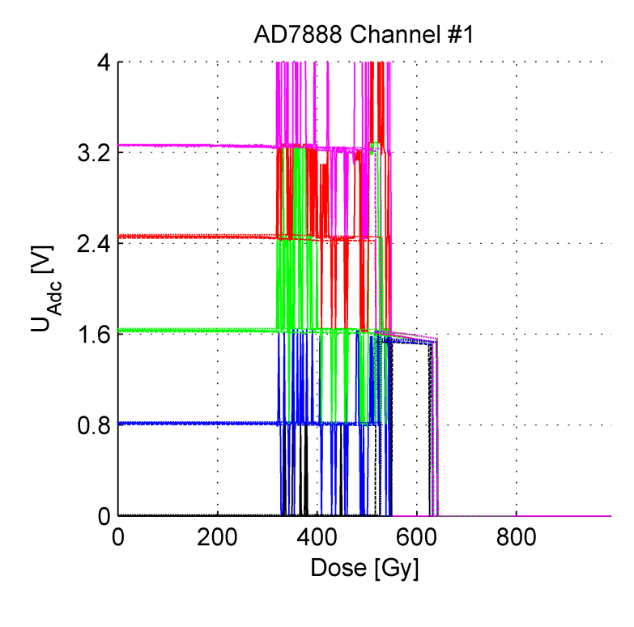
Parts from one lot necessary
Example: total ionizing dose test of a 8 channel A/D converter.
Before radiation both Converter performed identically.
I_{supply} = 10 mA
2006: I_{supply} constant up to 350 Gy
2009: I_{supply} started to increase at 150 Gy and reached 175 mA at 350 Gy
Samples from 2006
Samples from 2009

Slide 28


Parts from one lot necessary
COTS are usually traceable with their date code which represents the timing of the packaging
No direct link to the production date
Multiple production lines for one component → lot-to-lot variation
Outsourcing of different production steps (manufacturing, testing, packaging)
BUT
Increased number of fabless companies on the market → more centralized production
Manufacturer merging → less fabs

Slide 29



Parts from one lot necessary
Cooperation with manufacturer → best solution
Parts from one lot, process information, maybe samples for testing are available
Good and experienced QML part distributer → acceptable solution
Parts from one lot probable, process information difficult
Mass market distributor → challenge
highly recommended to buy complete trays, bars or even wafers, no guarantee for one lot
Counterfeit Parts
  Lucrative business → increasing number of parts detected
  Not only industrial parts → part buying agencies detect faked high-rel parts
A high number of parts for testing required (consider ≥ 40 parts for testing)
Controlled part storage recommended due to long time from purchase to flight.

Slide 30
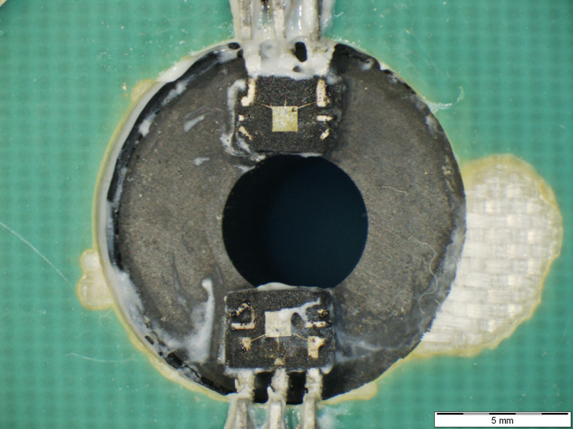
Test preparation for Heavy Ion testing
Package de-lidding e.g. by etching or backside thinning necessary due to limited energy of the accelerators.
Adaption of etching process necessary → additional samples required
When parts are small and fragile, supporting structures required
Part might behave different when the package was opened
Etching brings a lot of Hydrogen on the die.

Slide 31
RoHS and Obsolescence
Due to RoHS (Restriction of Hazardous Substances) campaign more and more parts containing lead are replaced by lead-free parts
Solder process must be adapted;
when RoHS and Non-RoHS parts are mixed on one board detailed information on the used materials is necessary.
Whisker growing in vacuum requires special attention and mitigation actions.
High dynamics in the technology market → extremely short life cycle of COTS
Sometimes the evaluation process lasts longer than the part is on the market.

Slide 32
Risk management and radiation hardness assurance
Covers the whole process starting with parts selection, electrical and environmental testing, package screening, post-procurement testing, system design, mission planning.
Be aware that all these tests may not guarantee the same level of reliability usually offered by space grade parts.
Adaptive latch-up protection might be necessary (variable threshold due to increasing supply current);
triggered by current slew rate event.
Radiation tolerant system supervisor might be necessary to restart COTS due to SEFI
FMEA / FMECA helps to find weak points
All additional hardware measures helps you, but jeopardize the space advantage of the COTS parts.

Slide 33
Agenda
Introduction to DLR-RM
Usage of COTS – a short overview
Radiation testing
Some test results of motor driver solutions
Challenge COTS
Conclusion

Slide 34
Conclusion
COTS parts offers some fascinating features or high performance.
Don’t expect to save money or time when using COTS parts.
Carefully trade is necessary whether all the benefits of the used COTS parts are worth to pay the prize in total.
Due to developments on the parts market, the introduction of COTS parts in space application is unavoidable, but rises some challenges for the component engineers.

Slide 35

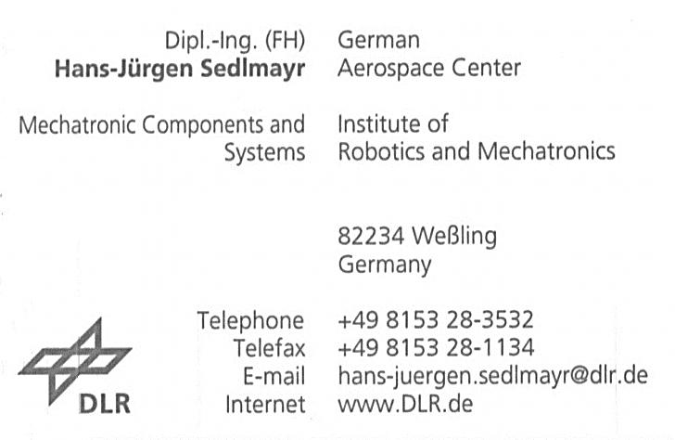
Thank you for your attention.
Any Questions?

