Slide 1
Scheduling a manufacturing process with several rail-bound and identical machines in the project EWiMa
Author: Markus Schreiber

Slide 2
Agenda
EWiMa and GroFi
Scheduling strategies for multihead fibre placement
Experimental results
Areas of Improvement

Slide 3
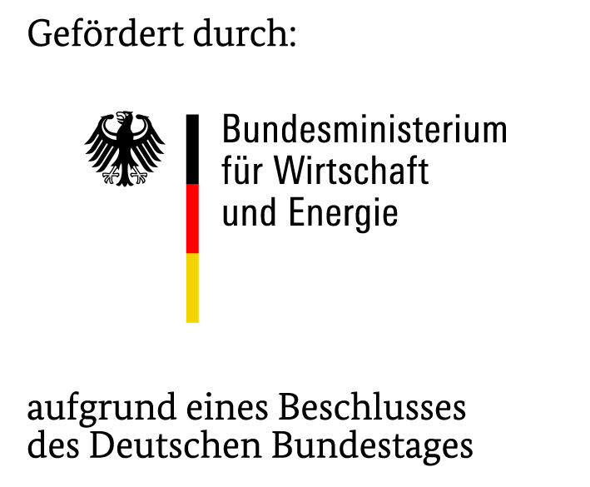
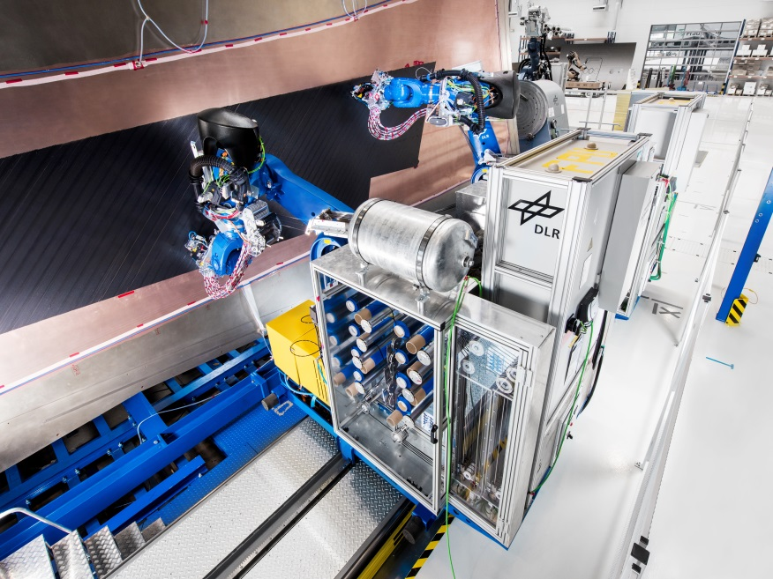
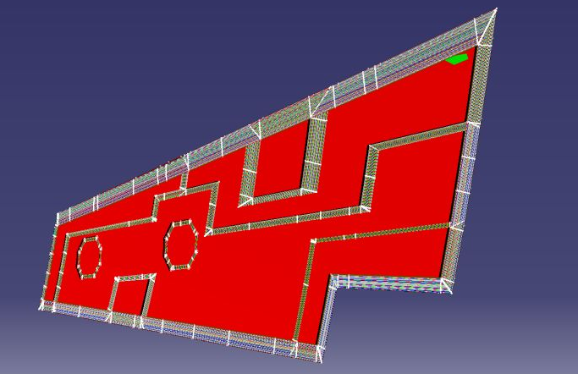
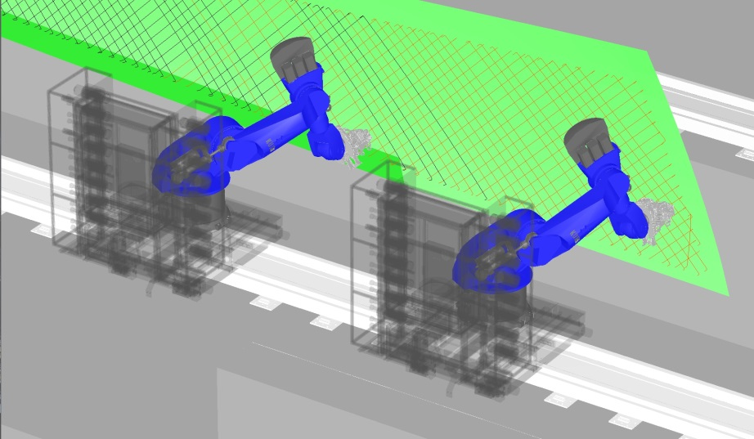
EWiMa – Effective Wing Cover Manufacturing
One task of the project EWiMa is the demonstration of a multihead layup with two coordinated fibre placement robots.

Slide 4
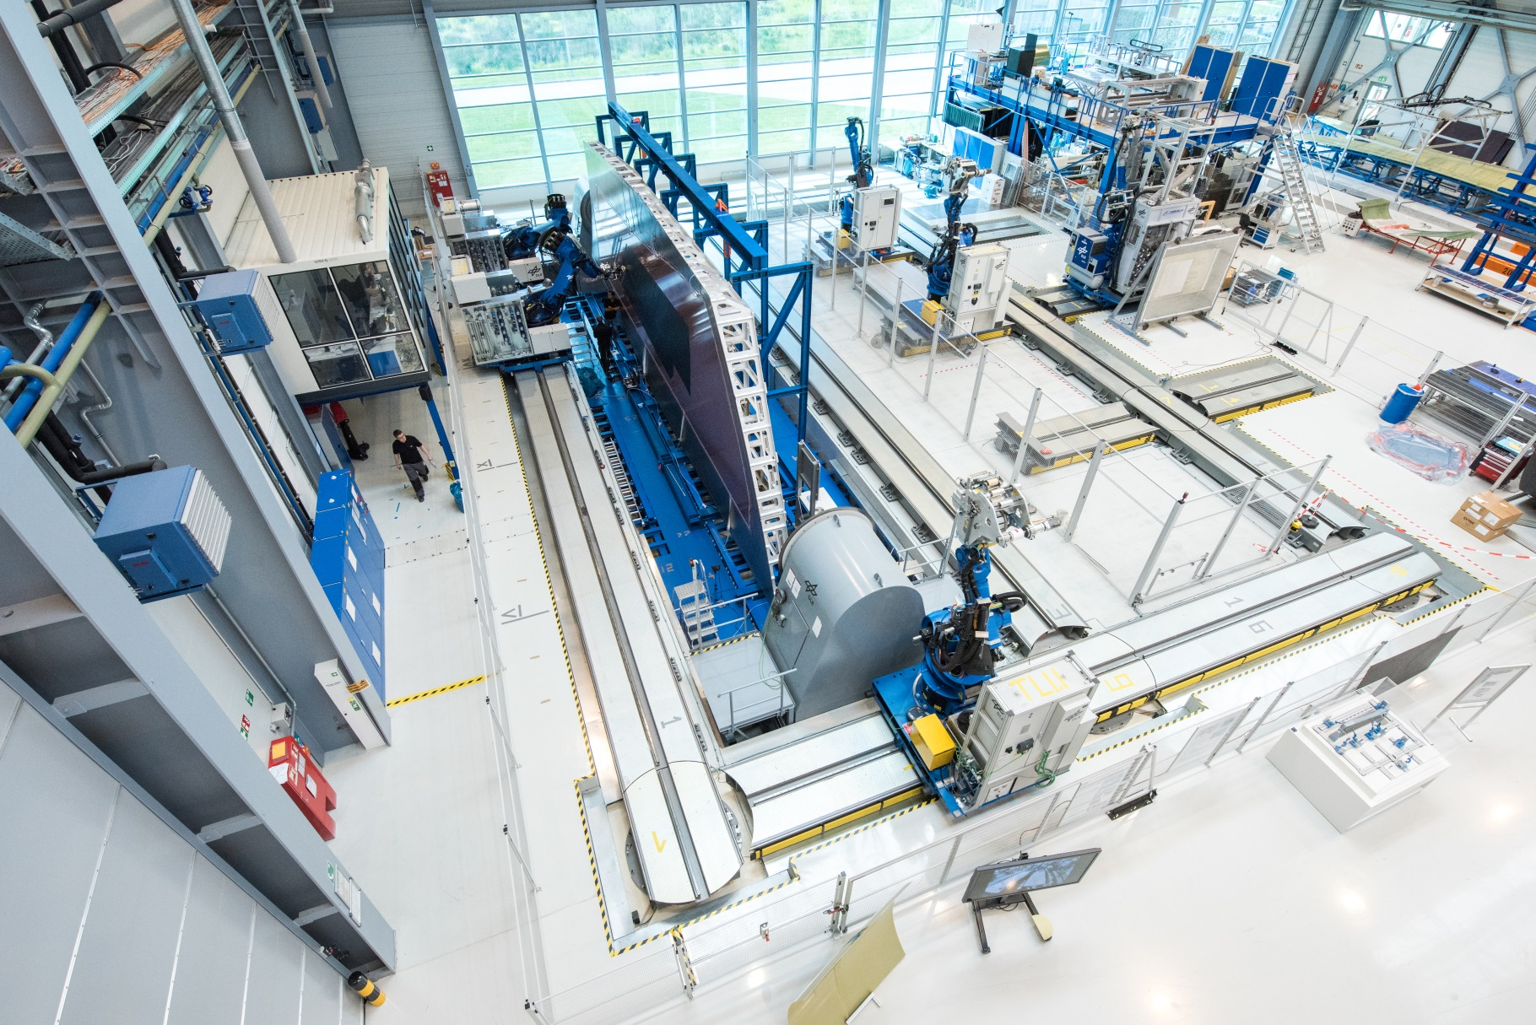
GroFi – an Automated Fibre Placement Research Platform

Slide 5
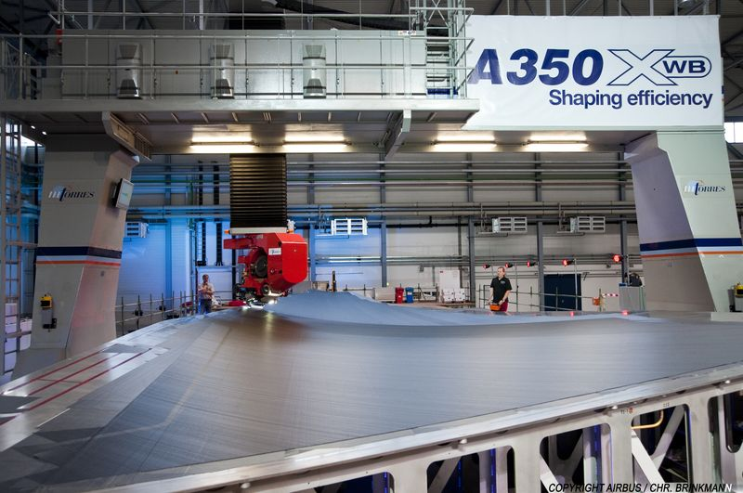
State of the Art Fibre Placement Technology
State of the Art
One lay-up unit operates at one tool
Low fibre mass throughput of 10-15 kg/h
High mass
A lot of space is needed
High investment (6-10 Mio. €)
Source: Airbus

Slide 6
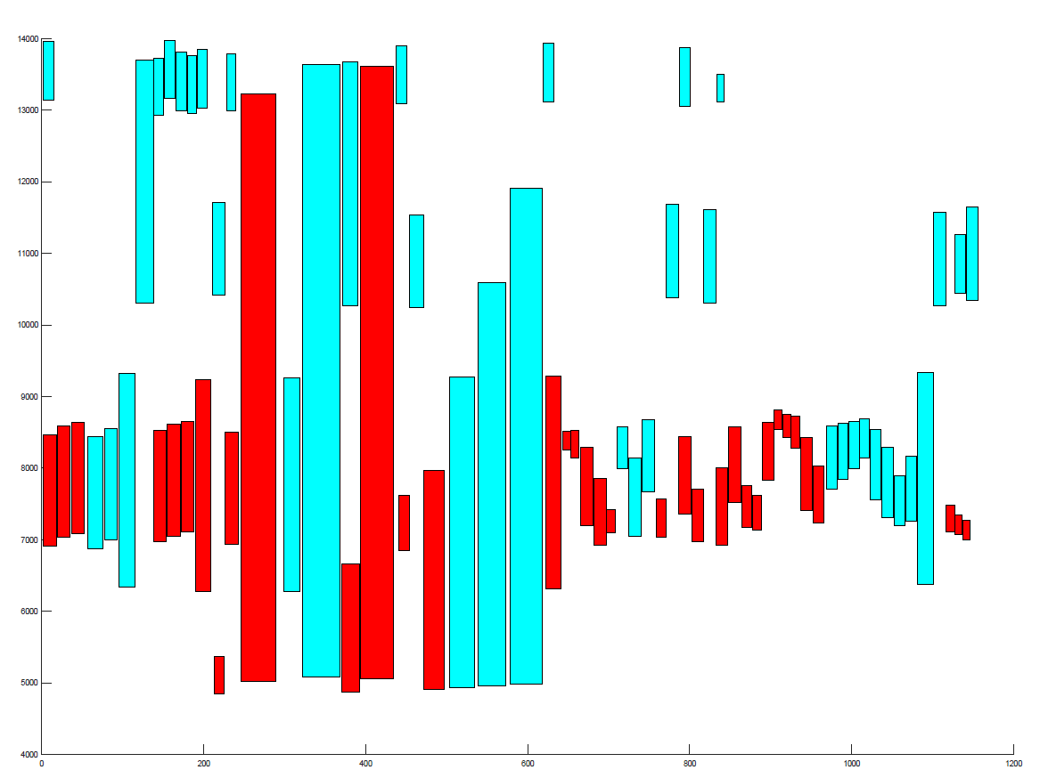
Scheduling for EWiMa
Conditions for Scheduling:
Simulated data are vague.
The exact position of the lay-up unit while running on a course is unknown.
The collision control will not prevent collisions of the robot arms.
0° ply strategy
Straightforward scheduling
Courses are handled in alternating order by both machines.
Each course needs an evasion move.
±45° and 90° ply strategy
A modified Quay Crane Scheduling Model is used.
Evasion moves are generated by the scheduler if necessary.

Slide 7
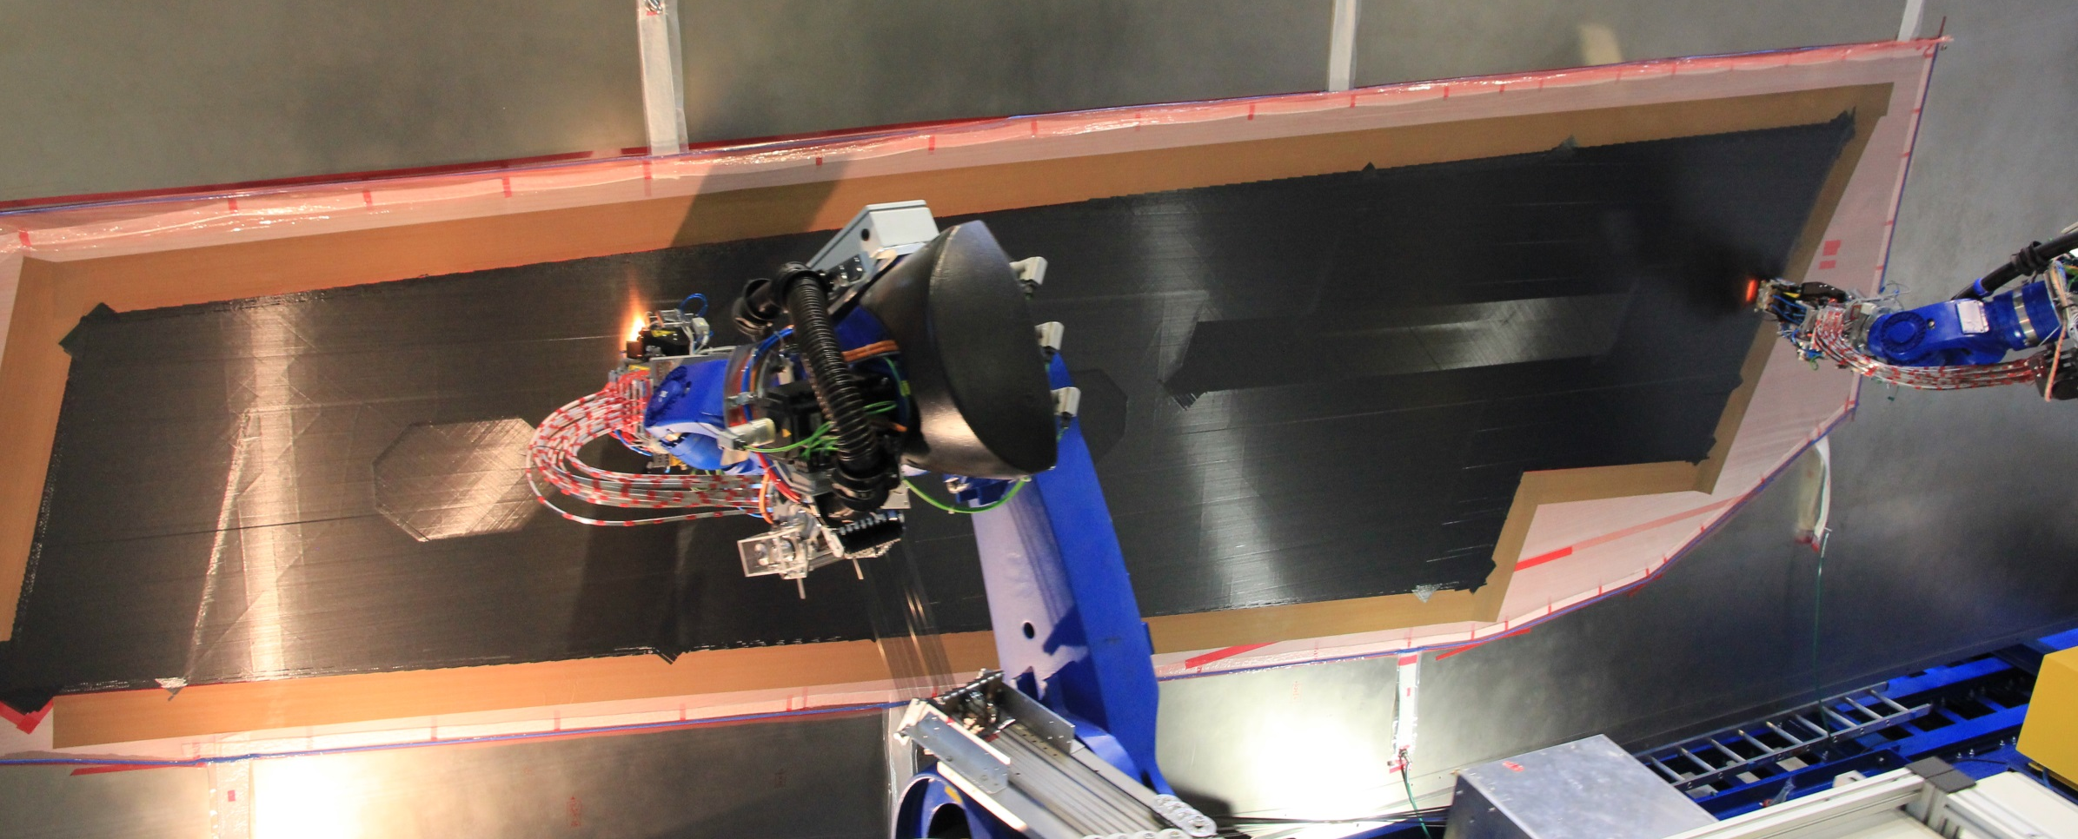
Coordinated Layup Video

Slide 8
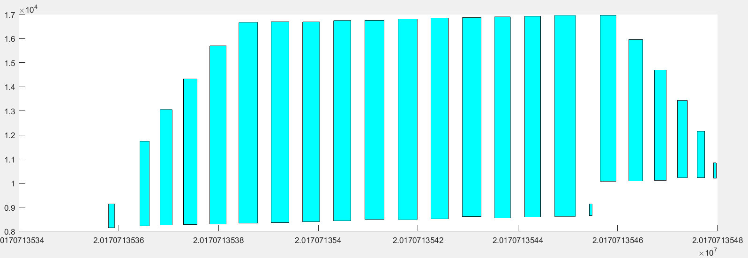
Multihead Scheduling – 0° Data Evaluation
Single machine layup:
24 courses
Two machine layup:
26 Courses in 95%
of the time above

Slide 9
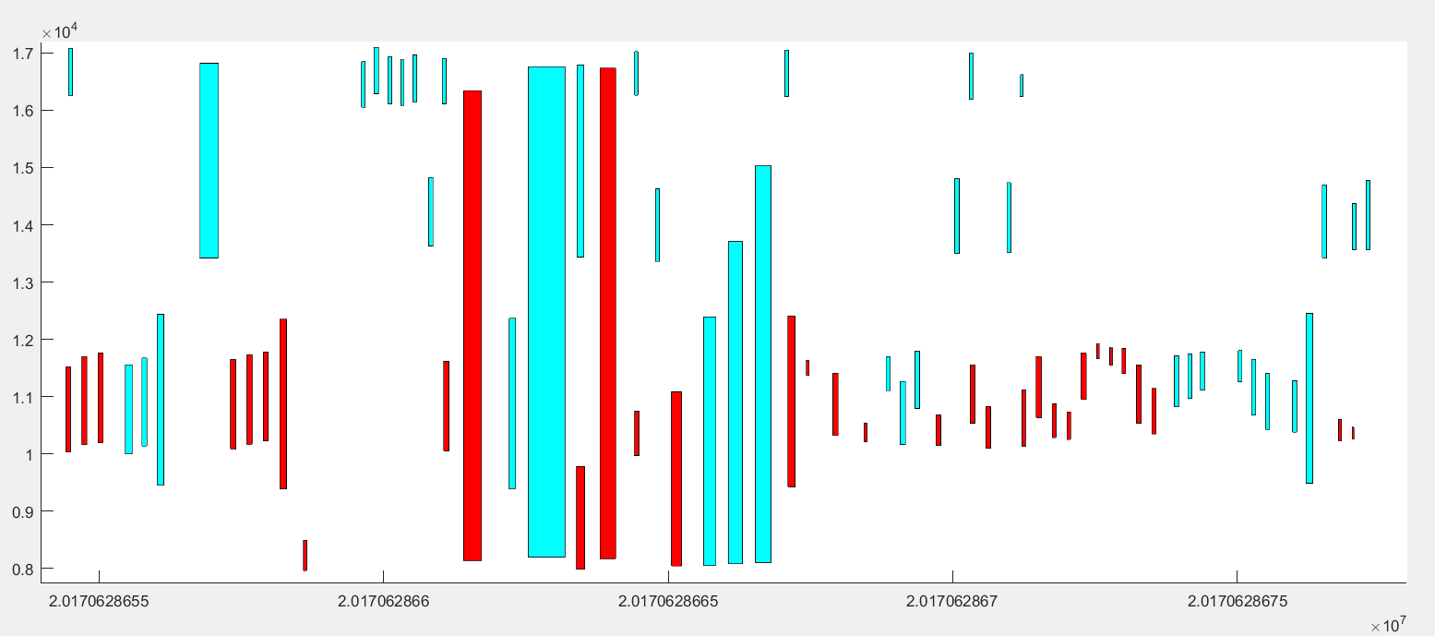
Multihead Scheduling – Simulation vs Reality
Simulated schedule:
Evaluated process data:
Takes 80% longer
than simulated

Slide 10
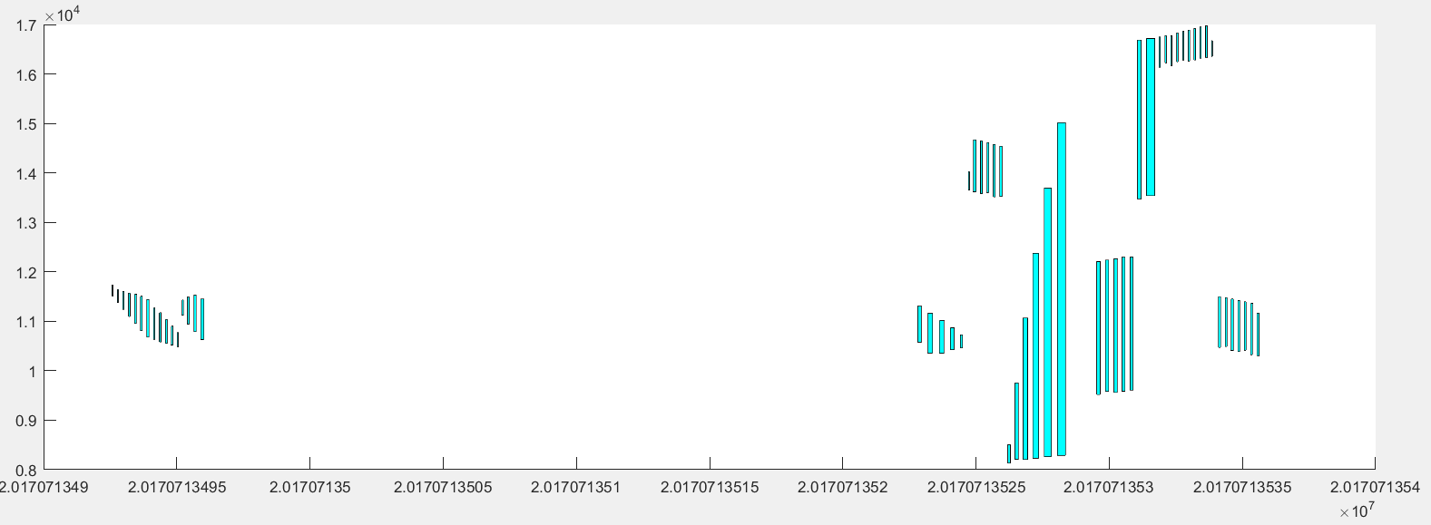
Multihead Scheduling – ±45° and 90° Data Evaluation – Sometimes Two can be Slower
Single machine layup:
Two machine layup:
34% slower

Slide 11
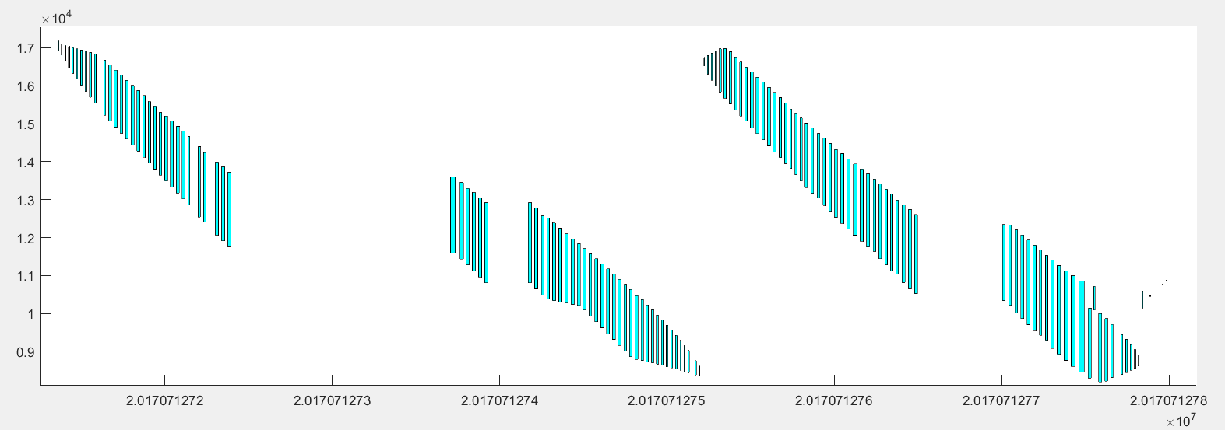
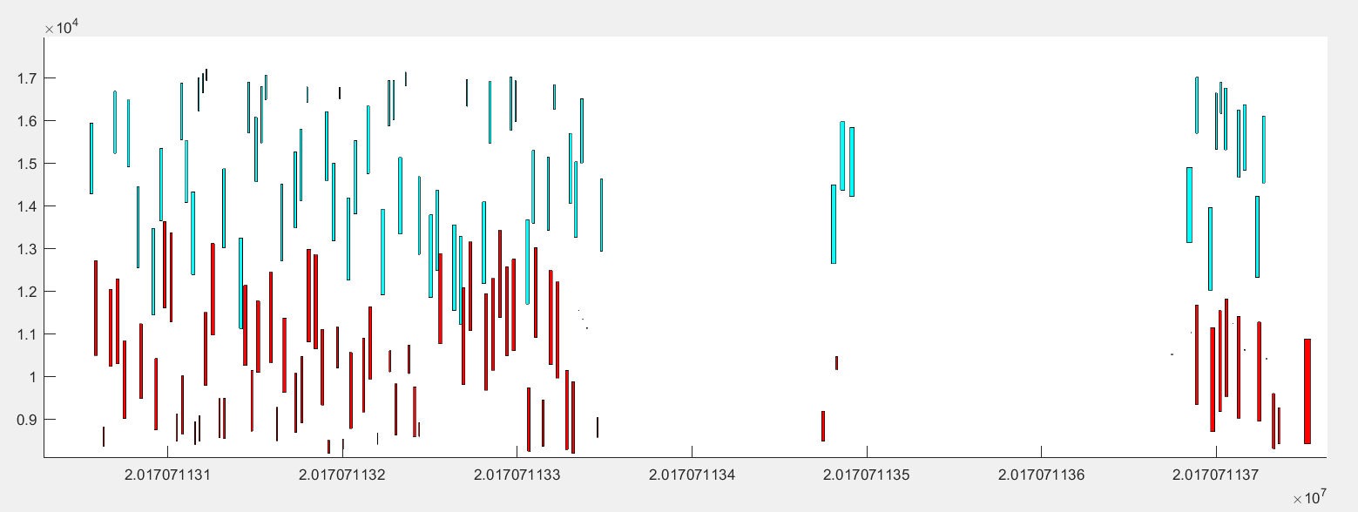
Multihead Scheduling – ±45° and 90° Data Evaluation
Single machine lay-up:
Two machine lay-up:
ca. 20% time reduction

Slide 12
Areas of Improvement
Simulation
Times for evasion moves and program calls are to short or not calculated
→Improve the precision of simulated times
GroFi plant and control software
Reduce times for program calls
More redundant layup units → continue production despite maintenance
Improve collision control → allows schedules with overlapping working areas
Scheduling
Online rescheduling → continue production despite maintenance
Better Schedules using other heuristics

Slide 13
Conclusion
The demonstration of a complex AFP manufacturing process with two robots was described.
Two different scheduling strategies for rail-bound automated fibre placement were introduced.
Recorded process data for the single and multihead demonstration got compared and linked to the simulation data.
Both scheduling strategies allow multihead manufacturing with an reduced production time.
Areas of improvement were presented.

Slide 14
Future Topics
Support automated production in an Industry 4.0 environment.
Online rescheduling in case of unexpected events.
Adjust schedules without stopping the production process.
Further modifications to the model and the offline solver.
Which process characteristics should be considered to improve reality performance?
How can more precise simulation data be used for better schedules?
Comparing the solution to other approaches.
Scheduling for more than 2 layup units.
Markus Schreiber
Markus.schreiber@dlr.de
Deutsches Zentrum für Luft- und Raumfahrt
Institut für Faserverbundleichtbau und
Adaptronik
Ottenbecker Damm 12
21684 Stade

