Slide 1


Commissioning and Tests of a Mini CSP Plant
Lisa Willwerth
Co-Authors: Lisa Willwerth, Margarita Rodriguez, Esther Rojas, Ridha Ben Cheikh, Souha Ferchichi, Amani Jmili, Abdallah Baba, João Soares, Francesco Parise, Barbara Weinzierl and Dirk Krüger

Slide 2
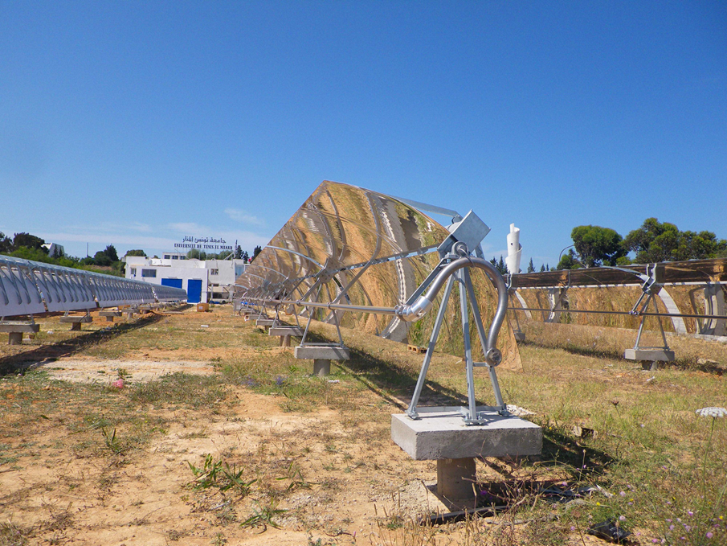






EU Project REELCOOP: Prototype 3
Demonstration of small scale electricity production at ENIT in Tunis
Parabolic trough collector field ~1000 m²
ORC 60 kW_{el}
Back up biomass boiler
Status
Commissioning
Testing until end of project in Feb. 2018
Website
www.reelcoop.com
Partners within P3

Slide 3
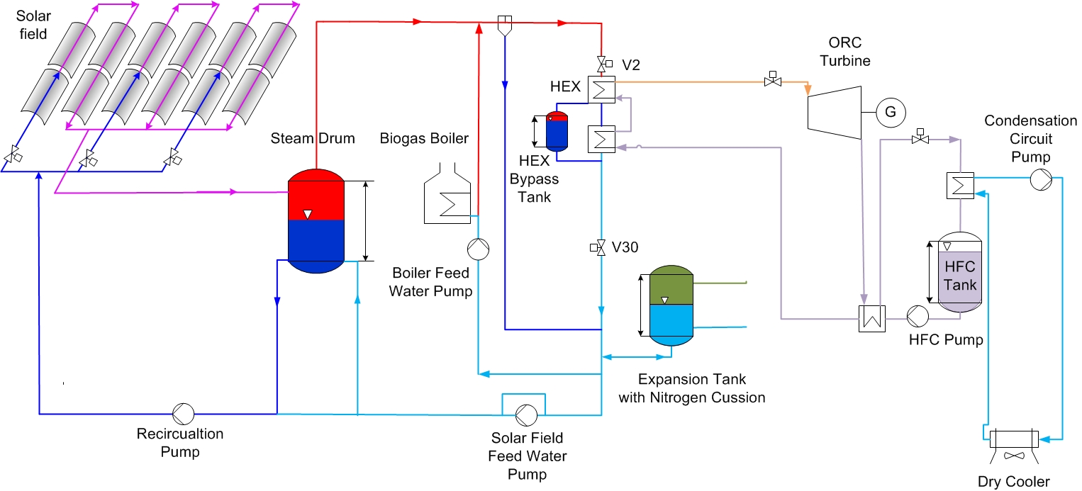
Plant scheme
Direct steam generation (DSG) → ~160-175°C / 6,2-8,9 bar_{abs}
Recirculation mode
Closed loop

Slide 4
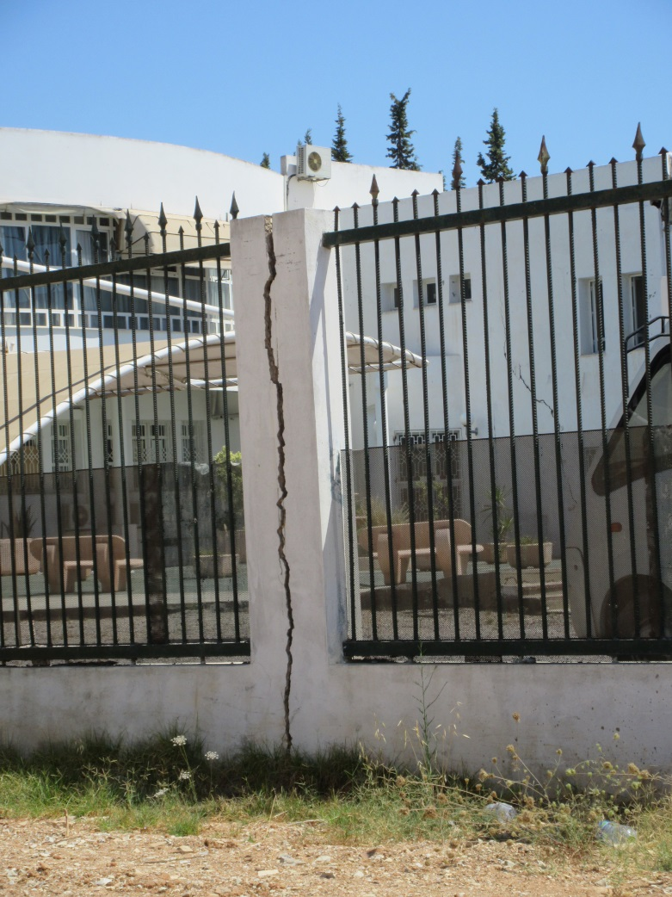
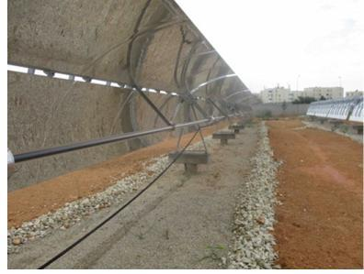
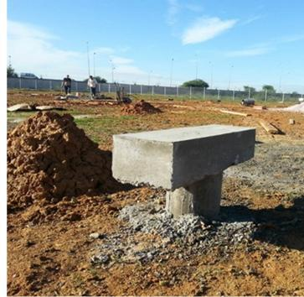
Land Works and Fundaments
Challenging soil:
ground movement due to flooding
caused cracks in neighboring buildings
Solution (by AES):
drainage system
pylon type foundation

Slide 5
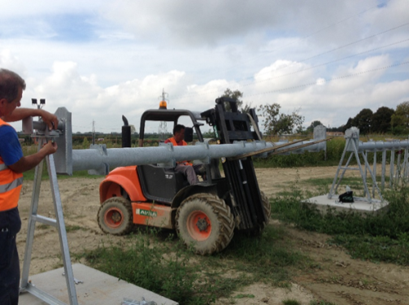
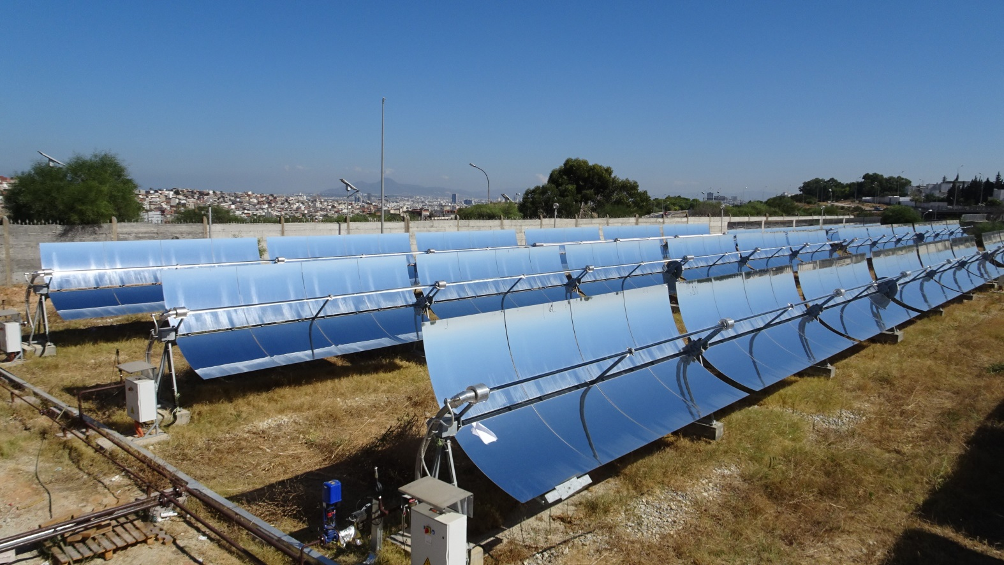

Solar Field
3 Loops, with each 4 parabolic trough collectors =12 collectors
Robust and simple collector design → Easy installation

Slide 6
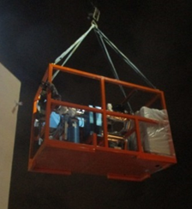
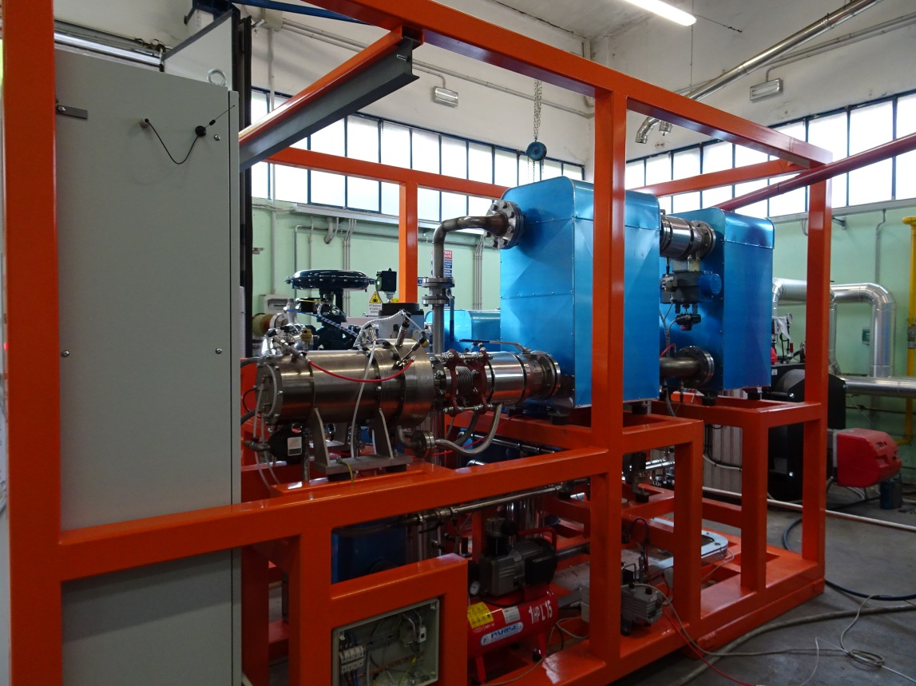
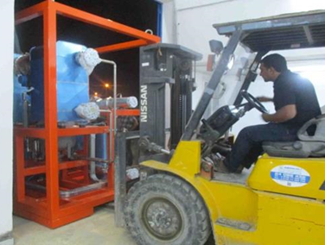
Organic Rankine Cycle (ORC) Turbine
New generator Design with new winding geometry
Compact solution → Easy transport and installation at ENIT
Notes:
expert in electric machine design from the University of Padua
The complete ORC module was easy to transport with a lifting or a forklift as a whole.

Slide 7
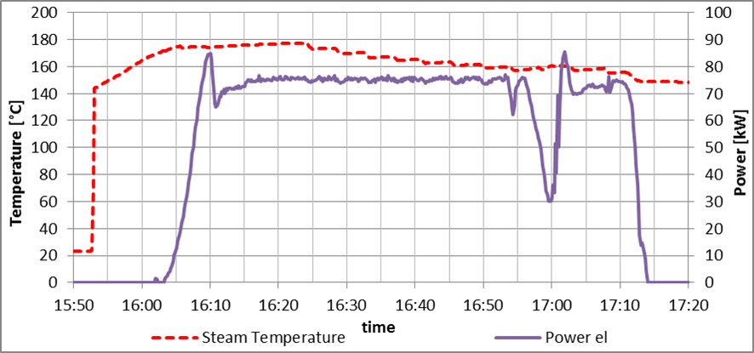
Organic Rankine Cycle (ORC) Turbine
ORC commissioning with fossil boiler in Italy by Zuccato
76 kW_{el} was provided continuous
Start up time ~15 min
First measured efficiency ~13%
Afterwards the turbine wheel has been changed from 80 to 65 kW

Slide 8
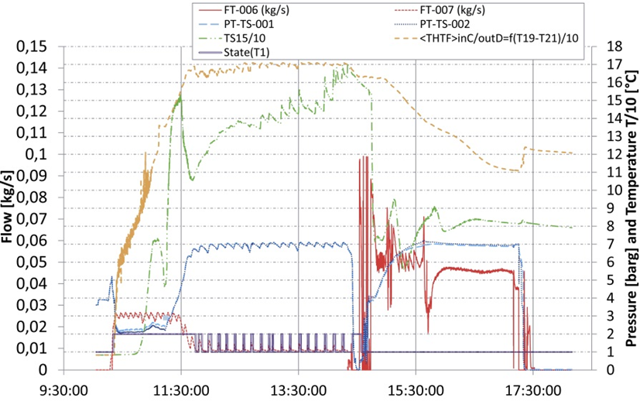
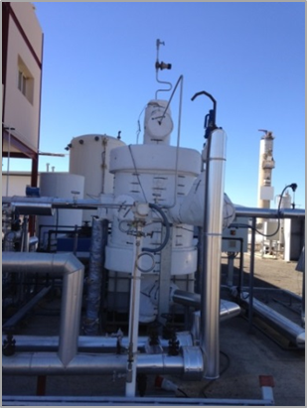
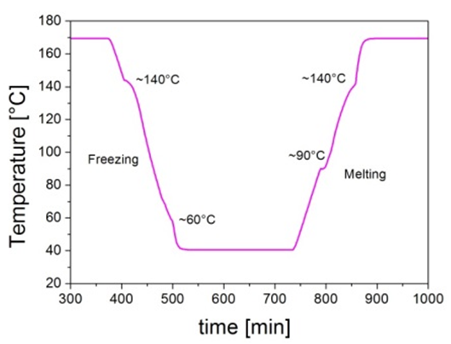
Storage at Plataforma Solar de Almeria
Latent storage
Modified spiral plate heat exchanger
Hitec® salt as phase change material
Publication of the results at the SHC conference

Slide 9
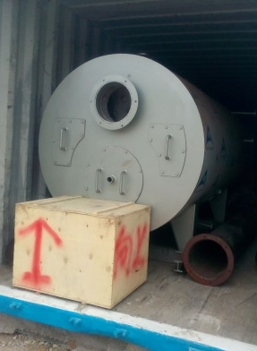
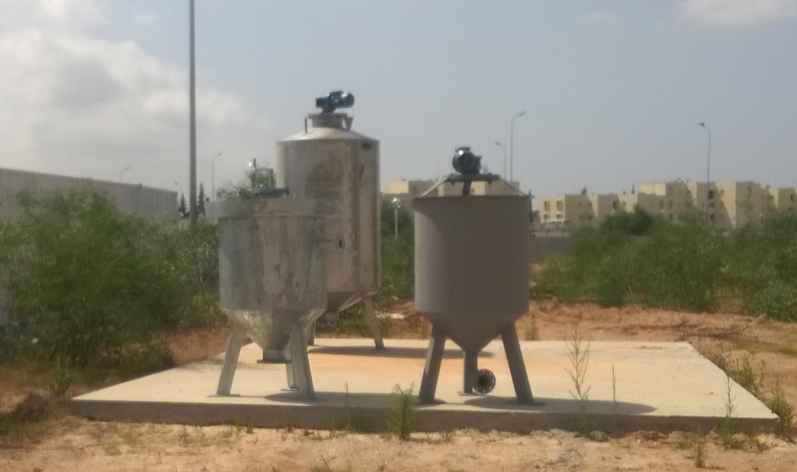
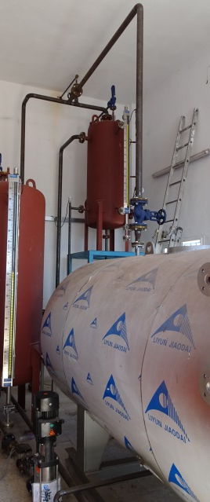
Biomass System
Backup energy: (bio-) gas boiler + biomass
Organic wastes from university restaurant
For ORC steam demand (500 kW_{th}) huge biomass amounts are required
Installed boiler is able to operate on both, natural gas and biogas
Medium size one stage wet continuous digester (3 m³ )
Boiler and biomass system are on site, but not completely installed yet
(bio-) gas boiler
Digester, mixer and decanter

Slide 10
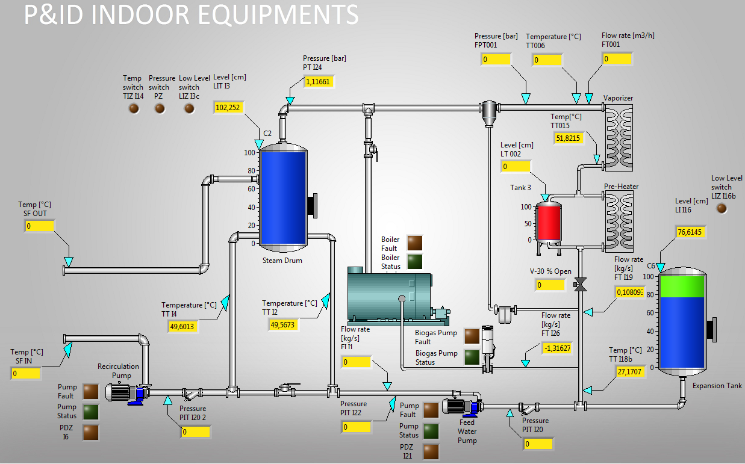
Operating System
Semi-automatic operation
4 screens (indoor, solar field, ORC, diagrams with trends)

Slide 11
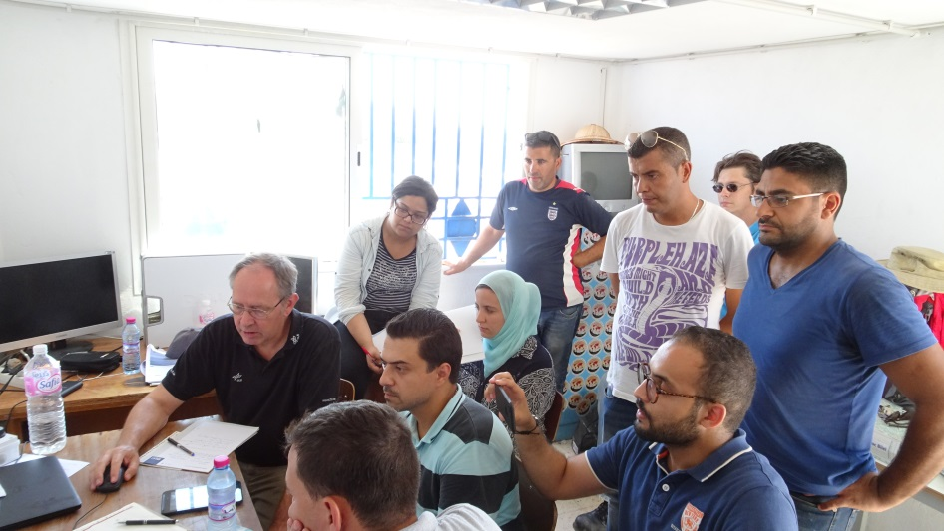
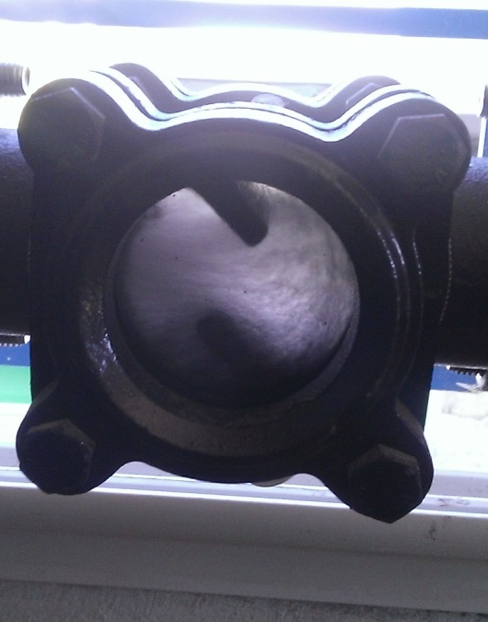
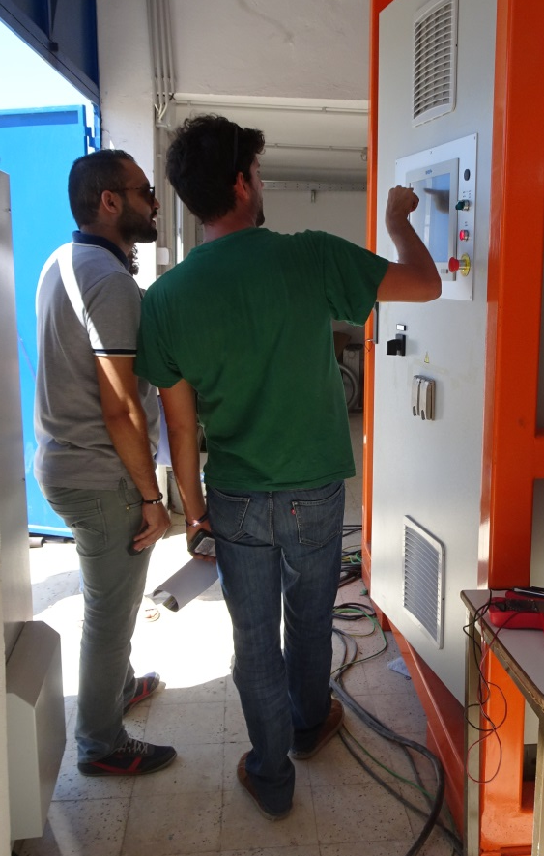
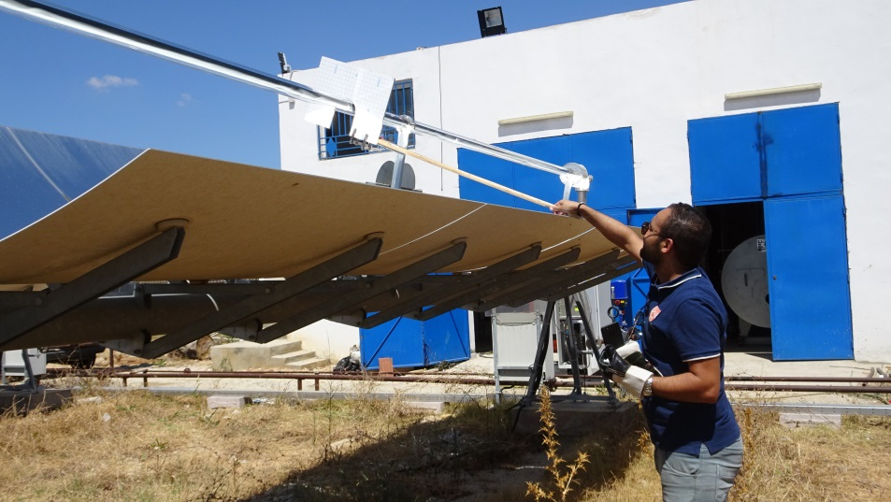
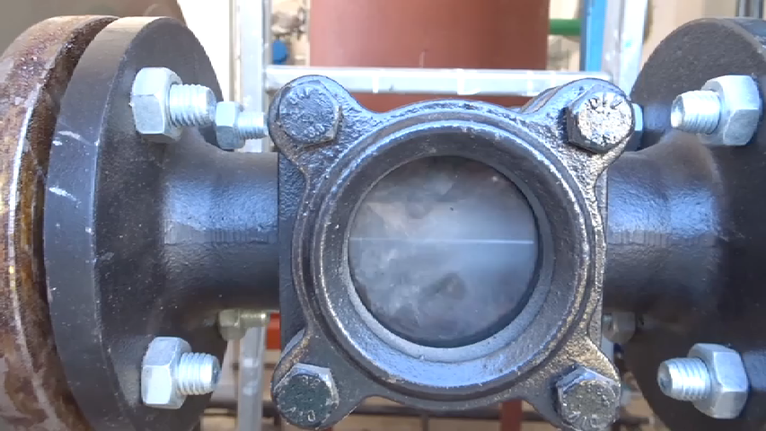
Commissioning 22.-25. August 2017
First steam production
First solar electricity generation
Checking and adapting of plant control
Instructing operators at university

Slide 12
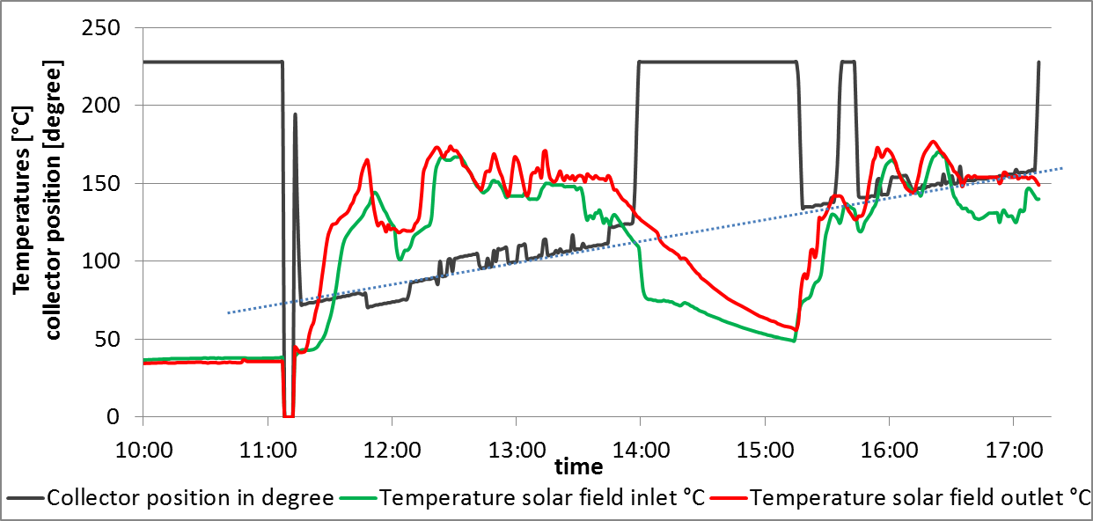
Commissioning Data
Only two of three loops focused (electrical component malfunction in one loop)
Start up ramp: from 35°C to 165°C in 40 min.
Some steam hammers occurred in the beginning and could be avoided later
22th of August 2017

Slide 13
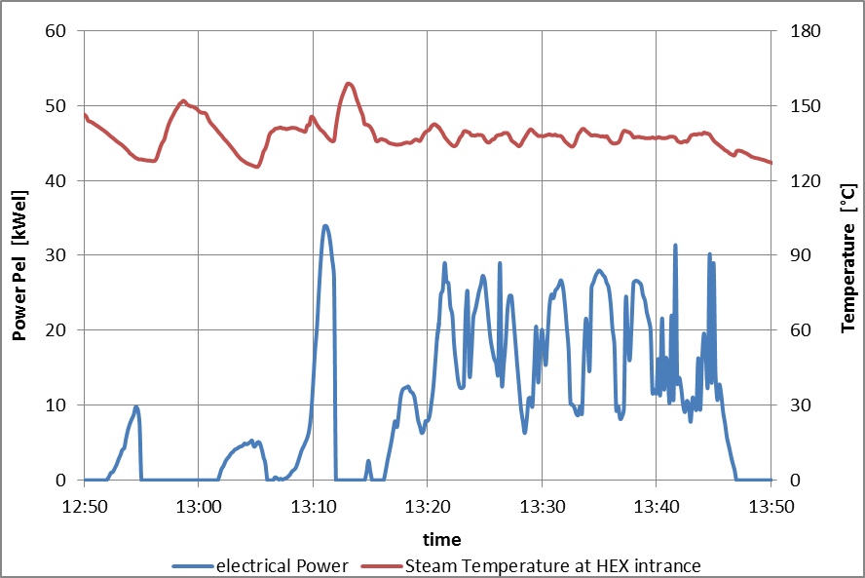
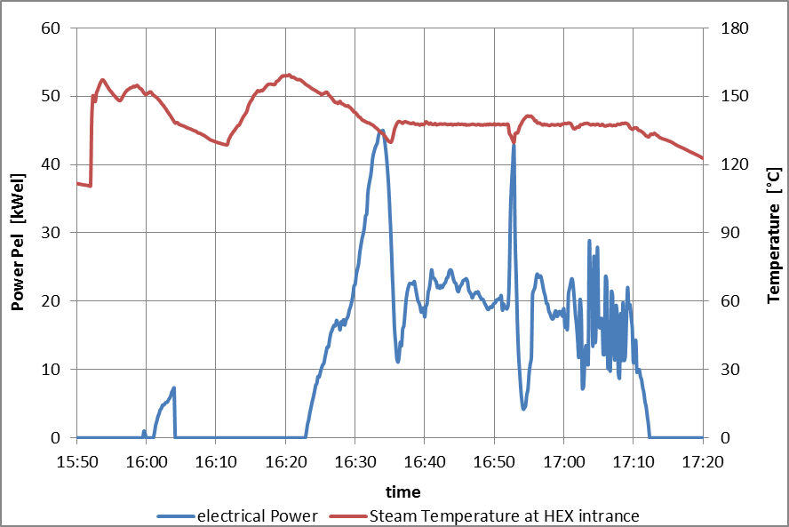
Commissioning Data
Only two of three loops focused
Piping and steam drum not yet insolated
Steam temperature ~130°C (low temperature preferred for commissioning)
Electrical Power ~25 kW, peak 45 kW
22th of August 2017

Slide 14
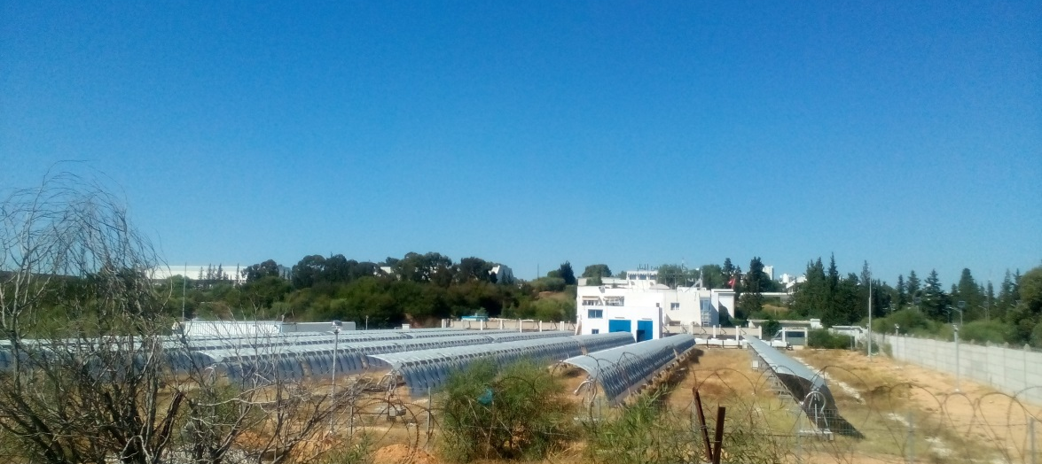
Conclusions
A parabolic trough power plant with direct steam generation and ORC turbine has been build as a student laboratory at the University ENIT in Tunis
A spiral heat exchanger was tested as latent storage module with Hitec® salt
Steam production works well
First electricity was generated
Hybridization with a biomass system will be demonstrated soon

