Slide 1
Real-time Immersive Visualization for Satellite Configuration and Version Comparison
Y. Liu, M. Deshmukh, J. C. Wulkop, P. M. Fischer and A. Gerndt
Simulation and Software Technology
German Aerospace Center
SESP 2017 / 29.03.2017

Slide 2
Contents
Introduction of version comparison for spacecraft design
Architecture for visualization of Virtual Satellite
Version comparison in Virtual Satellite
Summary and outlook

Slide 3
Version Comparison for Spacecraft Design
Displaying differences between different versions of configuration data

Slide 4
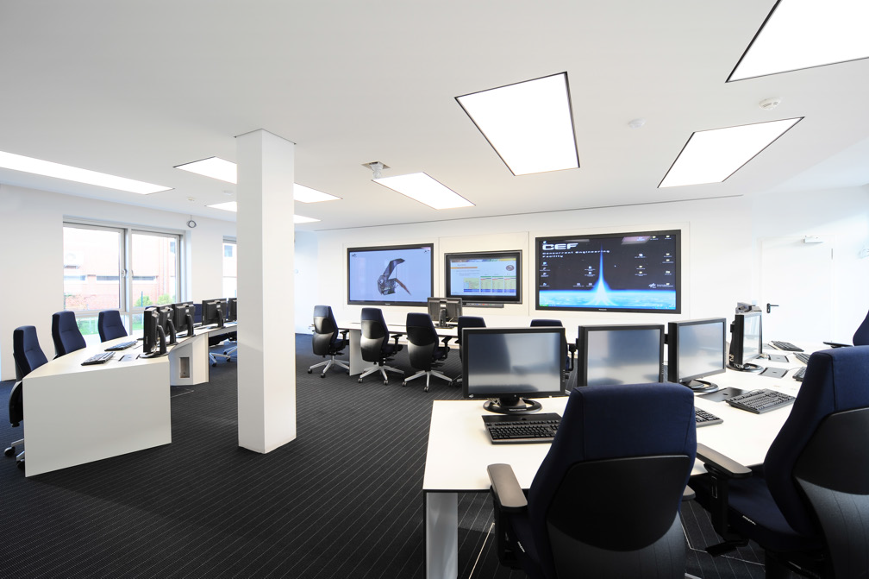
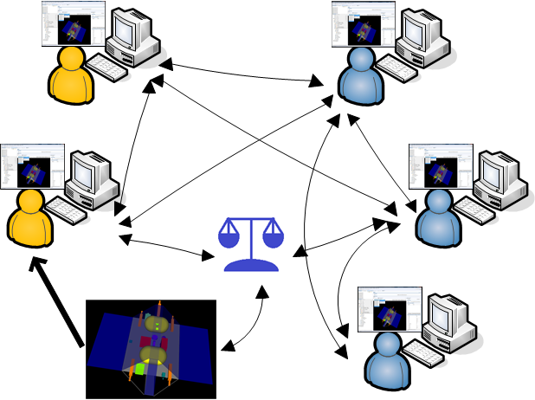
Spacecraft design in a Concurrent Engineering Facility
Image from paper “Interactive 3D Visualization to Support Concurrent Engineering in the Early Space Mission Design Phase”

Slide 5
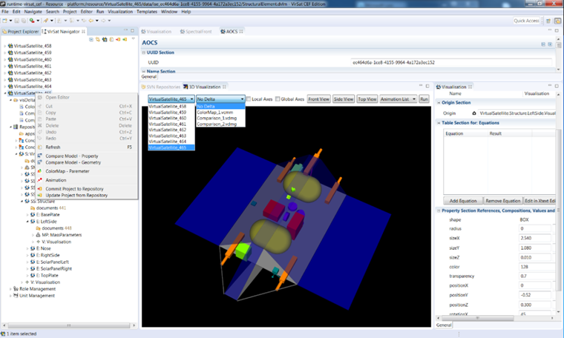
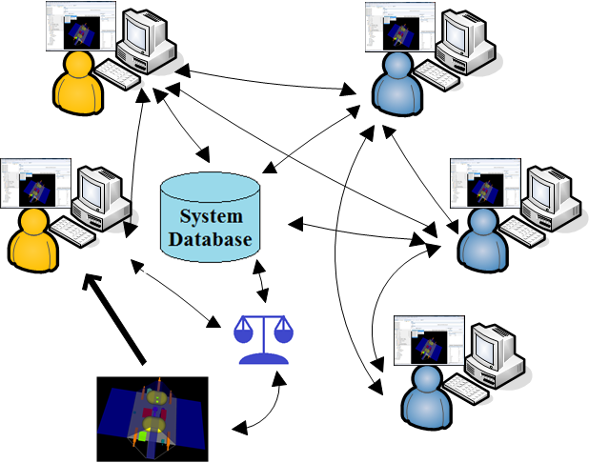
Virtual Satellite as the standard tool for Concurrent Engineering studies

Slide 6
Configuration differences of many versions of design need to be handled

Slide 7

Advantages of version comparison
Decision making
For stakeholders
  Grasp design progress
For experts
  Learn lessons from the comparison between evolving versions
  If needed, the current design may be refused and a different version may be selected
  Design decisions might be approved
  A new system based on older versions or other similar systems.
Version 2
Version 1

Slide 8
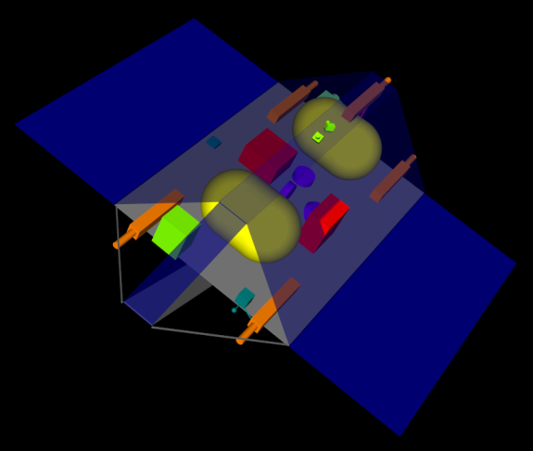
Problems for getting comparison results of multi versions
Problems:
  Many versions of one system
  Many subsystems, many parameters of one system
  Textual data files

Slide 9
Our effort: graphical comparison approaches for intuitive understanding

Slide 10
Architecture for Visualization of Virtual Satellite

Slide 11
Architecture overview for visualization
Each expert
  One Instance of Virtual Satellite
  Local copy of system model data
  Only can alter data if with sufficient permissions
Version Control System
  Subversion
  Consistent System Data
  Concept data model following MBSE approach
  Hierarchical tree-like demonstration
  System, subsystems, and equipment
  Geometric, other configuration parameters
Visualization Environment
  3D visualization in Virtual Satellite
  VR environment
  Transmission Control Protocol

Slide 12
Version Comparison in Virtual Satellite
Version comparison with 3D visualization and VR

Slide 13
Virtual Satellite interface
Virtual Satellite Navigator
  Multiple versions
  Textual Editor
  Geometric model
  Other configuration parameters
  3D visualization viewer
Comparison operation
  Comparison of geometry
  Comparison of parameter
  Color Map for parameters
  Animation

Slide 14
Delta Model for comparison visualization

Slide 15
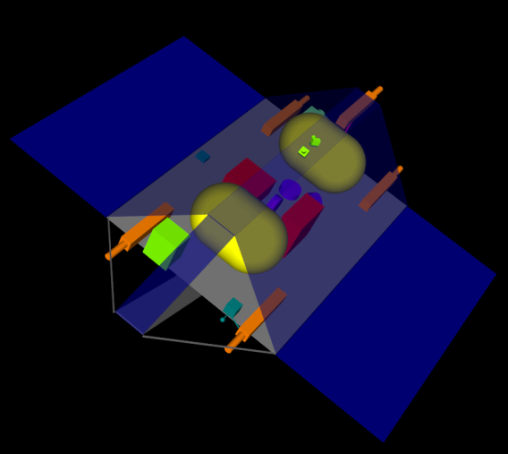
Version Comparison
  Hard to find differences with eyes from pictures
  Other kinds of parameter beside geometry: mass, power, temperature…
  Tedious, unclear, and time consuming to check the textual files

Slide 16
Our effort: graphical comparison approaches for intuitive understanding
Our effort to solve these problems:
  Virtual Satellite extended for graphical comparison approaches
  Differences between versions computed automatically
  3D visualization and VR environment
  Intuitive, quick, clear understanding of differences between versions.

Slide 17
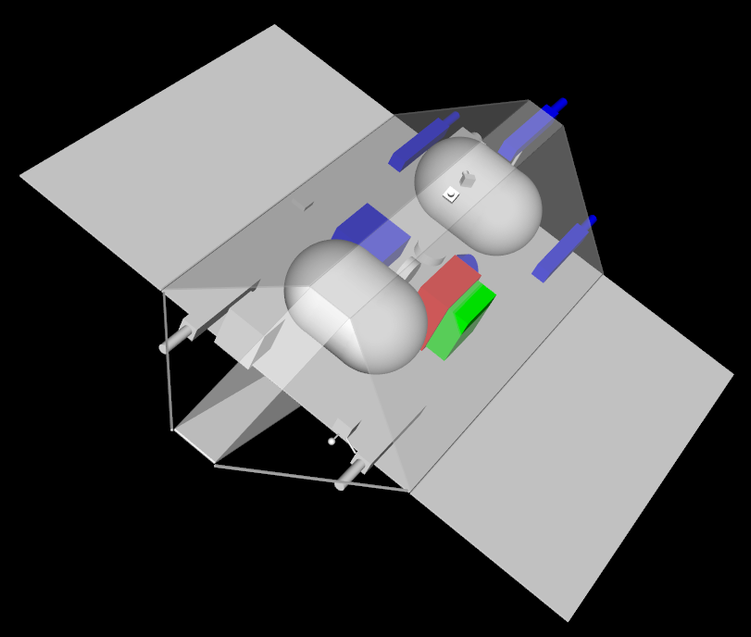
Version Comparison of geometry
Geometry
  Shape
  Size
  Position
  …
Four kinds of comparison possibilities :
  Something has been added
  Something has been removed
  Something has been modified
  Something is unchanged
  Keep removed equipment
Too much detailed will cause confusion

Slide 18
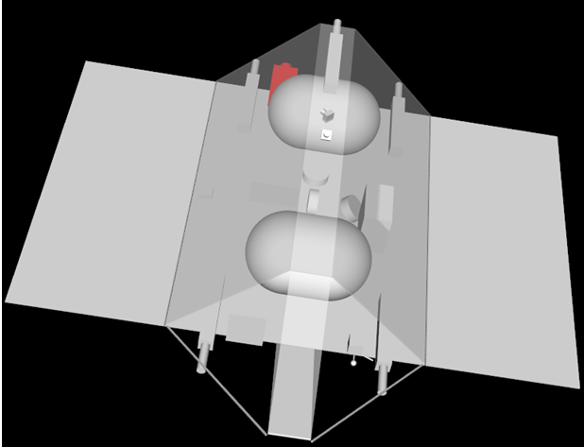
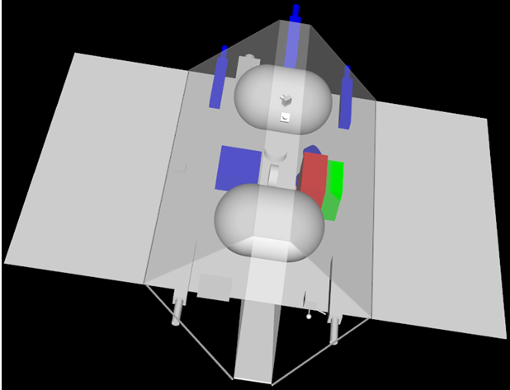
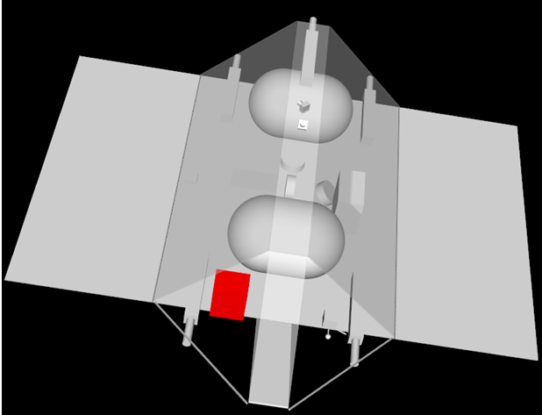
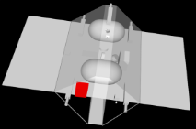
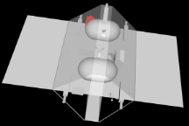
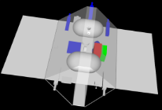
Animation mode for Version Comparison

Slide 19
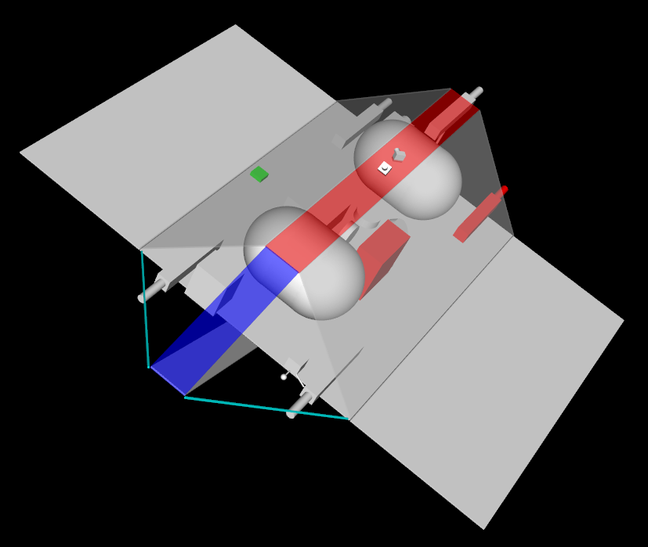
Version Comparison of parameter
Key performance indicator, important parameter
  Mass, Power consumption, Temperature
  Restriction due to vehicle’s capacity
  Center of gravity
  Thermal constrains
Five kinds of comparison possibilities :
  Something has been added
  Something has been removed
  Value has been increased
  Value has been decreased
  Something is unchanged

Slide 20
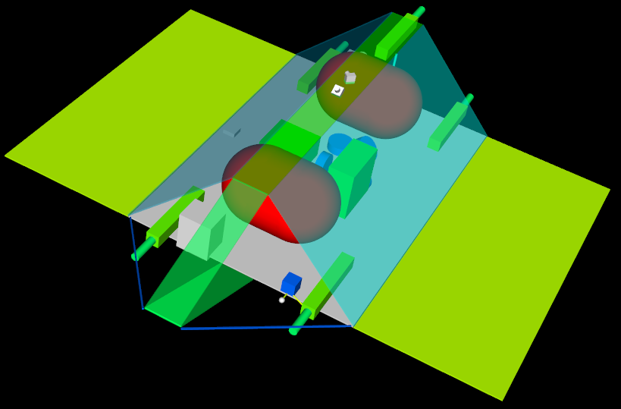
Color Map of parameter
Not comparison within versions
  For one version
  Different color according to parameter value
Key performance indicator, important parameter
  Mass, Power consumption, Temperature
Parameter value distribution of each equipment
  Overview perception
  No need to create table of distribution of subsystems
  No need to check textual data
Remind of equipment without parameter

Slide 21
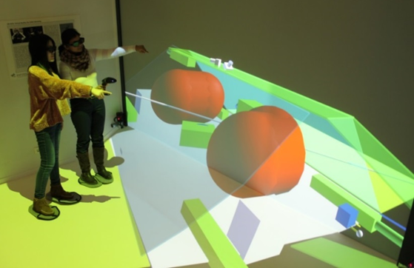
Version Comparison In VR
VR immersive environments
  Dynamic
  First-person viewing perspective
  Communication in nature way

Slide 22
Summary and Outlook
Version comparison with 3D visualization/VR and Future challenges

Slide 23
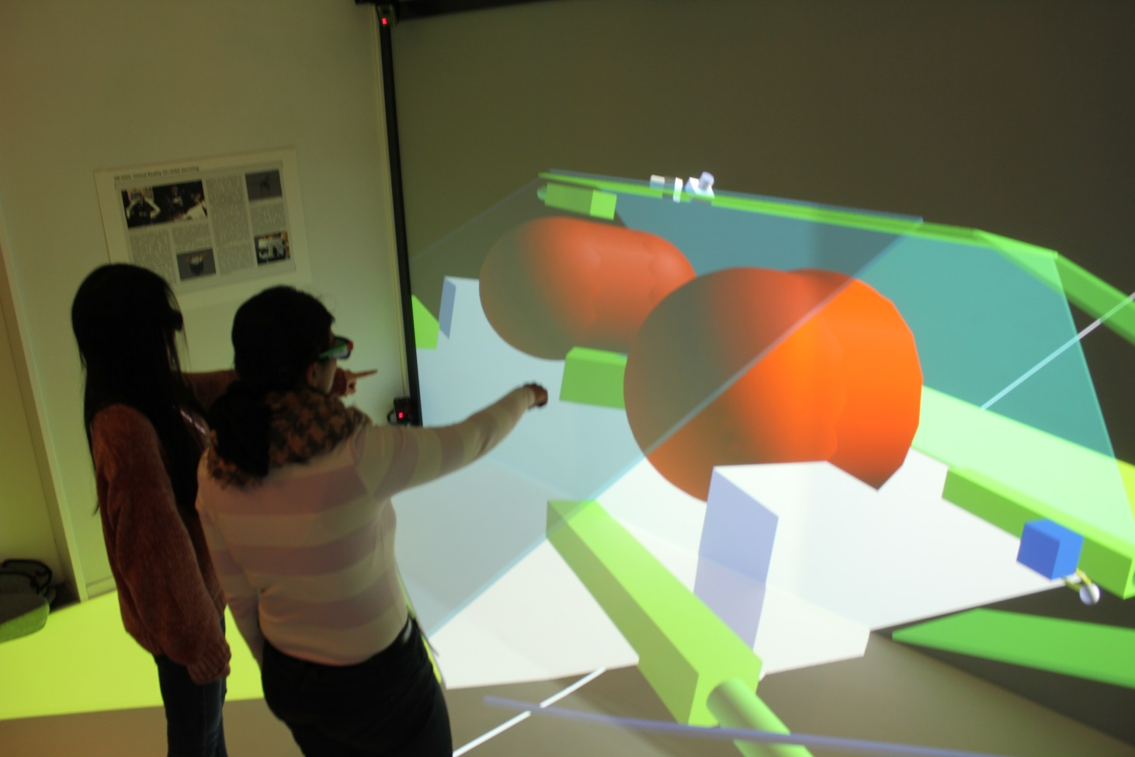
Version comparison with 3D visualization and VR technology
Intuitive, quick, clear understanding
  Version Comparison of geometry
  Animation of design progress
  Version Comparison of property
  Color Map of property
Delta Model
  Describing differences between versions
  Easily fused into visualization

Slide 24
The Future and next steps
Interaction with model data in VR environment
Combination of emerging trends
  Microsoft HoloLens
Later projects phases
  Assembly Integration and Test (AIT)

Slide 25
End of Presentation
Y. Liu, M. Deshmukh, J. C. Wulkop, P. M. Fischer and A. Gerndt
Simulation and Software Technology
German Aerospace Center
CEAS 2017 / 29.03.2017

