Slide 1
Wie sieht die Zukunft der Stromerzeugung aus: zentral oder dezentral? – Ein Blick in die Zukunft und über die Grenzen Deutschlands
Energy Supply for Megacities
A concept and proposal by DLR
Jürgen Kern, System Analyst, DLR-TT
Bernhard Hoffschmidt, Director, DLR-SF
German Aerospace Center
Deutsches Zentrum für Luft und Raumfahrt e.V. (DLR)
Notes:
2012-10-30 approved JK

Slide 2

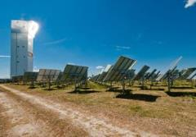




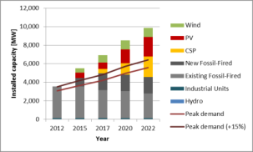
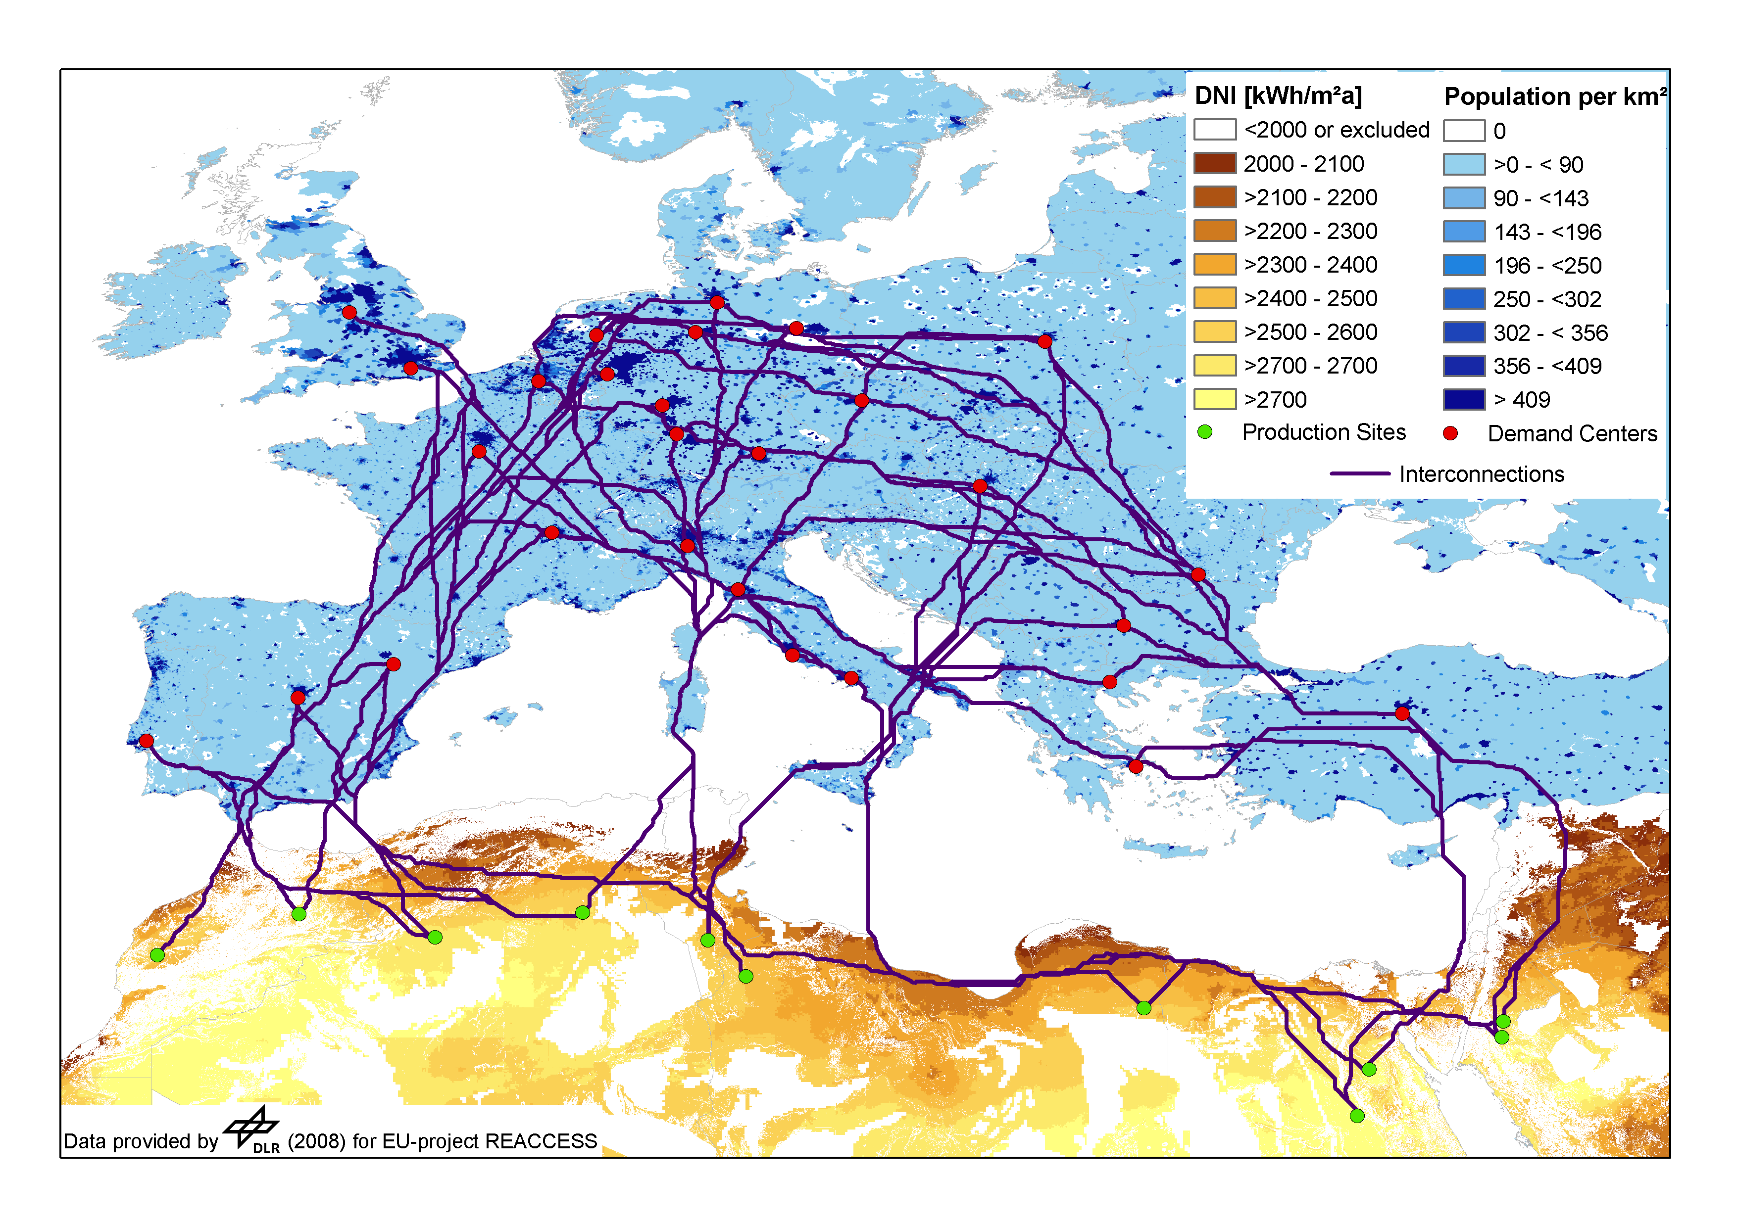
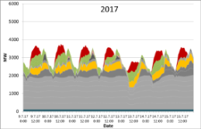
DLR
Forschungsbereiche
Energie
Raumfahrt
Luftfahrt
Verkehr
Energie
Sicherheit
Projektträger
Solarforschung
Windenergie
Thermische & Chemische Speicher
Brennstoffzellen
Verbrennung & Gasturbinen
Systemanalyse
Notes:
2012-10-30 approved JK

Slide 3
Überblick
DLR > Research Areas
Energy
Megacities
Publications & Contact

Slide 4
Research Areas
Aeronautics
Space Research and Technology
Transport
Energy
Space Administration
Project Management Agency
Notes:
2012-10-30 approved JK

Slide 5
Total income 2014 – Research, operations and management tasks: €881 Mio. (excluding trustee funding from the Space Administration / DLR Project Management Agency)

Slide 6
MegaCities

Slide 7
MegaCities – Europe - Africa
Europe
Africa
18 | Moscow | Russia | 16,900,000
24 | London | United Kingdom | 14,031,830
29 | Paris | France | 12,005,077
30 | Rhine-Ruhr | Germany | 11,316,429
21 | Istanbul | Turkey | 14,800,000
11 | Lagos | Nigeria | 21,000,534
15 | Cairo | Egypt | 18,810,000
27 | Kinshasa | Democratic Republic of Congo | 12,500,000

Slide 8
MegaCities - Asia
1 | Tokyo-Yokohama | Japan | 37,900,000
2 | Jakarta | Indonesia | 30,000,000
3 | Seoul | South Korea | 26,100,000
4 | Delhi | India | 25,703,000
5 | Shanghai | China | 25,400,000
6 | Karachi | Pakistan | 24,000,000
9 | Beijing | China | 21,650,000
12 | Mumbai | India | 20,741,000
13 | Osaka | Japan | 20,260,000
14 | Manila | Philippines | 20,040,000
17 | Dhaka | Bangladesh | 18,250,000
20 | Bangkok | Thailand | 15,350,000
22 | Kolkata | India | 14,766,000
25 | Tehran | Iran | 13,700,000
26 | Guangzhou | China | 12,700,000
28 | Shenzhen | China | 12,250,000

Slide 9
MegaCities – North and South America
7 | New York City | United States | 23,632,722
8 | Mexico City | Mexico | 22,200,000
16 | Los Angeles | United States | 18,550,288
10 | São Paulo | Brazil | 21,250,000
19 | Buenos Aires | Argentina | 16,500,000
23 | Rio de Janeiro | Brazil | 14,450,000

Slide 10
MegaCities
Europe – Africa - America
Asia
Moscow 17
London 14
Paris 12
Rhine-Ruhr 11
Istanbul 15
Lagos 21
Cairo 19
Kinshasa 13
New York City 24
Mexico City 22
Los Angeles 19
São Paulo 21
Buenos Aires 17
Rio de Janeiro 14
Tokyo-Yokohama 38
Jakarta 30
Seoul 26
Delhi 26
Shanghai 25
Karachi 24
Beijing 22
Mumbai 21
Osaka 20
Manila 20
Dhaka 18
Bangkok 15
Kolkata 15
Tehran 13
Guangzhou 13
Shenzhen 12

Slide 11
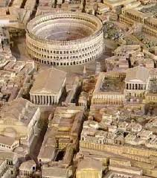

Definition of megacity
The definition of a megacity is arbitrary and has changed over time. In the ancient world, Rome was considered a megacity with its one million inhabitants.

Slide 12
Interesting facts
In 1800, only 3% of the world's population lived in cities
By the end of the 20th century, 47% lived in cities
In 1950, there were 83 cities with populations exceeding one million
In 2007, this number had risen to 468
If the trend continues, the world's urban population will double every 38 years
The UN forecasts that today's urban population of 3.2 billion will rise to nearly 5 billion by 2030, when three out of five people will live in cities.
http://en.wikipedia.org/wiki/Megacity

Slide 13
Attributes of MegaCities
Positive - Opportunities
Negative - Challenges
arts and culture atmosphere/events/
opportunities
educational opportunities
higher paying jobs/economic opportunities
…
..
.
trash pollution
slums
traffic congestion
water pollution
lack of basic needs – electricity/water
civil unrest
housing shortages/homelessness
transportation
political fighting
lack of basic sanitation
pollution of beaches and natural resources
inadequate infrastructure (roads)
public transportation
air pollution
lack of recreation areas
health risks/diseases

Slide 14
Attributes concerning Energy of MegaCities
Positive - Opportunities
Negative - Challenges
Good infrastructure
Waste into Energy
…
..
.
High density of energy demand
…
..
.

Slide 15
MegaCities Video – Dot Map
Each dot represents 1 million people. Video shows the population growth in the world since 179 A.D.
http://www.youtube.com/watch?v=QZPk2quRmKE&feature=related

Slide 16
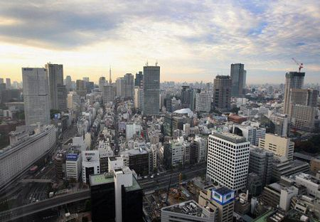
Tokyo, Japan
Current population = 36.7 million
Estimated population 2025 = 37.1 million

Slide 17
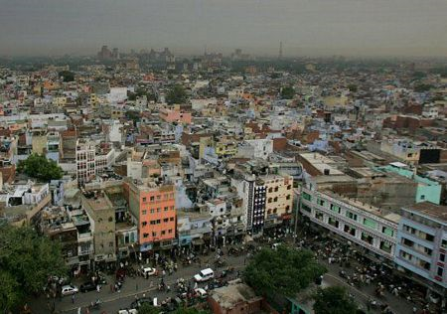
Delhi, India
Current population = 22.2 million
Estimated population 2025 = 28.6 million

Slide 18
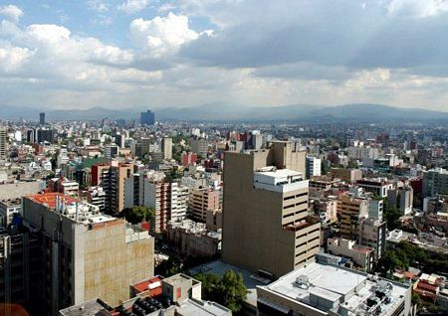
Mexico City, Mexico
Current population = 19.5 million
Estimated population 2025 = 20.7 million

Slide 19
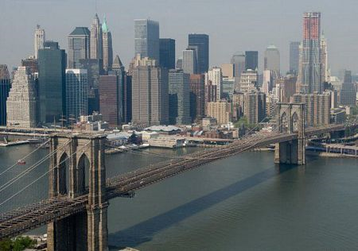
New York City
Current population = 20.4 million
Estimated population 2025 = 20.6 million

Slide 20
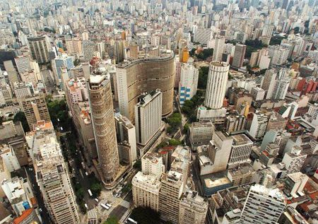
Sao Paulo, Brazil
Current population = 19.9 million
Estimated population 2025 = 23.7 million

Slide 21
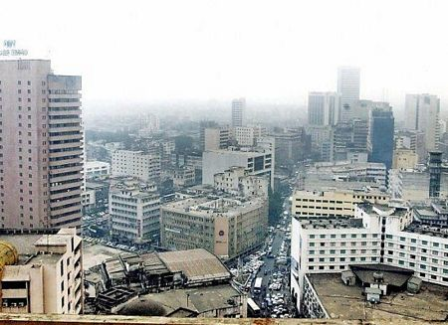
Dhaka, Bangladesh
Current population = 14.6 million
Estimated population 2025 = 20.9 million

Slide 22
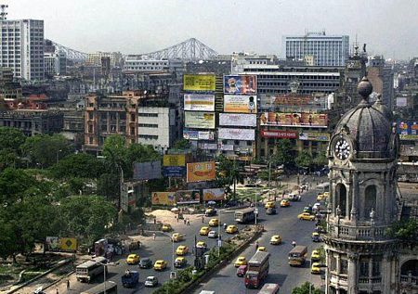
Calcutta, India
Current population = 15.6 million
Estimated population 2025 = 20.1 million

Slide 23
Beijing, China
Current population = xx.x million
Estimated population 2025 = xx.x million

Slide 24
Shenzen, China
Current population = xx.x million
Estimated population 2025 = xx.x million
Notes:
n

Slide 25
Solar MEgaCities

Slide 26
Solar Potential

Slide 27
Solar Potential versus Population
Moscow
London
Paris
Rhine-Ruhr
Istanbul
Lagos
Cairo
Kinshasa
New York City
Mexico City
Los Angeles
São Paulo
Buenos Aires
Rio de Janeiro
Tokyo-Yokohama
Jakarta
Seoul
Delhi
Shanghai
Karachi
Beijing
Mumbai
Osaka
Manila
Dhaka
Bangkok
Kolkata
Tehran
Guangzhou
Shenzhen

Slide 28
Solar Hotspot versus MegaCities

Slide 29
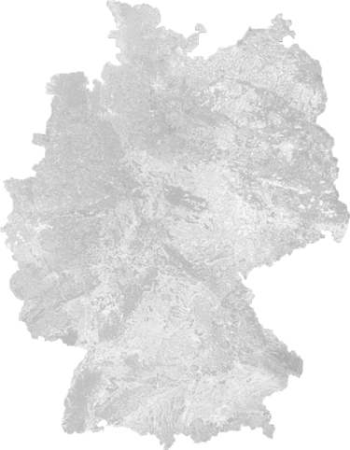
Institutes and Facilities Involved in Energy
Goettingen
Institute of Aerodynamics and Flow Technology
Cologne
Institutes of Propulsion Technology,
Solar Research and Materials Research
Stuttgart
Institutes of Technical Thermodynamics and Combustion Technology
Oberpfaffenhofen
Institute of Communications and Navigation
Almería (Spain)
Permanent team from the Institute of Solar Research at the Plataforma Solar de Almería (PSA)
n Goettingen
n Koeln
Stuttgart n
n Oberpfaffenhofen
Notes:
29
2012-10-30 approved JK

Slide 30
Contact
Jürgen Kern juergen.kern@dlr.de +49 711 6862 - 8119
Tobias Fichter tobias.fichter@dlr.de +49 711 6862 - 779
Dr. Massimo Moser massimo.moser@dlr.de +49 711 6862 - 334
Dr. Franz Trieb franz.trieb@dlr.de +49 711 6862 - 423
Deutsches Zentrum für Luft- und Raumfahrt e.V. (DLR)
Institute for Engineering Thermodynamic
System Analysis and Technology Assessment
Wankelstraße 5 | 70563 Stuttgart | Germany
www.DLR.de/tt/system

