Slide 1
Multisdiscplinary Design Chain for model rotor blades
Bram van de Kamp
DLR Braunschweig – Institute of Composite Structures and Adaptive Systems

Slide 2
Outline
Introduction and Motivation
Design Chain
Manufacturing
Blade Tests
Discussion and future outlook
Notes:
Good afternoon ladies and gentlemen,
Thank you for joining me here today.
I‘m Bram van de Kamp and I work for DLR – the German Aerospace Center – in Braunschweig.
I work there as a researcher in the field of adaptronics, where I focus on structural simulation of morphing structures, mainly helicopter rotorblades.
Therefor I am going to talk about a Multidisciplinary design chain for our model rotor blades which we are establishing and which is in ongoing development.
I will start giving a short outline on the presentation to come.
Introduction and Motivation will answer the question why we need model rotor blades and a chain to design them. Also i‘ll show a brief overview over the project in which the rotorblades where build and its purpose.
The main part of this presentation will be about the design chain covers all steps from defining boundary conditions and collecting input data to the actual iterative design process and strength calculations.
Furthermore interesting is the manufaturing process and the blade test, proving our calculations.
Then I‘d like to conclude with a disscusion and a future outlook.

Slide 3
Introduction and Motivation
Why do we need model rotorblades?
Research with windtunnel tests
Very complex for simulation
Reduce costs

Slide 4
Introduction and Motivation –
What are the demands and challenges in building a model rotorblade?
High mechanical requirements
Scaling
Miniaturizing limits
demands to accurate manufacturing
Complex geometry
Wide variety of Boundary Conditions
Notes:
Scaling
Materials and Components cannot always be scaled in the way the geometry is, miniaturizing limits

Slide 5
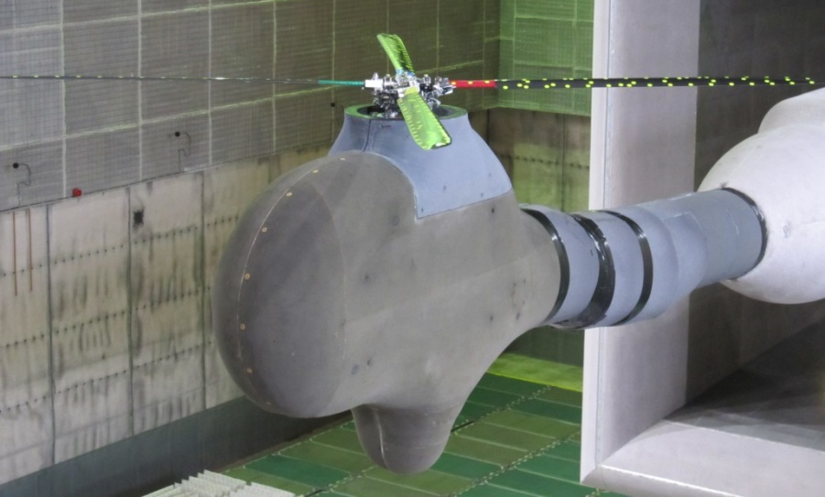
Design Chain – Example Rotor blades
Windtunneltest: DNW Large Low-Speed Facility (LLF)
FTK project
LuFo-V-1
Multiple Swashplate Control System
At DLR with support from Airbus Helicopter Germany (AHD)

Slide 6
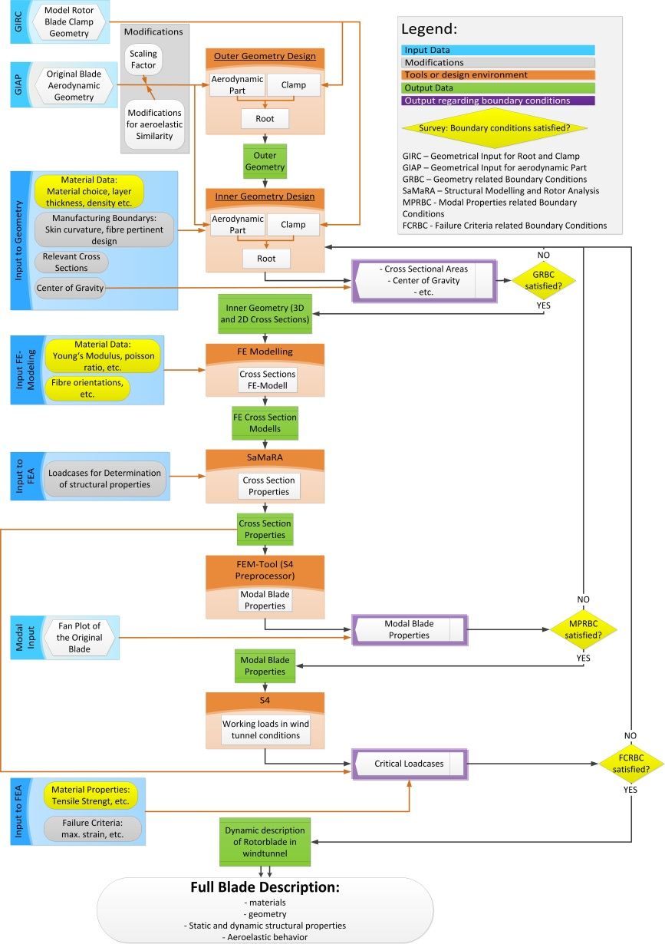
Design Chain
Major Steps in the iterative design Chain:
Outer Geometry Design
Innergeometry Design
FE Modeling
Samara
FEM (S4 Preprocessor)
S4
Full Blade Description

Slide 7
Design Chain - Boundary Conditions and Input Data
Aerodynamic (outer) geometry
Scaling to model size
Flutter and dynamic stability
Strength under static and dynamic loads
Integration of sensor and actuator concepts
Manufacturing limits

Slide 8
Design Chain - Design
EC – 145 C2
Section wise
Geometric and aeroelastic Scaling
Outside-to-Inside principle
Parametric design – stability
Relevant Cross sections differ between inner and outer geometry
Limited space and many boundary conditions
Center of gravity

Slide 9
Design Chain - FE-Modeling
Composed from two parts
Isotropic and unidirectional components
Composite parts with surface and layer dependent layer orientation
Auxiliary Geometries based on manufacturing geometries -> detailed FE cross section models
Contact elements with Linear bonded contact between parts

Slide 10
Existing DLR Tools
SaMaRA – Structural Modeling and Rotor Analysis
FEM
S4

Slide 11
Strength Calculation

Slide 12
Manufacturing – Boundary Conditions

Slide 13
Manufacturing process

Slide 14
Blade Tests

Slide 15
Discussion
Operationality for other rotor blade design tasks
Design chain has to be adaptable regarding
Starting Conditions
In process Boundary Conditions
In- and Output
Sequence of the iterative process
Notes:
Besipiele?

Slide 16
Future Outlook
Automation of the process
Optimization tools
Geometry updates with respect to the given boundary conditions
Standardization of interfaces
Simple data exchange
Easier coperation with other parties
More modular concept

