Slide 1
Effectiveness of [...] INCENTIVES on EV-uptake considering [...] frameworks within the EU
Christoph Schimeczek, Doruk Özdemir, Stephan Schmid
German Aerospace Center (DLR) Institute of Vehicle Concepts
@ ETC Barcelona, October 6th 2016

Slide 2
The challenges
Traffic
air pollution
CO₂ emissions
noise
EV uptake
purchase cost
charging time
➔Electric Vehicles (EV)
electric range
➔Provide incentives
Incentives
different incentives
varying effects
➔Which incentives are most effective?
➔Which user group will profit?

Slide 3
Approach
Spain
national boundary conditions
TCO
+
vehicle utility
effective-ness of incentives
fleet types & vehicle usage
Austria
Netherlands
Germany
United Kingdom
4 years of ownership
private & corporate ownership

Slide 4
Fleet types
rented to vehicle users
purchased and maintained by rental company
car rental
purchased and owned by a single user
private ownership
allocated to a single user
private and business purposes
company car
not allocated to a single person
used only on business purposes
commercial
Vehicle usage
Annual mileages: 5,000 km/a ... 40,000 km/a

Slide 5
Boundary condition analysis
 | VAT | CV purchase tax (€) | BEV incentives (€) ¹ | electricity cost (€/kWh) // diesel cost (€/l) ¹ | company profit tax rate | employee income tax rate
DE | 19% | - | 4,000 | 0.33 // 1.15 | 30% | 52%
NL | 21% | 200 - 4,500 | - | 0.24 // 1.19 | 25% | 42%
AT | 20% | 1,500 - 7,000 | - | 0.23 // 1.08 | 25% | 43%
ES | 21% | 0 - 2,500 | 5,500 | 0.25 // 1.07 | 25% | 37%
UK | 20% | - | 6,500 | 0.23 // 1.49 | 23% | 40%
No purchase taxes in DE & UK
No direct incentives in NL & AT
DE – high electricity prices, low fuel prices
AT & UK – high energy savings potential
Boundary conditions seem to favour Spain, Austria, UK.
^{[1]}1 £ = 1.3€

Slide 6
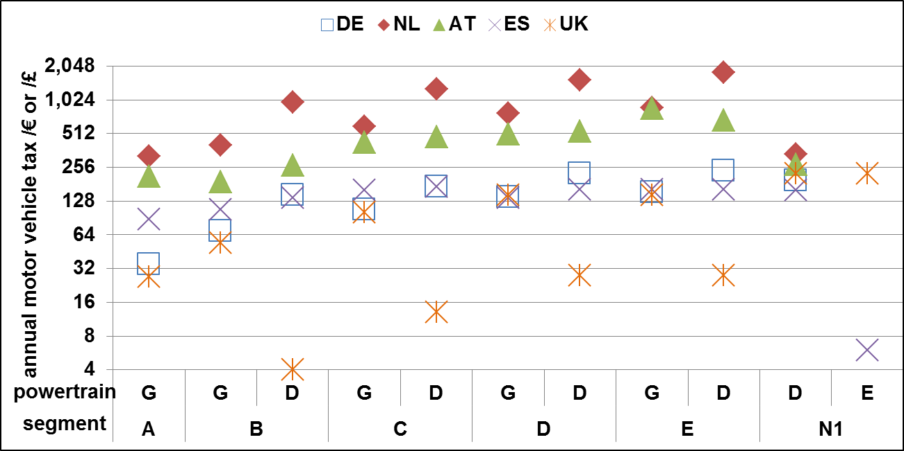
Boundary conditions – Annual motor vehicle tax
Behold, it is log scaled!
significant differences between countries
good tax savings potential in NL & AT
G: gasoline
D: diesel
E: battery electric

Slide 7
TCO – included items
resale value
registration cost
purchase taxes
insurance cost
purchase incentives
TCO
energy cost
list price (+VAT)
motor tax
cost of money
maintenance & repair
cost of vehicle substitution
company tax reliefs

Slide 8
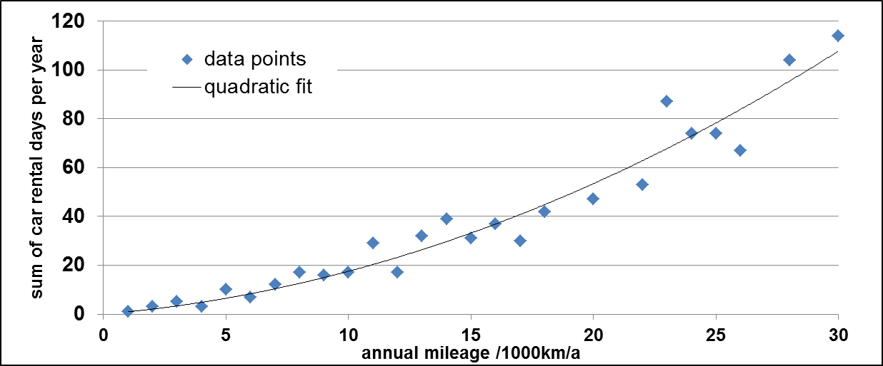
TCO – Vehicle substitution cost
BEVs drawbacks
restricted range
charging duration
➔Assumption
BEVs are replaced with conventional
vehicles on days with long-range trips
90 km effective el. range
real-world electric range
incidence of high daily mileage²
vehicle rental cost ³
¹ P. Mock et al., „From laboratory to road - A 2015 update of official and “real-world” fuel consumption and CO2 values for passenger cars in Europe“, ICCT, White Paper, 2015.
² DLR und Infas, „Mobilität in Deutschland 2008“, Ministerium für Verkehr, Bau und Stadtentwicklung, Bonn and Berlin, 2010.
³ www.billiger-mietwagen.de

Slide 9
Total Cost for vehicle Users (TCU)
Cost distribution by fleet type
fleet type | energy cost | insurance premiums | vehicle subst. cost
car rental | user | user | -
commercial | owner | owner | -
company car | user | owner | user
private ownership | owner | owner | owner
Benefit in kind (BIK)
BIK tax total | DE | AT | NL | ES | UK
Gasoline | 6,100 € | 6,700 € | 6,600 € | 2,400 € | 7,600 €
Diesel | 7,400 € | 7,900 € | 6,800 € | 2,100 € | 8,100 €
BEV | 10,500 € | 0 € | 1,800 € | 2,900 € | 4,200 €
Company cars only
no savings in DE & ES
good savings in AT & NL
Example: C-segment

Slide 10
Include non-monetary aspects – vehicle utility
Combine
TCO
TCU
well-to-wheel CO₂ emissions
acceleration time [0-100 km/h] (driving dynamics)
Utility of vehicle $i$
willingness to pay
inverse of cost summation
set to 100% for best conventional vehicle of same size
$$\frac{1}{{Utility}_{i}}=\sum_{k}{{β_{i}×k}_{i}}$$
Willingness-to-pay coefficients¹
$$k$$ | TCO | Total cost for user | Acceleration | CO₂ emissions
$$β$$ | 1 | 1 | 468 €/s | 213 €/t
¹Redelbach, Martin „Entwicklung eines dynamischen nutzenbasierten Szenariomodells zur Simulation der zukünftigen Marktentwicklung für alternative PKW-Antriebskonzepte“, Dissertation, Universität Stuttgart, 2016.

Slide 11
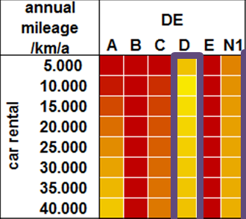
BEV utility
compared to best conventional vehicle of same size (100% utility)
green / blue – higher BEV utility
red / orange – lower BEV utility
purple boxes mark BEV business-case regions

Slide 12
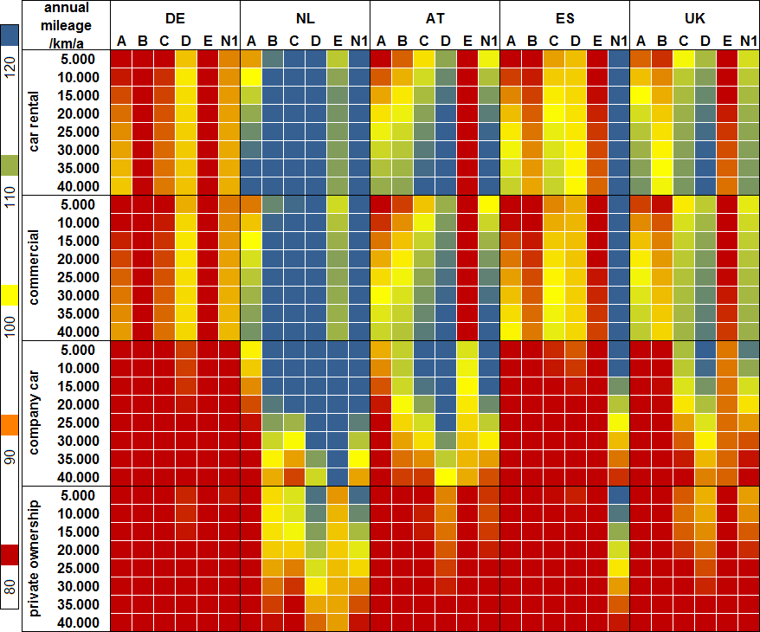

Slide 13
BEV utility – findings by country
Germany & Spain
(very) low utility
some potential in commercial fleets D-segment
no EV potential for private ownership & company cars
the Netherlands
high utility in corporate fleets
good utility for private sector with annual mileage < 25.000 km/a
Austria & the UK
high BEV potential in corporate fleets
reasonable utility for medium-sized company cars
low utility for private car ownership
Summary by country | DE | NL | AT | ES | UK
# BEV utility > 100 | 0 | 226 | 150 | 71 | 133

Slide 14
BEV utility – further findings
Summary by vehicle size | A | B | C | D | E | N1
# BEV utility > 100 | 25 | 20 | 78 | 90 | 17 | 145
high BEV potential
medium-sized cars
light commercial vehicles
Summary by fleet type | car rental | commercial | company car | private
# BEV utility > 100 | 46 | 145 | 54 | 10
high BEV potential
commercial fleets
low BEV potential
private ownership

Slide 15
Conclusions
DE: 5000€ additional incentives needed for comparable BEV TCO
best BEV utility for
medium-sized cars & light commercial vehicles
commercial fleets
worst BEV utility for
private ownership
mini cars & large cars
CO₂ emissions + acceleration do not turn the balance in favour of BEVs
Outlook
country- & fleet-type specific utility
include PEV-promoting measures
priority lanes
priority parking
entry restrictions

Slide 16
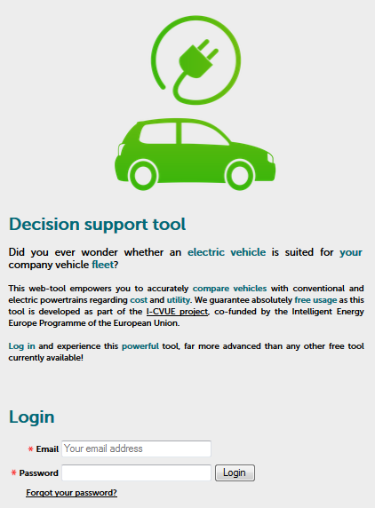
The project Incentives for Cleaner Vehicles in Urban Europe (I-CVUE)
http://icvue.eu
Partners
http://dsm.icvue.eu
Co-funded by the Intelligent Energy Europe Programme of the European Union.

