Slide 1
MFMC GBAS –
Flight Trials and Performance Studies
ENC 2016 – Helsinki – 01.06.2016
M. Felux, M.-S. Circiu, D. Gerbeth
Daniel.Gerbeth@dlr.de

Slide 2
Multi-Frequency Multi-Constellation GBAS
Why? How?
Protection against ionospheric gradient threat
Ionospheric scintillation issues in high/low latitudes
Weak constellations and required masking may have impact on performance

Slide 3
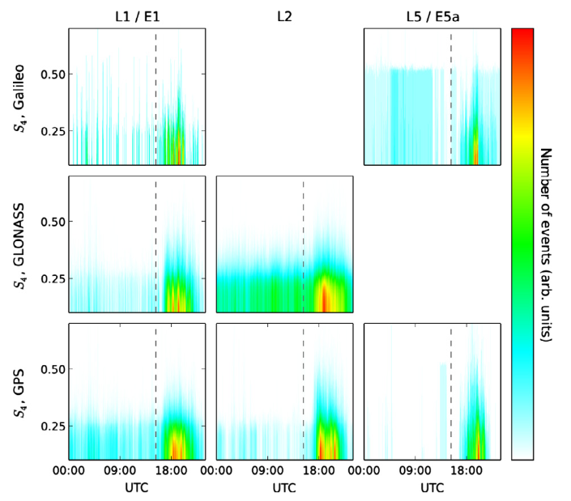
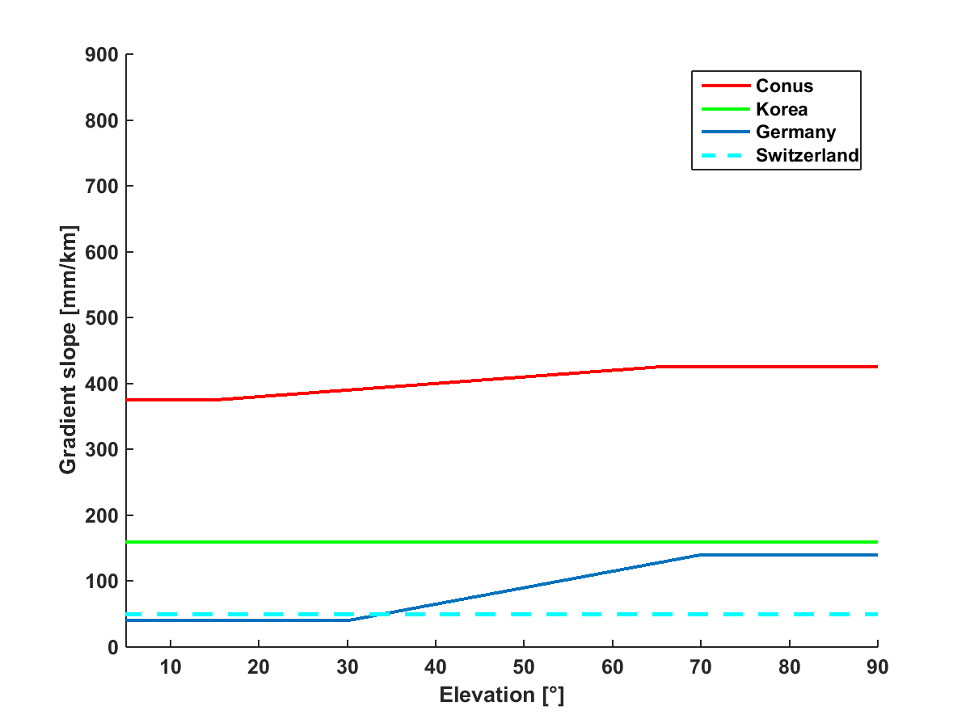

Motivation
Why?
Large ionospheric gradients and scintillation events can result in
significant unavailability of the GBAS
Graphic from: Hlubek N, Berdermann J, Wilken V, Gewies S, Jakowski N, et al.: Scintillations of the GPS, GLONASS, and
Galileo signals at equatorial latitude. J. Space Weather Space Clim., 2014, 4, A22
Notes:
Iono gradients – scintillations
Next: Motivation overview

Slide 4

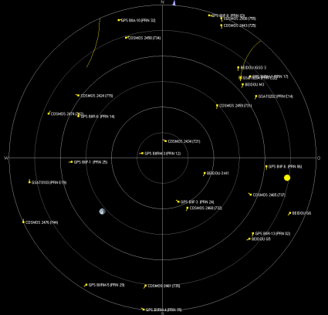
Motivation
How?
Dual-frequency GBAS can tackle the ionospheric gradient problem
Multi constellation GBAS can reduce the impact of scintillations on availability
Quickly growing Galileo constellation (all satellites with E1/E5a)
Currently 12 GPS Block IIF satellites with L1 and L5 operational, continuous launches all with second frequency
Notes:
Next: Outline

Slide 5
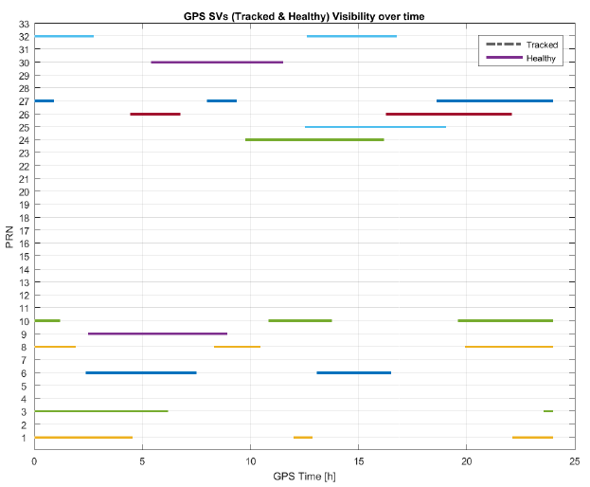
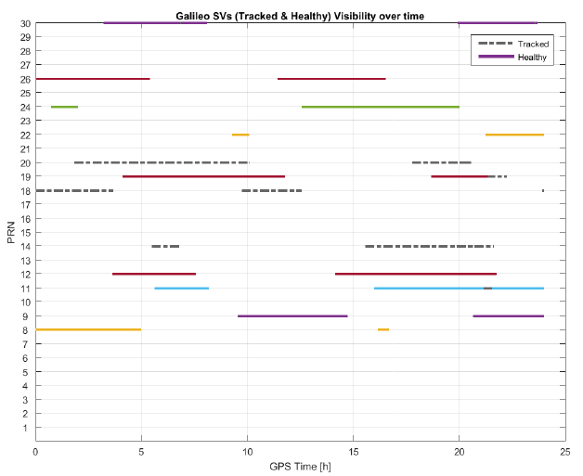
L5/E5a Satellite Status
(12 GPS Block IIF, 14 (9) Galileo)
GPS Block IIF and Galileo status

Slide 6
Performance Metric: Availability
Represented by protection levels:
Need to determine all the necessary parameters for the processing modes
Analysis of extesive ground and flight data to establish expectable performance models

Slide 7
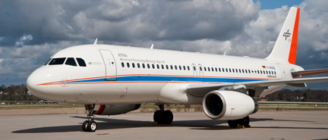

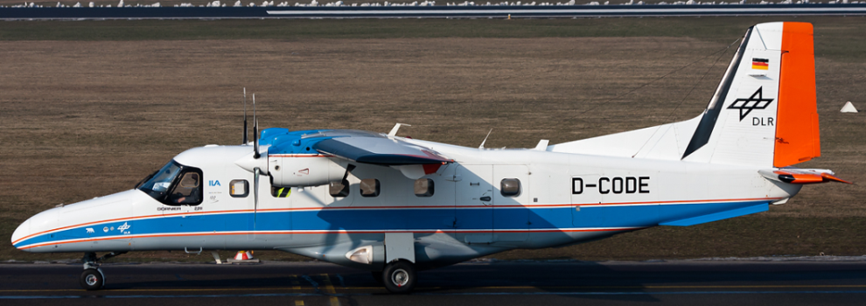
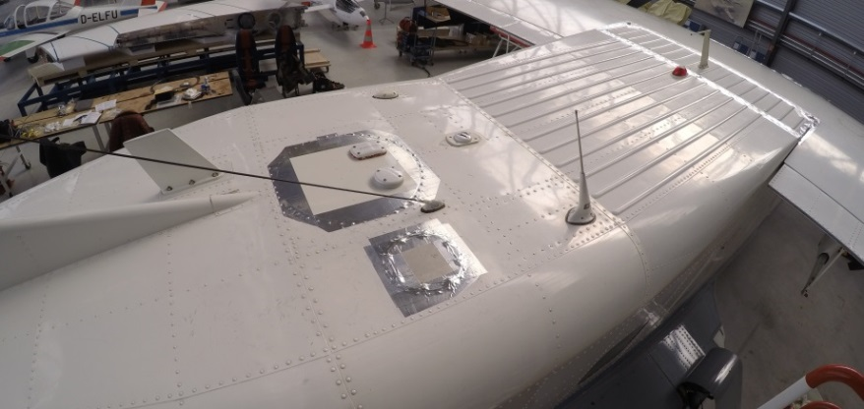
Data Collection
Duration: 100 hours A320 since May 2015
6 hours Dornier March 2015
Receiver: Javad Delta
23 Mhz bandwidth
2 correlator spacings
Airbus A320
Antenna: Antcom multiband
Dornier DO-228

Slide 8
Towards MFMC GBAS – Performance Assessments
Sigma_{air}
Elevation in A/C body frame [deg]

Slide 9
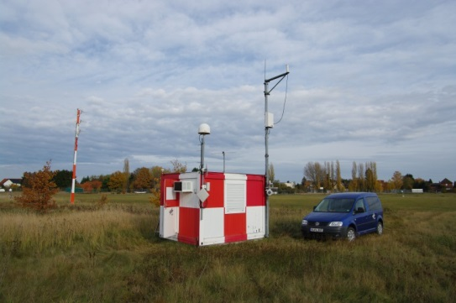
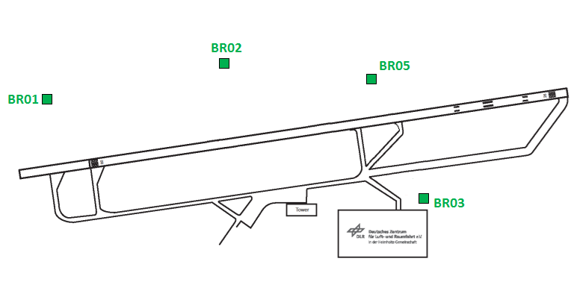
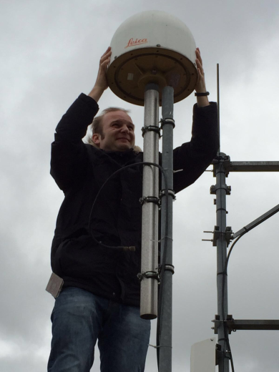


DLR Ground Facility
Braunschweig Airport
 | L1 | L2 | L5
BR01
BR02
BR03
BR05
Javad Delta Receivers with
GPS (L1/L2/L5) + Galileo (E1/E5a) + Glonass + BDS
Connected to Leica AR25 choke ring antennas

Slide 10
Evaluating Performance of GPS L5 and Galileo E1/E5a Using Ground Measurements
Improved performance of the Galileo signals
RX configuration:
  0.1 chips correlator spacing (L1/E1)
  1 chip correlator spacing (L5/E5a)
Multipath and noise on Galileo E1 is lower than on GPS L1, especially at low elevation
  BOC(1,1) modulation
  Wider transmission bandwidth
Galileo E5a shows lower multipath and noise than Galileo E1
  BPSK(10) signal
  Higher chip rate
  Higher signal power
Paper presented at ITM 2015 : M-S Circiu et. Al – “Evaluation of GPS L5, Galileo E1 and Galileo E5a Performance for Multi Frequency Multi Constellation GBAS”
10 GPS Block IIF , 4 Galileo
40 days of data – 100 sec smoothing constant

Slide 11

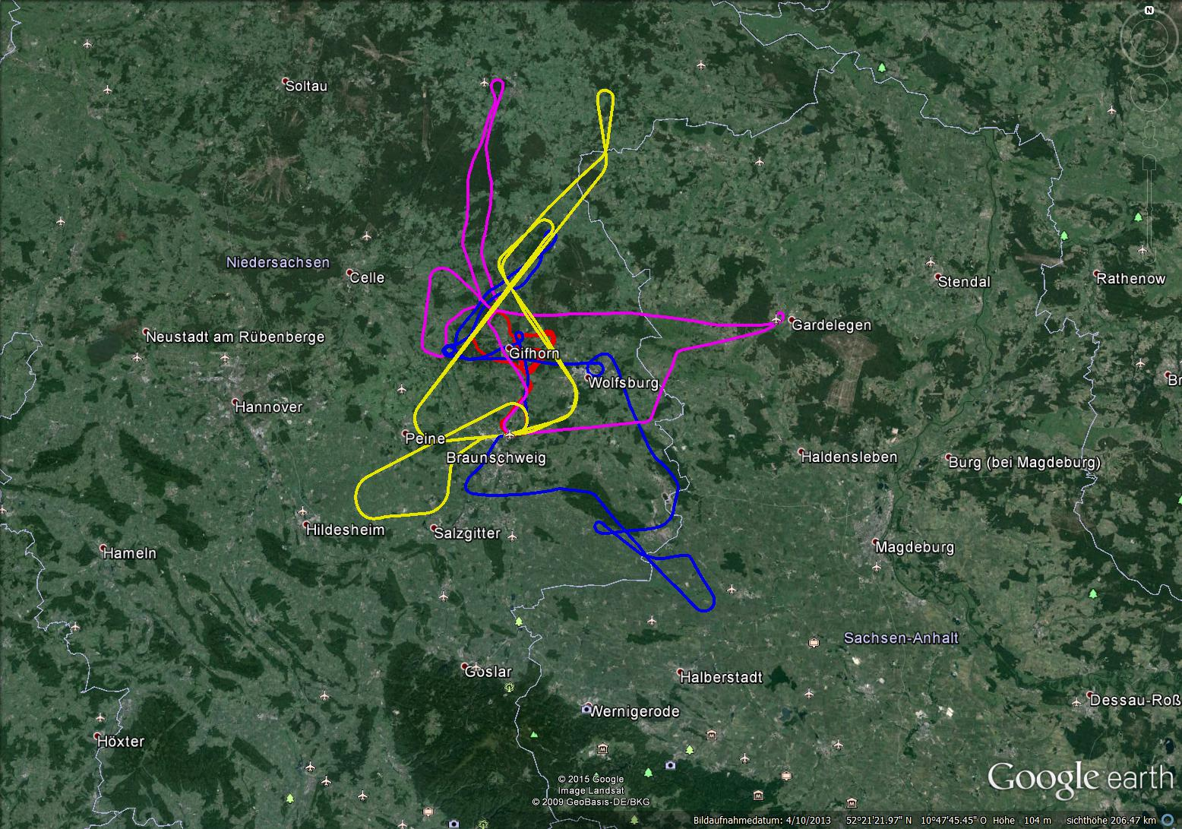
Dual-Frequency Dual-Constellation GBAS
Flight Trials
4 flights in March 2015
with Dornier DO-228 (6h total)
Satellite visibility: 5-7 dual frequency (GPS+Gal)
Single-frequency L5/E5a GPS and Galileo
Dual-frequency L1/E1+L5/E5a GPS and Galileo

Slide 12
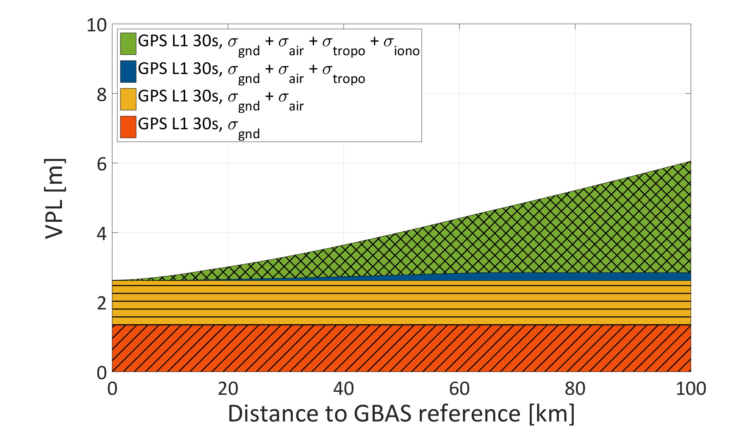
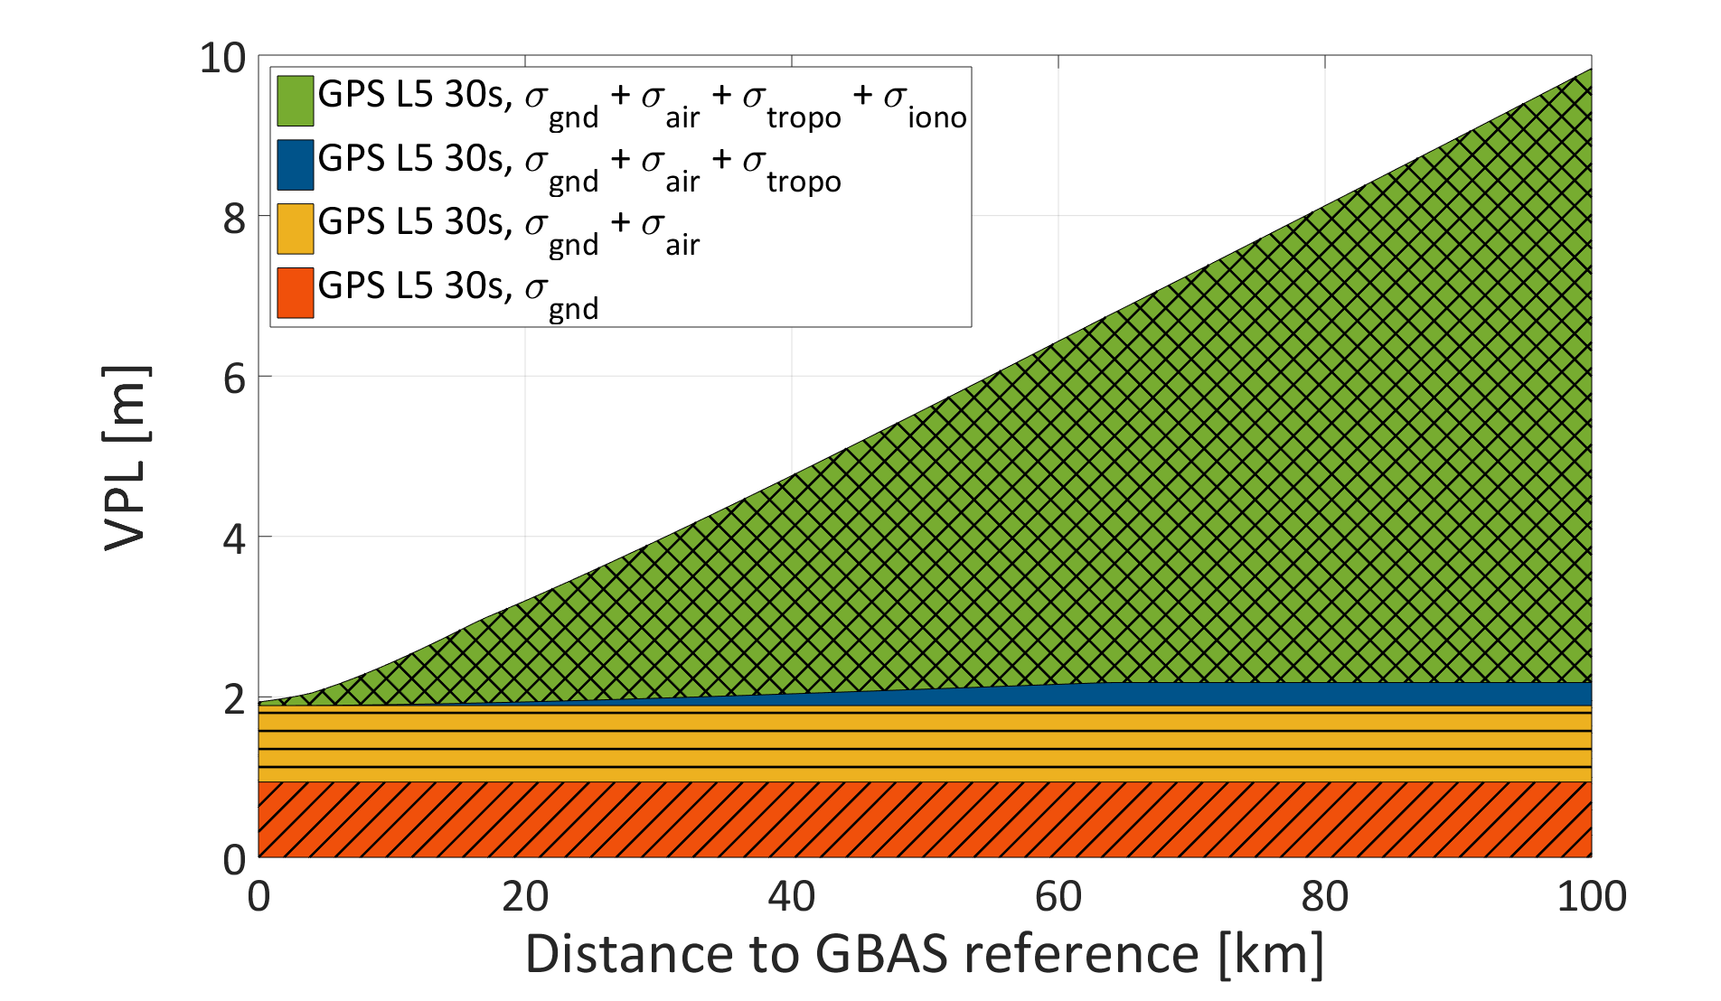
Protection Levels
Contribution of Different Sigma Terms
GPS L1 30s (GAST D)
GPS L5 30s

Slide 13
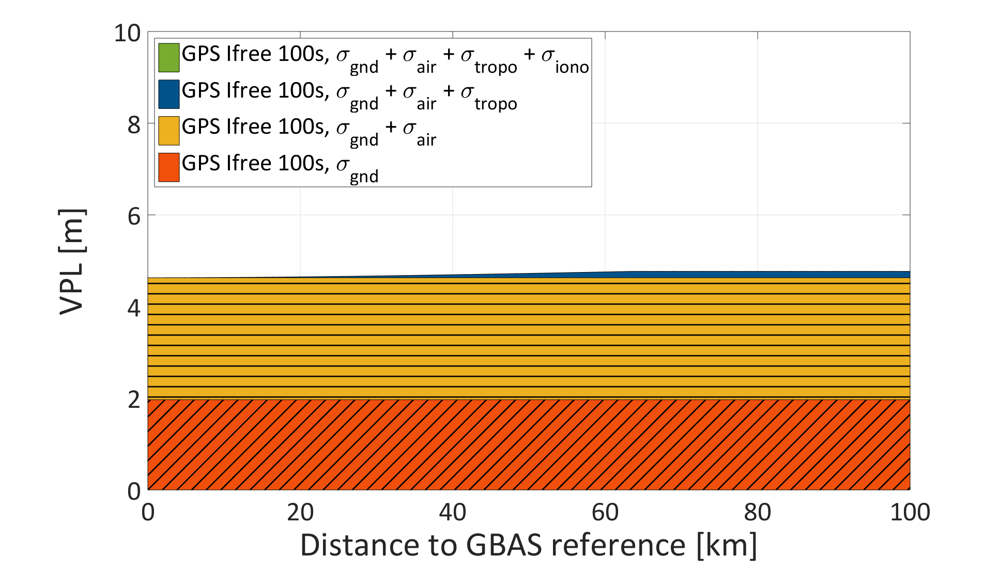
Protection Levels
Contribution of Different Sigma Terms
GPS L1 30s (GAST D)
GPS L1/L5 100s Ifree

Slide 14
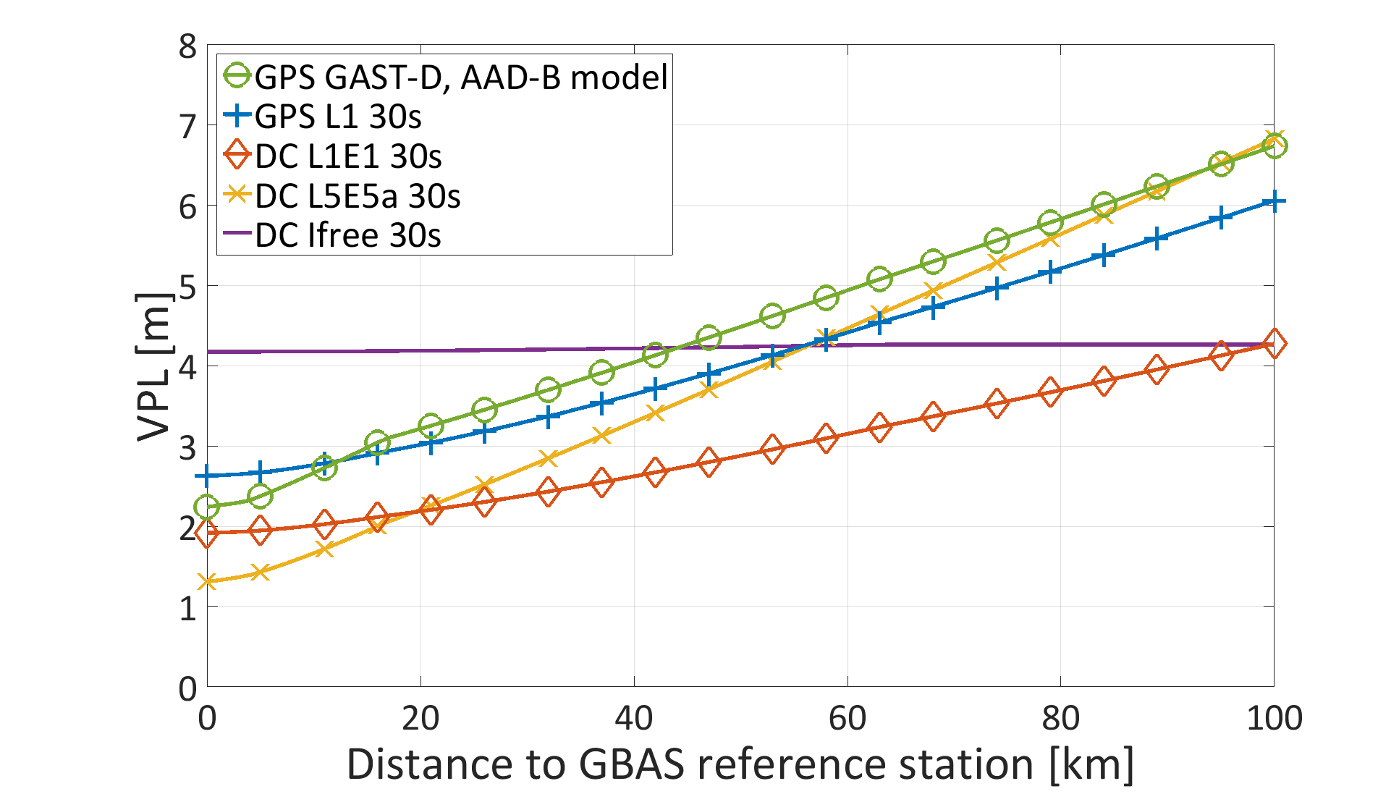
Comparison and Trade-Off Studies
30s Smoothing Constant
‘Nominal Performance of Future Dual-Frequency Dual-Constellation GBAS’
In press, August 2016, IJAE

Slide 15
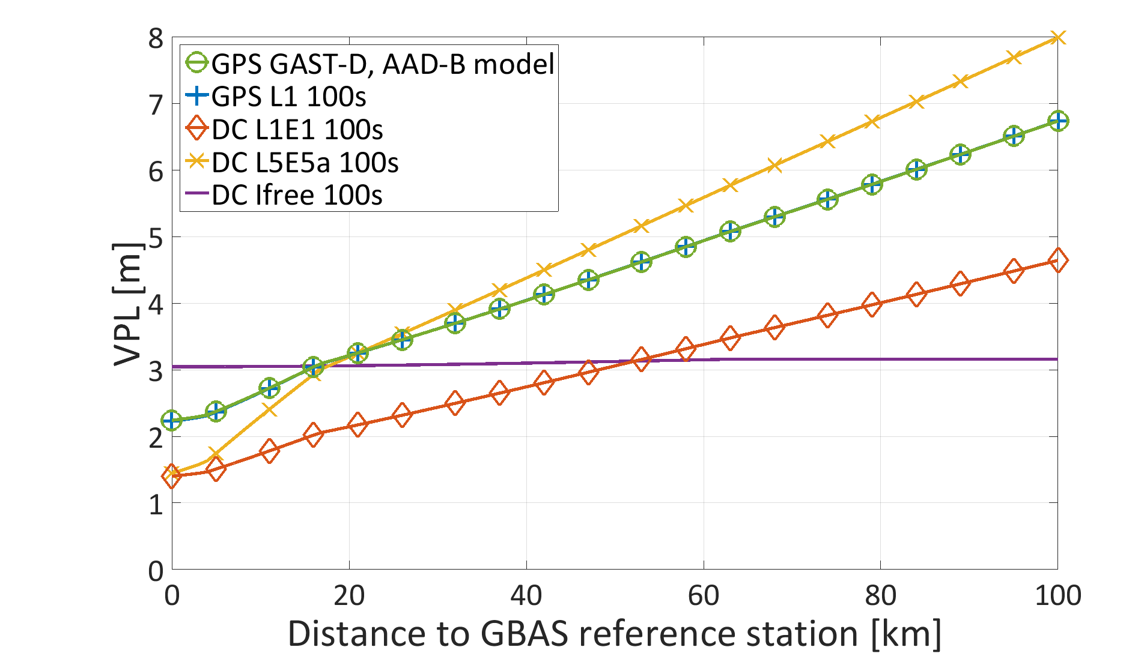
Comparison and Trade-Off Studies
100s Smoothing Constant
‘Nominal Performance of Future Dual-Frequency Dual-Constellation GBAS’
In press, August 2016, IJAE

Slide 16
Conclusions
Dual frequency and multi constellation GBAS can resolve many of the current GBAS issues
More data and investigations needed for suitable models covering all aircraft, receivers, antennas etc.
No solution to all problems
No defined way ahead concerning different modes
Trade-off is a difficult task

Slide 17
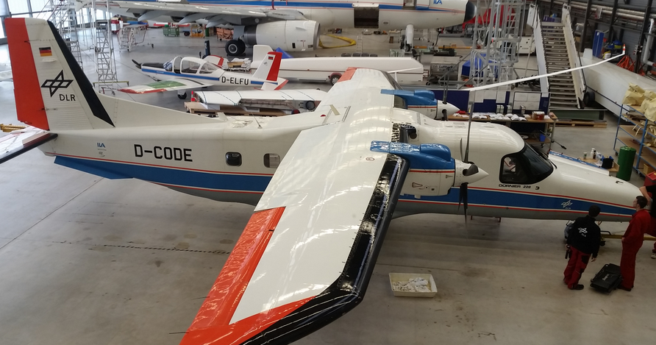
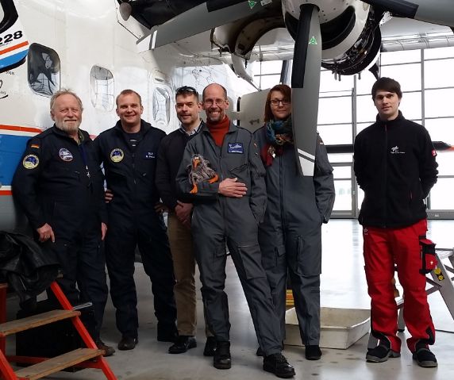
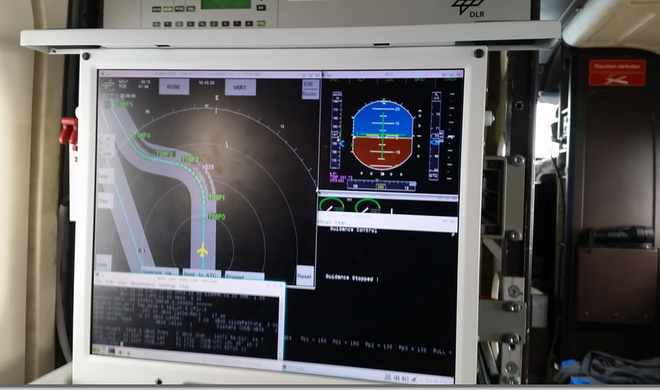
Thank you for your attention!
Questions?

