Slide 1
Recent Developments in FT Laboratory Spectroscopy at DLR
Manfred Birk, Georg Wagner, Joep Loos
German Aerospace Center, Remote Sensing Technology Institute

Slide 2
Introduction
Spectroscopic databases such as HITRAN,… essential for remote sensing
Accuracy requirement of spectroscopic data linked to accuracy requirement of remote sensing data product
Recent and future satellite missions targeting greenhouse gases have demanding requirements for Level 2, e.g.
  MERLIN, TROPOMI: CH₄ column amount better than 2%
  OCO-2: CO₂ columns better than 0.3%

Slide 3
Status of spectroscopic database
Content of spectroscopic database
  Line by line (LBL) parameters
  Absorption cross sections (ACS)
Background to LBL and ACS
Homogeneous medium with O = optical depth, α = absorption cross section,
l = absorption path, N = number density
ACS is the sum over all lines with S = line intensity and f = line profile function
ACS spectrum depends on pressure P and temperature T
ACS are directly measured in laboratory in case of dense complex spectra
Experimentally more demanding than line parameter measurements

Slide 4
Accuracy and completeness of spectroscopic database
Defined error bars are rare
LBL mainly based on Voigt profile
Data are rarely measured in atmospheric relevant temperature/column density range
Insufficient temperature range is less problematic for LBL since intensity temperature conversion from physical first principles but still a problem for e.g. temperature dependence of Lorentz width
ACS often measured with insufficient spectral resolution
Uncertainties of ACS are hard to quantify because of complex dependence on baseline errors, spectral resolution, and temperature inhomogeneities
Missing and misplaced lines are to a lower extent also an issue

Slide 5
Non-Voigt line profiles example 1: Line narrowing
Example based on DLR H₂O ν₂ measurements. Data in HITRAN 2012. Analysis based on Voigt profile.
Line narrowing (speed dependence/Dicke) was believed to be not important for remote sensing
Only small W-shaped residuals when using Voigt profile
T 317 K
P_{H2O} 0.2159 mbar
P_{tot} 50.43 mbar
Absorption path 79 m
MOPD 187.5 cm
Notes:
In the lab we measure normally optical thin lines, because we do not like the correlation beteween line intensity and line widths.

Slide 6
Non-Voigt line profiles example 1: Line narrowing
Spectroscopic parameters were retrieved from non-opaque lines
Modelling of opaque lines from new database is extrapolation
Attempt to model measured spectra with new database ⇒ systematic errors for opaque lines
Effective Voigt fit of opaque lines resulted in 3% larger Lorentzian width – residuals only noise (red trace in figure)
T 296 K
P_{H2O} 2.5 mbar
P_{tot} 200 mbar
Absorption path 21 m
MOPD 375 cm
Notes:
Opaque lines were in the spectra but not used in the spectroscopic analysis

Slide 7
Non-Voigt line profiles example 1: Line narrowing
Ratio of speed-dependent Voigt and Voigt becomes 1 in the line wing
Exponentiation in case of opaque lines blocks out disturbance due to narrowing close to line center and only leaves line wings
Opaque lines thus need true Lorentz width to model wings correctly
But: Effective Lorentz width obtained from non-opaque lines is smaller than true Lorentz width due to narrowing

Slide 8
Non-Voigt line profiles example 1 : Line narrowing
Problem solved by speed-dependent Voigt profile
Impact: Earth radiation budget, radiative forcing, remote sensing (especially NADIR sounding utilizing opaque signatures as IASI, MTG-IRS).
Lessons learned: a) Atmospheric opacities should be covered by laboratory
measurements
b) Atmospheric retrievals should include narrowing
T 296 K
P_{H2O} 0.024 mbar
P_{tot} 200 mbar
Absorption path 79 m
T 296 K
P_{H2O} 0.20 mbar
P_{tot} 200 mbar
Absorption path 21 m
Notes:
The narrowing caused the effective Voigt width to be too small when derived from non-opaque lines. Due to the exonentiation only line wings are important in case of the opaque lines and in the line wing the narrowing influence vanishes thus the wing is undisturbed and need the true but not the effective Lorentzian widths.

Slide 9
Non-Voigt line profiles example 2: Line mixing
Retrieval study for TROPOMI CH₄ column measurements carried out
Spectroscopic error contribution <0.7%
Omitting line mixing yields an error of ca. 1%
Conclusion: In case of molecules with strong line mixing like CH₄ it must be considered in retrievals

Slide 10
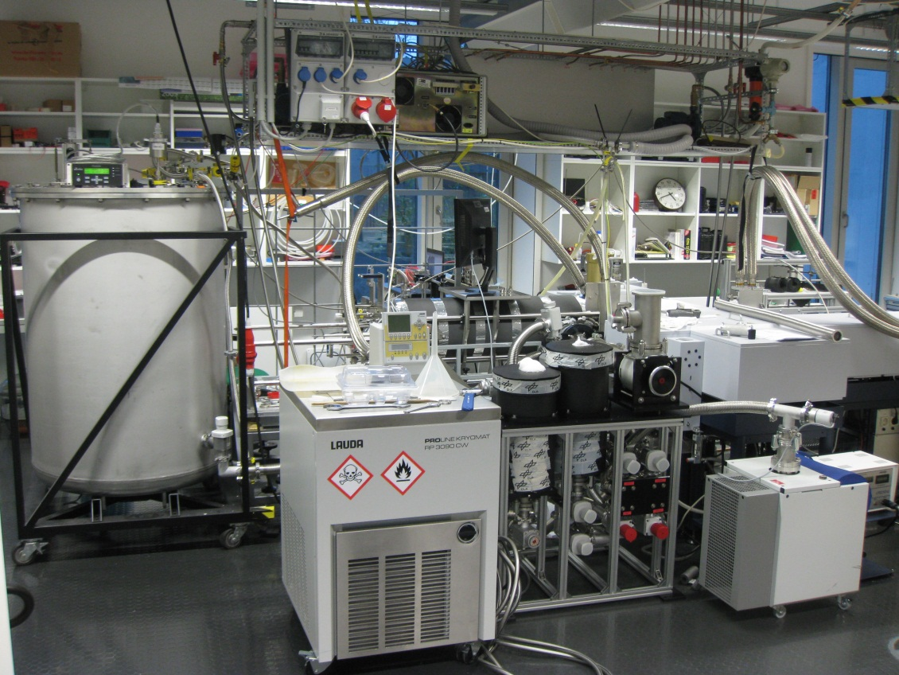
Laboratory equipment at DLR
Bruker IFS 125HR Fourier-Transform spectrometer (range 10 – 40000 cm⁻¹)
Coolable (190K), heatable (950K) cells, coolable (200K) 200 m multireflection cell
Lab equipment for production/handling of stable/unstable species
Mixing chambers for generation
of defined gas mixtures
High accuracy pressure and
temperature measurement
Notes:
In case of water flow is required due to wall absorption

Slide 11
The forgotten requirement: Temperature homogeneity
Line positions and intensities measured at room temperature – no problem
But: Pressure broadening, pressure-induced line shift require measurements covering atmospheric temperatures
ACS: Measurements covering atmospheric temperatures mandatory
Measuring at temperatures different from ambient can cause temperature inhomogeneities in the measured gas volume unless all surfaces (cell walls, mirrors, windows) have the same temperature
Knowledge of average gas temperature not sufficient
Proof: Number density/temperature fit from measured line intensities
Notes:
Line intensities and positions no problem – room temperature, but pressure broadening, pressure induced line shifts etc.. Are temperature dependenct and require measurements covering atmospheric conditions. In case of absorption cross sections the influence is even more pronounced, since temperature dependence of intensities not included.

Slide 12
N₂O measurement and analysis
Spectral range 2150 - 2270 cm⁻¹
MOPD 187.5 cm
P_{N2O} 0.00082 mbar
P_{air} 107.2 mbar
Absorption path 46.4 m
Mirror temperature 285 K
Cell temperature 198 K
Measured line intensities DLR IDL single spectrum fitting tool
Reference line intensities Hitran 2012
Fitted temperature 217.052(0.017) K
Notes:
Line intensities and positions no problem – room temperature, but pressure broadening, pressure induced line shifts etc.. Are temperature dependenct and require measurements covering atmospheric conditions. In case of absorption cross sections the influence is even more pronounced, since temperature dependence of intensities not included.

Slide 13
The forgotten requirement: Temperature homogeneity
Fit shows systematic residuals increasing with lower state energy up to 12%
Presence of temperature inhomogeneities causes systematic errors in line parameters hard to quantify
Temperature homogeneity is a challenging design driver in gas cell development
Notes:
Relative intensities wrong. Multispectrum fitting does not work

Slide 14
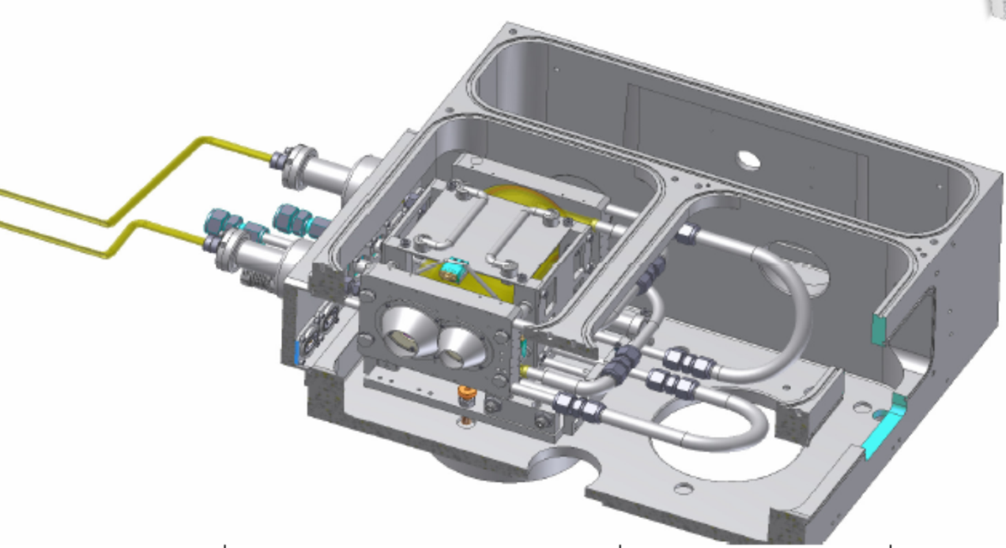
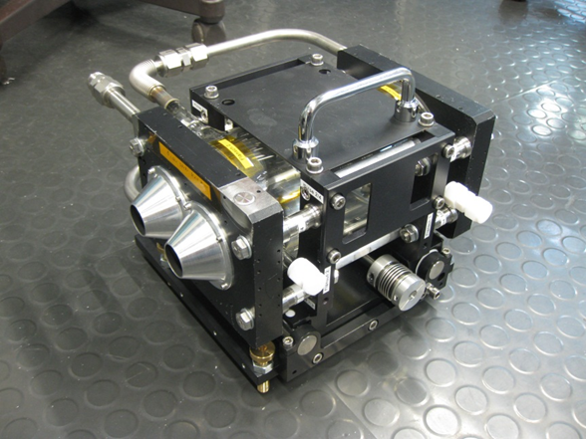
New short absorption path cell
20 cm absorption path, coolable to 190 K, in evacuated Bruker sample compartment
Two window pairs allowing UV+MIR, MIR+FIR, UV+FIR quasi-simultaneously
Cell movable from outside to select window pair in optical beam
High temperature homogeneity (<0.1 K) – thermal modelling of windows/holders – radiation shields – heat sinking of windows
Path length accuracy 0.1%
Notes:
0.1 K temperature homogeneity from comparision of measured cell temperature and fitted gas temperature from relative line intensities.

Slide 15
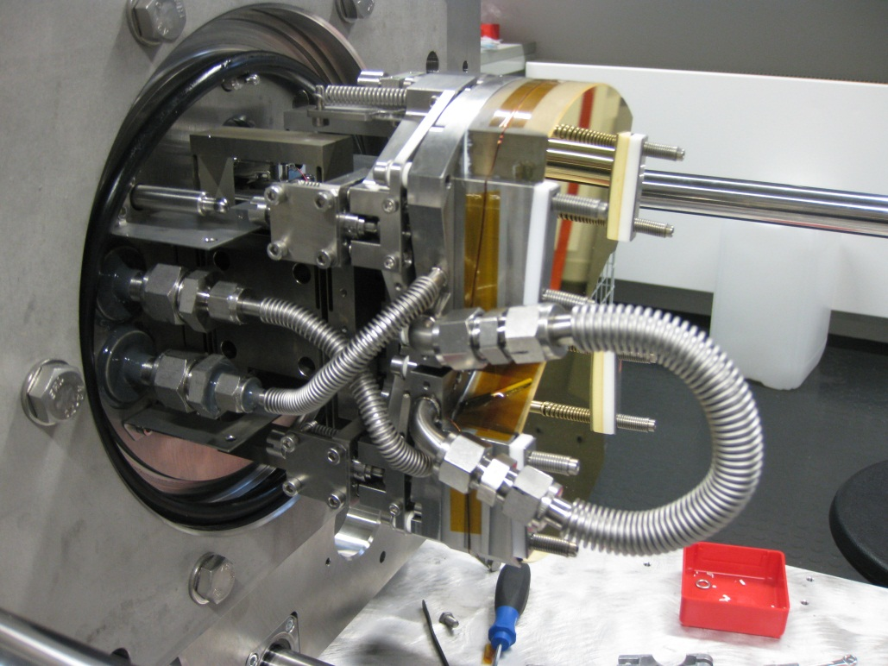
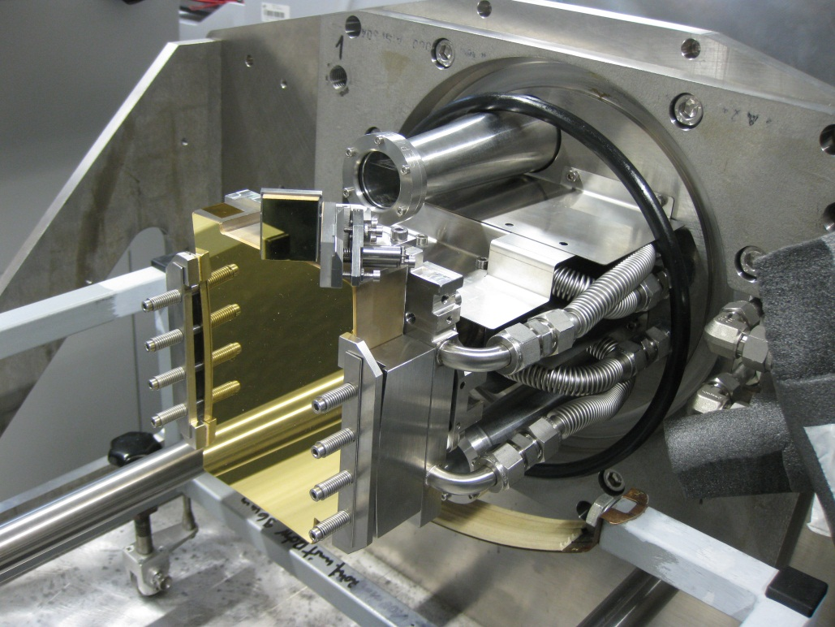
Multireflection cell
Designed at DLR 1991, refurbished 2012
80 cm base length, up to 200 m absorption path
Coolable down to 190 K, temperature homogeneity 1 K
Equipped for flow experiments with unstable species
Actively cooled mirrors, thermal shielding to separate ambient temperature flanges from cold gas between mirrors

Slide 16
Temperature homogeneity in refurbished multireflection cell
N₂O measurements for different total pressures
Line parameter retrieval and temperature/number density fit
Cell temperature for vacuum 197.2 K
Thermal conduction to warm flanges via gas leads to <2 K higher cell temperature
No systematic residuals in temperature/number density fit – example 100 mbar total pressure

Slide 17
Temperature homogeneity in refurbished multireflection cell
Agreement of cell and average gas temperature < 1 K, depending on total pressure
Difference T_{fit}-T_{cell} is a worst case measure for the temperature inhomogeneity
Actual temperature homogeneity may be better when gas in absorption volume is well mixed
All surfaces in contact with gas inside absorption volume are at the same temperature improving temperature homogeneity
Temperature homogeneity is excellent
P_{tot}/mbar | T_{cell}/K | T_{fit}/K | (T_{fit}-T_{cell})/K
100 | 198.71 | 198.853(61) | 0.143
200 | 198.73 | 198.981(56) | 0.251
500 | 198.96 | 199.817(75) | 0.857

Slide 18
Analysis software
Good instrumentation requires good analysis software
25 years of experience in spectral fitting of single spectra, further data reduction and extended quality assessment to ensure spectroscopic data with defined error bars
New multispectrum fitting tool developed benefiting from previous experience
  Ha line profile – i.a. including speed dependent and collisional narrowing
  Rosenkranz line mixing
  Several quality assurance routines – file cuts, χ tests
  Optional automatized microwindow and fitting parameter selection

Slide 19
Recent result with new analysis software: N₂O

Slide 20
Species | FIR | MIR/NIR | Purpose/application | Remark
O₃ | S, γ(T) | σ, S, γ(T), α(T,p) | MIPAS, NDACC, ACE
ClONO₂ |  | α(T,p) | MIPAS, Mark IV, ACE | difficult synthesis
BrONO₂ |  | α(T,p) | MIPAS | very difficult synthesis
N₂O₅ |  | α(T,p) | MIPAS, Mark IV, ACE
OH/HO₂ | σ |  | new methodology | extremely unstable
BrO | σ, γ(T) |  | MASTER/SOPRANO, MLS | extremely unstable
ClO | σ, γ(T) | σ, S | MASTER/SOPRANO, MLS | unstable
ClOOCl | σ | α(T,p) | MIPAS | sample preparation difficult
HOCl | σ |  | FIR database
CH₄ |  | S, γ(T), γ₂(T), LM | NDACC
CO | S, γ(T) | S, γ(T) | error characterisation, high temperature database, Q/A | <1% radiometric accuracy
CO₂ |  | α(T,p) | high temperature database
H₂O |  | σ, S, γ(T), γ₂(T), MIR+NIR | high temperature database improvement, climate, MIPAS, IASI, WALES, NDACC | sample preparation difficult
N₂O |  | γ, γ₂, LM | Basic research ☺
NO |  | σ, S, γ(T) | high temperature database, engine emissions
NO₂ |  | α(T,p) | high temperature database, engine emissions

Slide 21
Example for data quality: Water intensities in 1 µm region
NIST: cavity ringdown by Daniel Lisak and Joseph T. Hodges
HIT: HITRAN 2008, mainly experimental data by Robert A. Toth
Excellent agreement DLR-NIST, mostly <1%
HITRAN 2008 shows bias and large scatter
DLR intensities in Hitran 2012

Slide 22
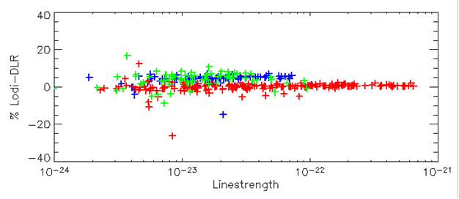
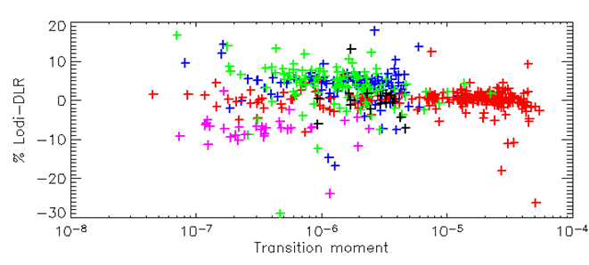
Example for data quality: Water intensities in 1 µm region
Lodi: ab initio calculations by J. Tennyson’s group
Good agreement for 2 0 1 ← 0 0 0 and 0 0 3 ← 0 0 0 with occasional outliers
Entire subbands shifted: 1 2 1 ← 0 0 0, 3 0 0 ← 0 0 0, 1 0 2 ← 0 0 0 up to 8%
Average differences
1 2 1 ← 0 0 0 4.1%
2 0 1 ← 0 0 0 0.0%
3 0 0 ← 0 0 0 4.0%
1 0 2 ← 0 0 0 -7.6%
0 0 3 ← 0 0 0 -0.1%
Notes:
Tennyson says: “My water line intensities are better than 1% but there is nobody to prove it” since he thought that “experiments are not good enough”. We had an intercomparison between 2 experiments (1µm water intensities from DLR and NIST) within stated uncertainties, mostly <1%. Tennyson – DLR <1% for a lot of fundamental and some overtone and combination band transitions, but other overtone and combination bands several % off, local resonances up to 50 % off. Anyway, agreement of 2 independent methods even for limited data set is good confirmation of data quality for both methods.

Slide 23
Summary and Conclusion
Current and future remote sensing instruments have demanding requirements regarding spectroscopic database
Remote sensing needs extended line profile, Voigt profile mostly not sufficient
To obtain spectroscopic data with quantified uncertainties dedicated hardware is required, especially temperature homogeneity is a key issue
  At DLR absorption cells were developed to ensure high temperature homogeneity
  Atmospheric relevant temperature range covered
  Absorption path 0.2 – 200 m
Multispectrum fitting tool developed with most recent line profiles
Example of line parameters with defined uncertainties: 1 µm H₂O intensities – agreement with other experimental work and theoretical calculations

