Slide 1
Cb-LIKE: thunderstorm forecasts up to 6 hrs with fuzzy logic
Martin Köhler
DLR Oberpfaffenhofen
8th European Conference on Severe Storms – ECSS 2015
14 – 18 September 2015, Wiener Neustadt, Austria

Slide 2
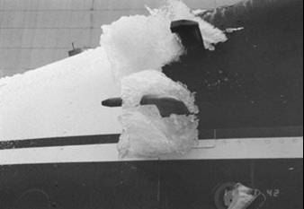
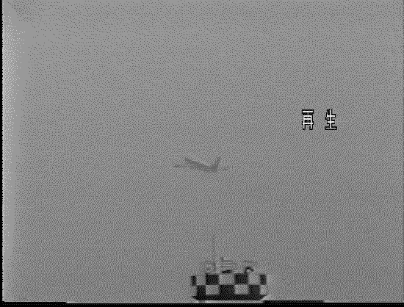
Long-term forecasts of thunderstorms – why?
-> Thunderstorms affect infrastructure such as commercial aviation
icing
lightning
hail
Adverse weather is responsible for 40-50% of all delays in Europe (Eurocontrol, 2007)
Thunderstorm activity is the reason for up to 90 % of all delays in the airspace over the USA during the summer months (Leighton, 2006)
Thunderstorms are the most dangerous weather phenomenon for aviation (survey with pilots)
Reliable long-term thunderstorm forecasts could help to increase safety and efficiency for air traffic

Slide 3
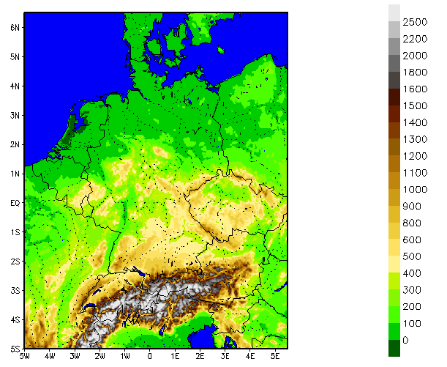
Cb-LIKE – Basic information
Cb-LIKE: Cumulonimbus LIKElihood
-> Calculation storm forecasts up to 6 hrs
Data source: COSMO-DE model
-> Nonhydrostatic NWP model operationally driven by DWD
-> High resolution (2.8 km), no parameterization of deep convection
Method: fuzzy logic
-> Combination of model data and calculation of final forecasts
http://www.cosmo-model.org/

Slide 4
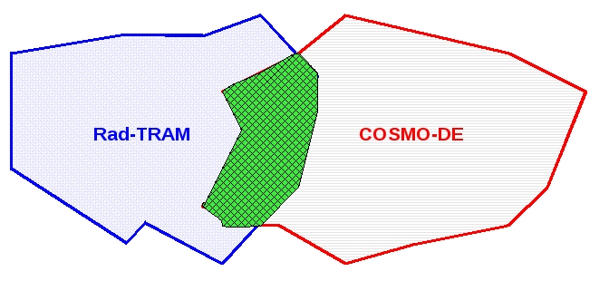
Cb-LIKE – Best-Member-Selection
Automatic selection of the best member of a COSMO-DE time-lagged ensemble including last 5 model runs
Best-Member: model run which matches best the current weather situation
Comparison:
Rad-TRAM* objects (37 dBZ) COSMO-DE radar objects (37 dBZ)
Object or pixel comparisons are available
Goal: Provision of the best data basis for calculating of the storm forecasts
* Rad-TRAM = Radar – TRacking And Monitoring (Kober & Tafferner, 2009)

Slide 5
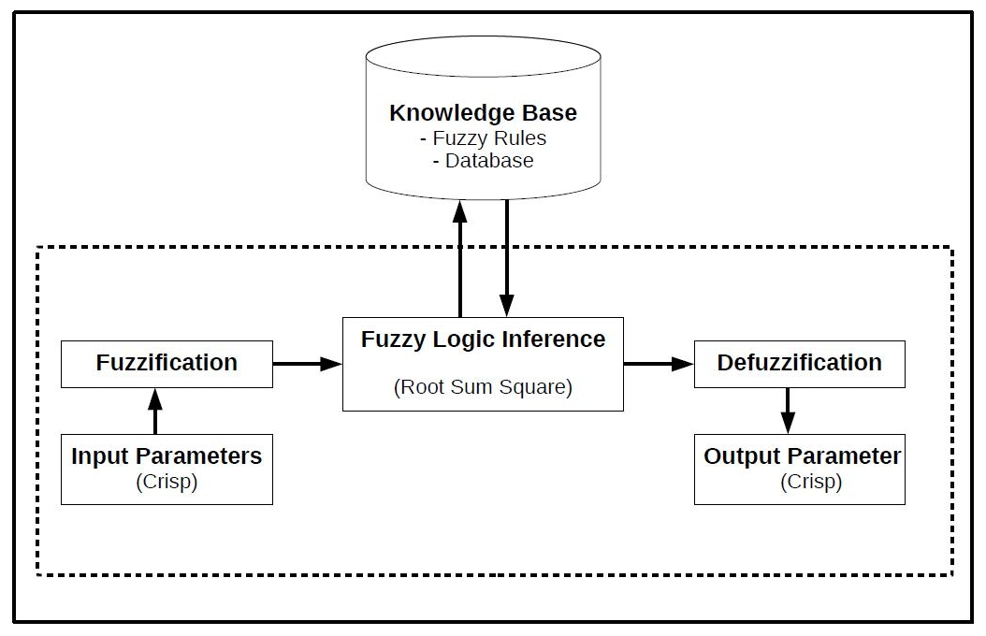
Cb-LIKE – Fuzzy logic system: general information
Djam et al., 2011
3 main steps: fuzzification, fuzzy logic inference and defuzzification

Slide 6
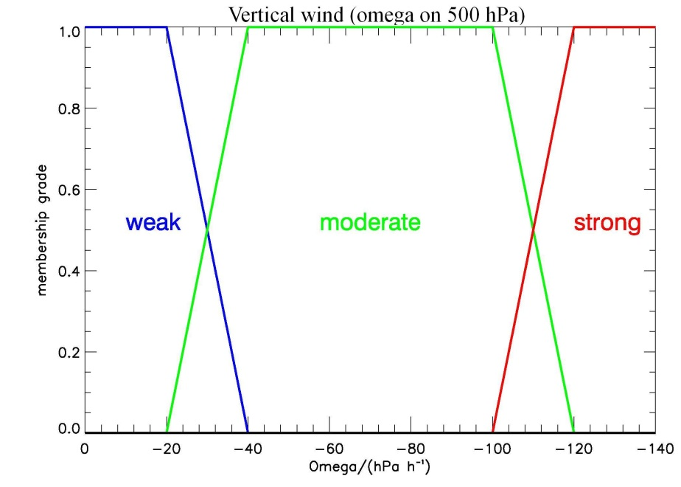
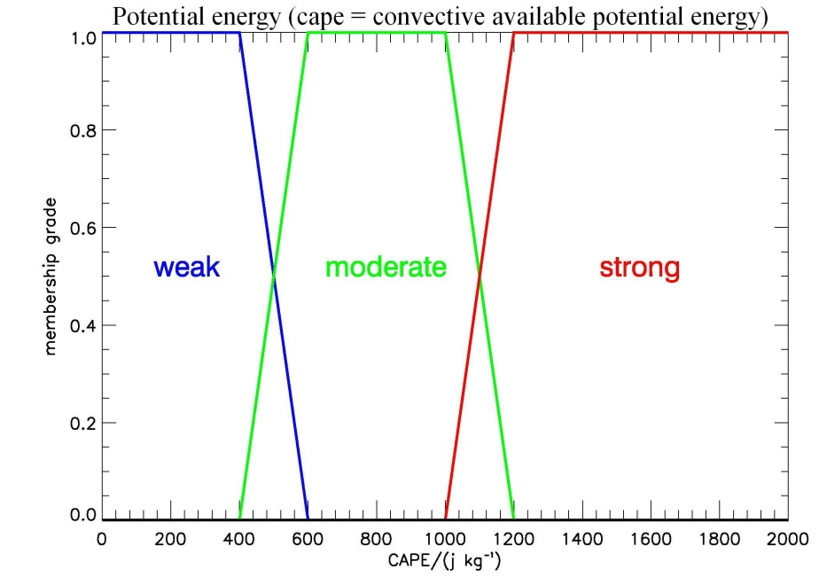
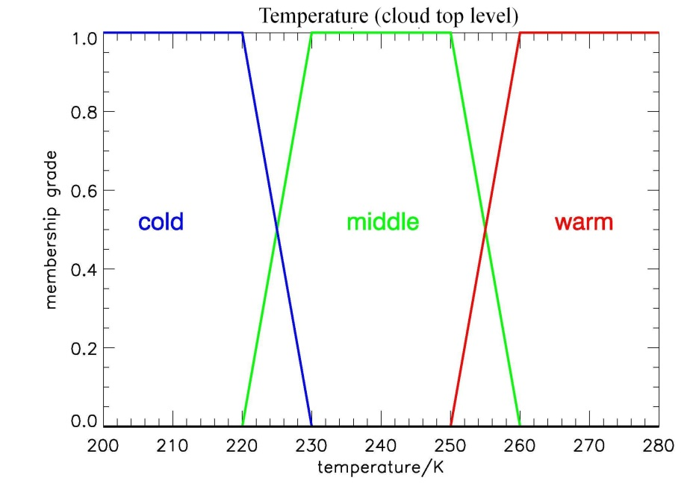
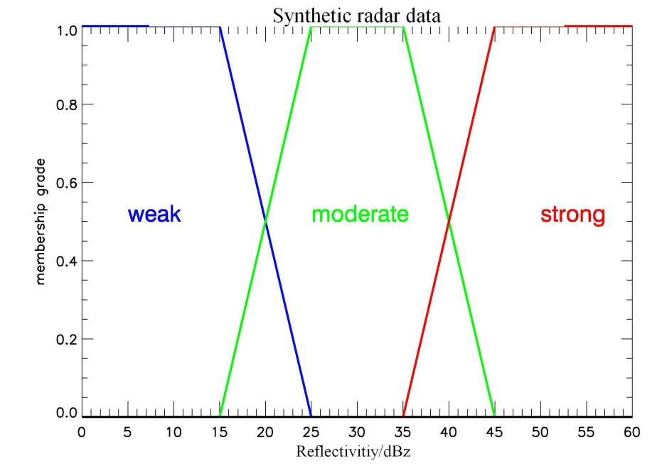
Cb-LIKE – Fuzzy logic system: input sets
4 parameters: CAPE, Omega (500 hPa), cloud top temperature, radar reflectivity

Slide 7
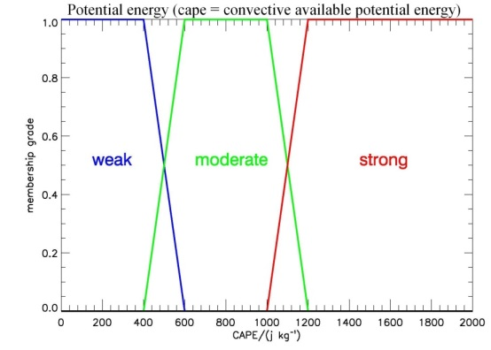
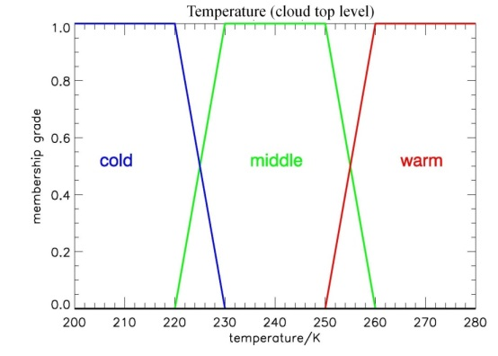
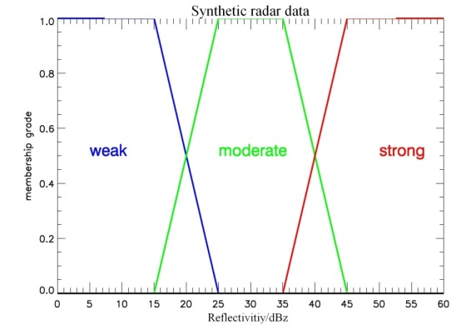
Cb-LIKE – Fuzzy logic system: rule base
Combination of weighted input sets within an „if … then“ decision rule base
if OMEGA_strong and CAPE_strong and CTT_cold and Reflectivity_strong then

Slide 8
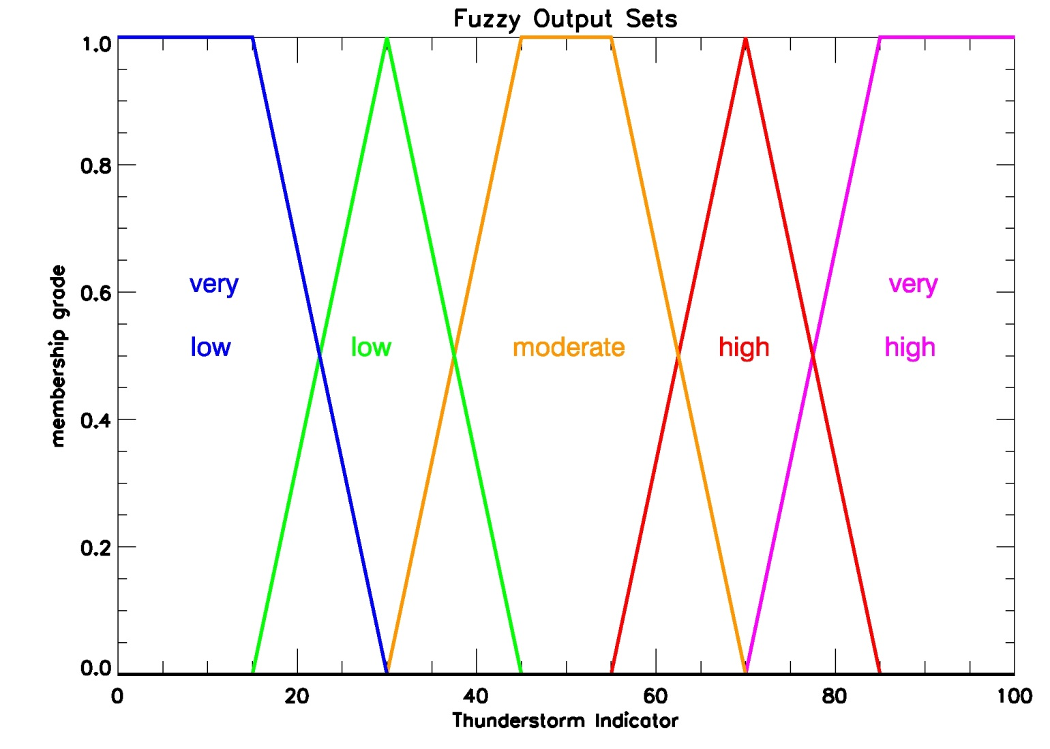
Cb-LIKE – Fuzzy logic system: output sets
Calculation of the crisp output value (thunderstorm indicator) using the different weightings of the output sets

Slide 9
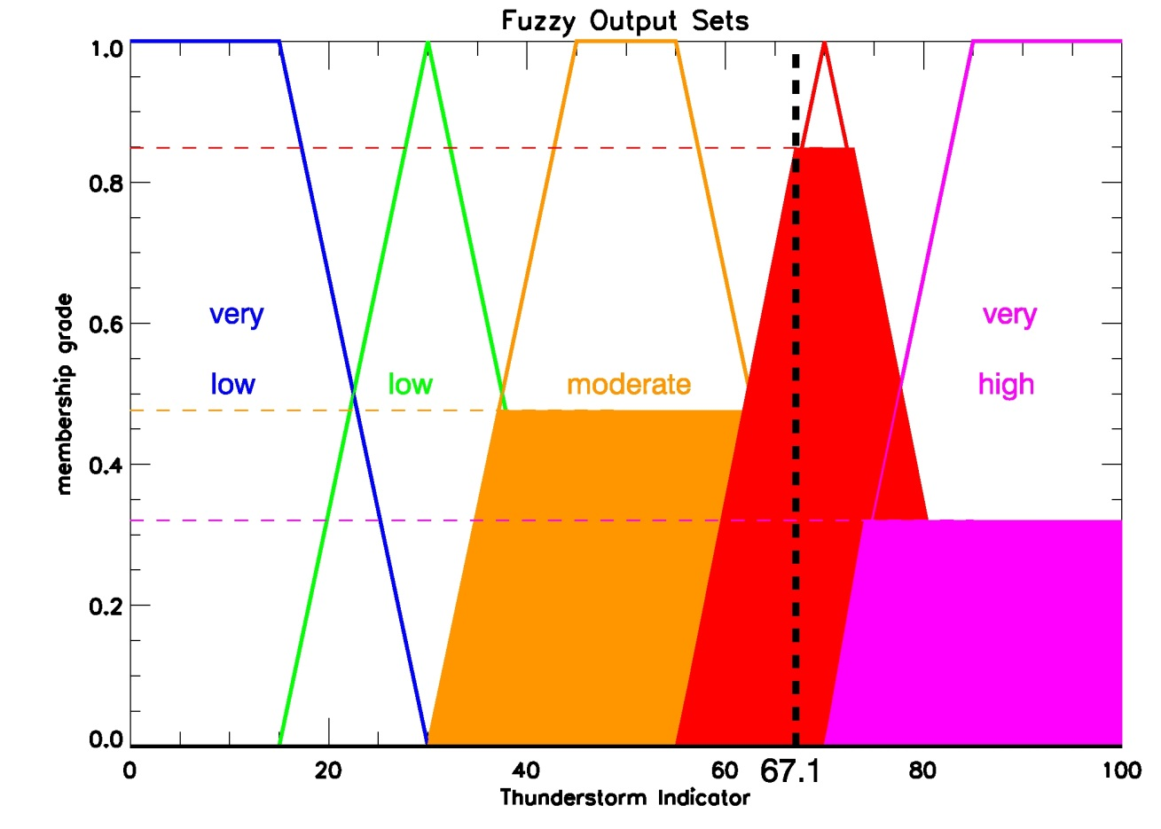
Cb-LIKE – Fuzzy logic system: example
Example values:
CAPE: 950 j/kg
Omega: - 98.0 hPa/h
CTT: 228 K
Radar: 41.0 dBZ
→ Thunderstorm indicator: 67.1

Slide 10
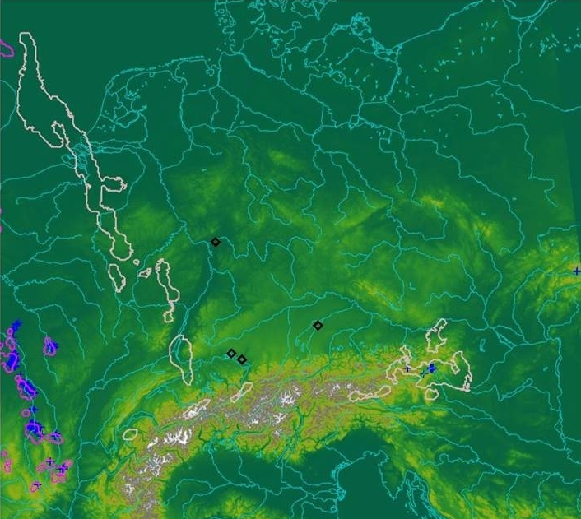
Cb-LIKE: case example
→ 06/11/2012: storm situation at 1200 UTC + 6 hrs forecast

Slide 11
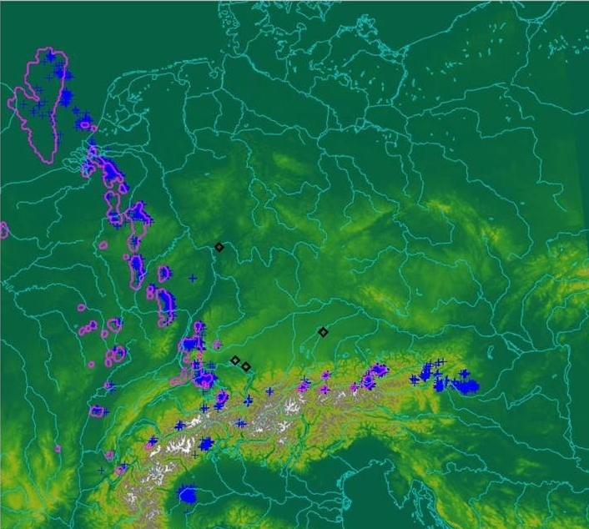
Cb-LIKE: case example
→ 06/11/2012: storm situation at 1800 UTC

Slide 12
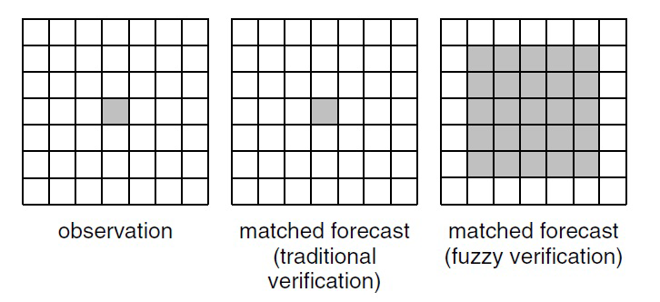
Cb-LIKE – Verification: basic setting
Observation data: Rad-TRAM; Forecast data: Cb-LIKE, COSMO-DE radar refl.
Type of comparison: object-based; Domain: Germany (ca. 400.000 km²);
Time: summer period 2012 (122 Days); Forecast steps: 1-6 hrs in hourly intervals
Approach: Neighborhood Method (e.g. Ebert, 2006)
No longer box-to-box comparison
Spatial distance between forecast
and observation can be taken into
account
Distinction between better and
poorer placed forecasts
-> depends on the size of the neighborhood
Ebert, 2008

Slide 13
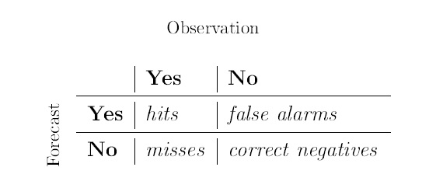
Cb-LIKE – Verification: results
Verification scores:
FAR = false arms/(hits + false alarms)
POD =hits/(hits + misses)
BIAS = (hits + false alarms)/(hits + misses)
CSI = hits/(hits + misses + false alarms)
Contingency table:
Tuned to a BIAS=1, Cb-LIKE shows better results in relation to the COSMO-DE radar reflectivity

Slide 14
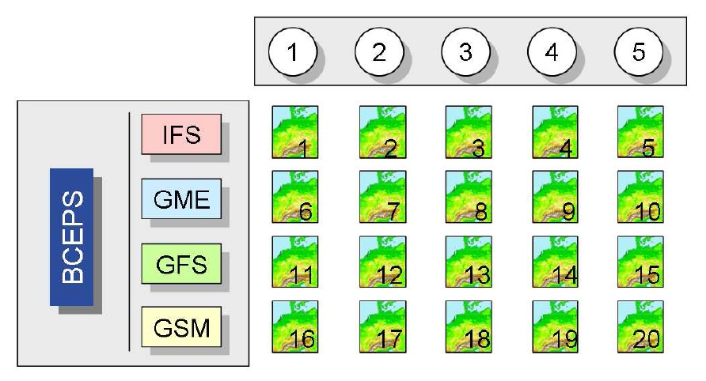
Cb-LIKE - Outlook
Application of additional meteorological parameters:
Vertical wind shear, solar radiation
Jetstream divergence, orographic forcing
Usage of COSMO-DE EPS:
20 members per model run
More input for Best-Member-Selection
Theis et al., 2012
Tuning of the fuzzy logic system:
Different shapes of input/output sets (e.g. bell curves)
Different weightings of input parameters (dependent on weather situations)

Slide 15
Thank you for your attention!
martin.koehler@dlr.de

Slide 16
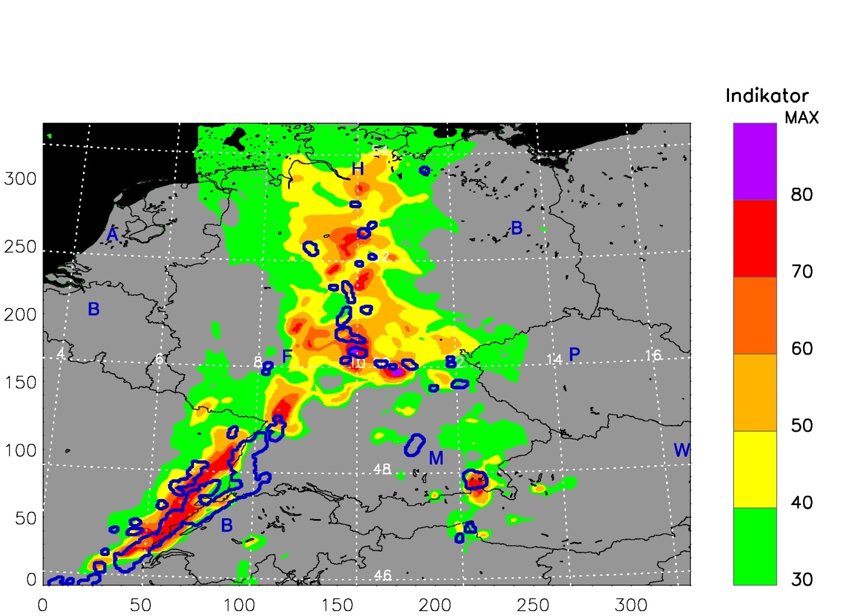
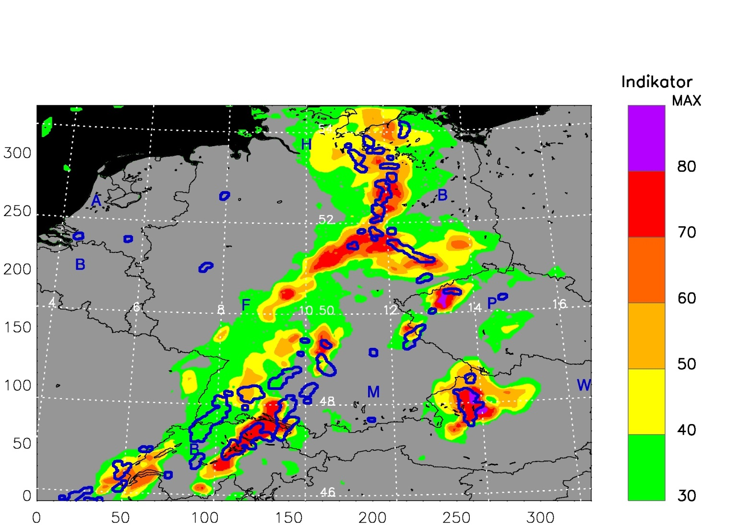
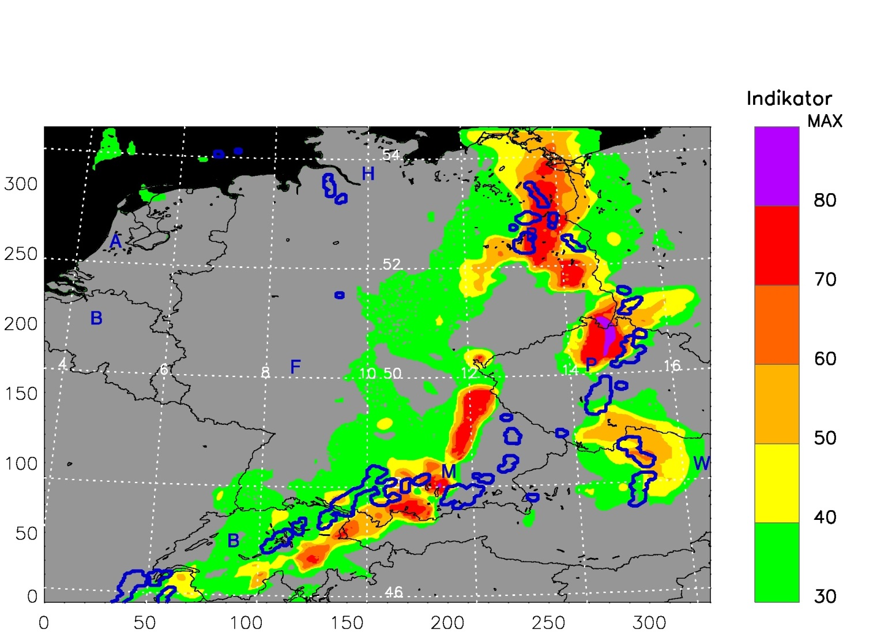
Cb-LIKE – Fuzzy Logic System: Example 2
Blue contours: Rad-TRAM observations
Colourful surfaces: Cb-LIKE forecasts (COSMO-DE model run 1200 UTC)
22/06/2011 – 1600 UTC -> 4 hrs forecast
22/06/2011 – 1800 UTC -> 6 hrs forecast
22/06/2011 – 1400 UTC -> 2 hrs forecast
Indicator

Slide 17
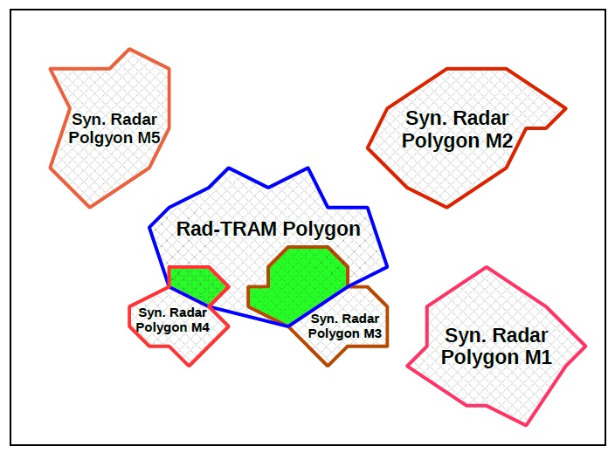
Cb-LIKE – Best-Member-Selection: example
Best-Member: M3 which is the youngest member overlapping with the Rad-TRAM object

Slide 18
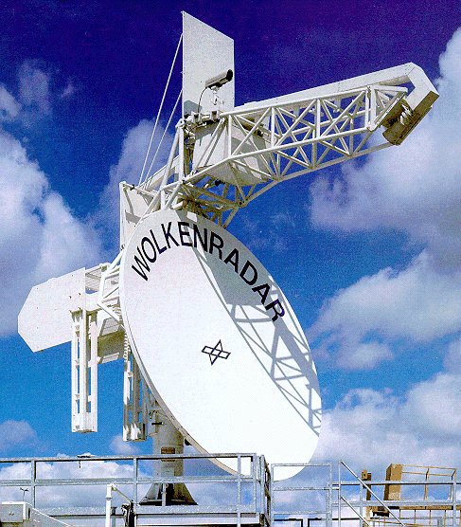
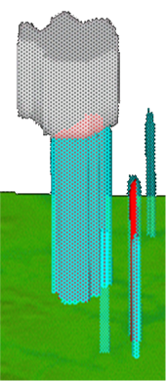
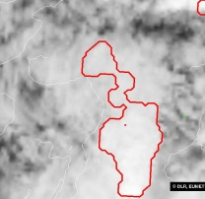
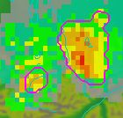
Weather Forecast User-oriented System Including Object Nowcasting
Predicting the future state of a weather object through:
Nowcast based on extrapolation methods
Forecast based on NWP models
(ensemble model and high resolution forecasts)
Selection of the forecast that agrees best with the observation
Cloud tracker
POLDIRAD
Lightning
Surface Analysis
Radar tracker
weather object
specification
oriented at user
requirements
Initiation
Track
Nowcast
Forecast
forecast validation
forecast validation
Object
Comparison
SYNSAT
COSMOairport
Object
Comparison
COSMO-DE
& Ensemble
SYNRAD
Local
forecasting
Tafferner et al., 2012

Slide 19
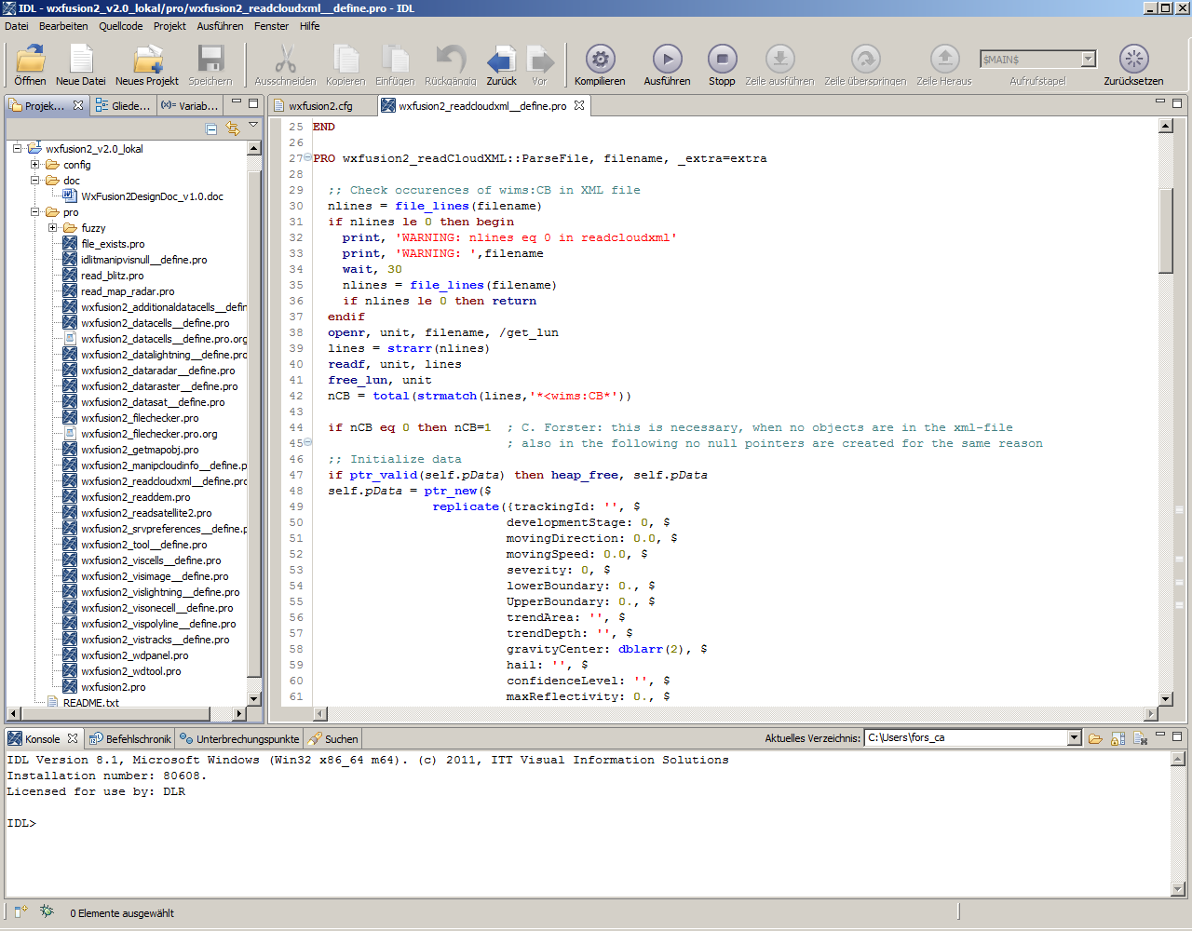
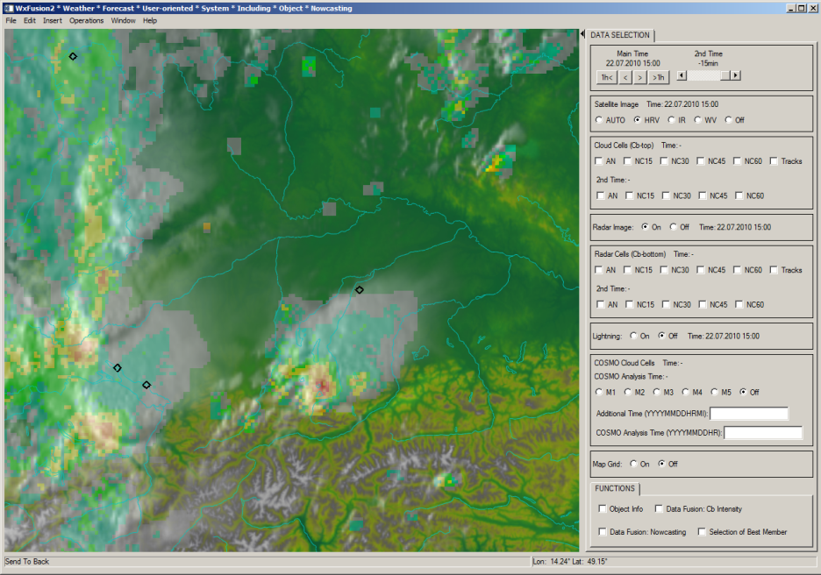
IDL: the platform to realize the WxFUSION concept
IDL …
is a platform for data analysis and visualization
provides a means to easily describe weather objects as well as their attributes
provides an effective platform to integrate and overlay different data sources
enables a quick analysis of the changes made in a WxFUSION algorithm
is highly specialized for the processing and display of geospatial imagery

Slide 20
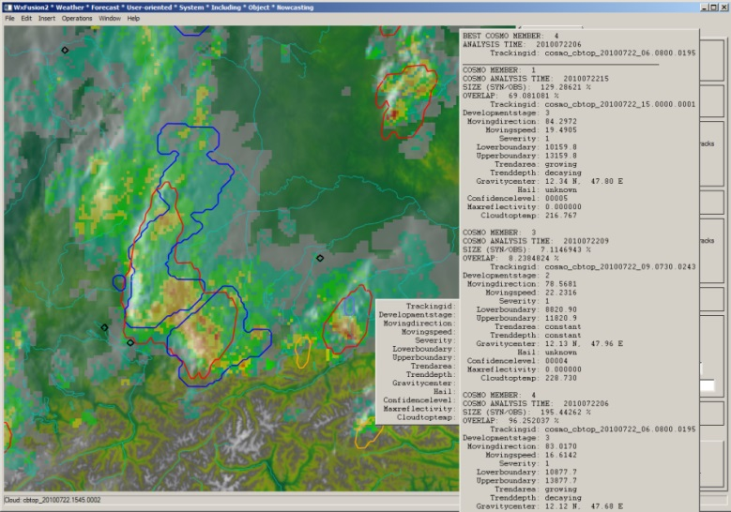
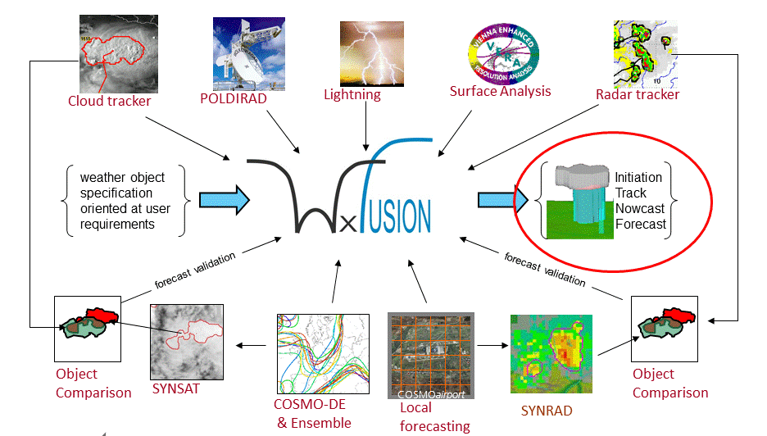
Summary
WxFUSION
integrates and overlays data from different tools and data sources (observations, nowcasts, forecasts)
uses an object-oriented approach
selects the best forecast out of an ensemble
combines data by using fuzzy logic
enables user-oriented nowcast and short range forecasts for up to 6 hrs
modules of WxFUSION have successfully been tested in real time at Munich Airport

Slide 21
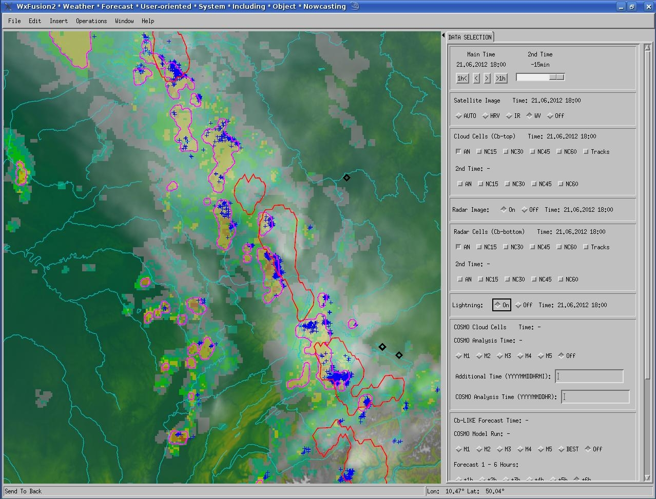
WxFUSION – Data example

Slide 22
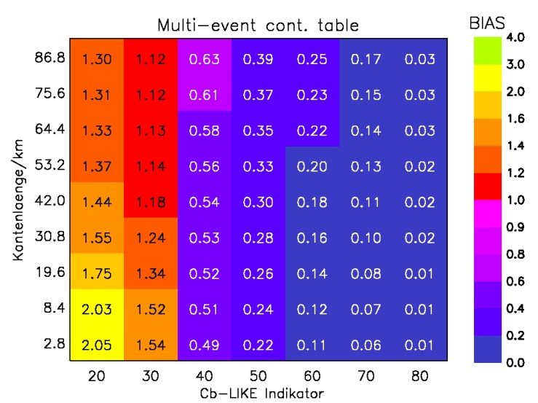
Cb-LIKE: BIAS for neighborhood/threshold ensemble

Slide 23
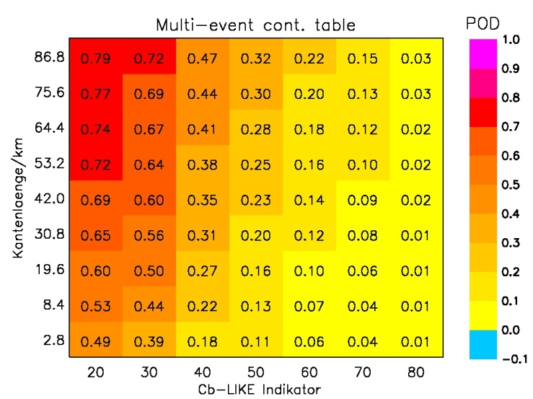
Cb-LIKE: POD for neighborhood/threshold ensemble

Slide 24
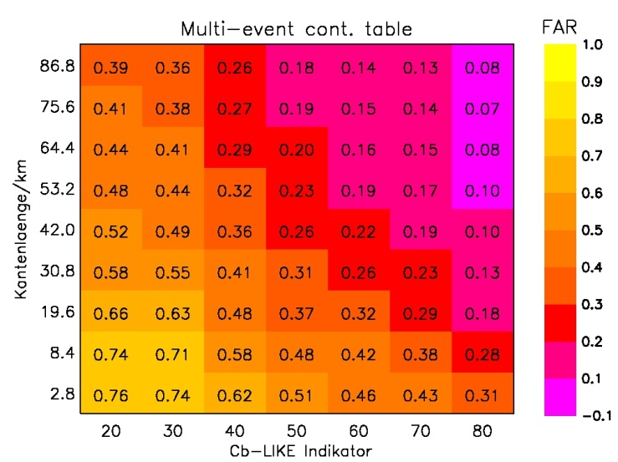
Cb-LIKE: FAR for neighborhood/threshold ensemble

Slide 25
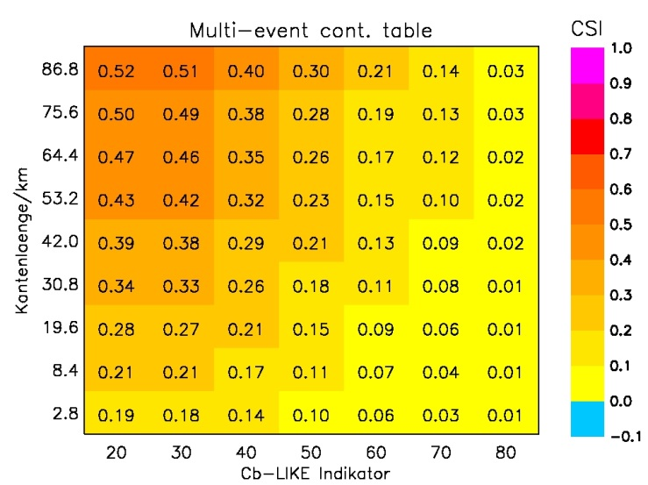
Cb-LIKE: CSI for neighborhood/threshold ensemble

Slide 26
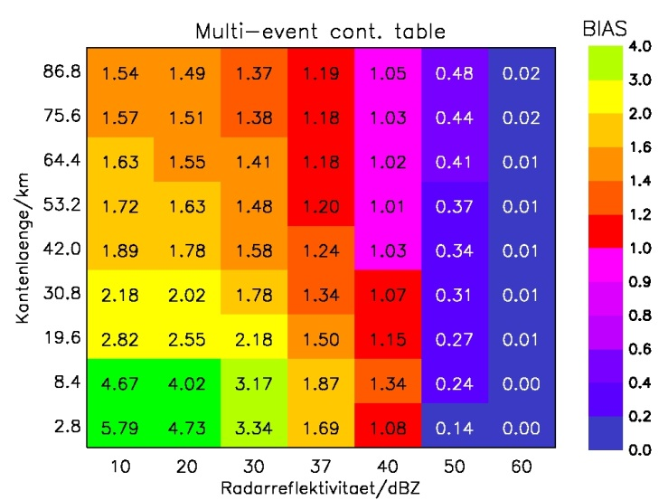
COSMO-DE refl.: BIAS for neighborhood/threshold ensemble

Slide 27
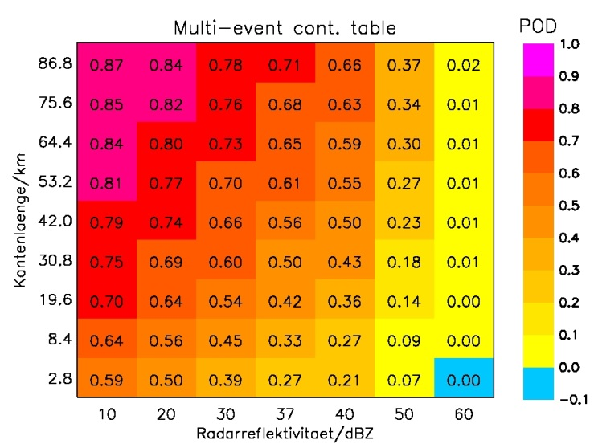
COSMO-DE refl.: POD for neighborhood/threshold ensemble

Slide 28
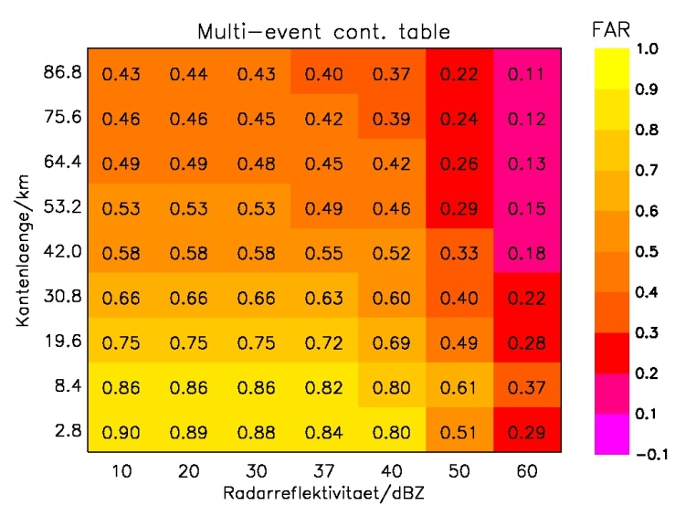
Cb-LIKE: FAR for neighborhood/threshold ensemble

Slide 29
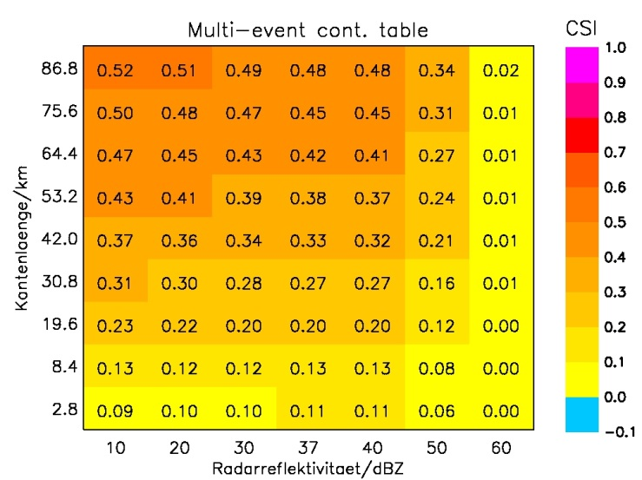
COSMO-DE refl.: CSI for neighborhood/threshold ensemble

Slide 30
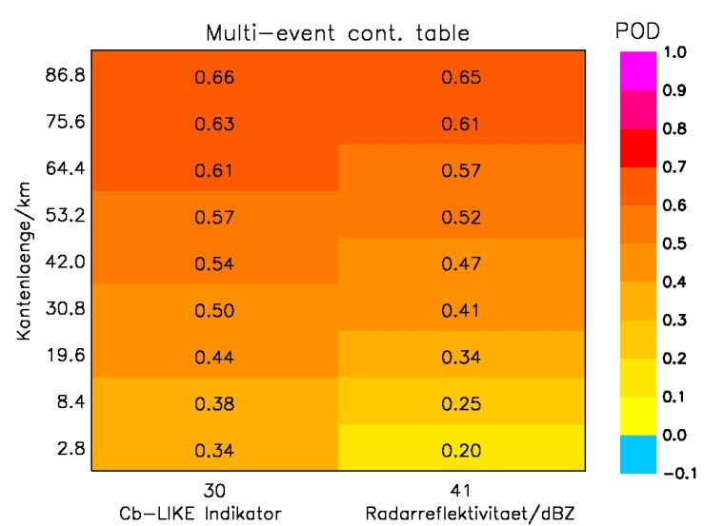
Comparison between Cb-LIKE/COSMO-DE reflectivity - POD

Slide 31
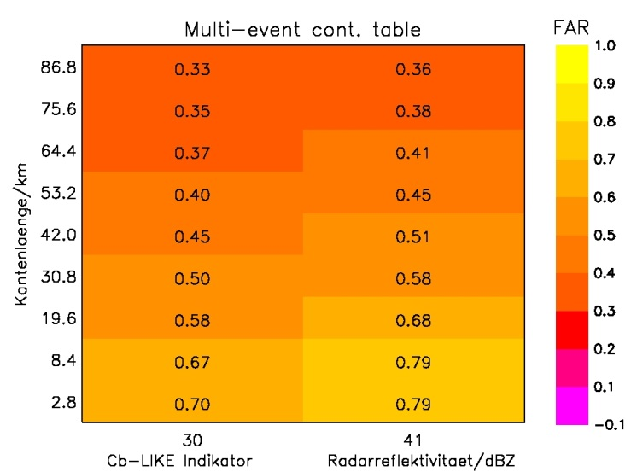
Comparison between Cb-LIKE/COSMO-DE reflectivity - FAR

Slide 32
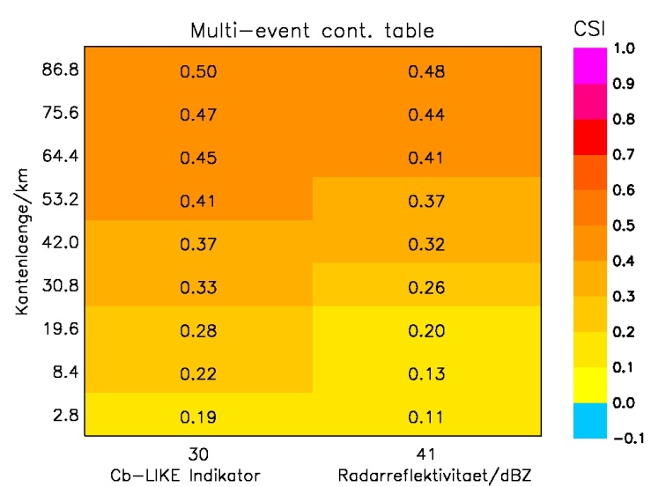
Comparison between Cb-LIKE/COSMO-DE reflectivity - CSI

Slide 33
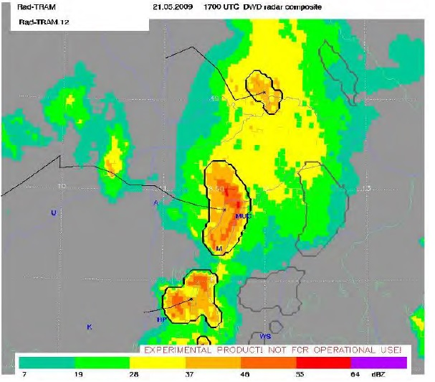
Rad-TRAM - general information

Slide 34
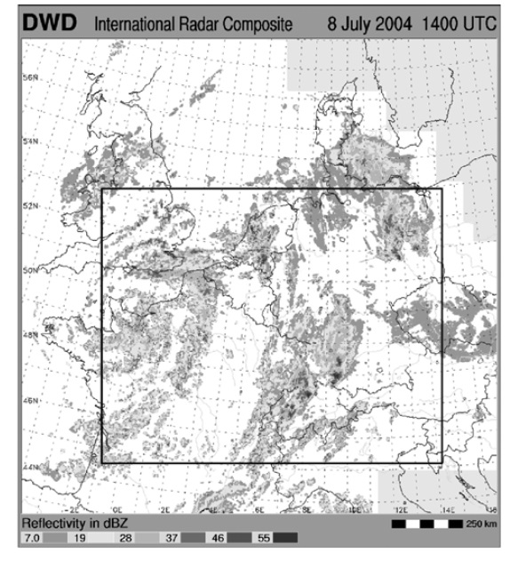
Rad-TRAM – General information II

Slide 35
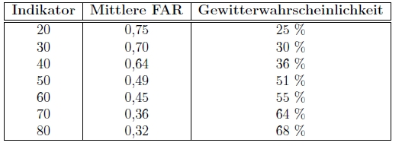
Cb-LIKE: transformation to PROBABILITY
Transformation of indicator to thunderstorm probability by using Success Ratio (1-FAR):
False/(Hits+False Alarms)

Slide 36
Cb-LIKE: references
Leighton, Q. (2006). Modeling and Simulation Needs for Next Generation Air
Transportation System Research. AIAA Modeling and Simulation Technologies
Conference and Exhibit, Keystone, CO, 21-24 August 2006, AIAA 2006-6109,
1-8.
Eurocontrol (2007). Performance Review Commission, 2007: Performance
Review Report 2006. 160 pp., verfügbar unter
https://www.eurocontrol.int/sites/default/files/content/documents/singlesky/
pru/publications/prr/prr-2006.pdf.
Djam, X. Y., Wajiga, G. M., Kimbi, Y. H., & Blamah, N. V. (2011). A Fuzzy
Expert System for the Management of Malaria. Int. J. Pure Appl. Sci. Technol.,
5(2), 84–108.
Kober, K. & Tafferner, A. (2009). Tracking and Nowcasting of convective cells
using remote sensing data from radar and satellite. Meteorol. Zeitschrift, 1,
75–84.

Slide 37
Cb-LIKE: references
Ebert, E. E. (2006). Fuzzy Forecast Verification. MAP D-PHASE workshop,
Novemer, 6-8, 2006.
Ebert, E. E. (2008). Fuzzy Verification of high-resolution gridded forecasts: a
review and proposed framework. Meteorol. Appl., 15, 51–64
Theis, S. E., Hense, A., & Damrath, U. (2005). Probabilistic precipitation forecasts
from a deterministic model: a pragmatic approach. Meteorol. Appl., 12,
257–268.

Slide 38
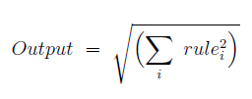
Cb-LIKE: Root-Sum-Square (RSS)
- Next step: calculation of the average weigth of all rules for each fuzzy output set → Weighting of each fuzzy output set
- Used method: Root-Sum-Square (RSS)
→ Formular RSS:

