Slide 1
Development of a solar driven tube receiver to superheat steam for the high temperature electrolysis
Stefan Breuer, Dennis Thomey DLR Institute for Solar research

Slide 2
Content
Overview
Designstudy
Thermal balancing
Constructing and assembling the receiver
Outlook

Slide 3
Overview
Overall Process
Development and experimental analysis
of a solar receiver in the DLR high flux solar simulator
2011-14
2012-14
Techno-economic analysis:
Flowsheeting and simulation of a MW-scale facility.

Slide 4
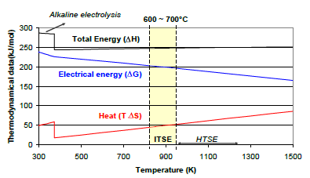
Overview
Motivation (HTE)
Electrical energy demand drops
Heat demand rises
Total demand rises very few
Overall efficiency improves at
higher temperature

Slide 5
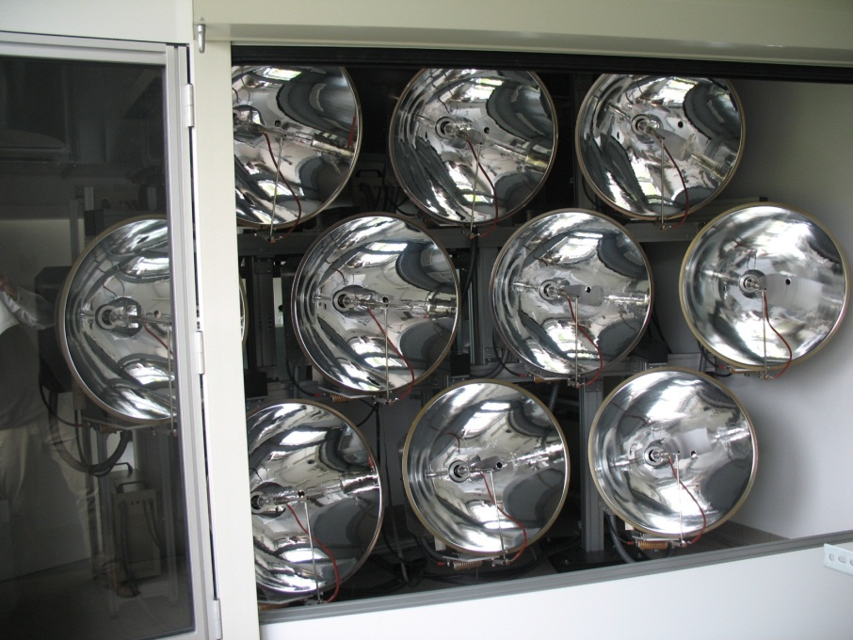
Overview
Solarsimulator
Solar Simulator in Cologne
10 Xenon Lamps
Max. peak power output at 36 kW
90% radiation hits target of 9 cm
Max solar flux density ~5 MW/m²
Implementing a shutter system for flux control

Slide 6
Designstudy volumetric and tubular differences
Volumetric Receiver | Tubular Receiver
Open system:
window needed
Closed system:
no window needed
Sealing problems with window
Lots of tube connectors
Extrusion of monolith structure
Use of standard parts (tubes)
SiSiC Structure
High temperature steel/alloy

Slide 7
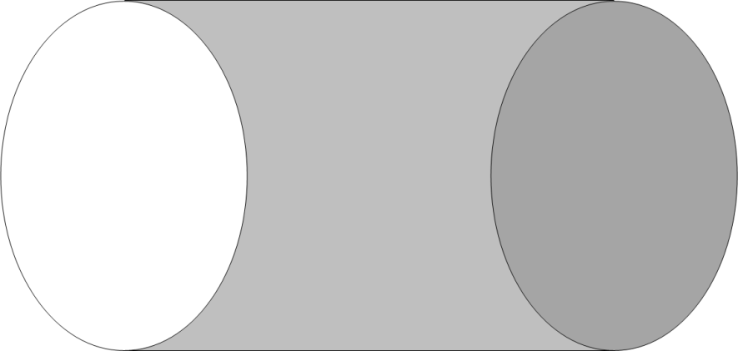
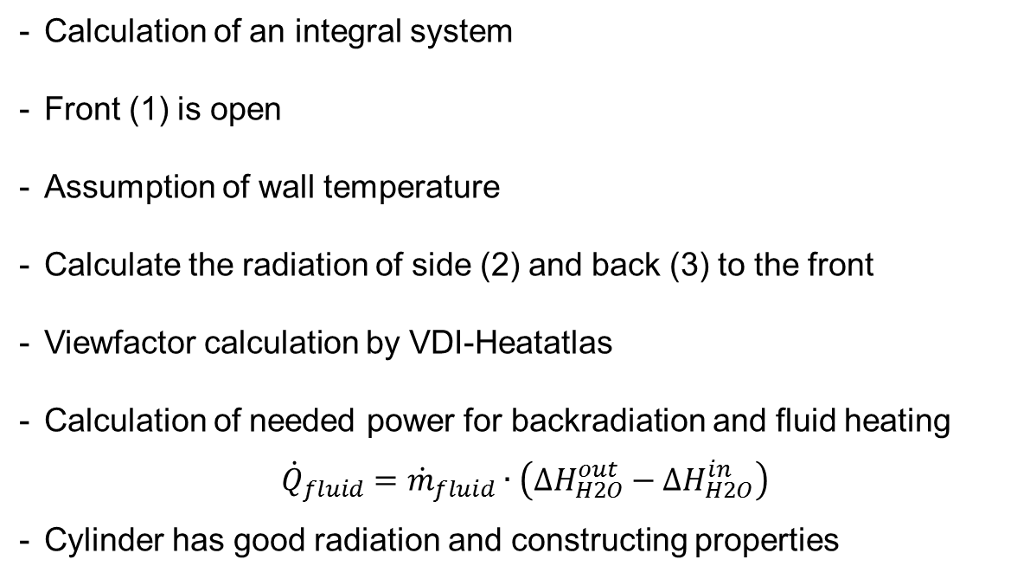
Thermal balancing
geometrical layout - integral calculation
Calculation of an integral system
Front (1) is open
Assumption of wall temperature
Calculate the radiation of side (2) and back (3) to the front
Viewfactor calculation by VDI-Heatatlas
Calculation of needed power for backradiation and fluid heating
$${\dot{Q}}_{fluid}={\dot{m}}_{fluid}∙\left({∆H}_{H2O}^{out}−{∆H}_{H2O}^{in}\right)$$
Cylinder has good radiation and constructing properties
2
1
3

Slide 8
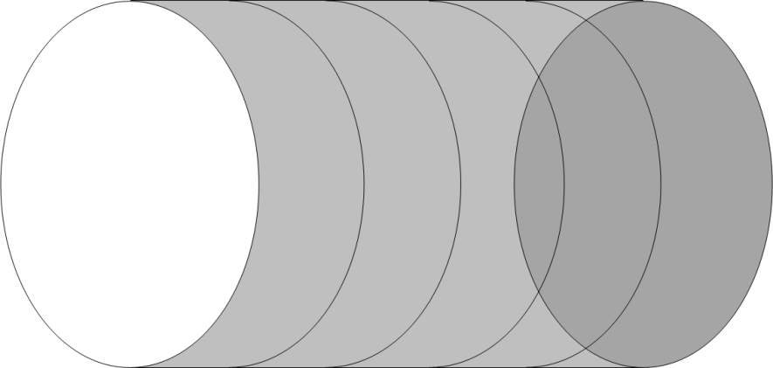
Thermal balancing
thermal layout - differential calculation
2
Segmentation into 10 ringelements
View factors calculated by MATLAB®
Wall temperature calculation via
ray tracing (OptiCAD ®)
Convectional heat transfer onto fluid per ringelement
Radiation heat exchange calculation
Implementing a flux-density controller (shutter-system)
2.1
2.2
2.3
2.4
2.n
1
3

Slide 9
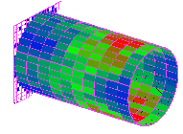

Thermal balancing
calculation methods - ray tracing
Raytracing executed by OptiCAD
Implemented solar simulator data
Division of wall into 10 ringelements with each 40 segments
Summation of incoming power per ringelement
Focus distance variation for optimized usage of incoming radiation

Slide 10
Thermal balancing
Thermal balancing - focus variation for incoming power

Slide 11
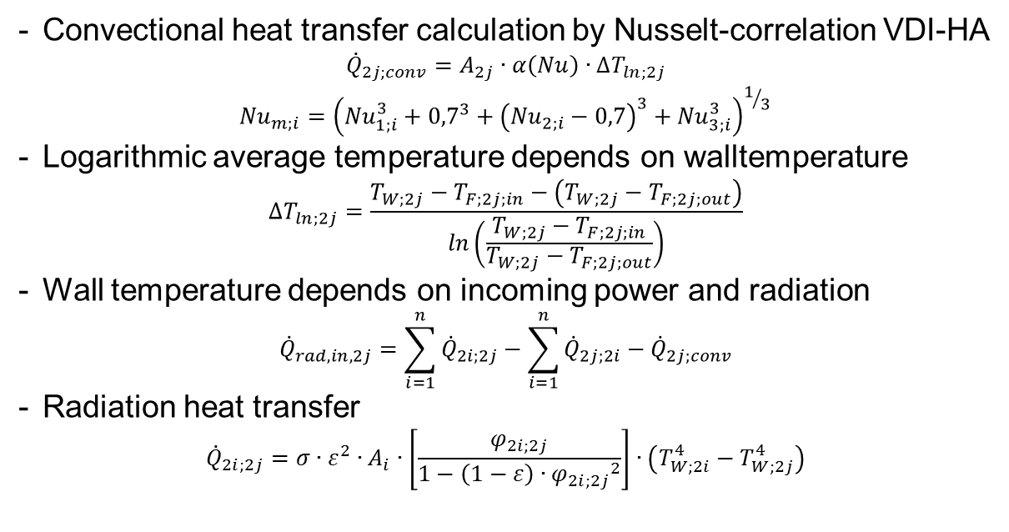
Thermal balancing
calculation methods - heat transfer
Convectional heat transfer calculation by Nusselt-correlation VDI-HA
$${\dot{Q}}_{2j;conv}=A_{2j}∙α\left(Nu\right)∙∆T_{ln;2j}$$
$${Nu}_{m;i}={\left({Nu}_{1;i}^{3}+{0,7}^{3}+{\left({Nu}_{2;i}−0,7\right)}^{3}+{Nu}_{3;i}^{3}\right)}^{1/3}$$
Logarithmic average temperature depends on walltemperature
$$∆T_{ln;2j}=\frac{T_{W;2j}−T_{F;2j;in}−\left(T_{W;2j}−T_{F;2j;out}\right)}{ln\left(\frac{T_{W;2j}−T_{F;2j;in}}{T_{W;2j}−T_{F;2j;out}}\right)}$$
Wall temperature depends on incoming power and radiation
$${\dot{Q}}_{rad,in,2j}=\sum_{i=1}^{n}{{\dot{Q}}_{2i;2j}}−\sum_{i=1}^{n}{{\dot{Q}}_{2j;2i}}−{\dot{Q}}_{2j;conv}$$
Radiation heat transfer
$${\dot{Q}}_{2i;2j}=σ∙ε^{2}∙A_{i}∙\left[\frac{φ_{2i;2j}}{1−\left(1−ε\right)∙{φ_{2i;2j}}^{2}}\right]∙\left(T_{W;2i}^{4}−T_{W;2j}^{4}\right)$$

Slide 12
Designing a test receiver for use in the
Thermal balancing - variation of mass flow (example calculation)

Slide 13
Constructing and assembling
Engingeering - construction & development
Construction was carried out in a 3D CAD system
Material research for high temperature steel (1.4841)
Insulation material used for building the cavity (Al₂O₃)
Implementing the measurement sensors for temperature & pressure
Programming a controlling system with LabView®

Slide 14
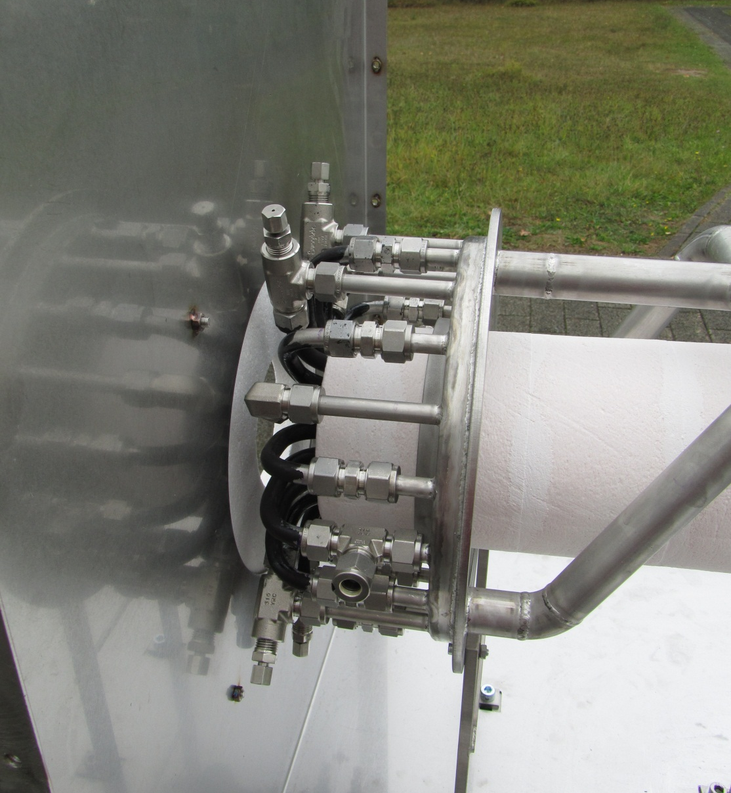
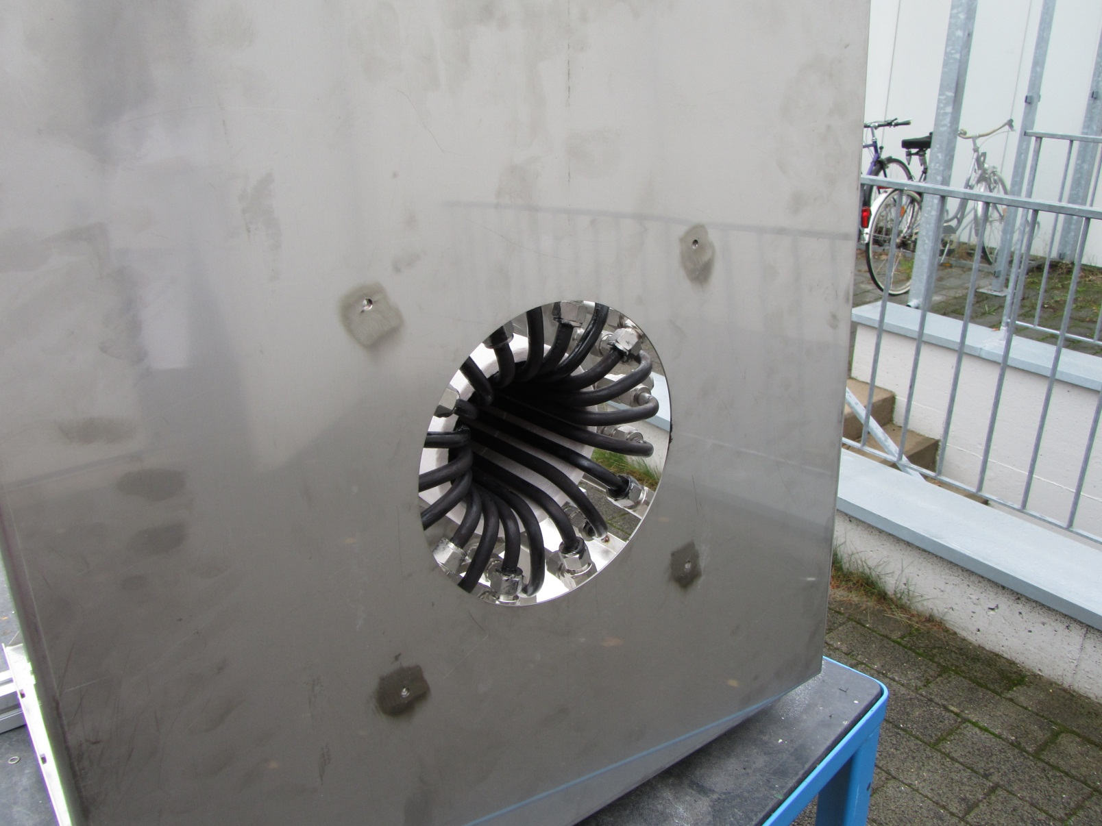
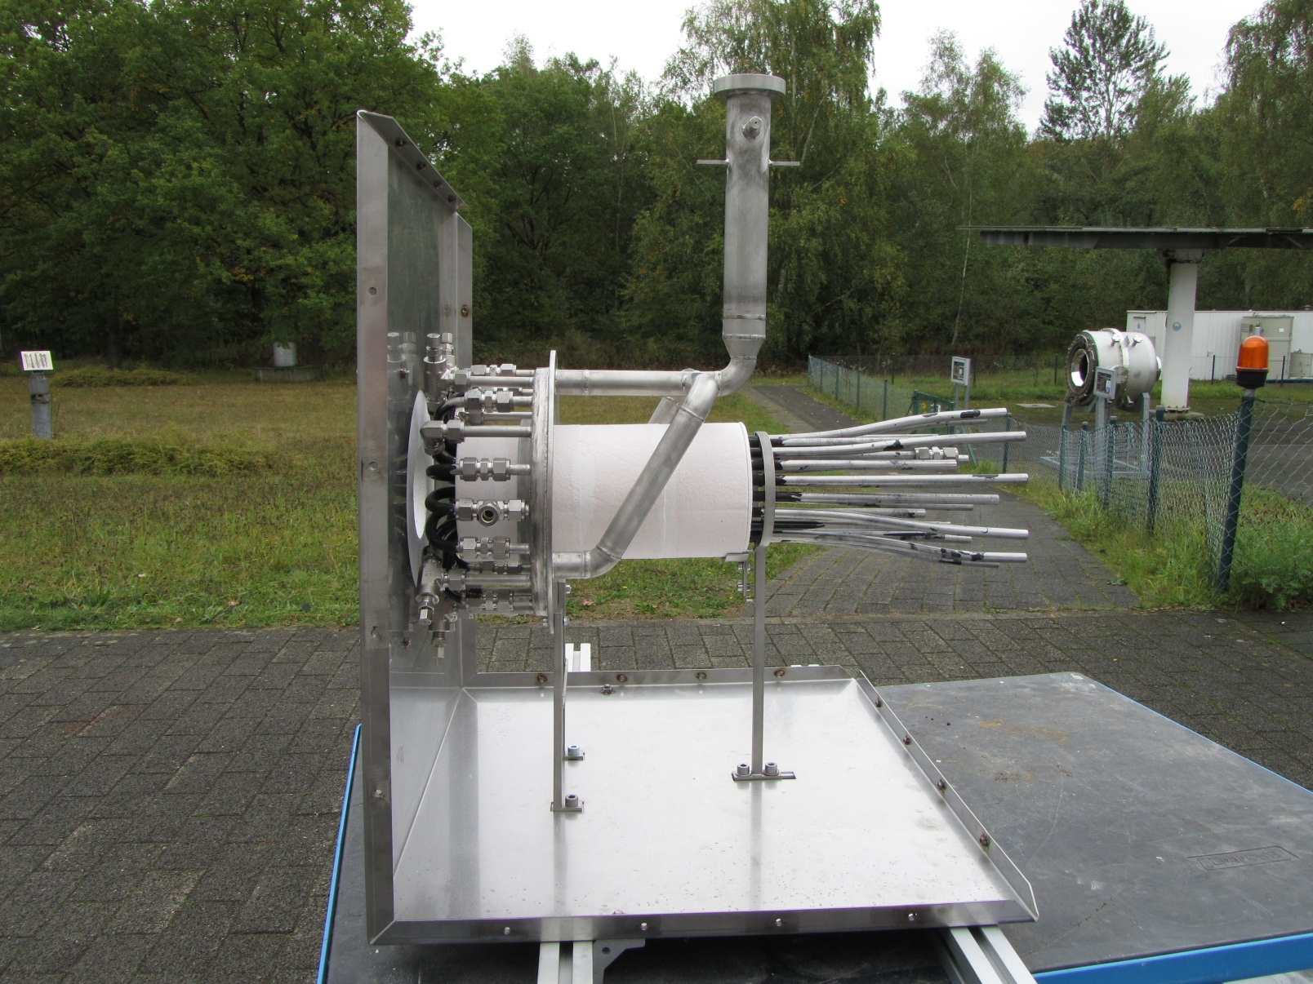
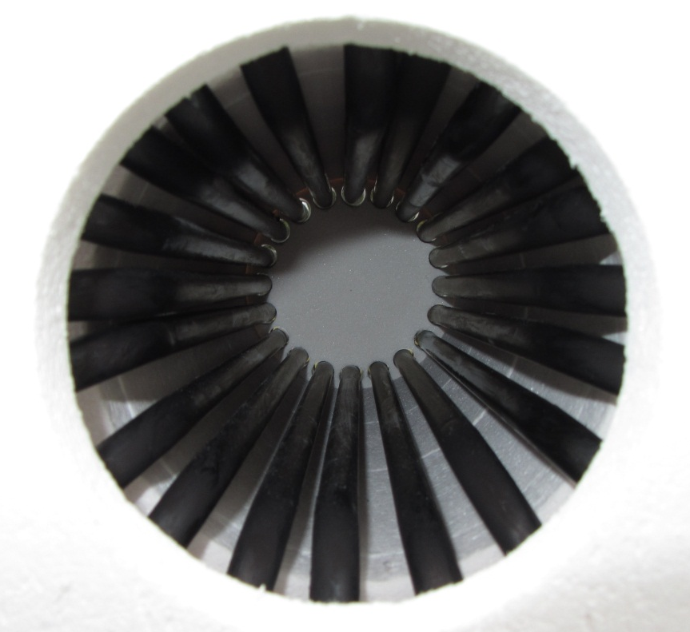
Constructing and assembling
Engingeering - assembling the receiver for solar simulator
Thermocouples
Steam outlet
Solar radiation
Steam inlet
Pressure measurement

Slide 15
Outlook
Thermal test campains will be executed in november and december
Bilancing of the existing system with experimental data
Optimizing the system with experimental results
Build a full high temperature electrolysis cycle
Improve the receiver and rebuild it with newly adapted data

Slide 16
Solar driven tubular heat exchanger
Thank you for your attention!

