Slide 1
Sentinel 5 Precursor Ozone Column products
K.-P. Heue¹, J. Xu¹, D. Loyola¹, P. Valks¹, C. Lerot², M. Van Roozendael², J.-C. Lambert², K Garane³, M. Koukouli³, D. Balis³, A. Delcloo⁴
1) Institut für Methodik der Fernerkundung am Deutschen Zentrum für Luft- und Raumfahrt (DLR), Oberpfaffenhofen, Germany
2) Koninklijk Belgisch Instituut voor Ruimte-Aeronomie / Institut royal d'Aéronomie Spatiale de Belgique, Brussels, Belgium
3) Laboratory of Atmospheric Physics, Aristotle University of Thessaloniki, Thessaloniki, Greece
4) Institut Royal Météorologique / Koninklijk Meteorologisch Instituut, Brussels, Belgium
Brussels, Belgium

Slide 2
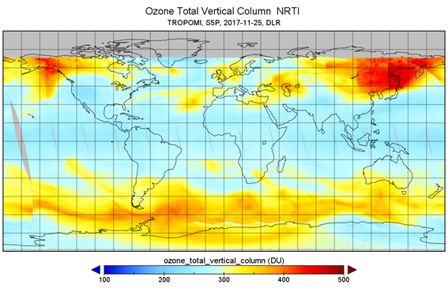
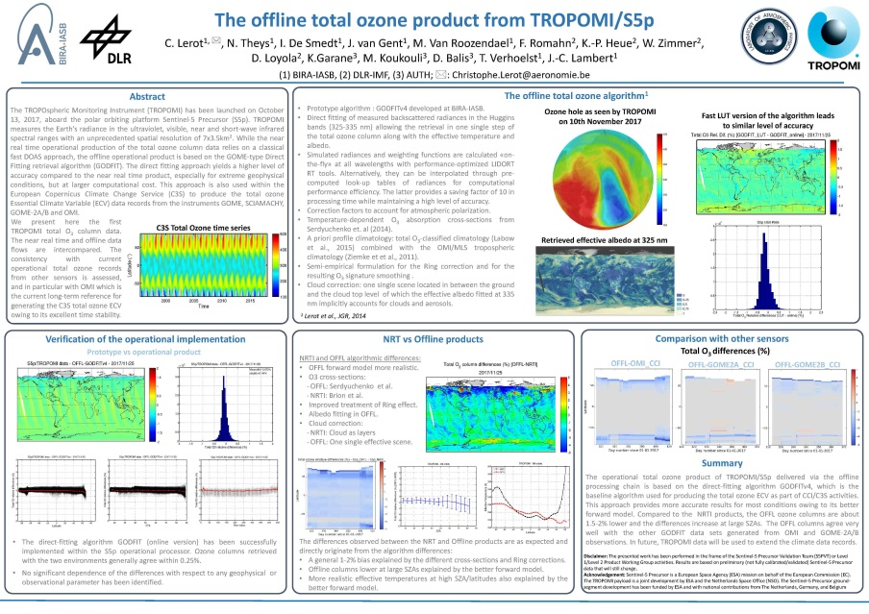
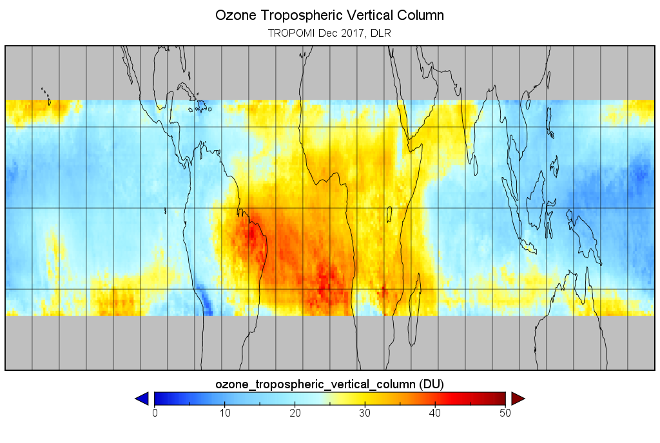
Overview
Near Real Time (DOAS)
Offline (GODFIT)
Total column
Poster C. Lerot et al.
X5.127 EGU2018-7850
The offline total ozone product from TROPOMI/S5p
Tropical tropospheric column

Slide 3
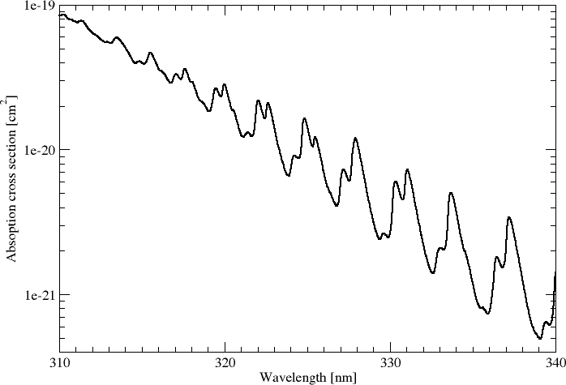
Heritage
TOMS
317.5 and 331.2 nm
Version 8 in 2004
TOMS on Nimbus 7 and Earth Probe, OMI on Aura
DOAS (GDP 4.x) x≤8
DOAS from 325 to 335 nm
AMF at 325.5 nm
Version 4 in 2004
GOME/SCIAMACHY/GOME-2/S5P

Slide 4
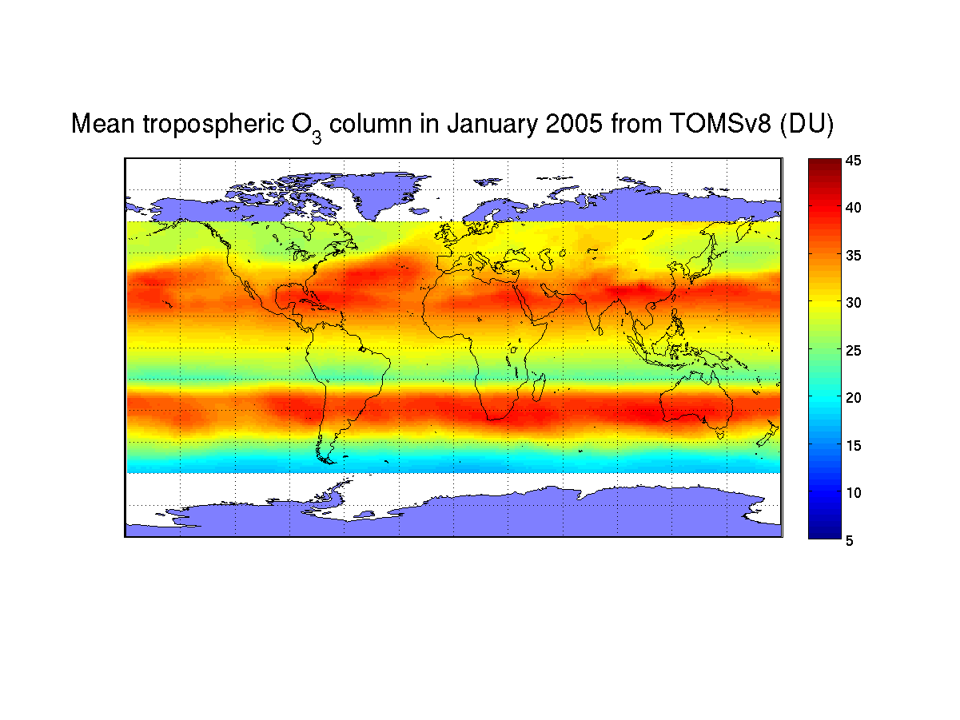
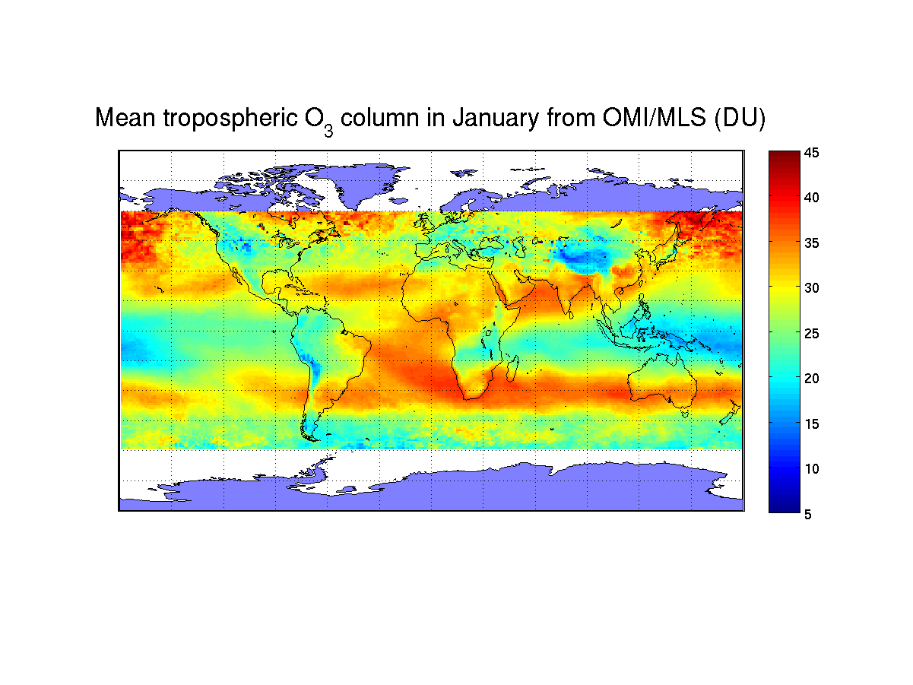
S5P Near Real Time Algorithm Developments
Polarization correction for AMF calculation
Improved a priori ozone profile climatology (troposphere) Ziemke et al., 2011
Optimal wavelength selection for AMF calculation
Change from 325.5 nm to 328.125 nm
New cloud model CAL (cloud as layer - presentation A. Argyrouli et al.: EGU2018-16787 Operational cloud products from Sentinel-5 Precursor)
No need of ghost-column and intra-cloud corrections
Destriping algorithm (test-phase)
Notes:
At high SZAs, larger errors in the retrieved O3 col. partly due to the AMF calculation at one single wavelength (325.5 nm in GDP 4.x)

Slide 5
First results

Slide 6
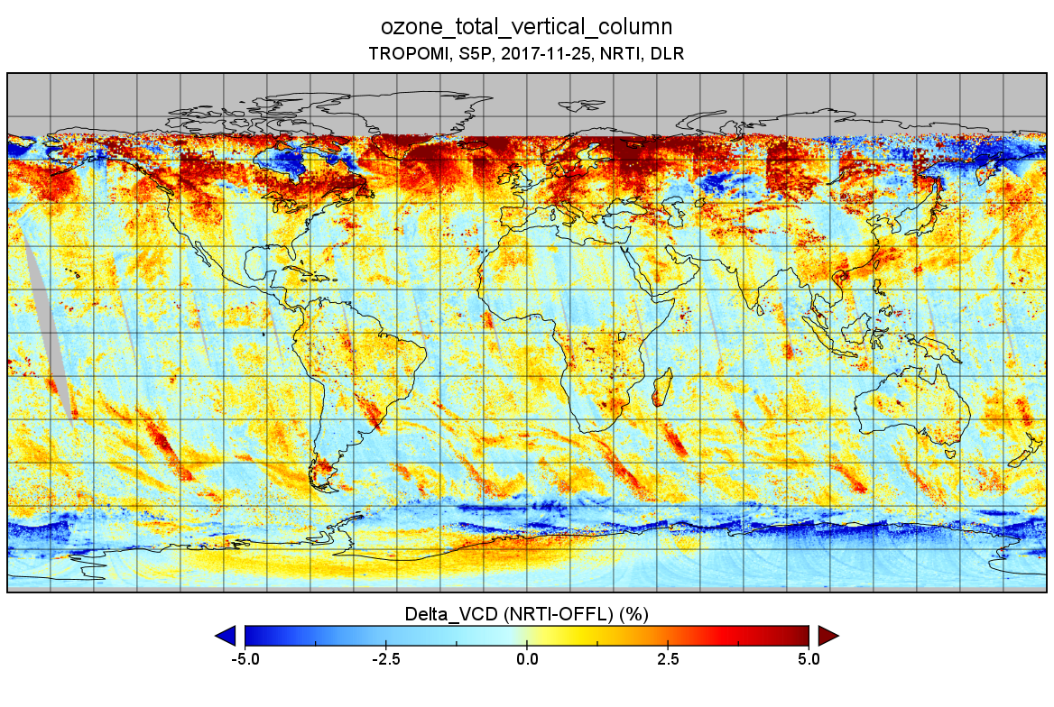
Comparison to S5P OFFL dataset

Slide 7
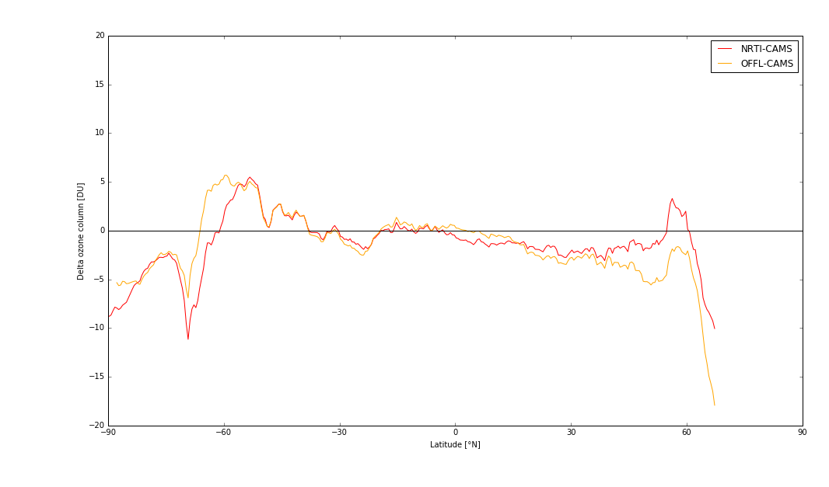
Comparison with other instruments and CAMS
400
350
20
S5P NRTI - CAMS
S5P OFFL - CAMS
15
300
total ozone column [DU]
10
5
250
Delta total ozone [DU]
0
-5
200
-90
-60
-30
0
Latitude
30
60
90
-10
-15
Good agreement of most sensors between 50°S and ~50°N
At higher SZAs large scatter between the instruments
-20
-90
-60
-30
0
Latitude [°N]
30
60
90

Slide 8
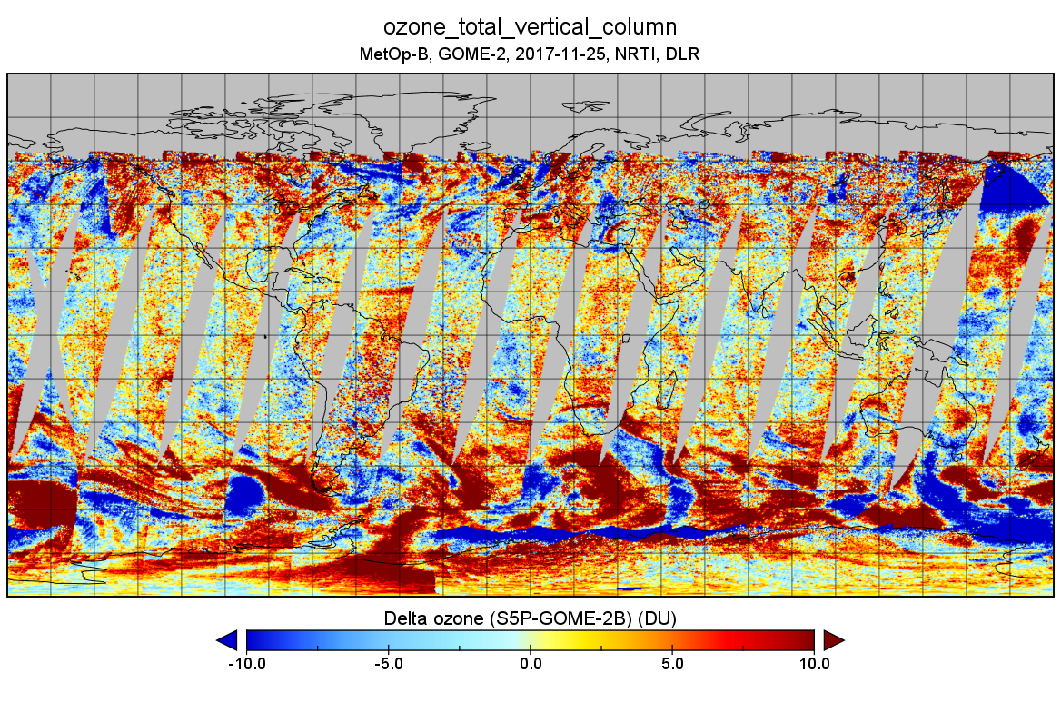
Comparison with GOME-2

Slide 9
Tropical Tropospheric Ozone Column

Slide 10
CCD method
Stratospheric O₃ col
Stratospheric O₃ col
~240 DU
above cloud column ozone
Top of tropospheric column 10 km
~240 DU
correction
<2 DU
total column ozone
tropical tropospheric column ozone
Cloud top height (Level 2 data)
~250-280 DU
~10-40 DU

Slide 11
First results S5P – February 2018
Notes:
Resolution 0.5° x 0.5°
Temporal resolution 5 Days

Slide 12
Validated results GOME-2B – February 2018

Slide 13
First Comparison
Compared to GOME-2B:
Underestimation over South East Asia
Overestimation over the Atlantic & Africa
different overpass times
new a priori in total ozone
different cloud data
Detailed validation needed

Slide 14
Conclusion
Total Ozone retrieval from Sentinel 5 Precursor works fine
Validation still to be performed
Good Agreement between NRTI and OFFL
Good Agreement with GOME-2 MetOp-B and CAMS total columns
Planned to be disseminated to the users in June 2018
Tropospheric ozone retrieval is also running fine
Validation still to be performed
Compared to GOME-2 much higher spatial and temporal resolution is achieved
Comparison to GOME-2B shows a deviation of less than 30% (different overpass times ?)
Planned to be disseminated to the users in August 2018

Slide 15
Acknowledgement & Disclaimer
Disclaimer: The presented work has been performed in the frame of the Sentinel-5 Precursor Validation Team (S5PVT) or Level 1/Level 2 Product Working Group activities. Results are based on preliminary (not fully calibrated/validated) Sentinel-5 Precursor data that will still change.
Acknowledgement: Sentinel-5 Precursor is a European Space Agency (ESA) mission on behalf of the European Commission (EC). The TROPOMI payload is a joint development by ESA and the Netherlands Space Office (NSO). The Sentinel-5 Precursor ground-segment development has been funded by ESA and with national contributions from The Netherlands, Germany, and Belgium

