Slide 1





Accuracy and Uncertainty of Sen2Cor Bottom‐of‐Atmosphere Product
(for granules containing vegetated area)
Bringfried Pflug , Jérôme Louis, Eric Vermote, Magdalena Main-Knorn, Vincent Debaecker, Uwe Müller-Wilm, Ferran Gascon

Slide 2
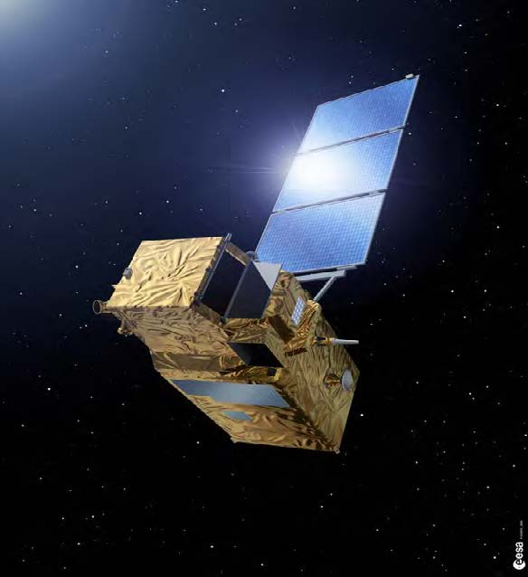
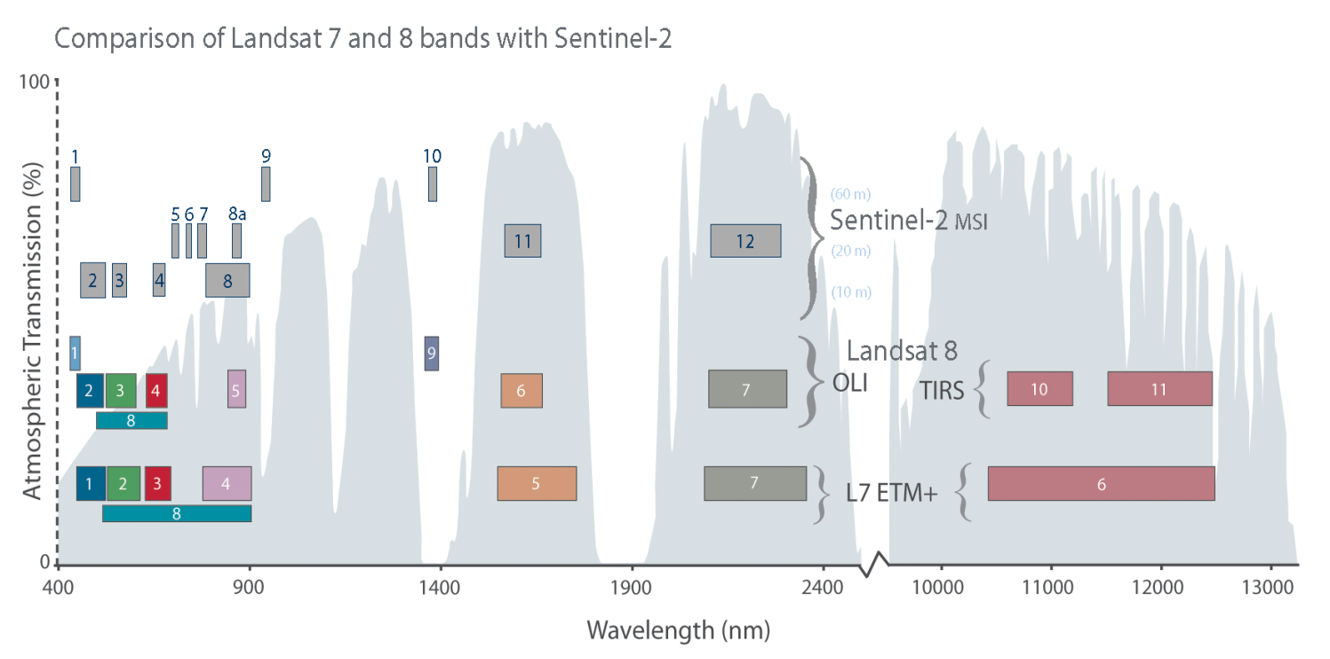
Sentinel-2 Mission
Optical mission for land and coastal region monitoring and emergency services
Constellation of 2 satellites S2A and S2B
Polar, Sun-synchronous orbit at altitude: 786.13km with LTDN 10h30 AM
Global coverage with swath of 290km
5 days or less revisit period with both satellites
13 spectral bands with different spatial resolution (10 m, 20 m, 60 m).

Slide 3
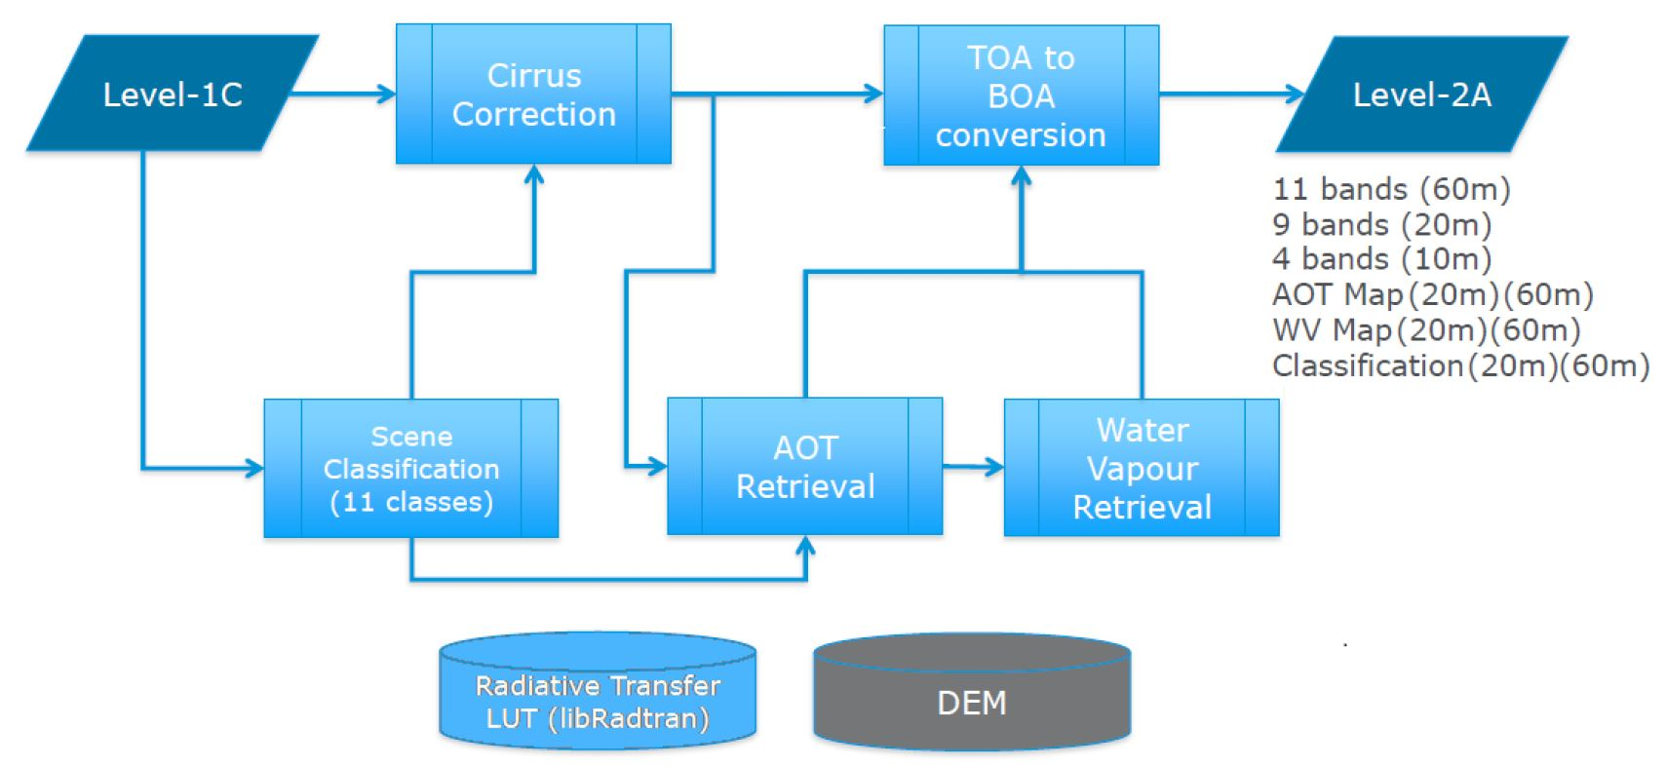
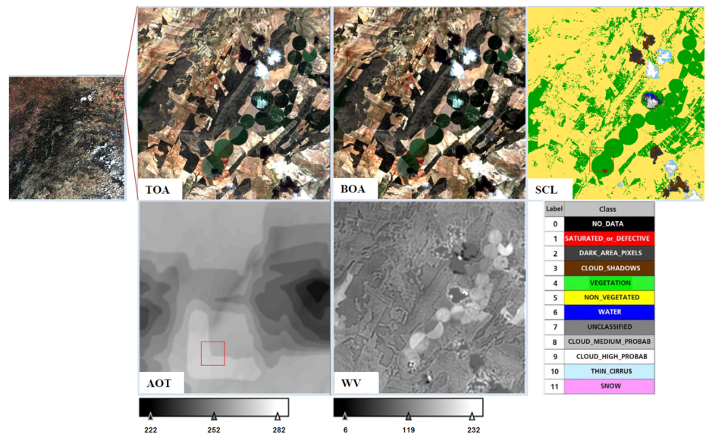
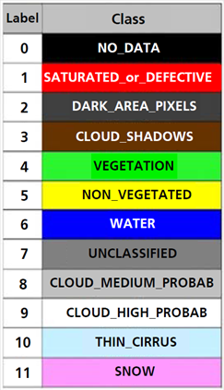
Sen2Cor Processor Framework
L2A-Product Example:
Barrax (Spain)
acquired on 19.05.2017
S2A_MSIL2A_20170519T105651_N0205_R094_20170529T104446
Two main modules : Scene Classification (SCL) and Atmospheric Correction (AC)
DEM downloaded automatically by the processor (SRTM) or provided by the user in DTED format
Set of Look-Up tables generated via libRadtran
SCL is mainly based on a series of threshold tests on L1C spectral bands, band ratios and indices
AOT derived at 550nm based on the DDV (Dense Dark Vegetation) algorithm
WV retrieval based on the Atmospheric Pre-corrected Differential Absorption Algorithm (APDA)
Notes:
SCL does not perform a land cover classification map in a strict sense!
Used internally in Sen2Cor in the AC module to distinguish between cloudy, clear and water pixels.
Processing procedure can use DEM
Atmospheric correction processor for Sentinel-2 data
developed by Telespazio VEGA Deutschland GmbH on behalf of ESA
Porting and adaptation of the ATCOR software (Version Dec 2010 in IDL) into Python
Corrects single-date Sentinel-2 Level-1C Top-Of-Atmosphere (TOA) products from the effects of the atmosphere and delivers a Level-2A Bottom-Of-Atmosphere (BOA) reflectance product
Encompasses optional:
cirrus correction
terrain correction
adjacency correction
empirical Bidirectional Reflectance Distribution Function (BRDF) corrections
Sen2Cor can be configured through the L2A_GIPP.xml file (Baseline processing options)
rural and maritime aerosol
midlatitude winter and midlatitude summer atmosphere (Auto selection)
ozone content (best approximation from metadata)

Slide 4
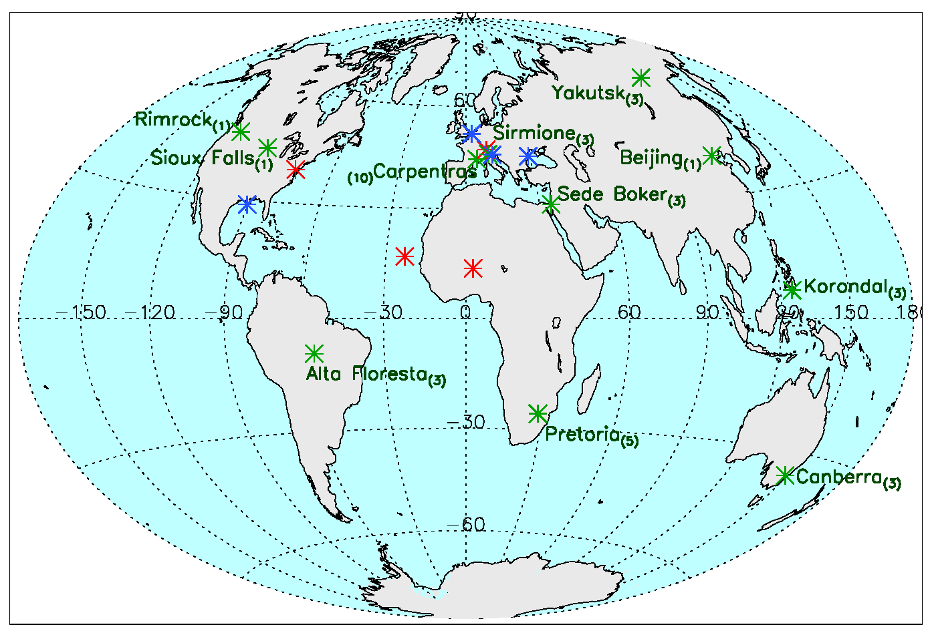
Validation data set
  DDV set (≥2% DDV pixels): (11 sites)
  17.11.2015 – 11.06.2016
  dataset covers different
    atmospheric conditions
    latitudes (various solar angles)
    continents
    topography and land cover type
    dataset covers not all seasons
  Sen2Cor (version 2.5) processing
    rural aerosols
    profile selection automatic
    (ozone content from metadata)
    no cirrus correction
    terrain correction with SRTM-DEM
    Adjacency correction
  * Vegetation (DDV) site * arid (noDDV) site * water site

Slide 5
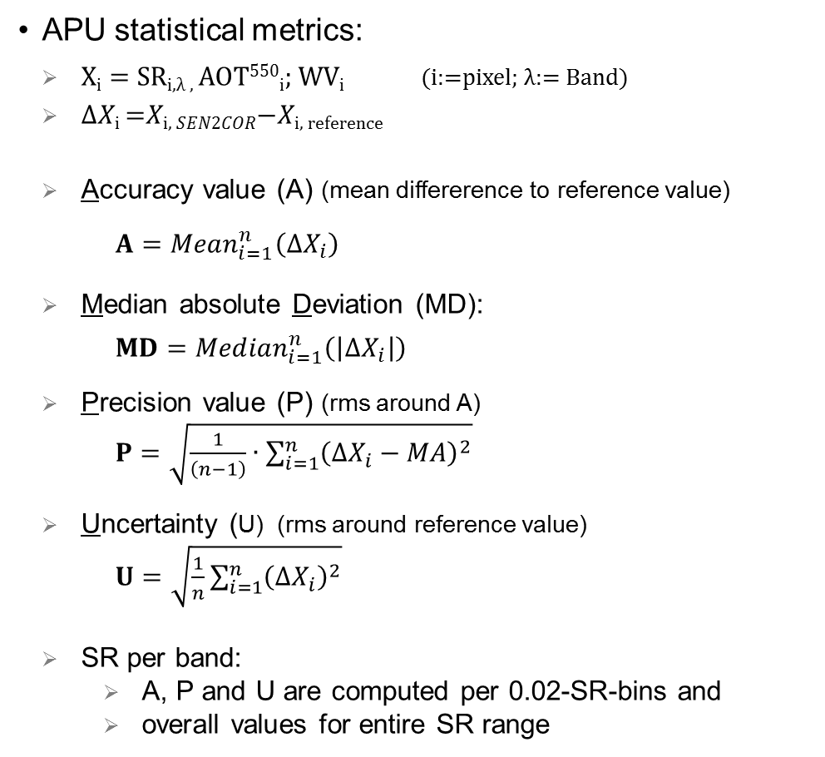
Validation procedure
AOT & WV validation procedure:
  direct comparison with AERONET as reference
  AERONET: satellite overpass time ±30 min
  Sentinel-2: average over
    9km x 9km area around sunphotometer of all
    vegetated and non-vegetated pixels
SR validation procedure:
  Pixel-by-pixel comparison with AERONET corrected
  (surface reflection) data as reference
  SR reference computed from [Eric Vermote]
    Sentinel-2 L1C (TOA) data with
    6S radiation transport model using
    aerosol parameters from AERONET as input
  AERONET: satellite overpass time ±30 min
  Sentinel-2:
    9km x 9km area around sunphotometer with
    only non-saturated, non-cloudy and non-missing pixels considered
APU statistical metrics:
  $X\text{i}=$ SR_{i,λ ,} AOT⁵⁵⁰_{i}; WV_{i} (i:=pixel; λ:= Band)
  Δ𝑋_{i} =𝑋_{i, 𝑆𝐸𝑁2𝐶𝑂𝑅}−𝑋_{i, reference}
  Accuracy value (A) (mean differerence to reference value)
  $A={Mean}_{i=1}^{n}\left({ΔX}_{i}\right)$
  Median absolute Deviation (MD):
  $MD={Median}_{i=1}^{n}\left(\left|{ΔX}_{i}\right|\right)$
  Precision value (P) (rms around A)
  $P=\sqrt{\frac{1}{\left(n−1\right)}∙\sum_{i=1}^{n}{{\left(∆X_{i}−MA\right)}^{2}}}$
  Uncertainty (U) (rms around reference value)
  $U=\sqrt{\frac{1}{n}\sum_{i=1}^{n}{{\left({ΔX}_{i}\right)}^{2}}}$
  SR per band:
    A, P and U are computed per 0.02-SR-bins and
    overall values for entire SR range
      High accuracy, low precision
      high precision, low accuracy

Slide 6
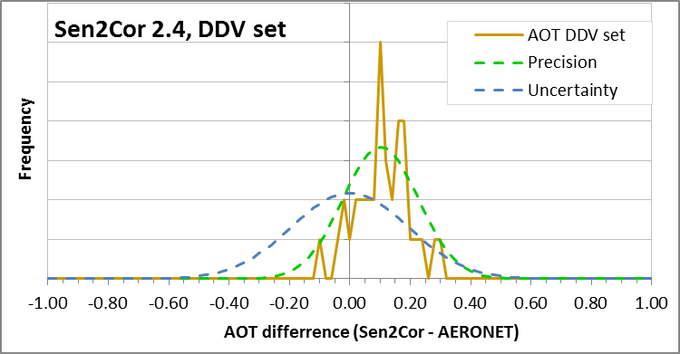
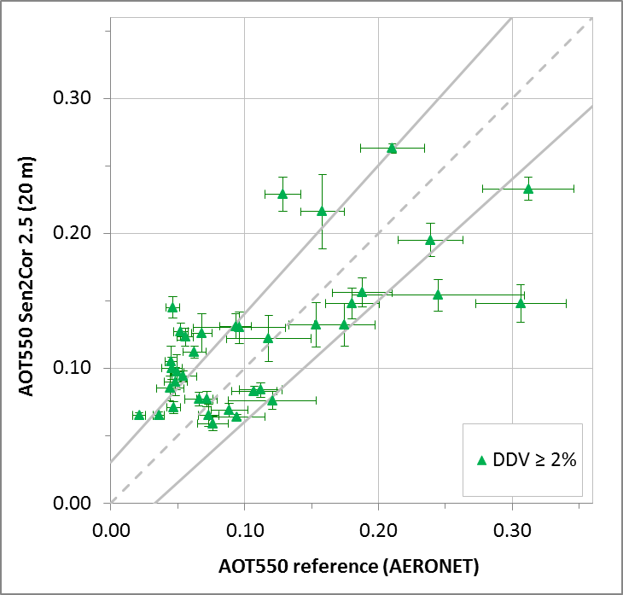
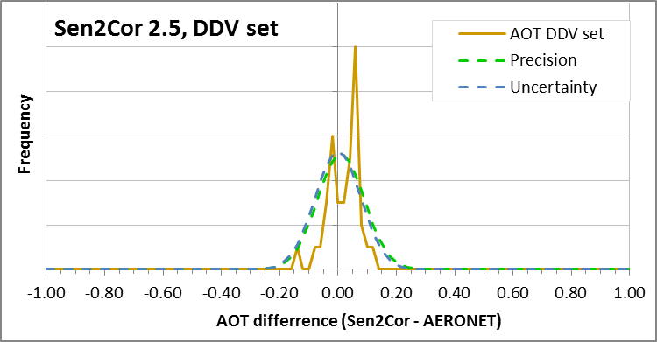
Validation of AOT Product
Accuracy requirement (solid lines): |ΔAOT₅₅₀| ≤0.1*AOT550_{ref}+0.03
AOT statistics | ver 2.4 | ver 2.5
Total no. of products | 37 | 37
Products within requirement | 22% | 49%
R² (Coefficient of variation) | 0.17 | 0.47
r (Pearson’s correlation coeff.) | 0.41 | 0.69
MA (Median Accuracy value) | 0.10 | 0.02
MD (Median deviation ) | 0.10 | 0.04
MP (Median Precision value) | 0.09 | 0.06
U (Uncertainty) | 0.14 | 0.06
Max AOT₅₅₀ difference | 0.29 | 0.16
95.4% Quantile | 0.24 | 0.08
68.3% Quantile | 0.15 | 0.04
Remarkable improvement since Sen2Cor 2.4
DDV-algorithm mostly overestimates AOT₅₅₀
Very good MA, MP und U for DDV-data set,
but still only ≈ 50% of products within requirement
MA ± MP = 0.02 ± 0.06 for granules with vegetation

Slide 7
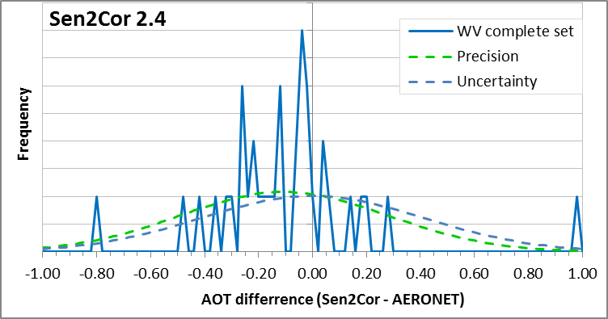
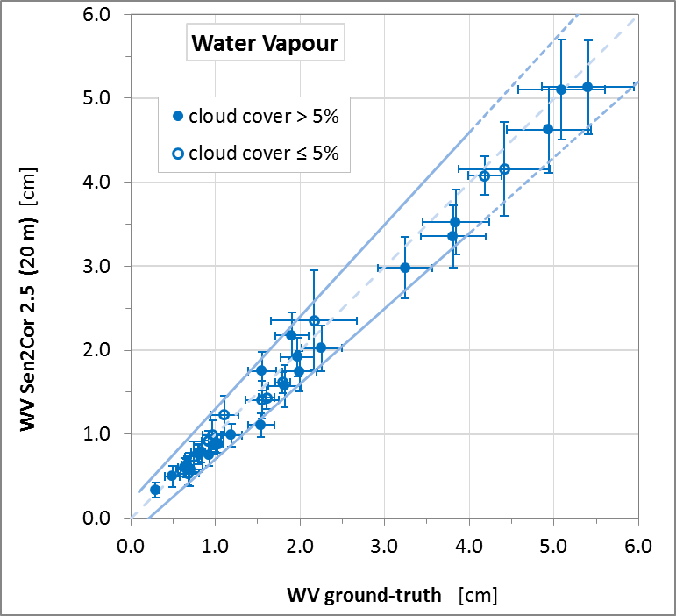
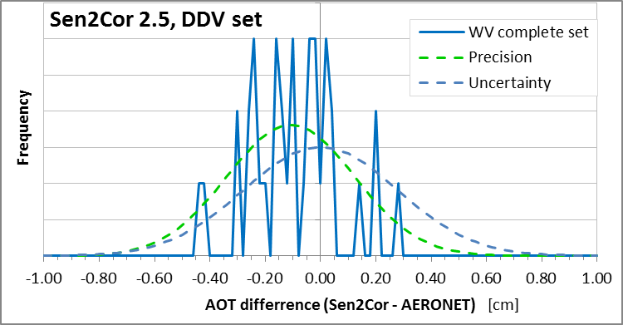
Validation of WV Product
Accuracy requirement (solid lines): |ΔWV| ≤0.1*WV_{ref}+0.2
WV statistics [cm] | ver 2.4 | ver 2.5
Total no. of products | 37 | 37
Products within requirement | 92% | 97%
R² (Coefficient of variation) | 0.97 | 0.99
r (Pearson’s correlation coeff.) | 0.98 | 0.99
MA (Median Accuracy value) | -0.12 | -0.11
MD (Median deviation ) | 0.04 | 0.02
MP (Median Precision value) | 0.27 | 0.16
U (Uncertainty) | 0.29 | 0.20
Max AOT₅₅₀ difference | 0.97 | 0.46
95.4% Quantile | 0.22 | 0.19
68.3% Quantile | -0.04 | -0.035
Already accurate WV estimation by Sen2Cor 2.4 is still little improved with Sen2Cor 2.5
Sen2Cor slightly underestimates WV
Very good MA, MP und U,
97% of products within requirement
MA ± MP = -0.11 ± 0.16 cm for granules with vegetation

Slide 8
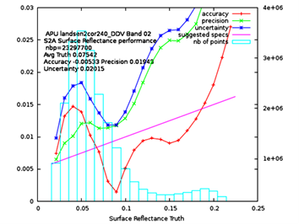
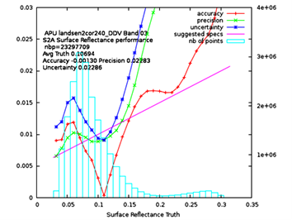
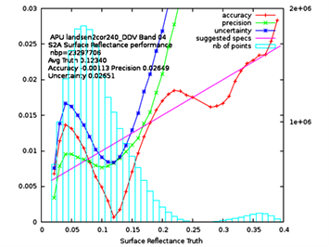
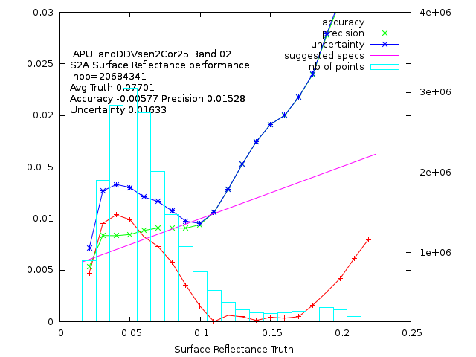
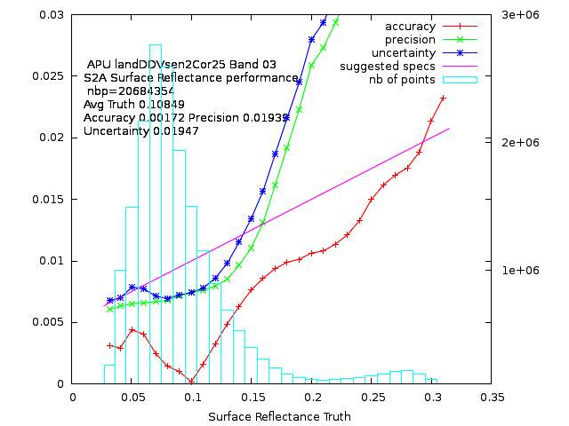
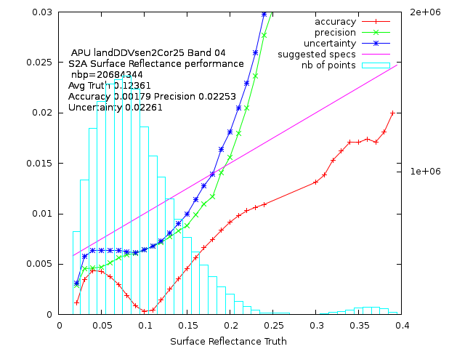
Validation of BOA Product (SR): Sen2Cor 2.5 versus 2.4 specs: |ΔSR| ≤0.05*SR_{ref}+0.005
Sen2Cor 2.4
B2
<U>=0.020
B3
<U>=0.023
B4
<U>=0.027
Sen2Cor 2.5
B2
<U>=0.016
B3
<U>=0.019
B4
<U>=0.023
All of A, P and U give better results for Sen2Cor 2.5 than for Sen2Cor 2.4

Slide 9
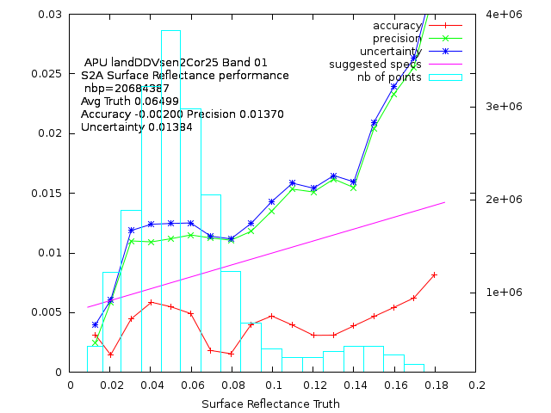
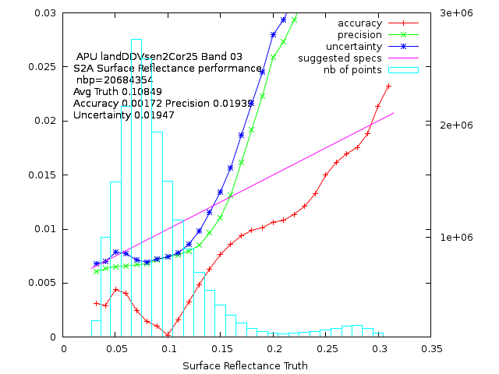
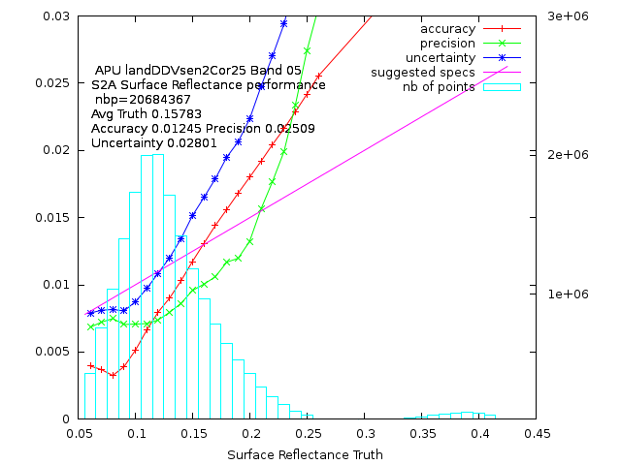
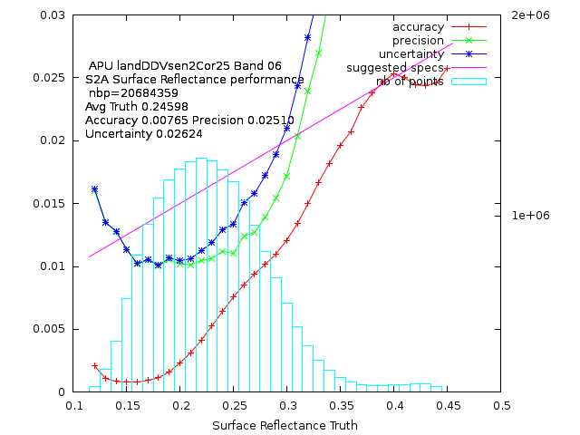
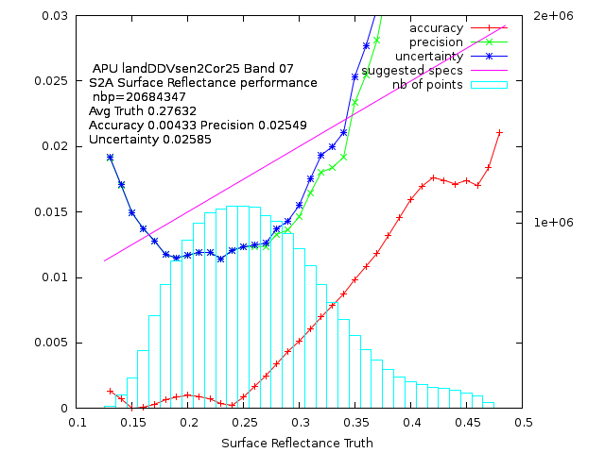
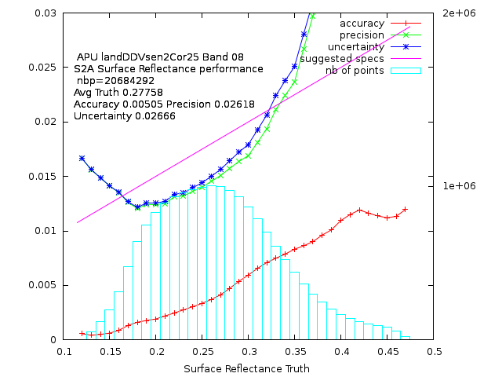
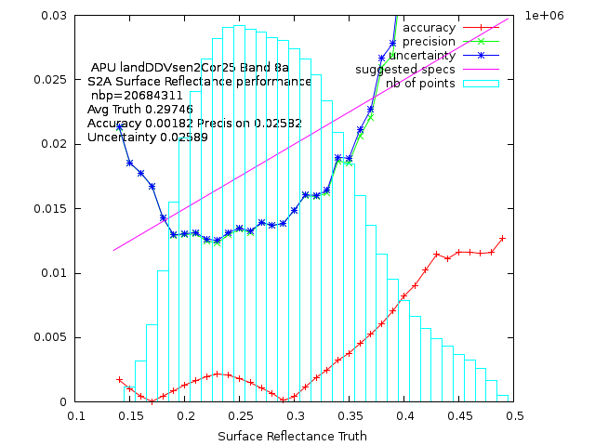
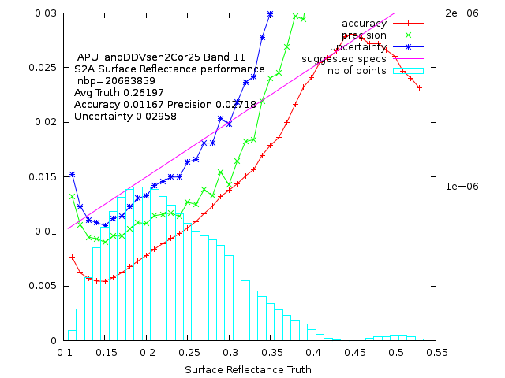
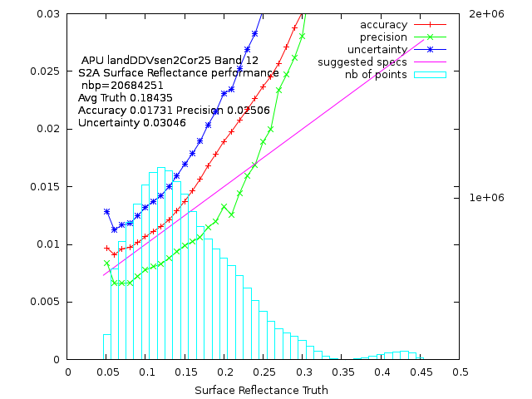
Validation of BOA Product (SR): All bands overview, all DDV sites specs: |ΔSR| ≤0.05*SR_{ref}+0.005)
B1
B2
B3
B4
B5
B8
B8A
B6
B7
B11
Accuracy better than Precision and Uncertainty
U within specs in many bands for most frequent SR
More problems with larger SR
B12

Slide 10
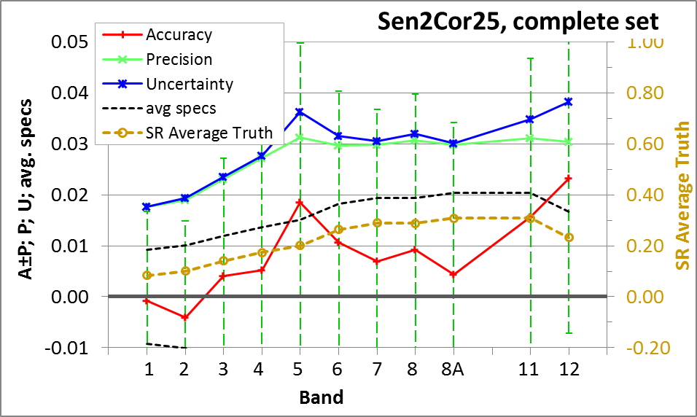
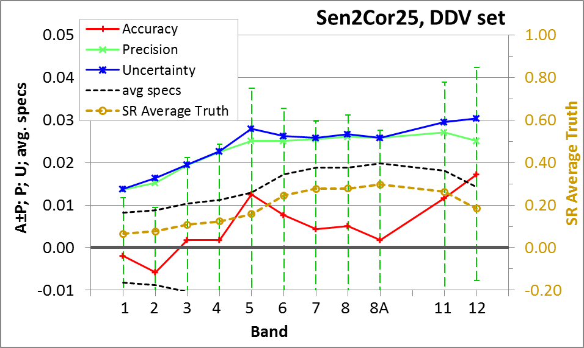
Validation of BOA Product (SR): Band average APU specs: |ΔSR| ≤0.05*SR_{ref}+0.005
DDV subset performs better than complete data set
Best accuracy for bands 3, 4, 8A, however better performance for bands 1 and 2 (lower U)
Average accuracy is within specs except (band 5_{complete_set} and) band 12
A, P and U are increasing with wavelength >> aerosol type issue?

Slide 11
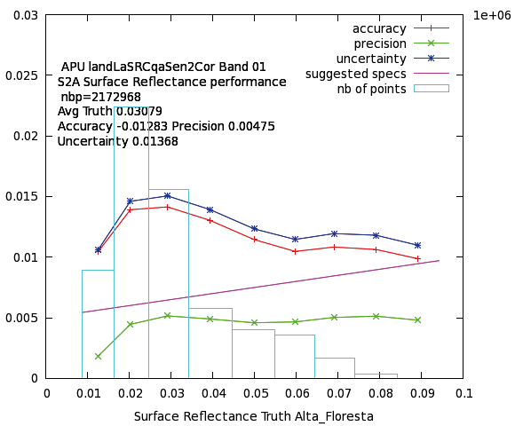
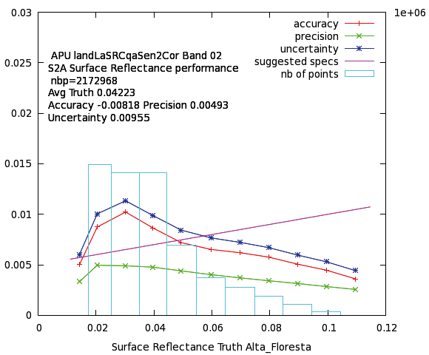
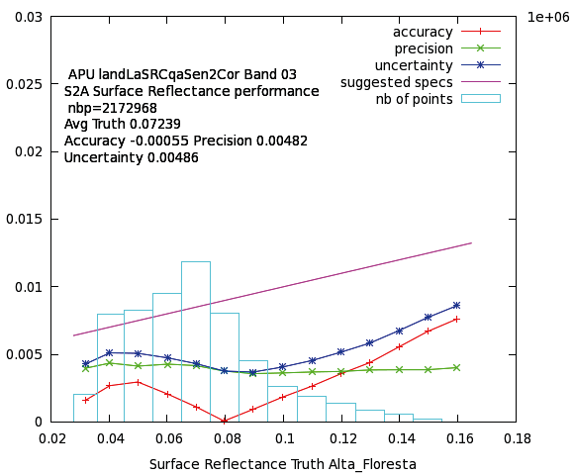
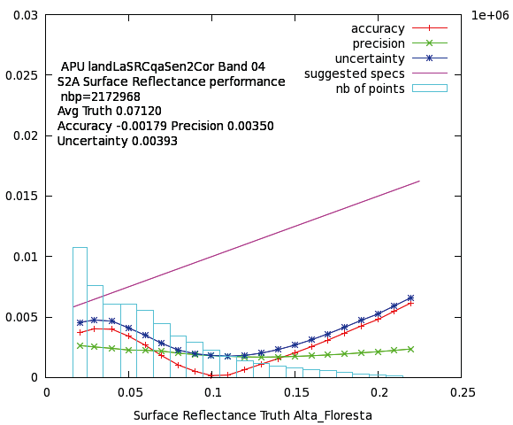
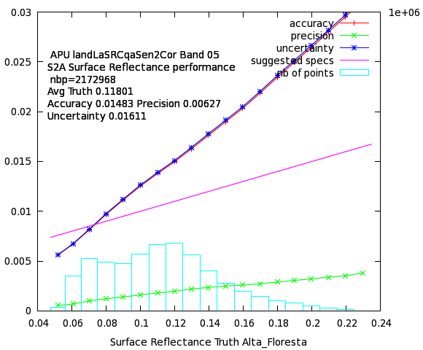
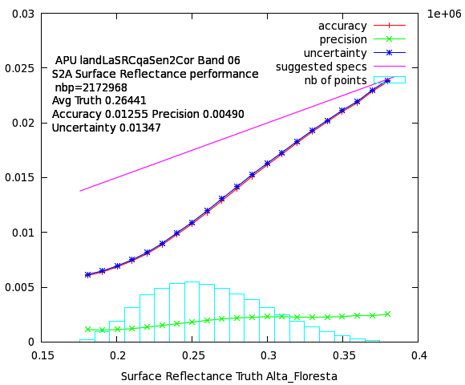
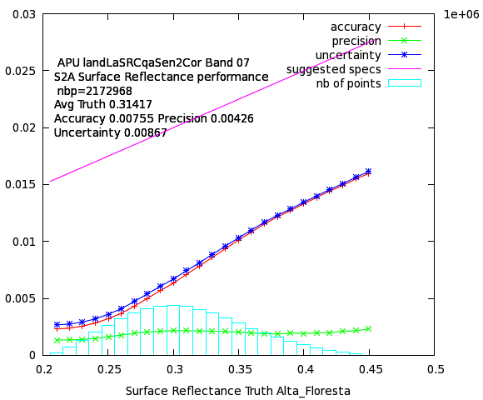
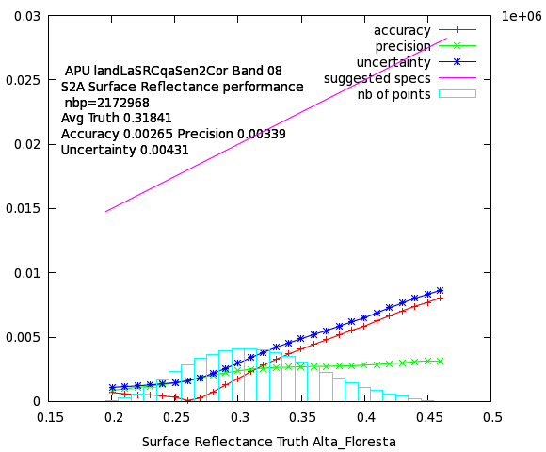
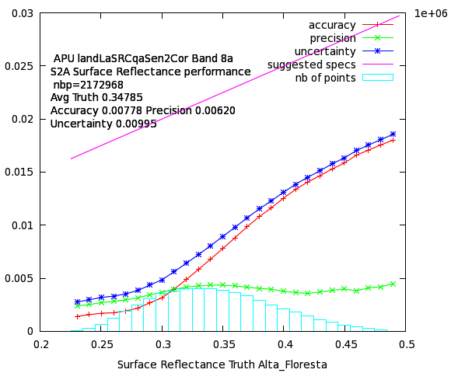
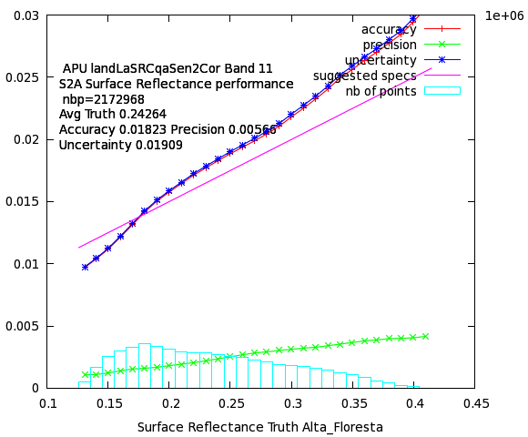
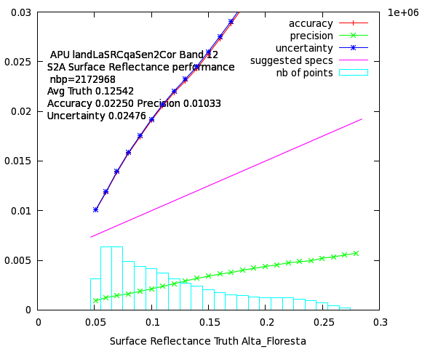
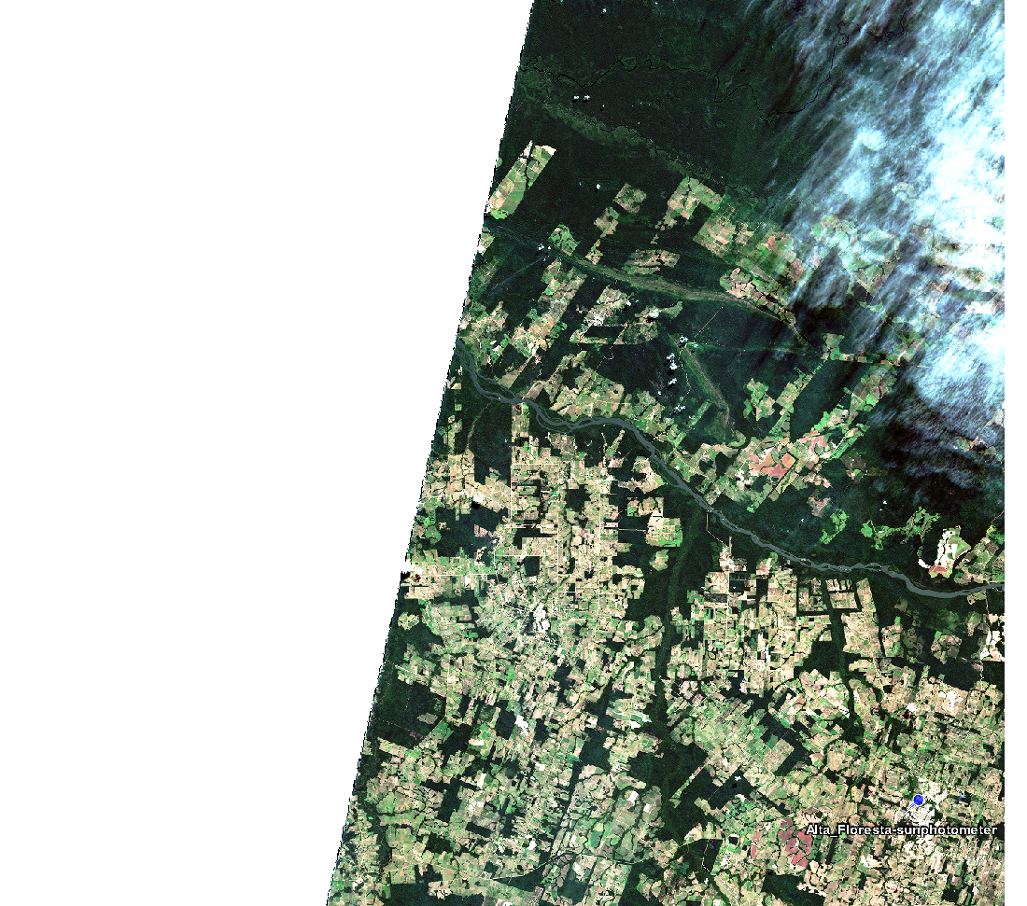
Validation of BOA Product (SR): All bands overview, Alta Floresta specs: |ΔSR| ≤0.05*SR_{ref}+0.005)
B1
B2
B3
B4
B5
B8
B6
B7
B8A
B11
A, P, U completely within specs in many bands 3 granules
More problems with larger SR
Most problematic: band 5 & band 11 & band 12
B12

Slide 12
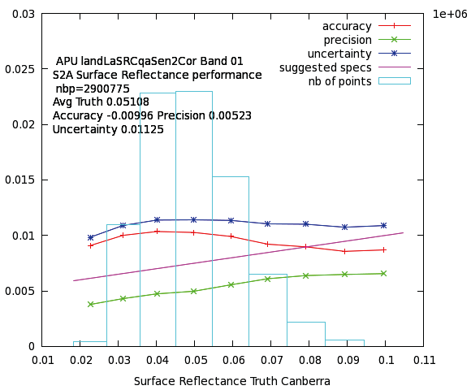
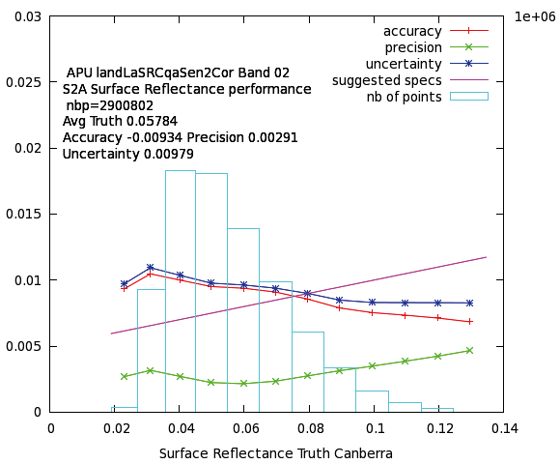
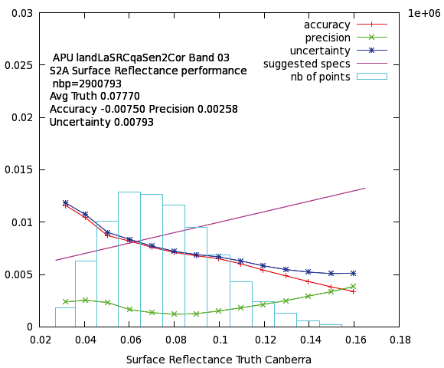

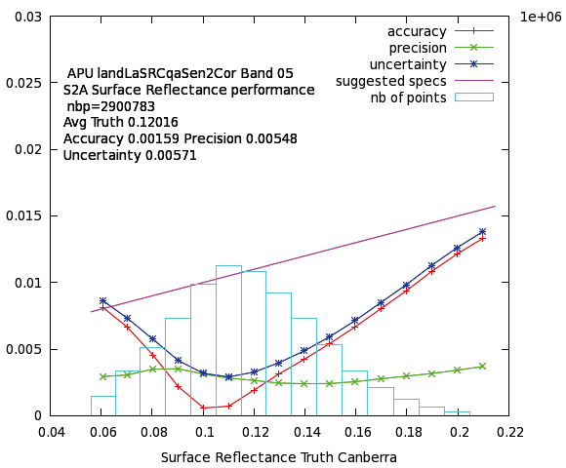
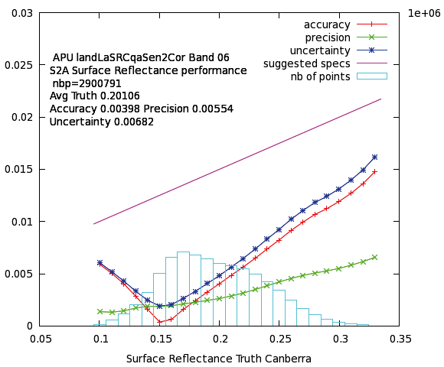
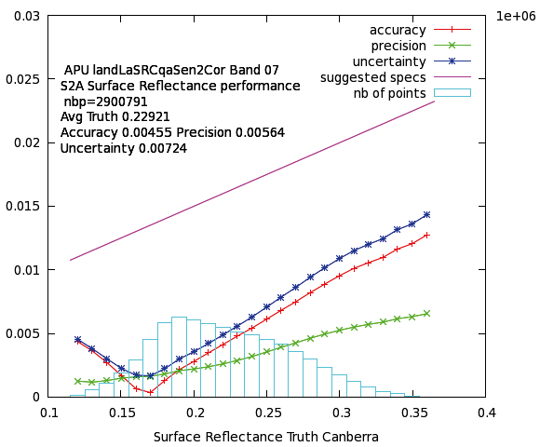
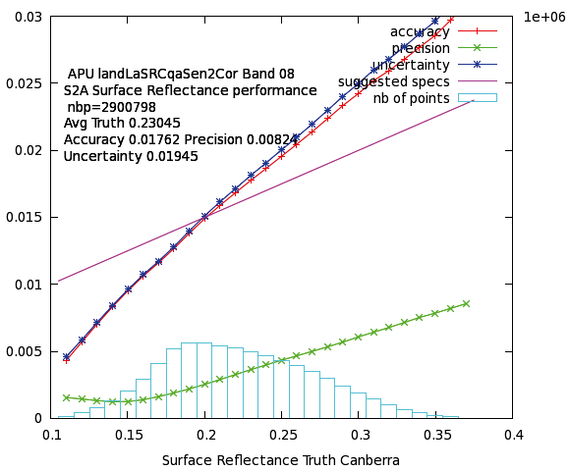
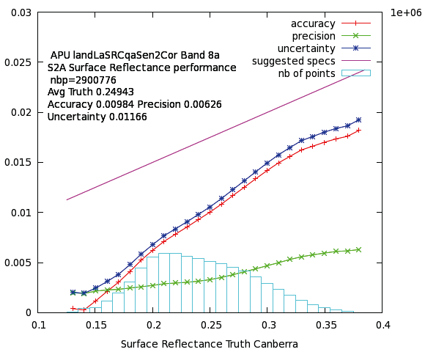



Validation of BOA Product (SR): All bands overview, Canberra specs: |ΔSR| ≤0.05*SR_{ref}+0.005)
B1
B2
B3
B4
B5
B8
B8A
B11
B6
B7
Band 2, 3, 4: A and U decrease with increasing SR 3 granules
Most problematic: not band 5 !, but band 8, band 11 & band 12
B12

Slide 13












Validation of BOA Product (SR): All bands overview, Carpentras specs: |ΔSR| ≤0.05*SR_{ref}+0.005)
B1
B2
B3
B5
B4
B6
B7
B8
B8A
B11
More problems with larger SR 10 granules
Most problematic: NIR and SWIR bands starting at band 5
B12

Slide 14












Validation of BOA Product (SR): All bands overview, Yakutsk specs: |ΔSR| ≤0.05*SR_{ref}+0.005)
B1
B2
B3
B4
B5
B6
B7
B8
B8A
B11
A, P, U completely within specs in many bands 3 DDV & 2 noDDV granules
More problems with larger SR
bands 5 & band 11 & band 12 again problematic
B12

Slide 15


Validation of BOA Product (SR): Reference measurements specs: |ΔSR| ≤0.05*SR_{ref}+0.005
First guess analysis of campaign at Lake Stechlin (Germany), 4th May 2018
Meadow
Lake
AOT_{Sen2COR} – AOT_{sunphotometer} = -0.01
WV_{Sen2COR} – WV_{sunphotometer} = -0.12 cm
SR: Good agreement in shape of spectrum
agreement S2B<>SVC within natural variability of target
Reflectance difference S2B<>SVC on meadow up to 0.022
Reflectance difference S2B<>MCS on lake up to 0.012
These SR differences correspond to uncertainties resulting from APU-analysis

Slide 16
Summary
Atmospheric correction implemented within Sen2Cor requires DDV pixels existing in the image.
Development of a new fallback solution for granules without DDV pixels is in preparation.
Very good MA, MP und U for DDV-data set
  AOT: MA ± MP = 0.02 ± 0.06 for Sen2Cor 2.5, Uncertainty 0.06
  WV: MA ± MP = (-0.11 ± 0.16) g/cm² for Sen2Cor 2.5, Uncertainty 0.20 g/cm²
TOA to BOA conversion (DDV-set):
  Accuracy almost within specs except for bands 5 and 12,
  Accuracy better than Precision and Uncertainty
  Uncertainty within specs in many bands for most frequent SR
  Best band averaged Accuracy for bands 3, 4, 8A, however lower Uncertainty for bands 1 and 2
  Equivalent SR differences found in SR-measurements performed in parallel to Sentinel-2 overpass
Sen2Cor processor can be freely downloaded and used http://step.esa.int/main/third-party-plugins-2/sen2cor/
L2A products over Europe are available: https://scihub.copernicus.eu/dhus/#/home
Systematic global production is being implemented in the ground segment, will start in July 2018
L2A Product Performance now reported in the L2A Data Quality Report:
  https://sentinels.copernicus.eu/documents/247904/685211/Sentinel-2-L2A-Data-Quality-Report
Notes:
L2A data production runs on systematic basis over Europe with dissemination through the Copernicus Open Access Hub since May 2017, PDGS production over Europe since April 2018
The systematic global production of Level 2A core products is being implemented in the ground segment will start in July 2018

Slide 17

Thank you for your attention!
ACKNOWLEDGEMENTS
The authors thank the PI investigators and their staff for establishing and maintaining the AERONET sites used in this investigation.
Bringfried Pflug, Jérôme Louis, Eric Vermote, Magdalena Main-Knorn, Vincent Debaecker, Uwe Müller-Wilm, Ferran Gascon
bringfried.pflug@dlr.de; www.DLR.de/eoc

Slide 18
Sen2Cor Processor – Module Atmospheric Correction (AC)
AOT correction
AOT derived at 550nm based on the DDV (Dense Dark Vegetation) algorithm
Uses the correlation between reflectance in SWIR (band 12) and VIS (red – band 4, and blue – band 2)
Requires enough reference pixels of known reflectance behaviour, preferably DDV and/or dark soil and water bodies
WV correction
Based on the Atmospheric Pre-corrected Differential Absorption Algorithm
Applied to Sentinel-2 bands:
  B8a (reference channel in an atmospheric window region)
  B9 (absorption region)
absorption depth evaluated by calculating the radiance for an atmosphere with no water vapour
(assumption: surface reflectance for measurement channel = the reference channel)
absorption depth = measure of the water vapour column content

