Slide 1
Bolted joints with radial pretension for thick-walled composites structures
ICCS20, International Conference on Composite Structures
4-7 September 2017 – CNAM, Paris, France
Lutz Beyland, Composite Design Engineer,
German Aerospace Center (DLR)
Institute of Composite Structures and Adaptive Systems
Elisabeth Ens
RWTH Aachen

Slide 2

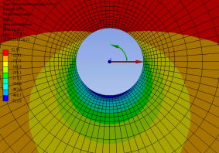
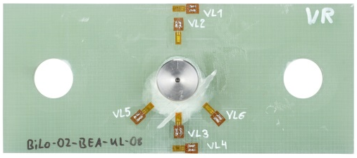
Outline
State of the art bolted joints in thick walled laminates
Concept of bolted joint with radial pretension
Analytical approach
FE-Calculation
Bearing tests
Conclusion and Outlook

Slide 3
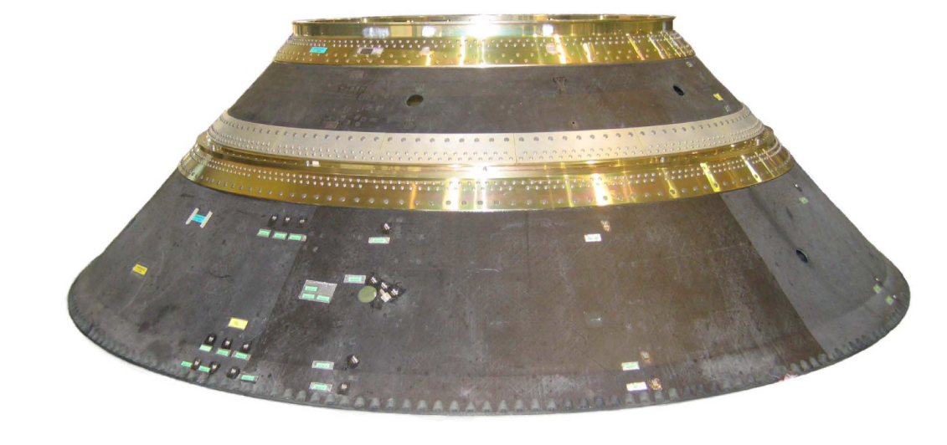
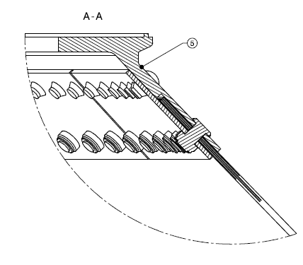
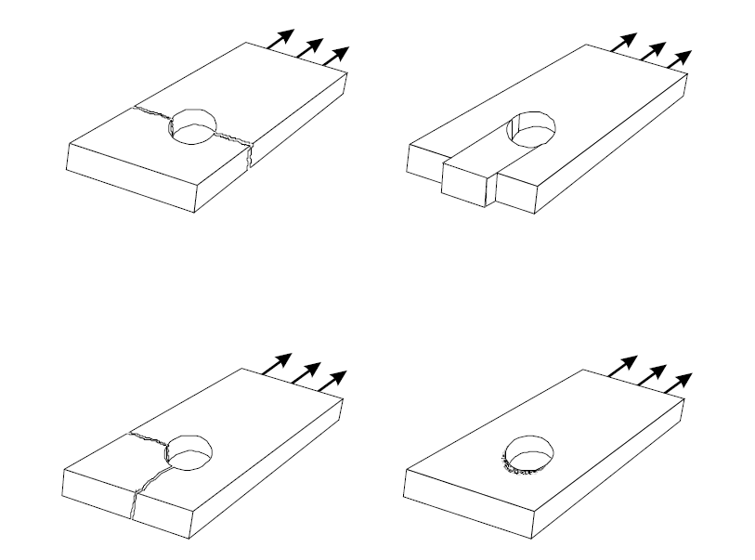
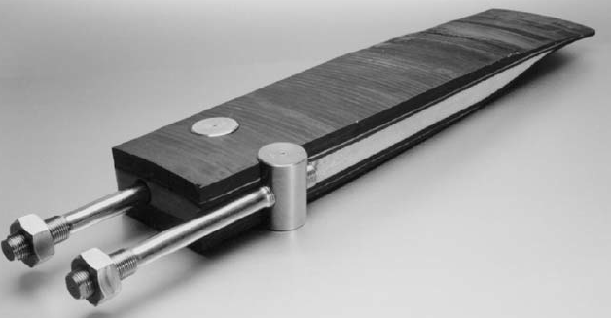
Bolted joints for thick laminates - state of the art
Fields of application for many decades
  multi-stage rockets for transportation of satellites
  connection of aircraft wing and fuselage
  root connection of rotor blades of wind turbines
Failure modes
Payload adapter Ariane 5 [DIEM]
Tension
Shear Out
T-Bolt connection for rotor blades [HAU]
Cleavage
Bearing

Slide 4
Problems of state of the art bolted joints
Big Clearance
Low Stiffness, high wear
Joint stiffness and wear depend on bolt-hole clearance
Avoiding big bolt-hole clearance leads to
  High effort for precise drilling of borehole
  Need for reaming / drilling of both joint parts in one process
P
P
Small / No Clearance
High Stiffness, medium wear
P
P
Radial Pretension
Very high stiffness, low wear
P
P

Slide 5
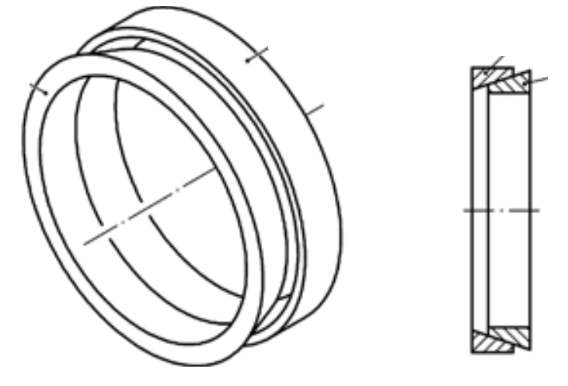
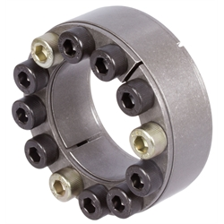
Concept of radial pretension
Outer ring
Outer ring
Inner ring
Inner
ring
3 - Radial Pretension
Inner
ring
Plate with bore hole
Bolt
Outer
ring
2 - No Clearance
1 - Clearance
Clamping bush [MÄDLER]
Clamping bush overcomes clearance and creates a radial pretension between bolt and bore hole
Radial pretension by axial tightening of inner and outer ring
Outer ring of clamping bush is slatted >> Diameter increase of 1 mm possible
Notes:
Spannring = clamping ring
Ausführung = Implementation

Slide 6
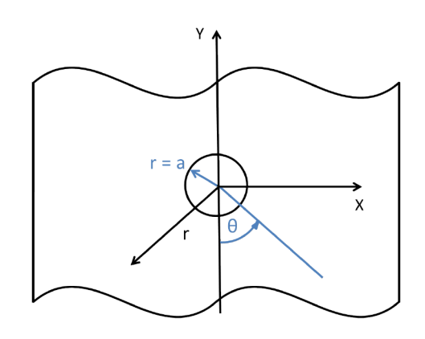
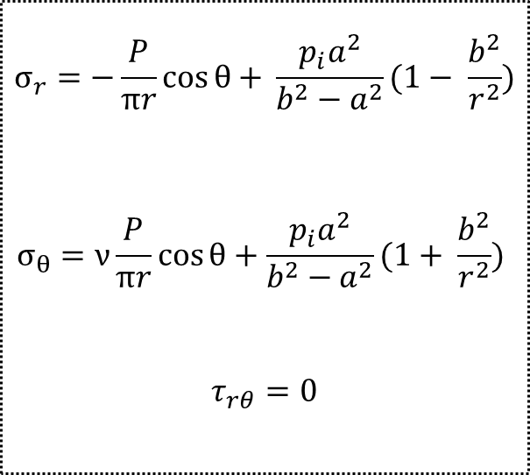
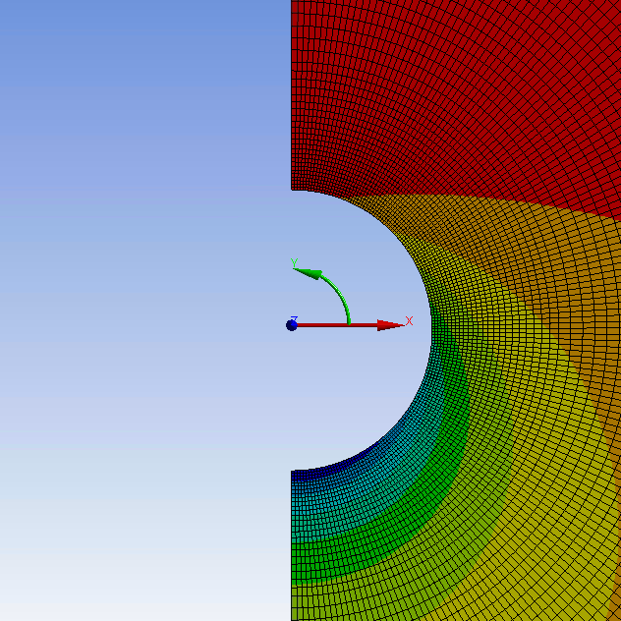
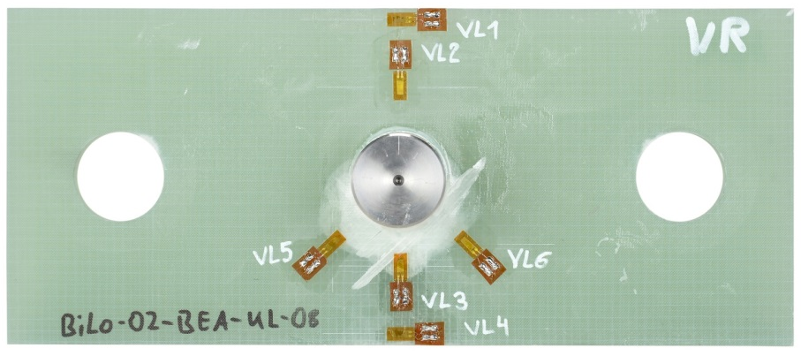

Research topics on bolted joint with radial pretension
Analytic model
to describe stress state around bore hole
FE model
to validate mathematical model and
for detailed analysis
$$F$$
Bearing tests
Static and fatigue strength

Slide 7


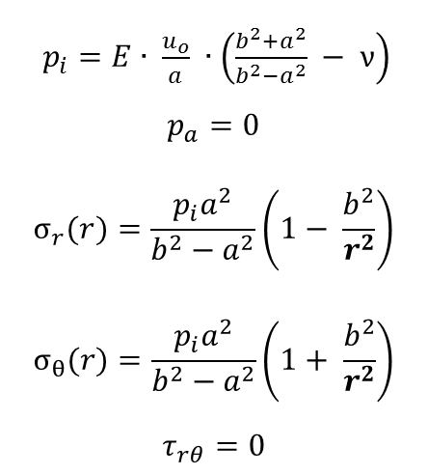



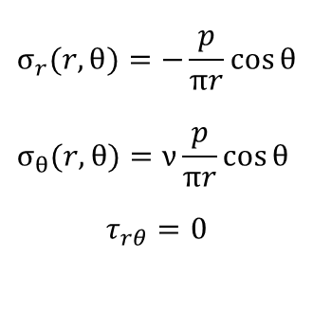






Analytic approach
Superposition
Pretension [Timoshenko]
Bolt load [Zhang]
$$pa$$
$p_{i}=E∙ \frac{u_{o}}{a} ∙\left(\frac{b^{2}+a^{2}}{b^{2}−a^{2}} − ν\right)$
$$p_{a}=0$$
$$σ_{r}(r)=\frac{p_{i}a^{2}}{b^{2}−a^{2}}\left(1− \frac{b^{2}}{r^{2}}\right)$$
$$σ_{θ}(r)=\frac{p_{i}a^{2}}{b^{2}−a^{2}}\left(1+ \frac{b^{2}}{r^{2}}\right)$$
$$τ_{rθ}=0$$
$$σ_{r}(r,θ)=−\frac{p}{πr}\cos{θ}$$
$$σ_{θ}(r,θ)=ν\frac{p}{πr}\cos{θ }$$
$$τ_{rθ}=0$$
$$pi$$
$$u0$$
$$p$$
$$a$$
$$r$$
$$r$$
$$θ$$
$$θ$$
$$b$$
$$p$$
Notes:
Quasiisotropic layoup
Disk under inner and outer pressure
Angle Theta

Slide 8
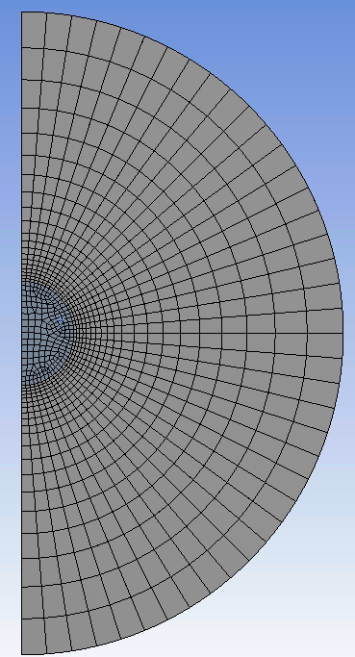
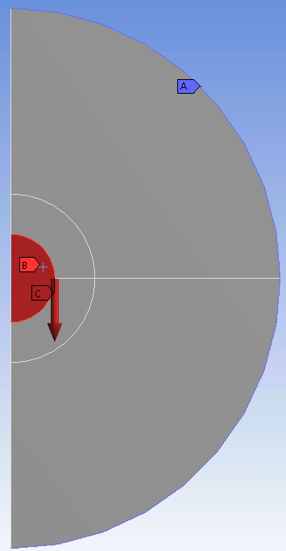
2D FE model - setup
Disk
FE-Software: Ansys Workbench 18.1
Boundary conditions
Symmetry at midplane
Fixed support of disk‘s peripheral surface
Bolt load as distributed force on bolt’s peripheral surface
Radial pretension by thermal expansion of bolt
Frictionless contact between bolt and hole
Material
Linear-elastic model
Disk: GFRP, quasi-isotropic stiffness
Bolt: Steel
Fixed
support
Bolt
Thermal expansion
Bolt load
Symmetry

Slide 9
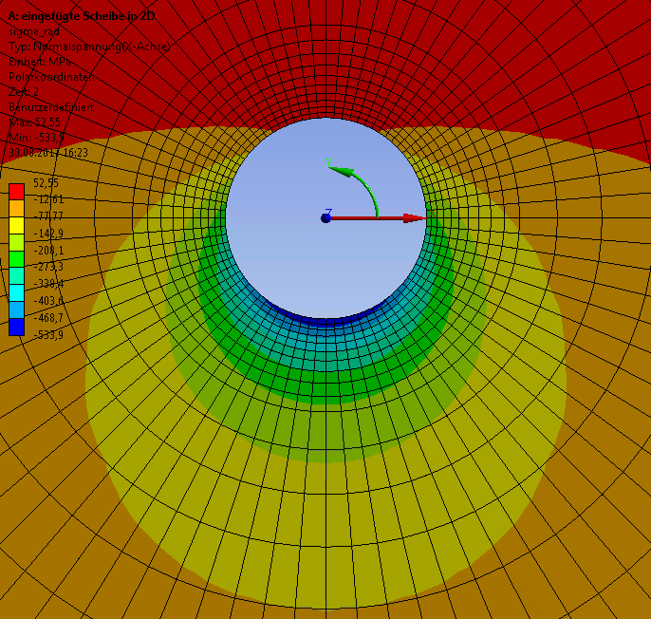
2D FE model - results
Use case
Radial stress
Parameter | Variable | Value | Unit
Radius bore hole | a | 32,5 | mm
Outer radius disk | b | 800 | mm
Young‘s Modulus disk | E | 27 | GPa
Poisson's ratio disk | ν | 0,343 | -
Pretension | p_{i} | 270 | MPa
Radial expansion (caused by pretension) | u₀ | 0,5 | mm
Bolt load | p | 28 | kN/mm

Slide 10
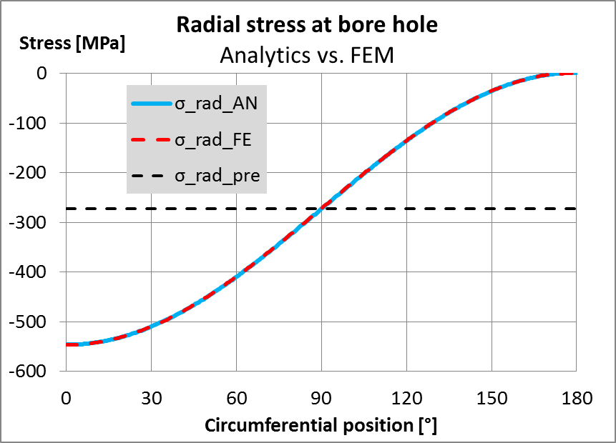
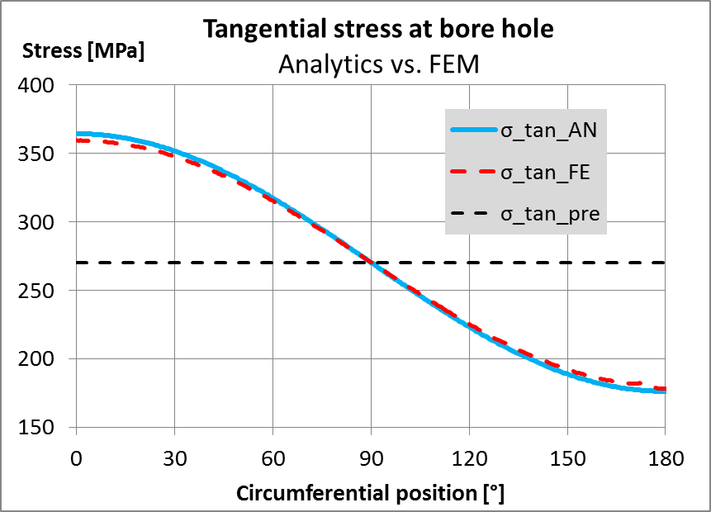




Comparison of analytical and FE model
$$θ=180°$$
$$θ=90°$$
$$p$$
Stresses at bore hole (circumferential path)
σ_{rad} maximum difference: 2 MPa
σ_{tan} maximum difference: 5 MPa
Conclusion: Analytical model is accurate for stresses at bolt hole
Circum-
ferential path
$$θ=0°$$

Slide 11
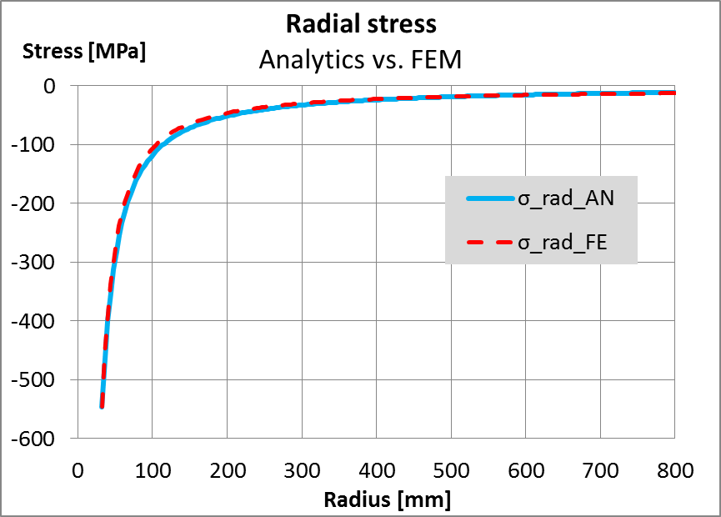
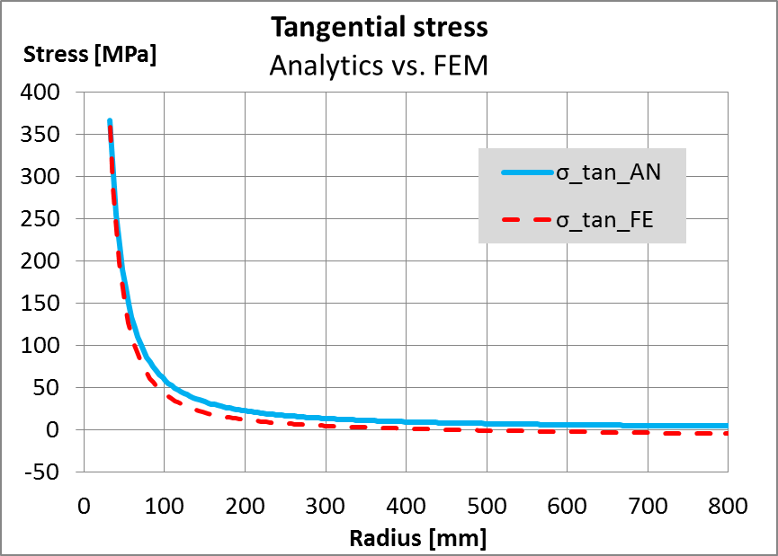




Comparison of analytical and FE model
$$θ=180°$$
$$θ=90°$$
$$p$$
Stresses at bore hole (radial path)
σ_{rad} maximum difference: 16 MPa (~7%)
σ_{tan} maximum difference: 20 MPa (~17%)
Conclusion: Analytical model is sufficient for stresses at whole disk
Radial path
$$θ=0°$$

Slide 12

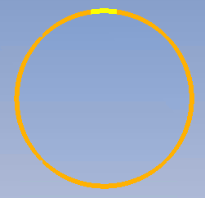
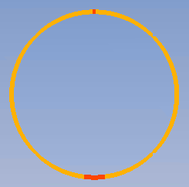
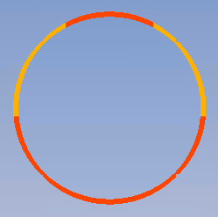
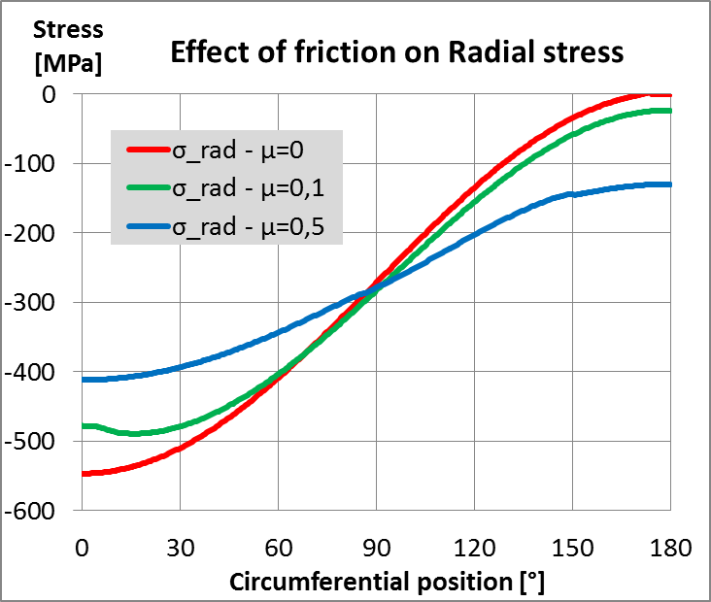
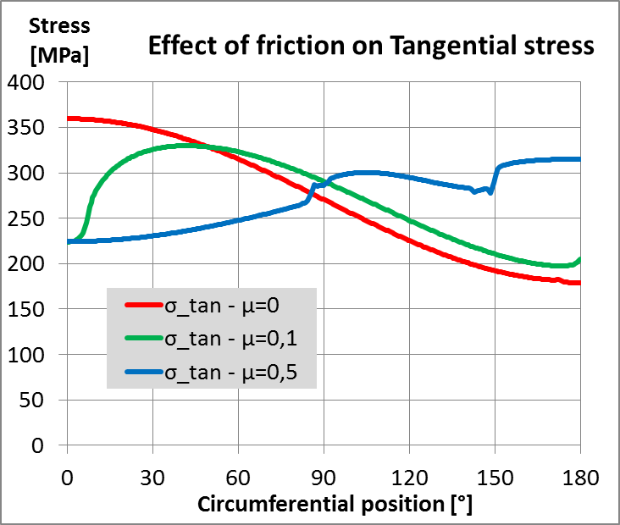





Effect of friction on stress distribution – 2D-FE
Contact status
Near
Sliding
Sticking
Friction strongly influences stress distribution
Coefficient of friction µ between bolt and hole is not well known
Literature [Cuntze] suggests
µ = 0,1 – 0,3
>>> µ = 0,1 chosen
µ = 0
µ = 0,1
µ = 0,5
$$p$$
$$p$$
$$p$$
$$θ=180°$$
$$θ=90°$$
$$p$$
Circum-
ferential path
$$θ=0°$$

Slide 13
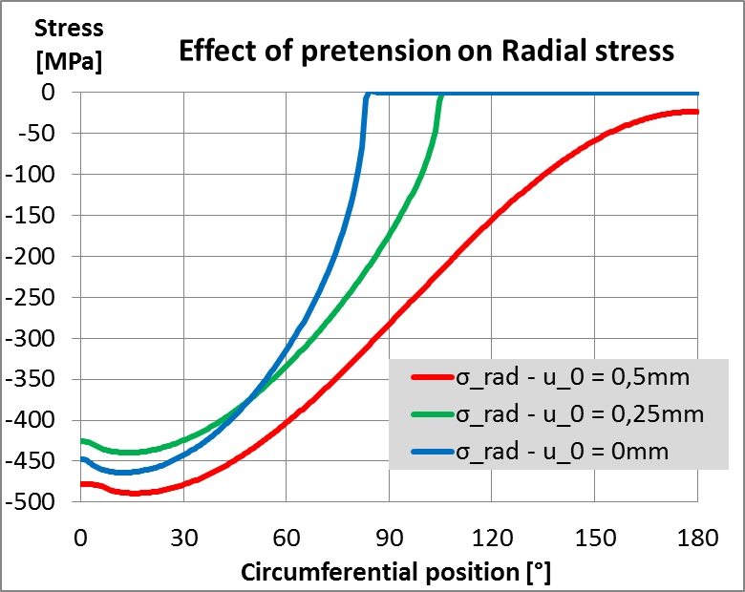
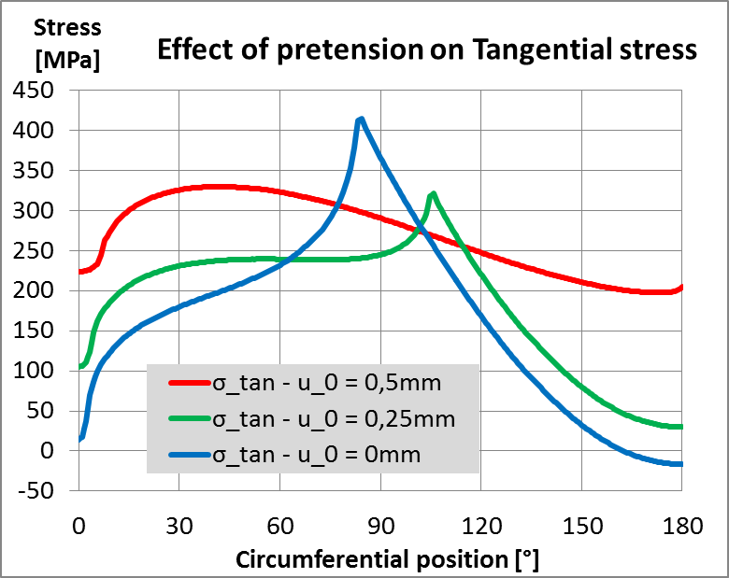


Effect of pretension on stress distribution – 2D-FE
Szenario | Pretension p_{i} [MPa] | Expansion u₀ [mm]
High pretension | 270 | 0,5
Medium pretension | 135 | 0,25
No pretension | 0 | 0
Amount of pretension significantly influences both radial and tangential stress
High pretension avoids clearance under bolt load >> no tangential stress peak at$θ≈90°$
Medium pretension results in minimum overall tangential and radial stresses
$$θ=180°$$
$$θ=90°$$
$$p$$
Circum-
ferential path
$$θ=0°$$

Slide 14
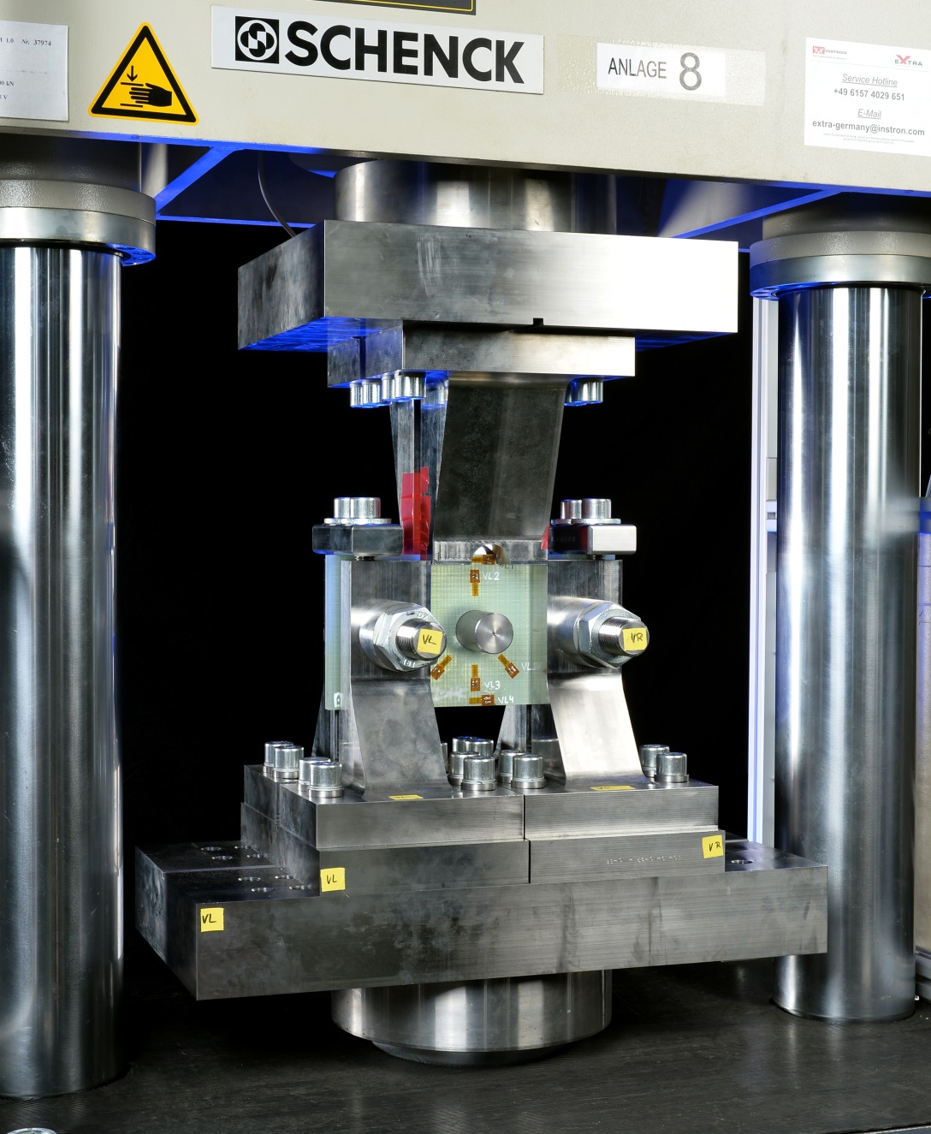
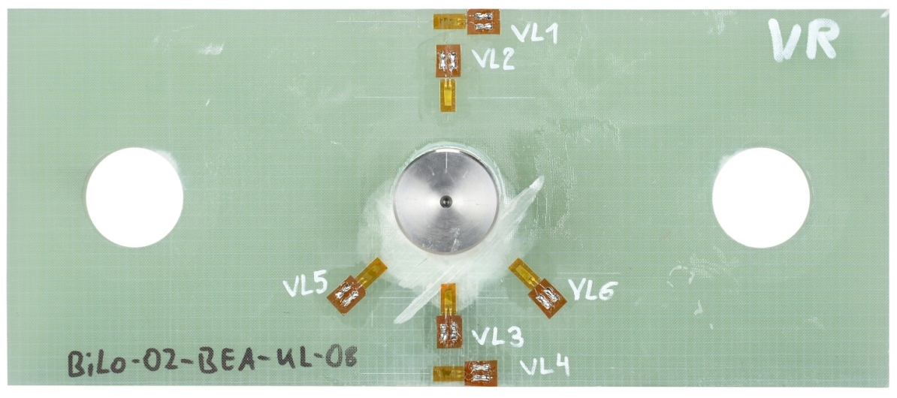

Bearing test setup
Special 3-Point bearing test setup
Laminate thickness t = 10…20 mm
Maximum static load: F = 500 kN
Maximum fatigue load: -50 kN < F < +200 kN
Specimen GFRP
[+45 / -45 / 0 / 90]_{5s}
Bolt
d = 40 mm
Bore hole for fixation
$$F$$
Bearing failure

Slide 15

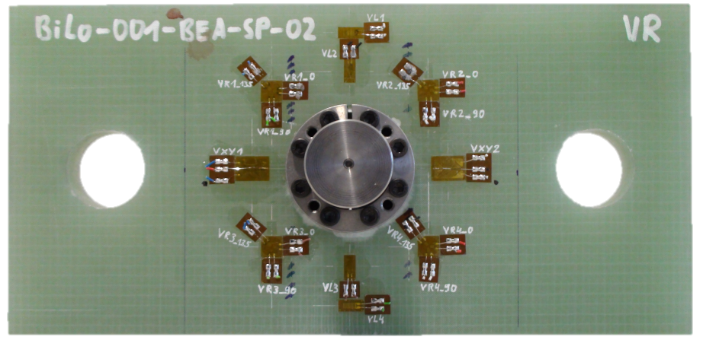
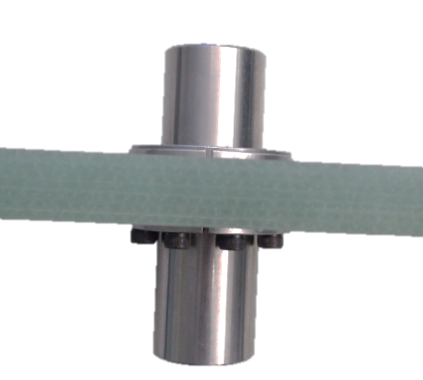
Clearance fit vs. radial pretension
Clearance fit
Clamping bush for radial pretension
Clearance = 0,1 mm
Radial expansion u₀ = 0,4…0,8 mm

Slide 16
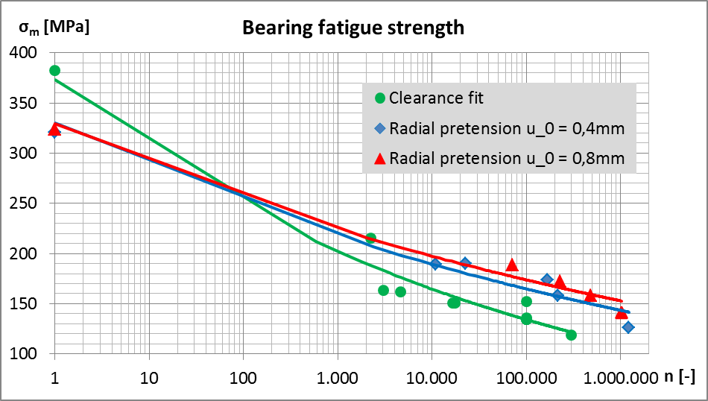
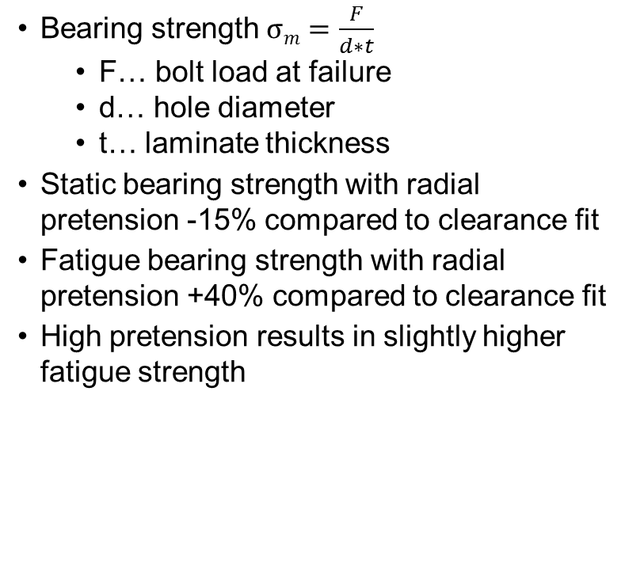
Results in bearing strength
Bearing strength $σm=\frac{F}{d∗t}$
  F… bolt load at failure
  d… hole diameter
  t… laminate thickness
Static bearing strength with radial pretension -15% compared to clearance fit
Fatigue bearing strength with radial pretension +40% compared to clearance fit
High pretension results in slightly higher fatigue strength

Slide 17
Conclusion and Outlook
Conclusion
Analytic model for bolted joints with radial pretension is found and validated by FE-calculation (neglecting friction and cleavage)
Friction has a big impact especially on tangential stresses
Radial pretension results in smooth distribution of stresses around the bore hole
Bearing tests with radial pretension show an increase in fatigue strength, but a decrease in static strength
Outlook
Detailed understanding of bearing failure with radial pretension
Prediction of failure load from FE-calculation
>>> failure criteria for bearing
Bearing tests with different pretensions
>> evaluation of optimum pretension
Bearing tests with combined radial and axial pretension

Slide 18

MANY THANKS FOR YOUR ATTENTION !
DO YOU HAVE ANY QUESTIONS ?
Lutz Beyland, Composite Design Engineer,
German Aerospace Center (DLR), Institute of Composite Structures and Adaptive Systems
Lilienthalplatz 7, 38108 Braunschweig, Germany
Lutz.Beyland@DLR.de

Slide 19
References
[DIEM]
Diem, H.: Tragfähigkeit von Bolzenverbindungen in dickwandigen Faserverbundstrukturen; Dissertation; TU München; 19.2.2007
[HAU]
Hau, E.: Windkraftanlagen: Grundlagen, Technik, Einsatz, Wirtschaftlichkeit, Springer Berlin Heidelberg, ISBN 978-3-540-72150-5
[MÄDLER]
Mädler GmbH: Spannsätze COM-AS Bohrung 19 bis 100mm; http://www.maedler.de/product/1643/1621/spannsaetze-com-as-bohrung-19-bis-100mm; accessed on 30.8.2017
[TIMOSHENKO]
Timoshenko, S.: Theory of Elasticity; McGraw- Hill; 1934
[ZHANG]
Zhang, K.-D.; Ueng, C. E.: Stresses Around a Pin-loaded Hole in Orthotropic Plates; Journal of Composite Materials 18 (1984), No. 5, p. 432-446
[CUNTZE]
CUNTZE, R.; Das Versagensmoduskonzept, ein praktikables Auslegungswerkzeug bei neuen Leichtbauwerkstoffen“; Handout, Dresdner Leichtbausymposium, 7.-9. June 2001

Slide 20
Anhang

Slide 21
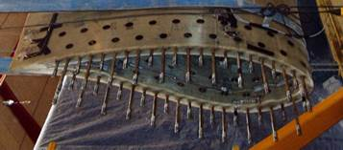
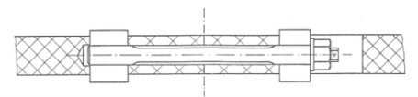
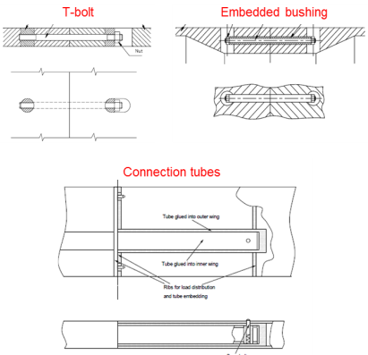
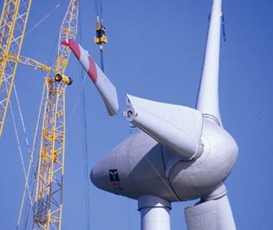
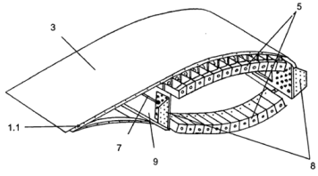
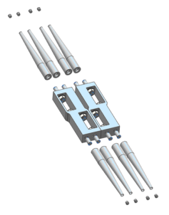
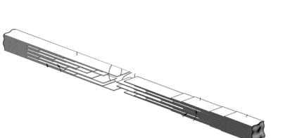
Lösungsraum für segmentierte
Rotorblätter
Megawind
T-bolts
JOULE III
T-bolts
DEBRA-25
Bolting in longitudinal direction
Enercon
E126
Metallic
inserts
JOULE III
Metallic
inserts
Detachable
Gamesa
Bolting in transversal direction
Form-fit
Innoblade
Connection principle
Force-fit
Indeol / CENER
Connection tubes
JOULE III
Connection tubes
Bolting of pieces with a large overlap
Bolting of shear web
Non-Detachable
Welding of thermoplasts
Single lap
Multi lap
Modular
Wind Energy
Bonding of thermosets
Single lap
Multi lap
Multi lap

Slide 22
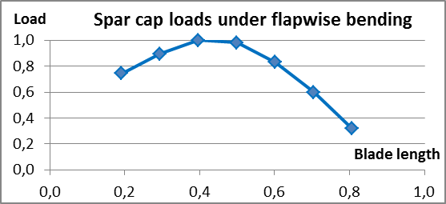
Wo teilen?
Bolting
Bonding
Transportation
Spar cap loads
Secondary loads
Big extra mass = extra cost
Extra mass = dynamic loads
Little space
0
0.2
0.3
0.4
0.5
0.6
0.7
0.8
1

Slide 23
Konzept „Stegverschraubung“
y
x
Tip-Gurt
Tip-Stege
Wurzel-Gurt
Wurzel-Stege
Detail Z
Schnitt A-A
B
z
x
y
Detail Z
x
Wurzel-
Gurte
Tip
Gurte
ca. 5m
Stegbuchse Wurzelsegment
Schraube mit Mutter (ca. M36)
Wurzel-Steg
Tip-Steg
B
Schnitt B-B
A
A
z
y
Stegbuchse Wurzelsegment
Stegbuchse Tipsegment
Stegbuchse Tipsegment

Slide 24
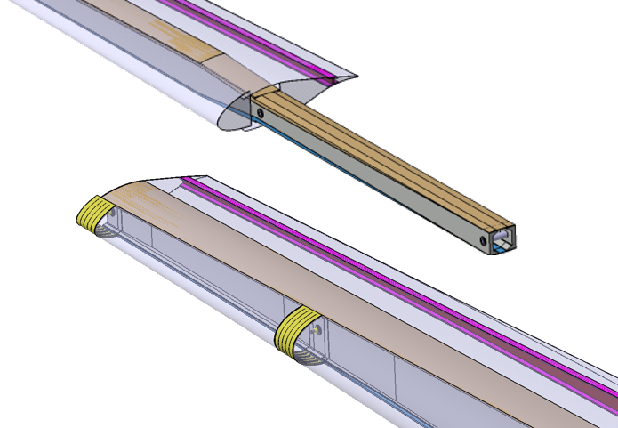
CAD-Modell „Stegverschraubung“ in Nordex-Rotorblatt NR58.5
tipseitige Verschraubung
wurzelseitige
Verschraubung

Slide 25
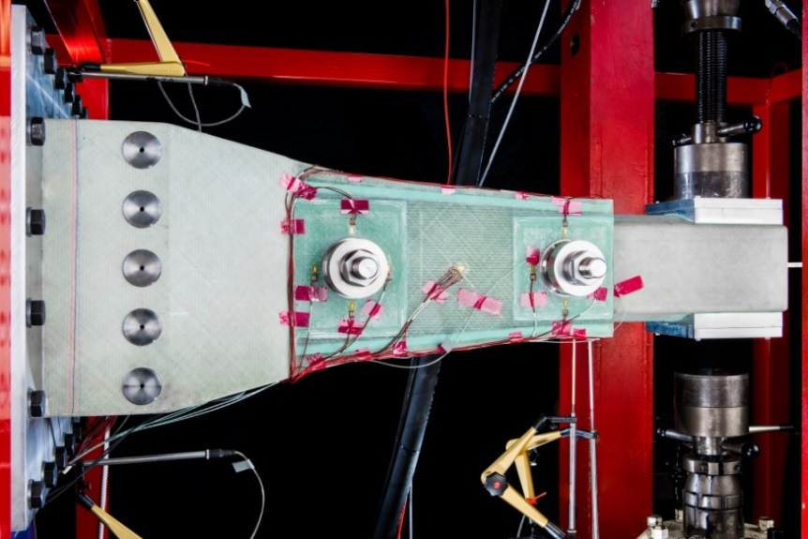

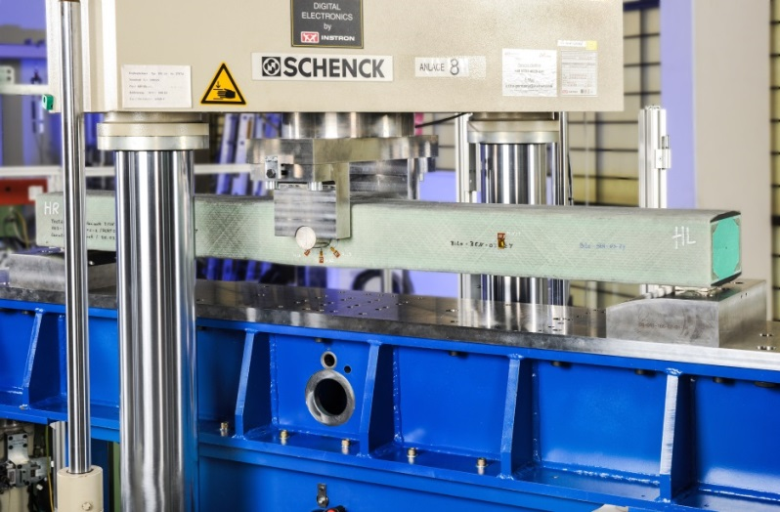
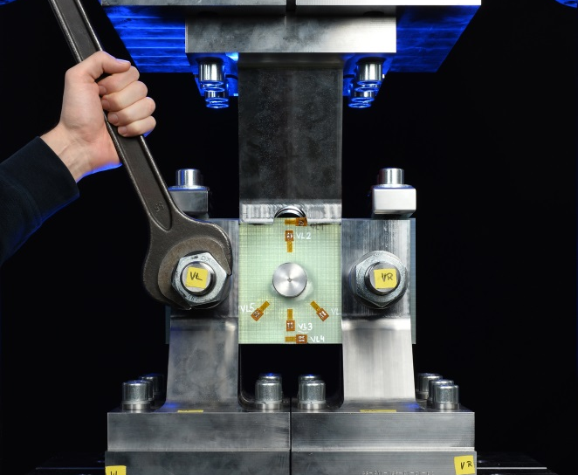
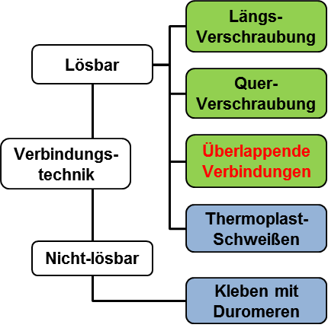
Segmentiertes Rotorblatt – Testpyramide (10-2016)
Coupon-Tests
Lochleibungstests
Biegebalken
Full
Scale
Test
Bauteil-Tests Verschraubte Holme
Design
Konzeptentwicklung
Vorauslegung
CAD-Modellierung

Slide 26
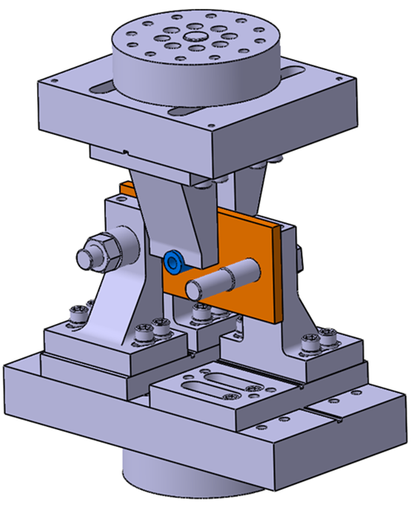
Lochleibungstests BiLo
Klebstoff
>> verklebte Probe ohne Flansch
Spielpassung
>> gesteckte Probe
Spannbuchse
>> verspannte Probe

Slide 27
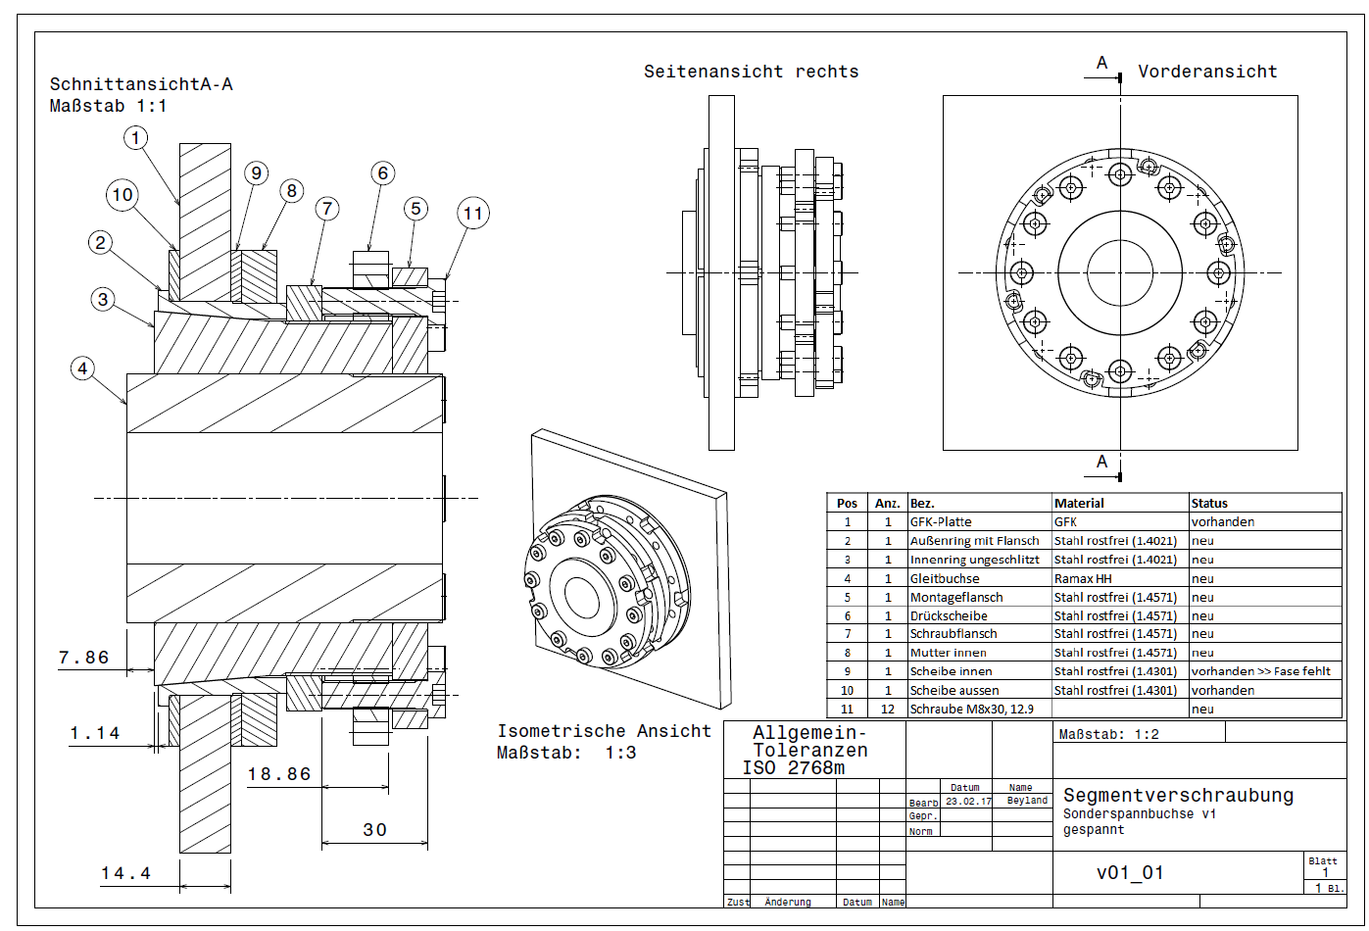
Rax-Buchse – Funktionsdemonstrator + Patentanmeldung

