Slide 1
High-Performance Computing Challenges in Aeronautics and Space Applications
Dr.-Ing. Achim Basermann
German Aerospace Center (DLR)
Simulation and Software Technology
Department High-Performance Computing
Linder Höhe, Cologne, Germany

Slide 2
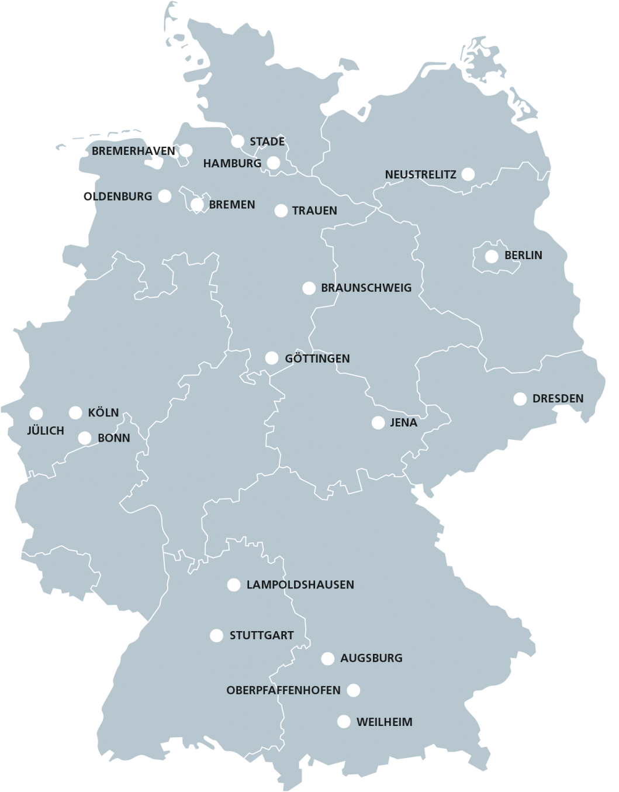
DLR Locations and Employees
Approx. 8000 employees across 40 institutes and facilities at 20 sites.
Offices in Brussels, Paris,
Tokyo and Washington.

Slide 3
DLR Institute Simulation and Software Technology Scientific Themes and Working Groups
Distributed Software Systems
Intelligent and Distributed Systems
Software Engineering
Intelligent Systems
High-Performance Computing
Intelligent Algorithms and Optimization
Departments
Working Groups
Parallel Numerics
Onboard Software Systems
Software for Space Systems and Interactive Visualization
Modeling and Simulation
Scientific Visualization
Virtual and Extended Reality

Slide 4
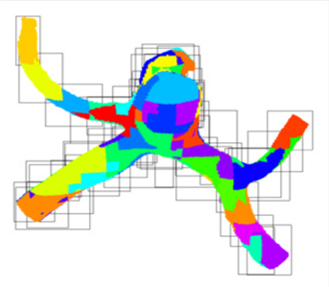
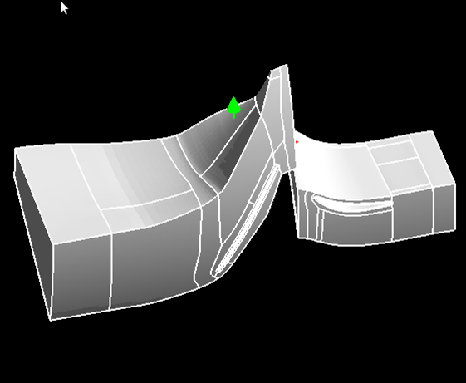
High Performance Computing – Survey of Topics
Parallel algorithms and data structures
Numerical libraries
Optimization algorithms and tools
Algorithms for quantum computers
Parallelization techniques for modern computer architectures
Parallel programming
Programming of quantum computers
Parallel basic libraries
Tools for parallel software systems
Data Science
Pre-processing, e.g. partitioning
High performance data analytics
Parallel monitoring

Slide 5
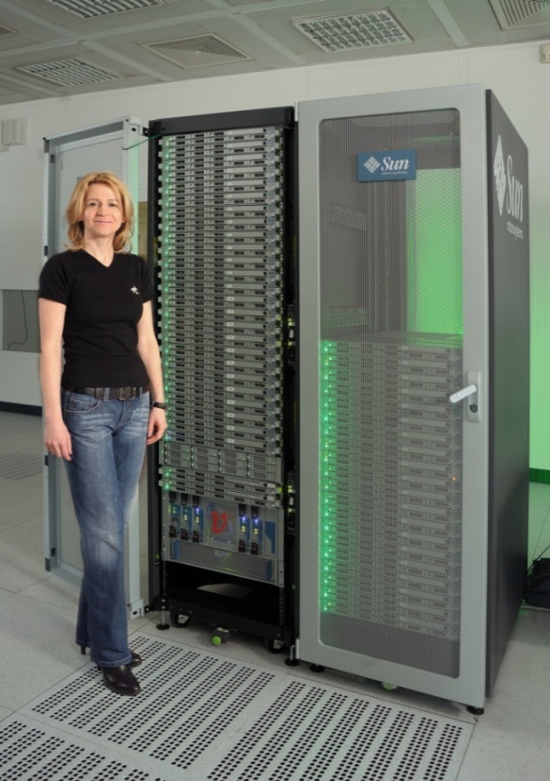
Projects in High Performance Computing at DLR

Slide 6
Survey on Projects
Exascale computing
Solvers for quantum physics problems
Pre- and Processing
Helicopter and aircraft simulation
TiGL – A Geometry Library for Airplanes
Optimization
Thermal management for spacecraft
Aeronautic and space problems for adiabatic quantum annealers
HPC for Space Situational Awareness (SSA)

Slide 7
ESSEX Motivation: Requirements for Exascale
DFG Projekt ESSEX
Hardware Fault tolerance Energy efficiency New levels of parallelism
Quantum Physics Applications Extremely large sparse matrices: eigenvalues, spectral properties,
time evolution
ESSEX
Exascale Sparse Solver Repository (ESSR)
ghost / PHIST
FT concepts,
programming for extreme parallelism
Sparse eigensolvers, preconditioners, spectral methods
Quantum physics / chemistry
ESSEX applications:
Graphene,
topological insulators, …
Notes:
We are motivated by applications from quantum physics that involve the solution of extremely large sparse eigenvalue problems. ESSEX has teamed up to enable this class of applications for exascale systems. We will implement an Exascale Sparse Solver Repository whose features will reach far beyond our target applications.
This is because the routines in the repository have a broad range of applications, and the basic concepts can server as blueprints for many other exascale projects.

Slide 8
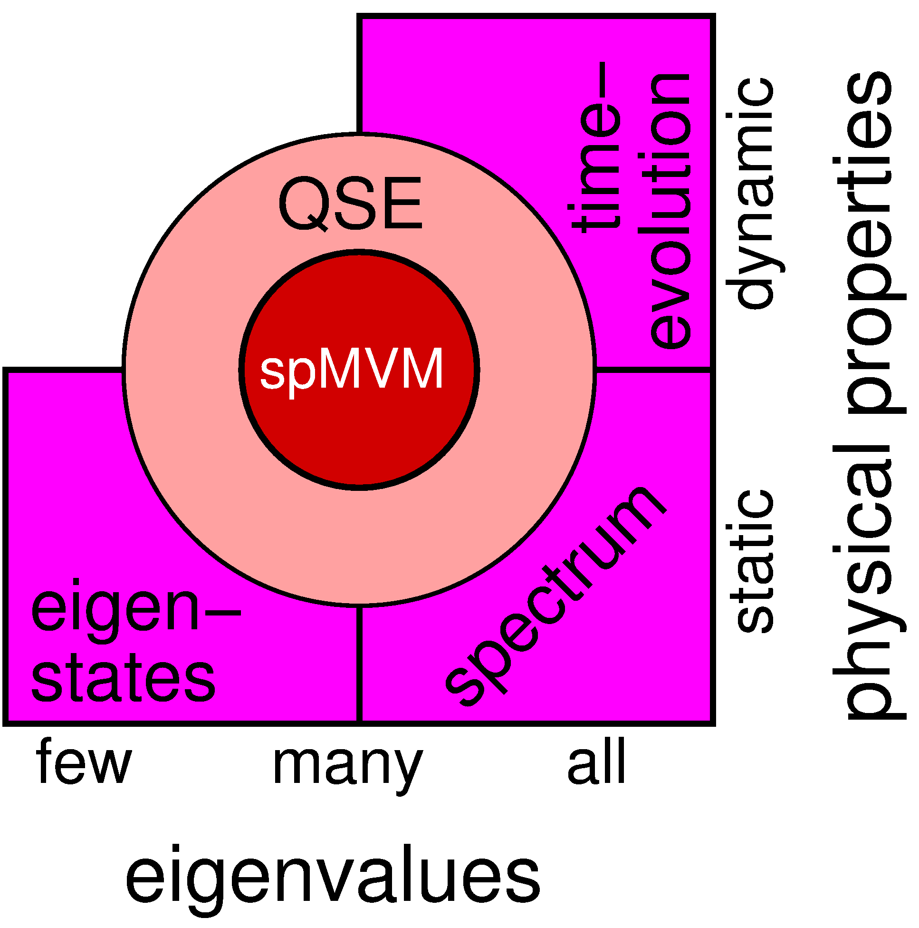
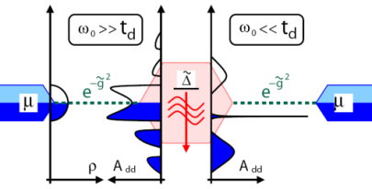
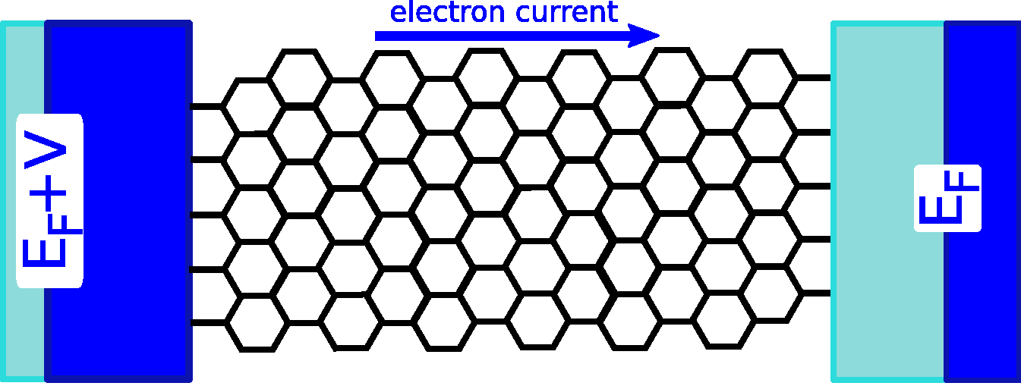
ESSEX: Physical Motivation and Sparse Eigenvalue problem
Solve large sparse eigenvalue problem $$H x= λ x$$
(𝝀_{i}, x_{i})
Notes:
The applications area is first concerned with optimally preparing physical setups for exascale computing. The QSE is crucial for the performance of most basic building blocks, for example a different view on the system’s DoF leads to a drastic change in the matrix sparsity pattern, with corresponding changes in the performance of basic spM operations.
Second, we finally want to solve relevant and challenging problems, which arise from the most fundamental equation of quantum physics: The Schrödinger Equation. Target applications to validate our work are graphene nano-ribbons, transport through quantum dots, and topological insulators.
QSE: Quality Software Engineering

Slide 9
ESSEX Software Development: Basics
Git for distributed software developement
Merge-request workflow for code review; changes only in branches
Own MPI extension for Google Test
Realization of continuous-integration with Jenkins server

Slide 10
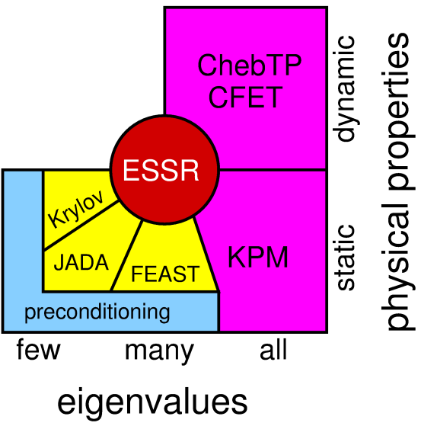
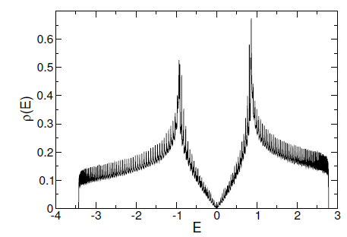
Application, Algorithm and Performance: Kernel Polynomial Method (KPM) – A Holistic View
Compute approximation to the complete eigenvalue spectrum of large sparse matrix $A$(with $X=I$)

Slide 11
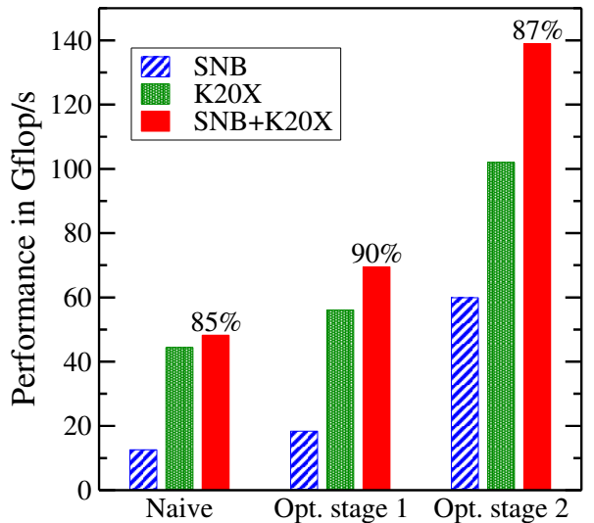
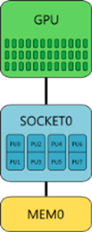
KPM: Heterogenous Node Performance
NVIDIDA K20X
Intel
Xeon E5-2670 (SNB)
2.3x
Heterogeneous efficiency
Topological Insulator Application
Double complex computations
Data parallel static workload distribution
4.8x

Slide 12
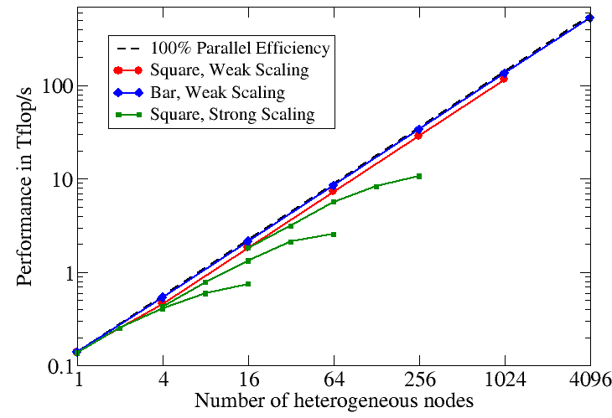
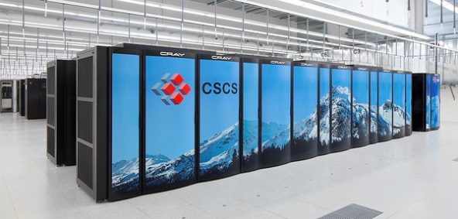
KPM: Large Scale Heterogenous Node Performance
CRAY XC30 – PizDaint*
0.53 PF/s
(11% of LINPACK)
5272 nodes
Peak: 7.8 PF/s
LINPACK: 6.3 PF/s
Largest system in Europe
Performance Engineering of the Kernel Polynomial Method on Large-Scale CPU-GPU Systems M. Kreutzer, A. Pieper, G. Hager, A. Alvermann, G. Wellein and H. Fehske, IEEE IPDPS 2015
*Thanks to CSCS/T. Schulthess for granting access and compute time

Slide 13
EC Project CRESTA (2011-2014)
Three year EU-funded collaborative project, 13 partners, €12 million costs, €8.5 million funding, start: October 2011
Collaborative Research into Exascale Systemware, Tools and Applications
Project coordinator: EPCC at The University of Edinburgh
CRESTA has a very strong focus on exascale software challenges
Uses a co-design model of applications with exascale potential interacting with systemware and tools activities
The hardware partner is Cray
Applications represent broad spectrum from science and engineering
CRESTA will compare and contrast incremental and disruptive solutions to Exascale challenges

Slide 14
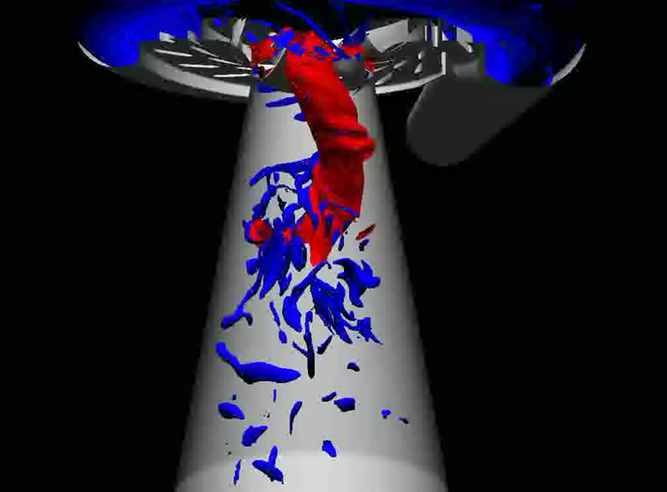
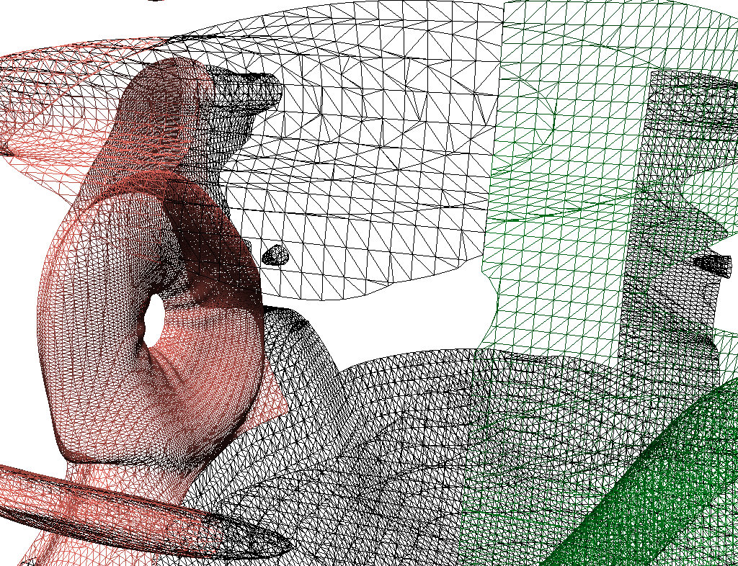
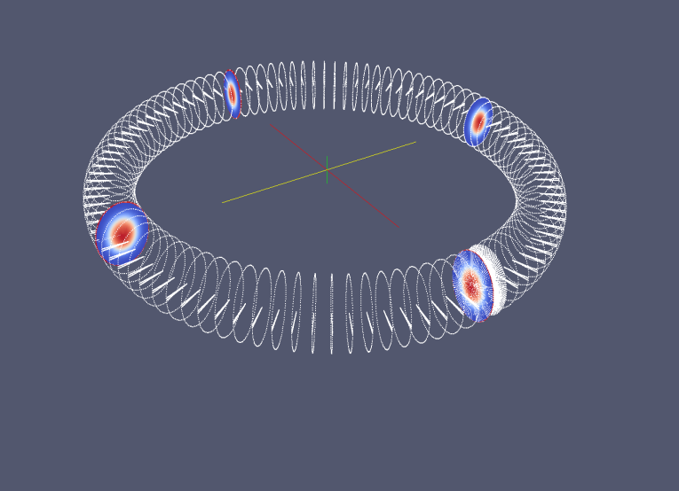
SC: Concepts for Exascale Pre- and Post-Processing
Goals: development of pre- and post-processing as well as remote hybrid rendering tools in order to support exascale applications and users with focus on
mesh analysis and partitioning tools,
visualization tools and
data management tools
in a co-design process with CRESTA applications

Slide 15
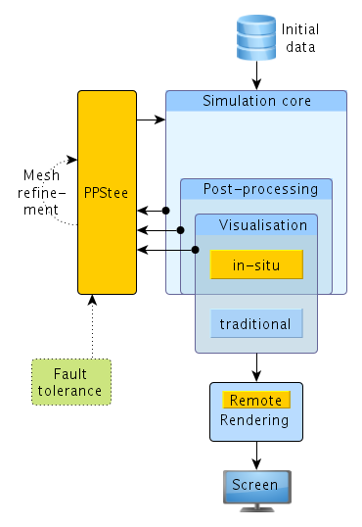
PPSTee: A Pre-Processing Interface for Steering Exascale Simulations
Swappable partitioning tools (ParMETIS, PTScotch, Zoltan)
Consideration of different simulation phases like core computations and visualization

Slide 16
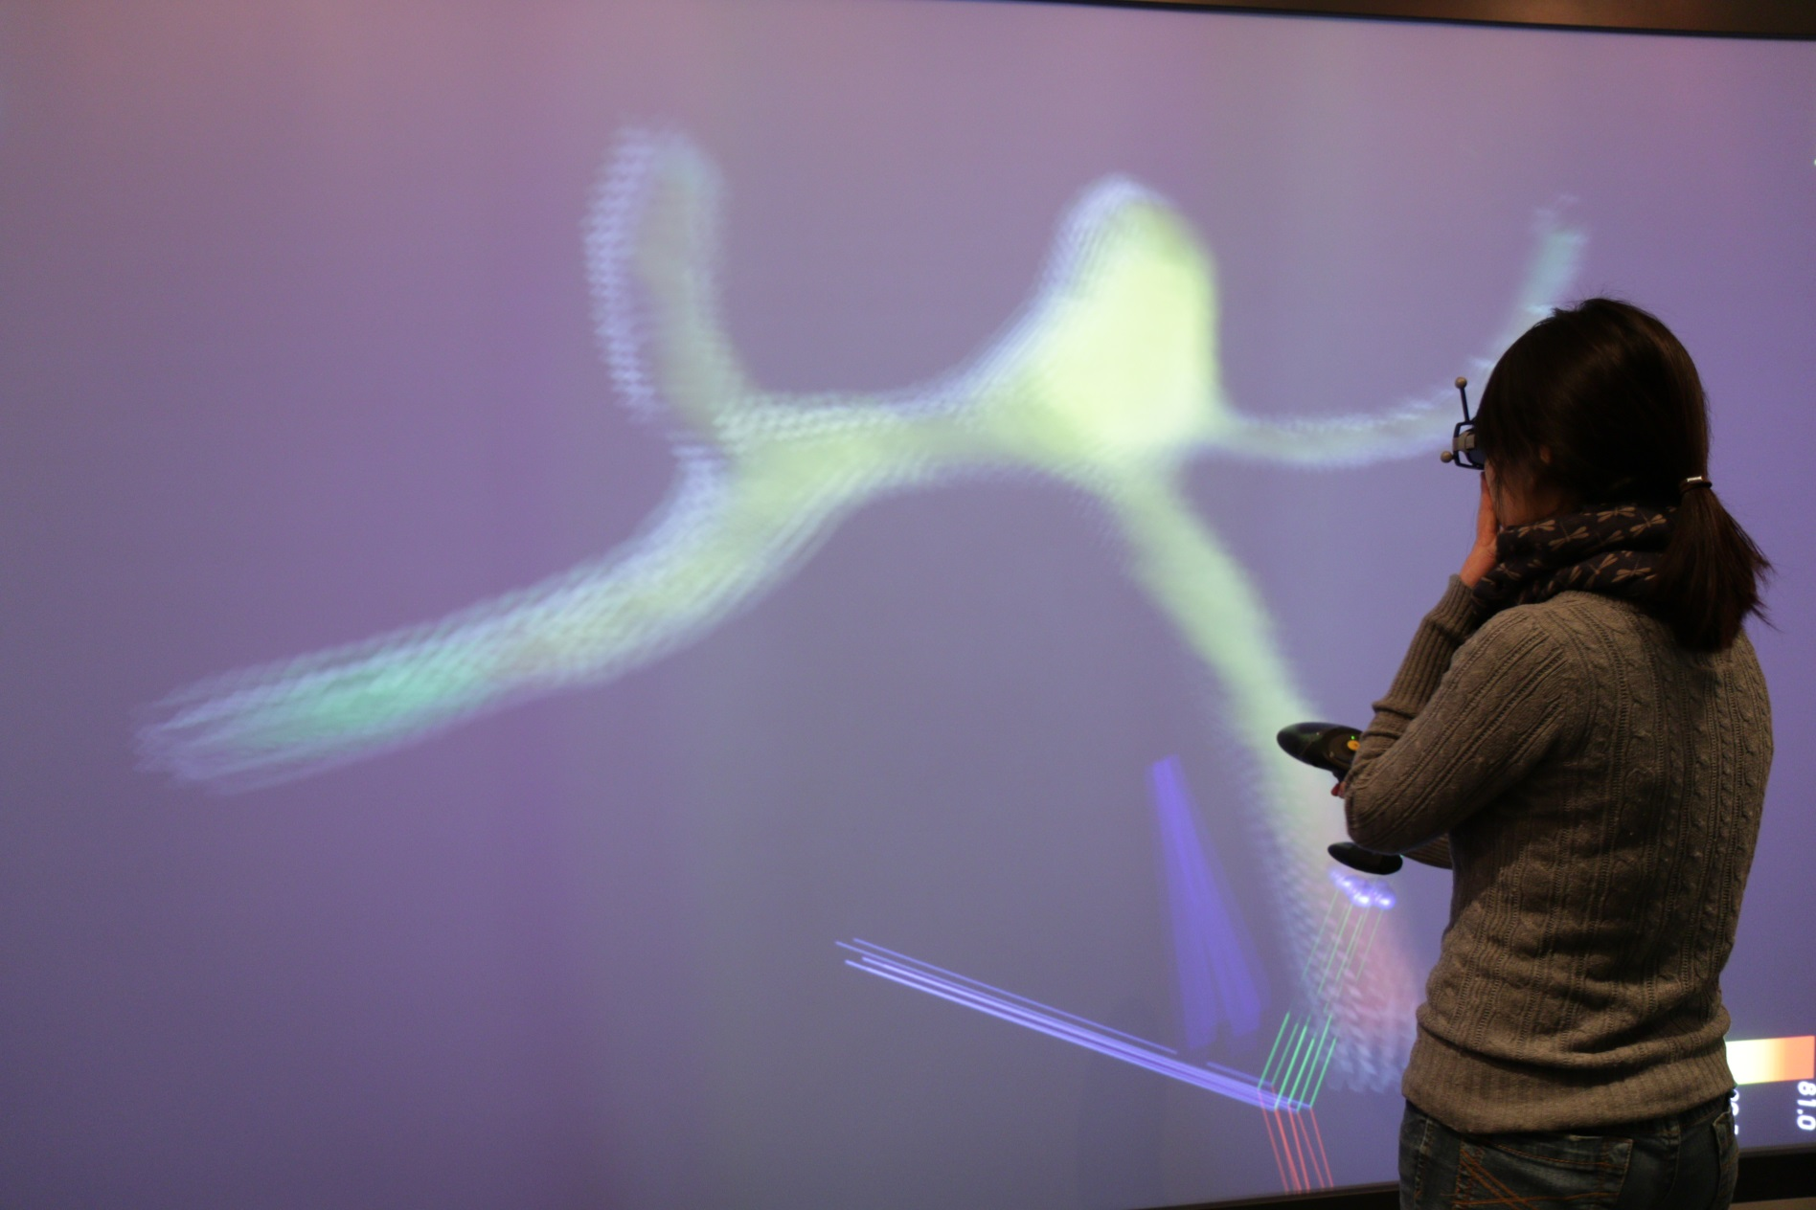
Interactive Particle Seeding

Slide 17
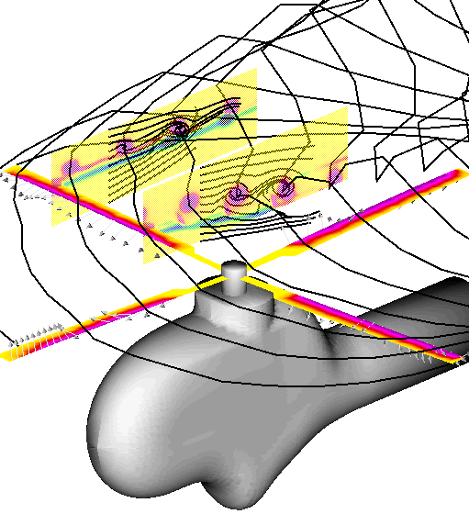
DLR Project Free-Wake
Developed 1994-1996 by FT-HS
implemented in Fortran
MPI-parallel
Used by the FT-HS rotor simulation code S4
Simulates the flow around a helicopter’s rotor
Vortex-Lattice method
Discretizes complex wake structures with a set of vortex elements
Based on experimental data (from the international HART program 1995)
SC´s task: hybrid Free-Wake parallelization for CPUs and GPGPUs

Slide 18
GPU Computing with OpenACC
program main
real :: a(N)
…
!$acc data copyout(a)
! computation on the GPU in several loops:
….
!$acc parallel loop
do i = 1, N
a(i) = 2.5 * i
end do
!$acc parallel loop
…
!$acc end data
! Now results available on the CPU
…
end program main

Slide 19
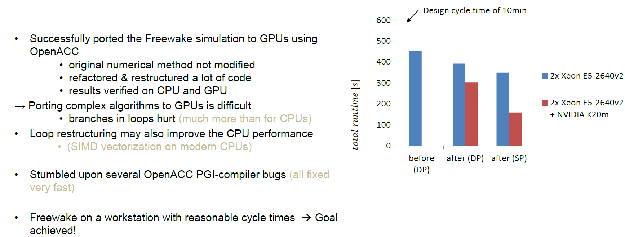
Port to GPGPU and Modernization

Slide 20
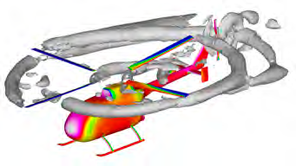
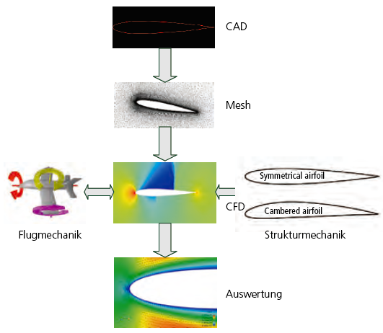
Parallel Coupling Frameworks
FSDM: Flow Simulator Data Manager
VAST: Versatile Aeromechanic Simulation Tool
Flight mechanics
Structural mechanics
Analytics
Coupling of several application components

Slide 21
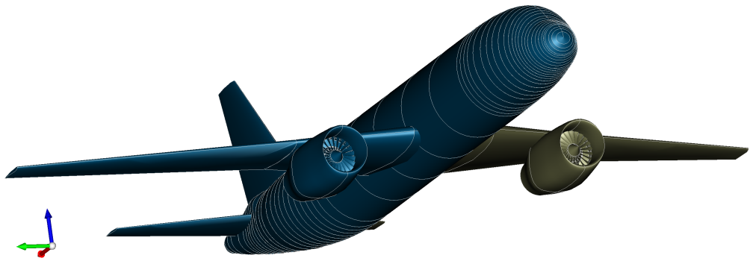
TiGL
A Geometry Library for Airplanes

Slide 22
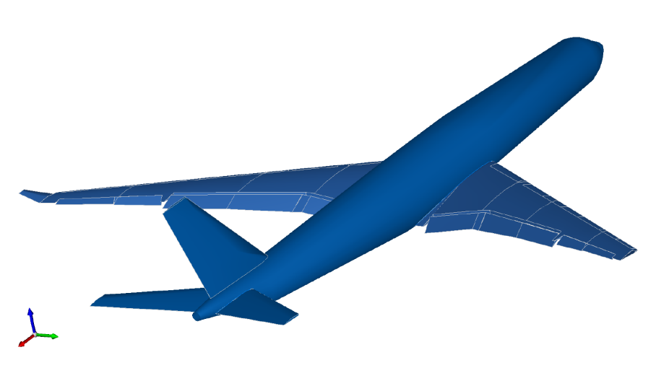
What TiGL does
CPACS (Common Parametric Aircraft Configuration Schema) is an xml scheme that describes the characteristics of an aircraft
includes a parametric description for airplane or rotor-craft geometries
TiGL
generates geometries from CPACS files
provides an interface for geometry manipulation and queries

Slide 23
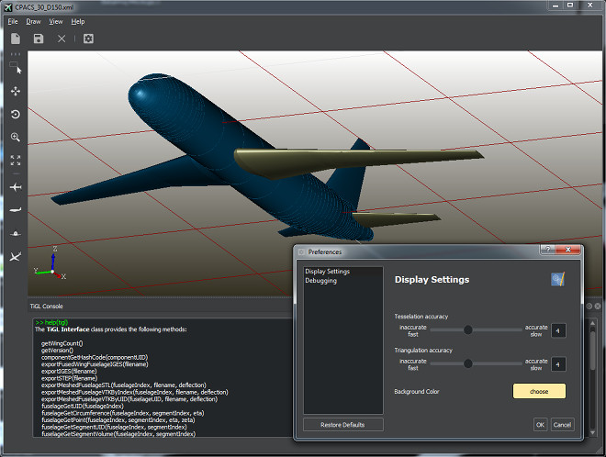
What TiGL is
TiGL is a C++ library with an interface for C, Java, Python, Matlab and Fortran
It uses the Open CASCADE CAD kernel to represent airplane geometries as NURBS surfaces
It is shipped with the TiGL Viewer for visualizing aircraft geometries or viewing CAD files.
It is Open Source and available on Github

Slide 24
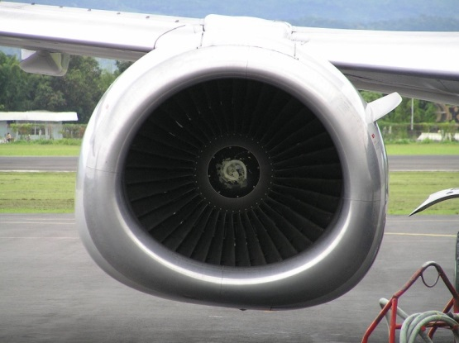
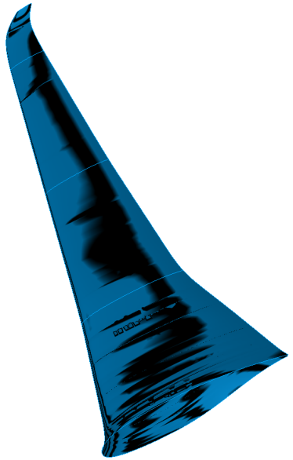
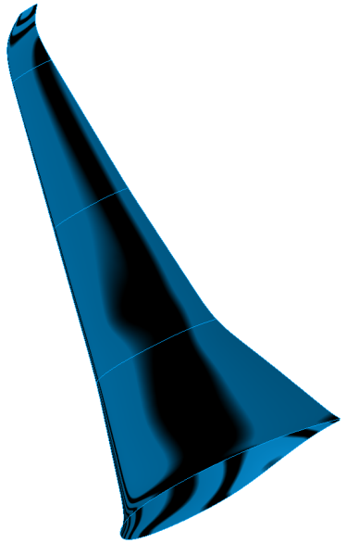
Two Recent Successes in TiGL Development
Optimization-friendly parametrization of engine nacelles
Konstantin Rusch, 2017
Smooth surface generation using Gordon surfaces
Merlin Pelz, 2017

Slide 25
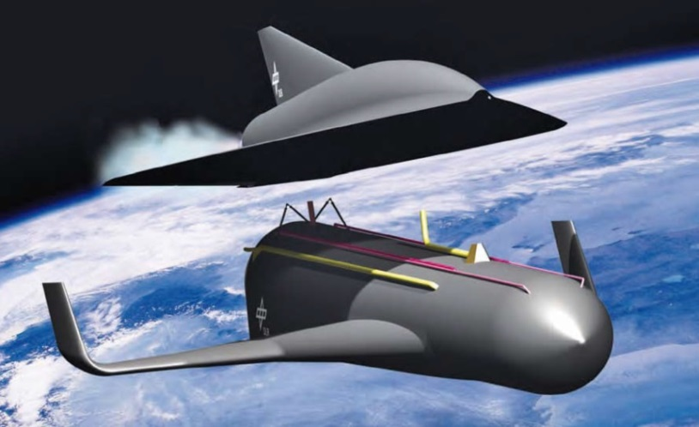
Analysis and Optimization of the Spaceliner Pre-Design
Development of a hypersonic passenger spacecraft for long distance flights
Descent should be accomplished in gliding flight
New research focus: development of a hybrid structure with integrated thermal control units involving magnetohydrodynamic (MHD) effects with cooled magnets

Slide 26
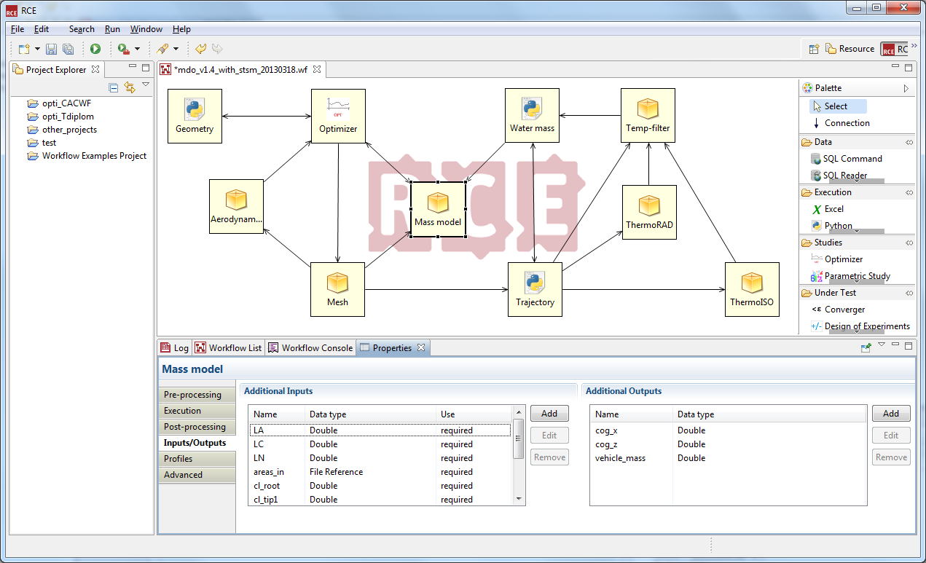
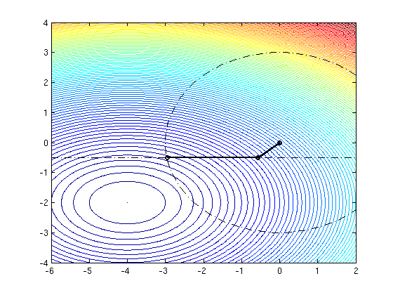
Implementation of a Multidisciplinary Optimization Loop
Implementation of the design as process graph in the software platform RCE (remote component environment) by coupling tools from different disciplines
Problem: no derivatives available
Up to now: use of derivative-free optimizers from toolbox DAKOTA
Our development: new algorithm for nonlinear derivative-free constrained optimization
Derivative-free trust-region SQP-method
Notes:
SQP: Sequential Quadratic Programming

Slide 27
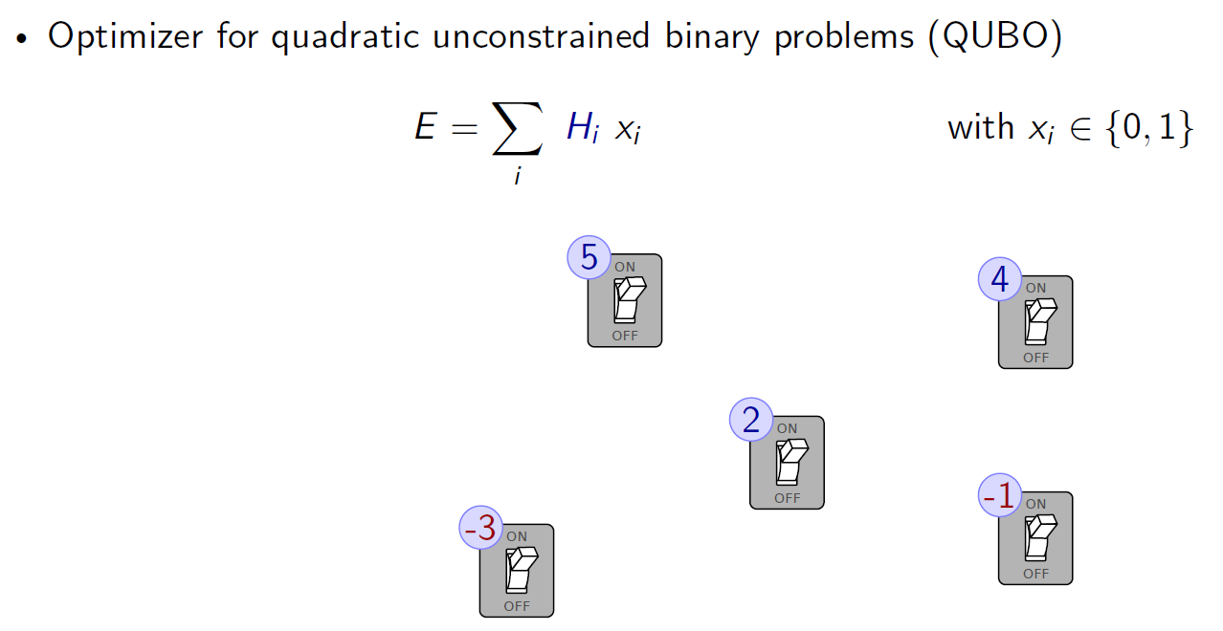
Adiabatic Quantum Computer

Slide 28
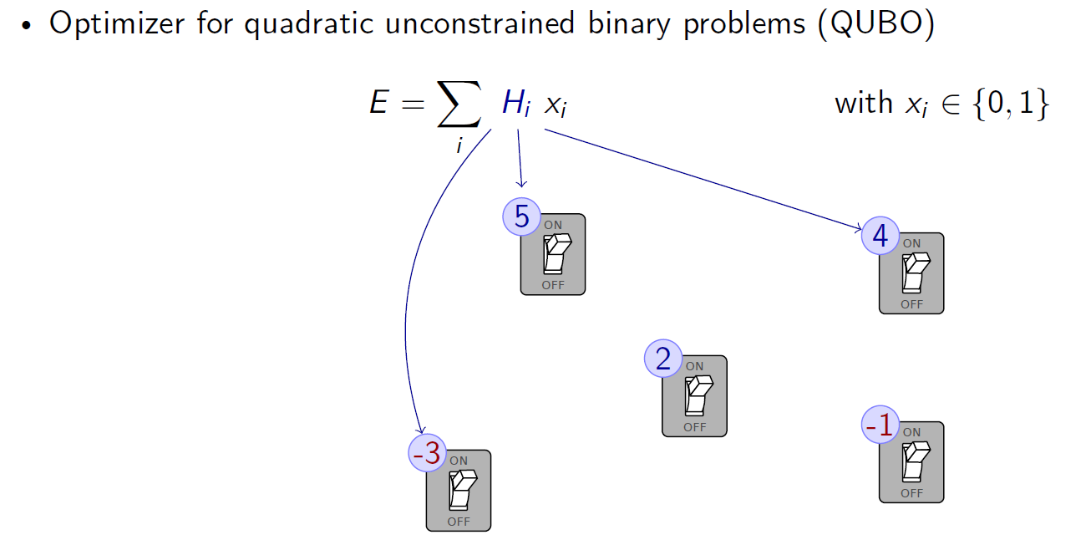
Adiabatic Quantum Computer

Slide 29
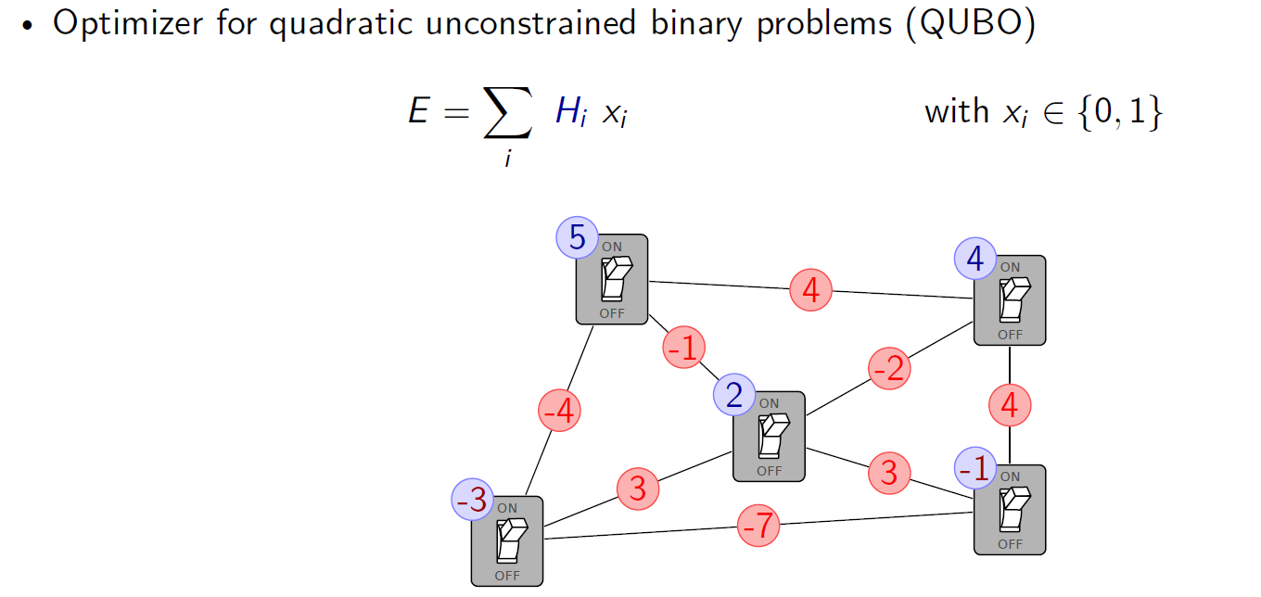
Adiabatic Quantum Computer

Slide 30
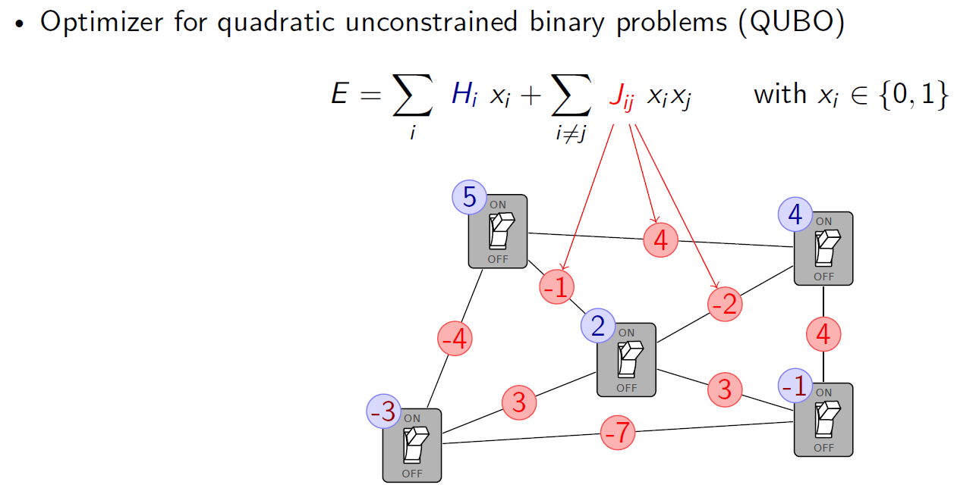
Adiabatic Quantum Computer

Slide 31
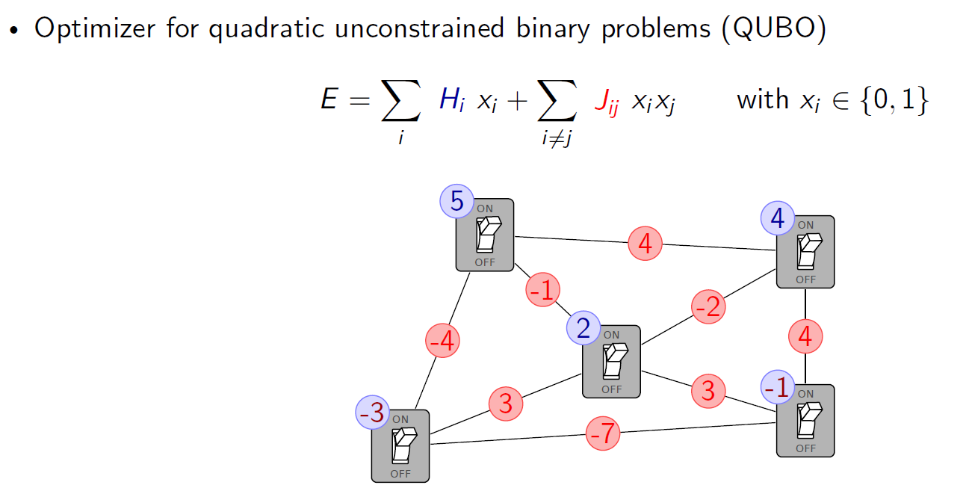
Adiabatic Quantum Computer

Slide 32
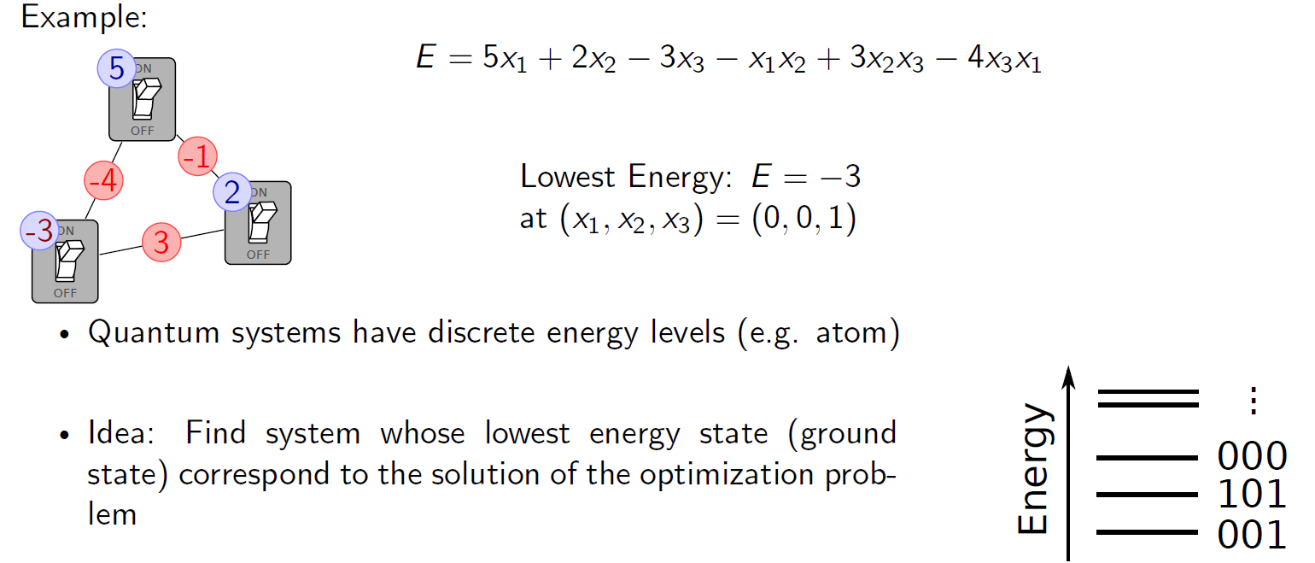
Adiabatic Quantum Computer

Slide 33
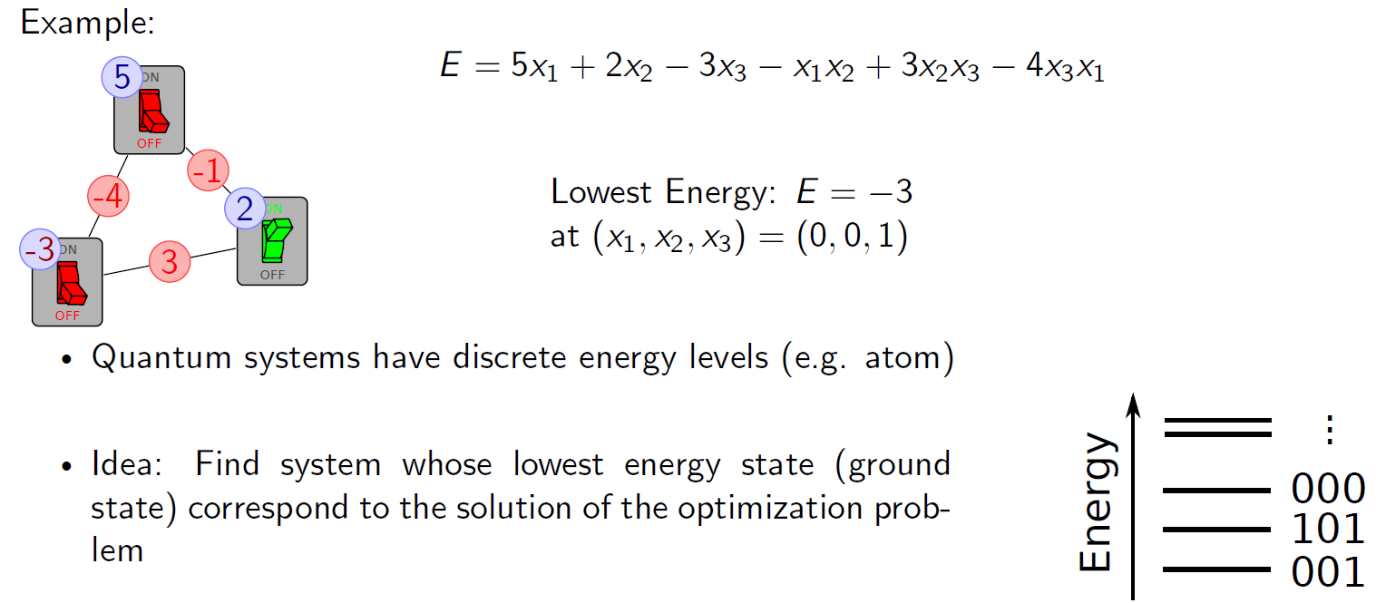
Adiabatic Quantum Computer

Slide 34
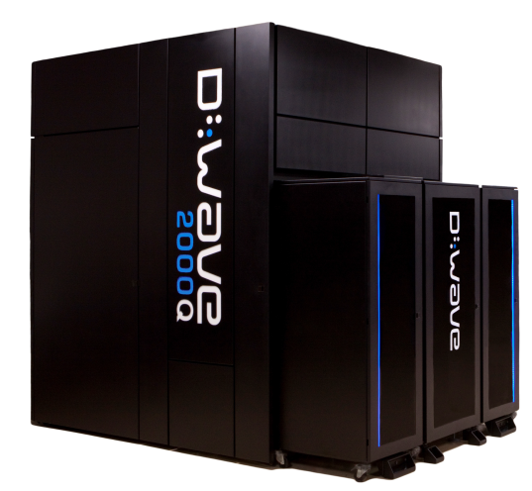
Applications for Quantum Annealers

Slide 35
DLR Application: Satellite Scheduling

Slide 36
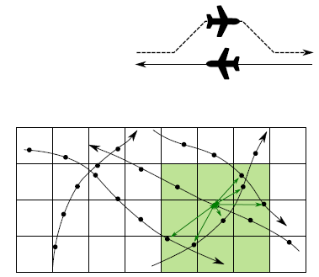
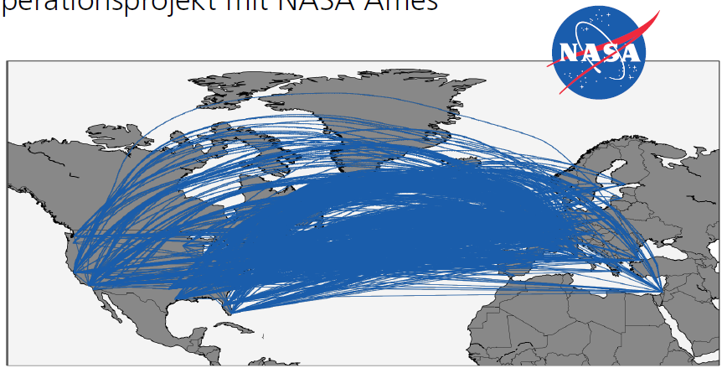
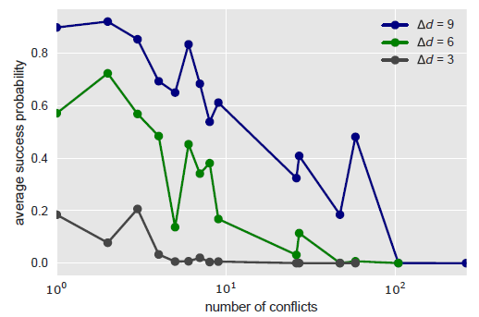
DLR-NASA Application: Air Traffic Management
Optimization problem represented as QUBO
Preprocessing: cluster dependent conflicts
Computation of simplified instances
Preliminary results:
Success probability decreases with increasing problem size
Precision of parameters limited

Slide 37
DLR Software BACARDI: Backend Catalog for Relational Debris Information
Increasing number of space debris
26,000 known objects > 10 cm
Objects > 1 cm problematic
Current capabilities at DLR, GSOC
Orbit propagation
Collision detection
Observation planning and correlation
Composition of a DLR database
TLE unprecise
Precise data restricted
Copyright ESA

Slide 38
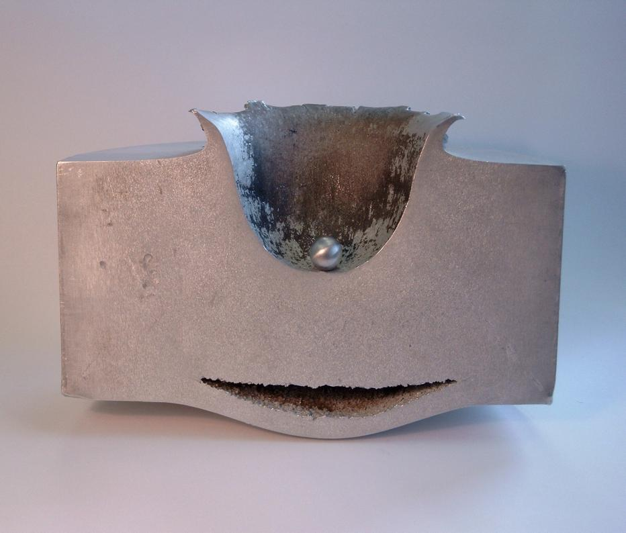
Big Damage through Small Debris Particles

Slide 39
Conclusions
HPC technology successfully exploited in aeronautic and space applications
Development of scalable and maintainable software crucial
New architectures arise with specific application areas
New problem formulations required for certain new architectures
Development of new algorithmic approaches necessary
High performance data analytics increasingly important

Slide 40
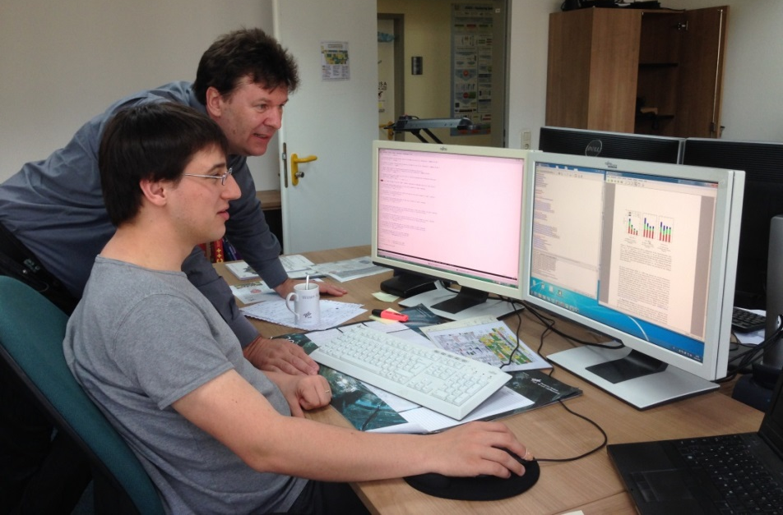
Many thanks for your attention!
Questions?
Dr.-Ing. Achim Basermann
German Aerospace Center (DLR)
Simulation and Software Technology
Department High Performance Computing
Achim.Basermann@dlr.de
http://www.DLR.de/sc

