Slide 1
Towards a THz stand-off Single-Pixel Camera using Compressed Sensing
1st CoSIP Colloquium 04.07.16 - 05.07.16 in Aachen
${\text{Sven} \text{Augustin}}^{(1)}$, ${\text{Benjamin} \text{F}\text{ü}\text{rsich}}^{(2)}$
(1) Humboldt Universität zu Berlin, Mathematisch-Naturwissenschaftliche Fakultät, Institut für Physik, Optische Systeme,
(2) Signal Processing in Earth Observation (SiPEO), Technische Universität München

Slide 2
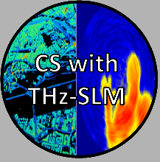
Introduction
Project Goal: „Development of a Terahertz stand-off Single-Pixel camera for security imaging applications“
Hardware part: camera setup development
Software part: algorithmic CS reconstruction framework

Slide 3
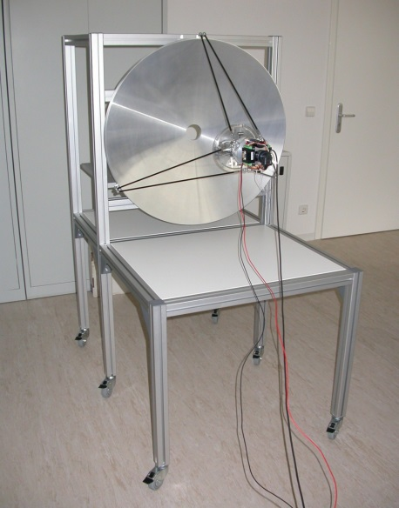
Introduction: Terahertz Radiation (THz)
electromagnetic radiation outside of the visible range
Advantages:
ability to penetrate many optical obstructions (clothing, plastics, etc.)
not harmful to people/living tissue (unlike X-rays!!!)
→ good suited tool for „Security applications“
Disadvantages
invisible radiation
difficult to generate/detect
limited analog processing capabilities
large optical components necessary
THz-Body Scanner
≈2m
how can CS help with that?
≈1.5m

Slide 4
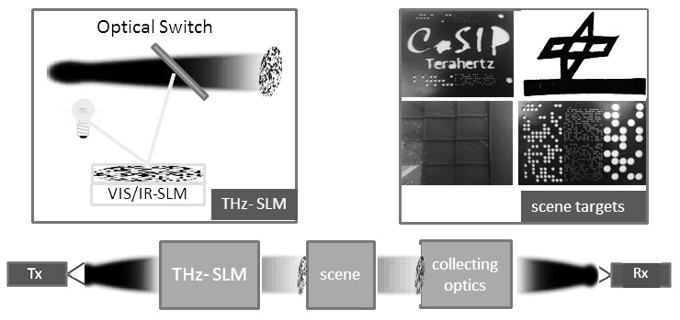
Introduction: CS for THz Body Scanners
Block Diagram
THz-SPC
on the THz-SLM runs an acquisition scheme → here CS can help
reduce number of measurements
reduce acquisition time
improve image resolution
combat imaging artifacts
etc.

Slide 5
Introduction: Software Experiments
Bernoulli-Masks
Hadamard-Masks
pseudo-random illumination patterns
deterministic illumination patterns
what is the optimal illumination pattern (acquisition scheme)
real data needed → Project Roadmap

Slide 6
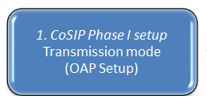
Project - Roadmap
start: 09/2015
→ improving THz spiral imaging through sparse domains
11/2015
→ optimal mask switching
06/2016
→ blind calibration with THz-SLM
07/2016
→ 3D imaging
This is the Status at the
1st CoSIP Colloquium 04.07.16 - 05.07.16 in Aachen

Slide 7
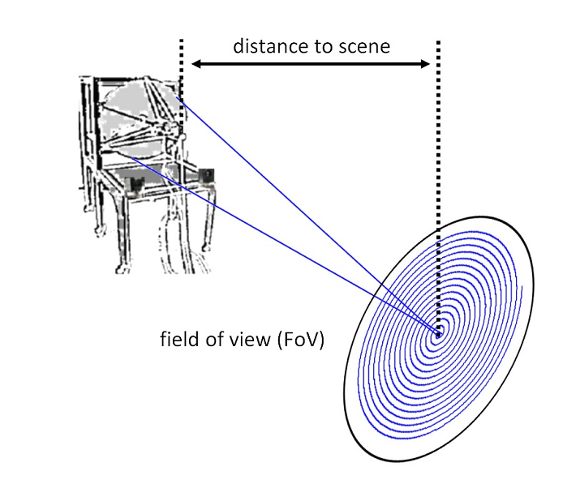
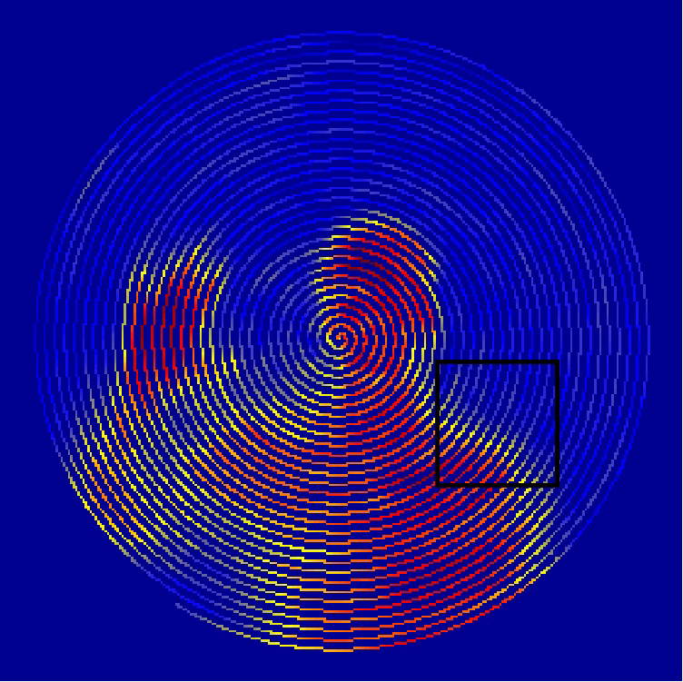
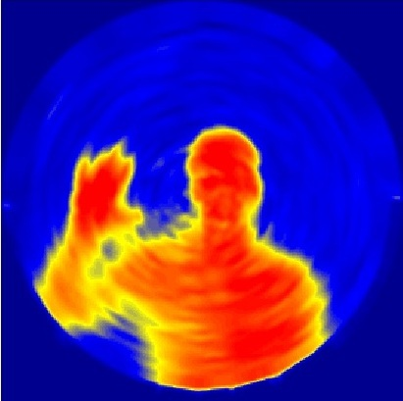
Improving THz spiral imaging through sparse domains
Stand-off THz spiral imaging (state-of-the-art)
Image acquired using spiral scanning setup
Problem: images show severe artifacts
sparse domains for THz images?
spiral images act as reference for the rest of the project
Notes:
The project stated …. (data, mechanical scanning, telecope optic, spiral trajectory)
Here you see … (human body image by the setup with 5m, 3 things on a software level: Interpolation, artefact reduction and finding a good sparse representation)
This is what a Interpolated image by nn- looks like.., as you can see (comic like features that motivate certain sparse representations like TV), but also artefacts probably due blurring,
- During the project we use these images as reference point for studies with the spc

Slide 8
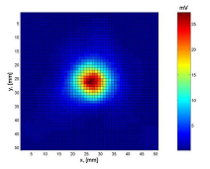
Improving THz spiral imaging through sparse domains
Goal: Modeling of blurring artifacts during sparse reconstruction
Model equation:
Prior knowledge: measured Point Spread Function (PSF) at different positions of the field of view:
$y=Φ ∙B∙Ψ^{−1}\left(α\right)$, with $Ψ\left(x\right)=α$
$$y$$
$$α$$
Measurements in pixel domain
Reconstruction
in sparse-domain Ψ
Deblurring
Undersampling by spiral trajectory
Wavelet,
Shearlet,
TV
$$B$$
$$Φ$$
$$Ψ$$
Notes:
One Idea we had ( interpol the inamges, model these artefacts with a CS reconstruction)
We have this model
So we have the undersampling given by PHI, Blurring described by B and sparsifying transform described by PSI.
B is geiven by prior Knowledge of PSF of our system,

Slide 9
Improving THz spiral imaging through sparse domains
Simulation for spiral imaging:
Sampling with spiral trajectory
Test image
CS reconstruction
Position dependent blurring
Notes:
In a first step we try to simulate the artefacts in the spiral imaging,
We start with a test img…
Still in the process of testing diffrent representation domains and blurring
In a next step we want to apply this to real data

Slide 10
Project - Roadmap
start: 09/2015
→ improving THz spiral imaging through sparse domains

11/2015
→ optimal mask switching
06/2016
→ blind calibration with THz-SLM
07/2016
→ 3D imaging
This is the Status at the
1st CoSIP Colloquium 04.07.16 - 05.07.16 in Aachen
Notes:
The next part is about…

Slide 11
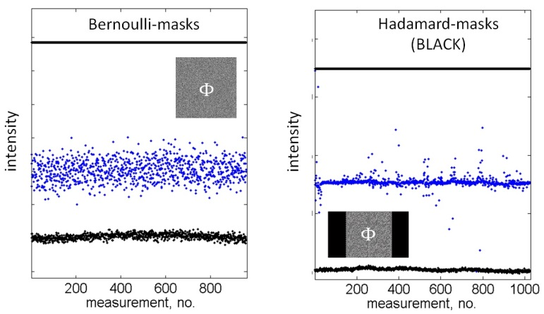
Mask Switching: Deterministic vs Non-Deterministic
THz-SLM based measurements with a single detector

Slide 12
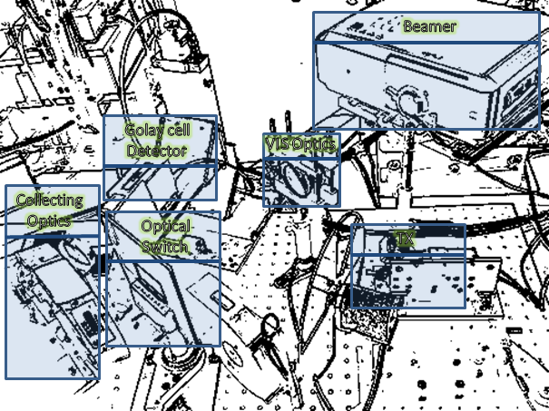
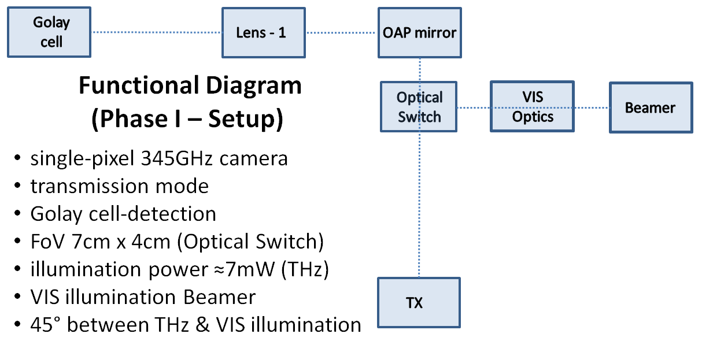
Mask Switching: Phase I Setup
first Reconstruction Results:
lsqnonneg
pinv
cvx

Slide 13
Mask Switching: Image Reconstruction Example
Phase I – Example Measurement (horizontal grid)

Slide 14
Project - Roadmap
start: 09/2015
→ improving THz spiral imaging through sparse domains


11/2015
→ optimal mask switching
06/2016
→ blind calibration with THz-SLM
07/2016
→ 3D imaging
This is the Status at the
1st CoSIP Colloquium 04.07.16 - 05.07.16 in Aachen
Notes:
I talk a bit about what we are trying calibrating

Slide 15
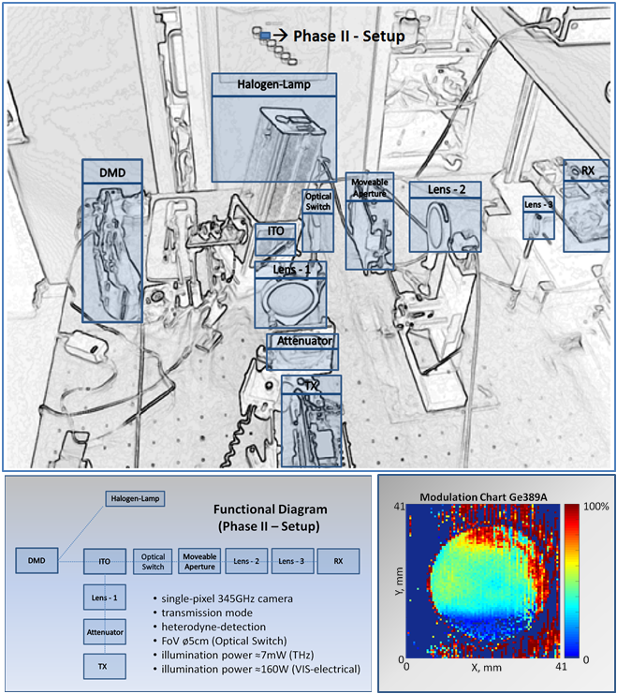
Blind Calibration: Phase II Setup
Notes:
- This is the… (currently used lens setup, faster measurement, higher res., due to a improved optical switch,)
Here on the bottom ( intensity distrib. Of THz rad behindthe optical switch)
As you can see some bigger variations there problably due to the optics, which will ultimatly effect the reconstruction quality
- This motivates that we calibrate of the imaging setup according to these differences.
Such Hardware calibration fails on pixel level because SNR is to low

Slide 16
Blind calibration with THz-SLM: Idea
Measurements are adversely affected by e.g. non-uniform modulation of the THz radiation by the SLM and setup inhomogeneities in general:
Blind Calibration:
Reconstructing unknown gains $D=diag(d)$ on compressed sensing measurement, when provided enough measurements Y
utilize this methodology to calibrate THz SLMs
$$D$$
$$Φ$$
$$Y=D∙Φ∙X$$
$$D, X$$
Notes:
The CS community gives us Blind Calibration methods that allows for reconstructing a unknown gains up to a global gain factor together with the measured images, when we provide enough measurements.
We aim to utilize this technique to calibrate our THz SLM and calculate the specific pixel modulation without the need for a light shade behind the semiconductor
This software based method, should us allow to overcome the SNR limitation we have when using a hardware based calibration.

Slide 17
Blind calibration with THz-SLM
$$Y=\left(ϕA+\left(𝕀−ϕ\right)B\right)X$$
Goal
Recovery of A and B
$$A=\left(\left[\begin{matrix}a_{1} & ⋯ & 0 \\ ⋮ & ⋱ & ⋮ \\ 0 & ⋯ & a_{n}\end{matrix}\right]\right)∈{\left[0,1\right]}^{n×n} B=\left(\left[\begin{matrix}b_{1} & ⋯ & 0 \\ ⋮ & ⋱ & ⋮ \\ 0 & ⋯ & b_{n}\end{matrix}\right]\right)∈{\left[0,1\right]}^{n×n}$$
$φ=\left(\left[\begin{matrix}φ_{11} & ⋯ & φ_{1n} \\ ⋮ & ⋱ & ⋮ \\ φ_{m1} & ⋯ & φ_{mn}\end{matrix}\right]\right)$ $∈ℝ^{m×n}$ $𝕀=\left(\left[\begin{matrix}1 & ⋯ & 1 \\ ⋮ & ⋱ & ⋮ \\ 1 & ⋯ & 1\end{matrix}\right]\right)$ $∈1^{m×n}$
A = intensity matrix when pixels are turned on
B = intensity matrix when pixels are turned off
$φ$ = Sensing Matrix
Notes:
Unlike the visible light case we can not turn pixels off completely, but also always have some intensity when the semiconductor is not illuminated
Our system model is described by this equation (pointer) here. Y is again our measurement vector, X our reconstructed signal.
A gives a matrix whose elements are related to the different pixels that are turned on. B gives a matrix, with diagonal elements being related to the passing THz radiation, with no illumination on the pixel.
In order to find the pixel modulation we need to calculate a/b,
Next steps for this project part to apply this to a specific measured data with the phase 2 setup to check if we can improve the reconstruction quality with this approach.

Slide 18
Project - Roadmap
start: 09/2015
→ improving THz spiral imaging through sparse domains


11/2015
→ optimal mask switching
06/2016
→ blind calibration with THz-SLM

07/2016
→ 3D imaging
This is the Status at the
1st CoSIP Colloquium 04.07.16 - 05.07.16 in Aachen
Notes:
Now I want to talk about the extension for 3D imaging

Slide 19
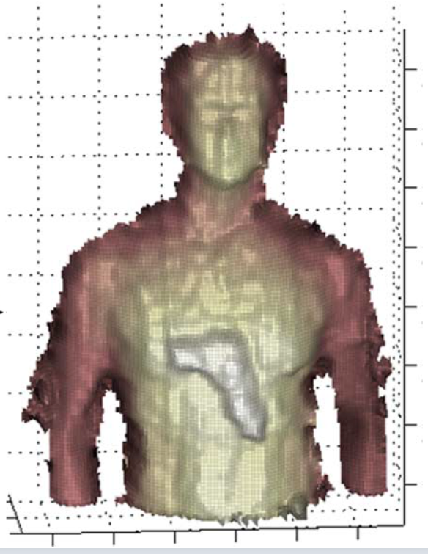
3D imaging: Reconstruction for 3D single-pixel FMCW radar
Extending the 2D THz single-pixel camera to 3D imaging by frequency modulated continuous wave radar (FMCW)
Cooper et al. (1)
Goal: to Build an optimized reconstruction framework for the 3D case
Notes:
For the Phase 2 setup, we aim to extend our 2D single-pixel imaging to 3D imaging using FMCW radar in the reflection mode.
This image from Cooper et al. is what we are aiming for with the setup extension. So we want surface profiles combined with depth information.
- On the software part, we aim to provide a reconstruction framework for this 3D extension.

Slide 20
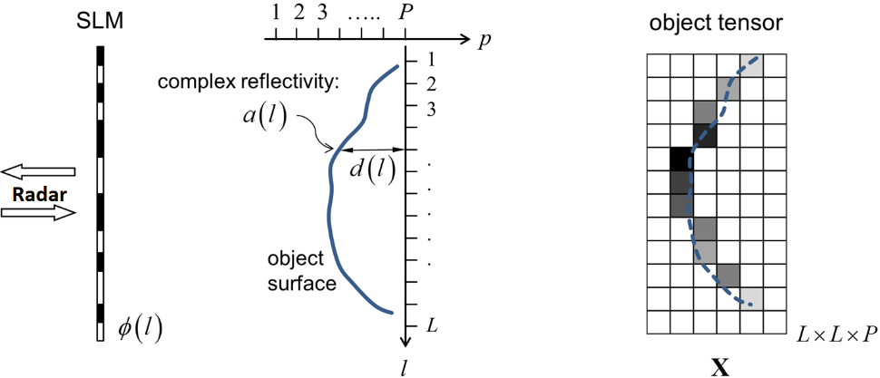
3D imaging: Reconstruction for 3D single-pixel FMCW radar
Model:
Measurement equation:
$Y= φ X+E$
Projection map:
$a= X ∙1$, with $1={\left[1 1…1\right]}^{T} ∈ℝ^{px1}$
Depth map:
$d= X ∙p ∙diag{\left(a\right)}^{−1}$,
with ${p=\left[1 2…P\right]}^{T}∈ℝ^{px1}$
Notes:
In a first step I explain the model we are using for the 3D imaging case:
We are denote a Matrix Y for measurements and X the radar signal , which ultimately corresponds to a 3D object tensor. Along the Rows of Y and X we encode the range direction and along the columns we have all the pixel of a certain 2D slice.
The measurement equation can then be written as standard linear form … + an error term
- We can call the vector a projection map because it projects the 3D object tensor down to a 2D image. So from the matrix to a vector.
- We can call d the depth map which encodes the range information in a vector.

Slide 21
3D imaging: Reconstruction for 3D single-pixel FMCW radar
Model:
Measurement equation:
$Y= φ X+E$
Projection map:
$a= X ∙1$, with $1={\left[1 1…1\right]}^{T} ∈ℝ^{px1}$
Depth map:
$d= X ∙p ∙diag{\left(a\right)}^{−1}$,
with ${p=\left[1 2…P\right]}^{T}∈ℝ^{px1}$
Different reconstruction approaches:
Separate slice wise
$$x_{i, rec}=\underset{x_{i}}{\underbrace{argmin}}\left\{\frac{1}{2}{\left\| φ x_{i}−y_{i}\right\|}_{2}+λ_{1}{\left\| Ψ\left(x_{i}\right)\right\|}_{1}\right\}$$
Iterative approach using sparsity in the projection map
$a_{rec}= \underset{a}{\underbrace{argmin}}\left\{\frac{1}{2}{\left\| φ a−Y∙1\right\|}_{2}+λ_{1}{\left\| Ψ_{a}\left(a\right)\right\|}_{1}\right\}$, solve $X_{d, guess}= \underset{X}{\underbrace{argmin}}\left\{{\left\| φ X−Y\right\|}_{F}\right\}$ iteratively
3D reconstruction with additional regularizing terms
$$X_{rec}= \underset{X}{\underbrace{argmin}} \left\{\frac{1}{2}{\left\| φ X−Y\right\|}_{F}+λ_{1}{\left\| Ψ_{a}\left(a(X)\right)\right\|}_{1}\right.\left.+λ_{2}{\left\| Ψ_{d}\left(d(X)\right)\right\|}_{1}+λ_{3}{\left\| [∇\left(a\left(X\right)\right),∇\left(d\left(X\right)\right)]\right\|}_{1,2}\right\}$$
Notes:
Currently we are investigating different reconstruction strategies for this scenario.
A first approach is to just reconstruct each column of X separately with each column of y denoted as x_i and y_i. We use a regularizing term of the l1 norm for sparsyfing each slice
In this second approach we once solve a l1 optimization for the Projection map and iterativly solve the data fidelity term for 3D.
In a third approach we propose to do a full 3D reconstruction in a single optimization, where we introduce 3 regularizing terms: the lamda 1 und lambda 2 term regularize on sparsity on the projection map and depth map. The last term regularizes on a coupling of edges in both maps bsed on a cosparse representation.
We are still working on implementing the third method and trying to find good sparsifying transforms for the depth map
- So I will talk a bit about the second method and show some simulation results.

Slide 22
3D imaging: Reconstruction for 3D single-pixel FMCW radar
Iterative approach using sparsity in the projection map
Includes the knowledge that we probably have only one element in each row:
Step 1: Solve $a_{rec}= \underset{a}{\underbrace{argmin}}\left\{\frac{1}{2}{\left\| φ a−Y∙1\right\|}_{2}+λ_{1}{\left\| Ψ_{a}\left(a\right)\right\|}_{1}\right\}$ up to a high accuracy of a
Step 2: $X_{d, guess}= \underset{X}{\underbrace{argmin}}\left\{{\left\| φ X−Y\right\|}_{F}\right\}$ iteratively
Step 3: Find maxima in each row of X
Step 4: New X is created with zeros and projection map coefficients at the maxima positions
Step 5: Go to step 2
Notes:
In the second method we are using sparsity in the projection map and include the knowledge that we probably have only one major element in each row of our radar signal matrix X
Thus in a first step we optimize for the projection map
Then we solve the data fidelity term and find the maximum element of each row of X
Then we construct a new initial X by inserting the guessed A vector at the maxima positions of X
We repeat steps 2-4 several times until the for finding the correct positions in X

Slide 23
Reconstruction for 3D single-pixel FMCW radar
Simulation with human 3D point cloud for varying measurement noise:
Higher noise
Projection map:
Depth map:
Sampling ratio: M = 0.75N
Notes:
So we applied this reconstruction to some simulated data generated from a 3D human point cloud and wavelets as a sparsifying bases with a sampling ratio of 0.75
Here you can see how the reconstruction performs for different SNR levels corresponding to Gaussian noise added in the error term.
This reconstruction method seams quite robust especially for the depth map

Slide 24
Reconstruction for 3D single-pixel FMCW radar
Simulation with human 3D point cloud for varying number of measurements:
Lower Sampling
Projection map:
Depth map:
Notes:
We also performed simulations for different sampling ratios, …
Need for better sparser representation of projection and depth map, than simple haar-wavelets.
Because we are already at the limit with our sparsity.
-

Slide 25
Project - Roadmap
start: 09/2015
→ improving THz spiral imaging through sparse domains


11/2015
→ optimal mask switching
06/2016
→ blind calibration with THz-SLM

07/2016
→ 3D imaging

This is the Status at the
1st CoSIP Colloquium 04.07.16 - 05.07.16 in Aachen
Notes:
We will present these results of these investigations at the CoSeRa this year..
This is the achived status

Slide 26
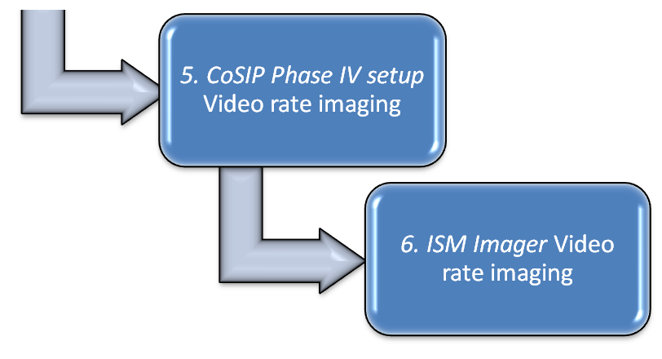
Project Roadmap: Next Steps
05/2017
12/2017
Prototype of a THz-CS stand-off SPC

Slide 27
Thank you!

Slide 28
References
K. B. Cooper, R. J. Dengler, N. Llombart, B. Thomas, G. Chattopadhyay, and P. H. Siegel, THz imaging radar for standoff personnel screening, IEEE Trans. THz Sci. Technol., vol. 1, no. 1, pp. 169–182, 2011.

