Slide 1
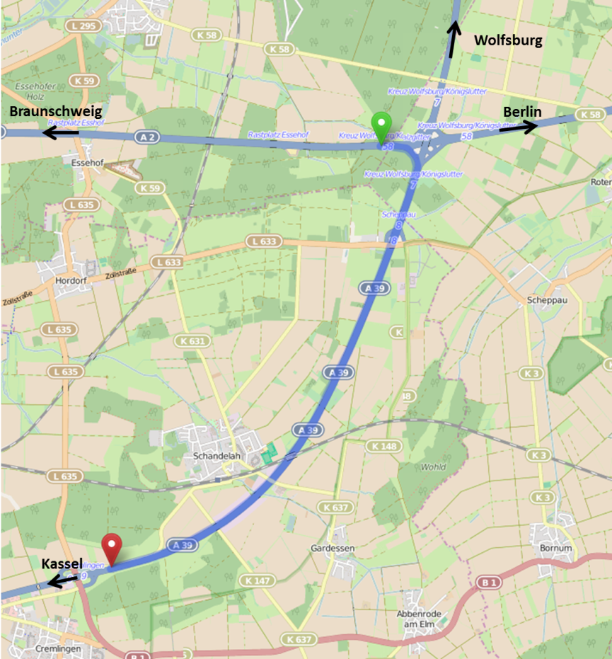
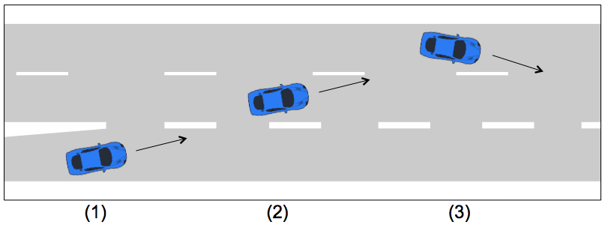
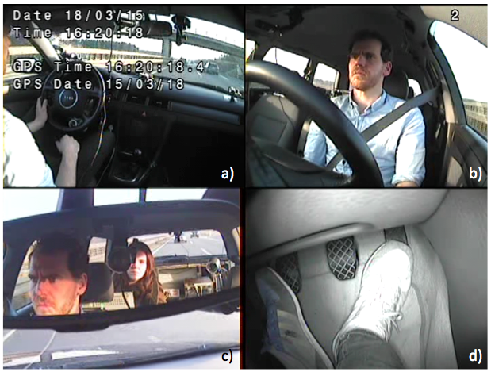
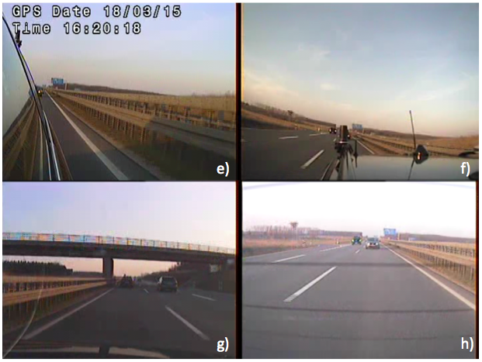
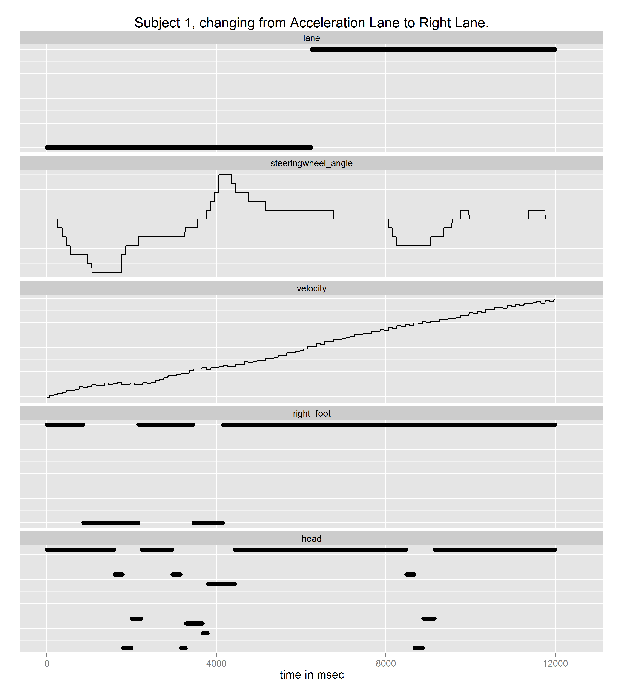
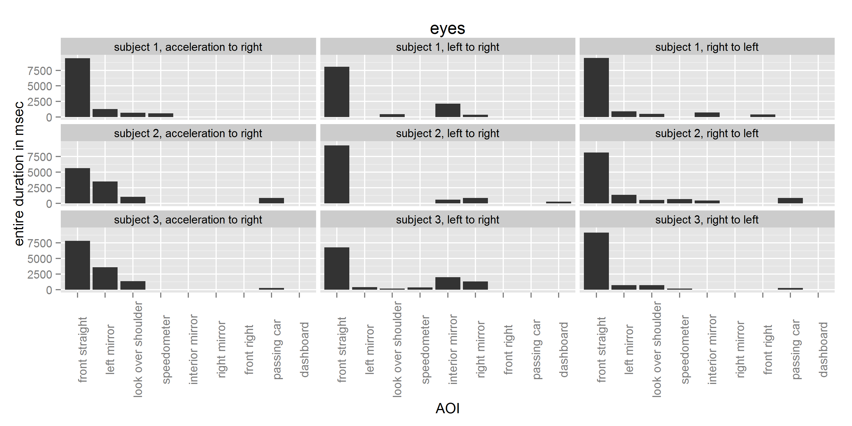
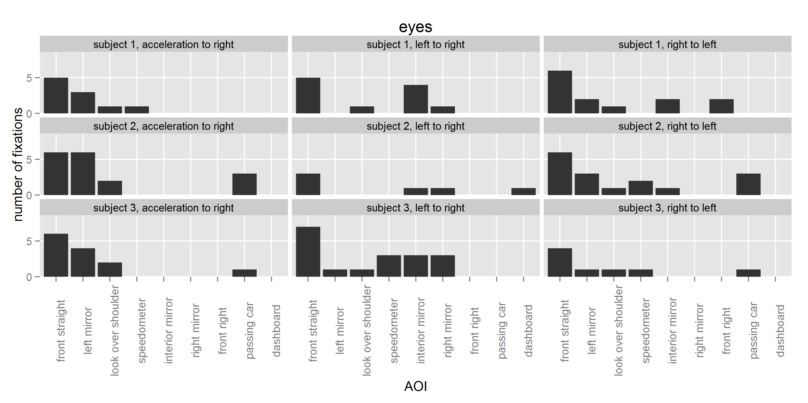
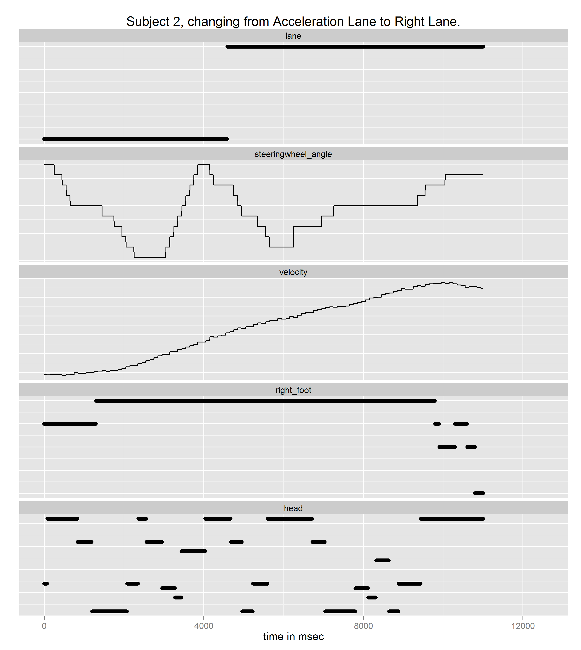
A CPM-GOMS approach for decomposing lane changes on a two-lane highway
David Käthner, Alina Andree, Uwe Drewitz, Klas Ihme
Background
Method
Optimal design of driver assistance requires a detailed understanding of the driving task and driver cognition.
We used CPM-GOMS (John & Gray, 1995) to study both. Its advantages:
structured description of perception, motoric actions and cognition
explicit consideration of the time course of driving manoeuvres
connection of driver behaviour and driving task
grounded in empirical data
3 subjects (1 female, 22-33 yrs)
recording of video and car data
annotation of 3 lane changes
Results
right lane
acceleration lane
5
0
-5
110
100
90
press accelerator strongly
press accelerator medium
front
from front to left mirror
from look over shoulder to front
from left mirror to look over shoulder
look over shoulder
from left mirror to front
left mirror
right lane
acceleration lane
5
0
-5
Preliminary Conclusion
110
100
90
CPM-GOMS well suited for modelling the driving task:
parallelism built-in
different data sources easy to handle
great data representation
usable results at every step
press accelerator medium
press accelerator strongly
press accelerator slightly
rest on accelerator
from left mirror to front
front
from front to left mirror
left mirror
from left mirror to look over shoulder
look over shoulder
from look over shoulder to front
from look over shoulder to left mirror

