Slide 1
Discrete optimisation problems on an adiabatic quantum computer
Tobias Stollenwerk, Elisabeth Lobe, Anke Tröltzsch
Simulation and Software Technology
German Aerospace Center (DLR)
BFG 2015, London, 16.6.2015

Slide 2
Outlook
Introduction to Adiabatic Quantum Computing
Hardware limitations
Application: Clique Problem

Slide 3
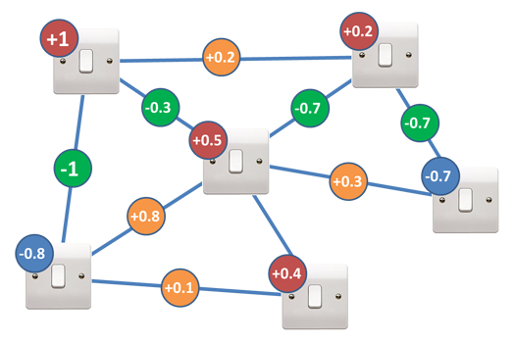
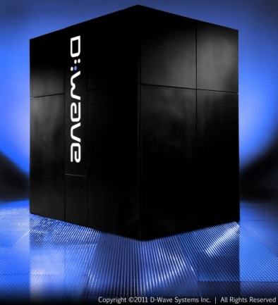
What is an Adiabatic Quantum Computer?
Device by company D-Wave Systems commercially available
We have access to hardware simulator / programming interface
Solver for Quadratic Unconstraind Binary Optimisation Problems (QUBOs)
$E(s_{1},s_{2}$,…, $s_{n}$) = $\sum_{i}{H_{i}s_{i}}$ + $\sum_{ij}{{J_{ij}s}_{i}s_{j}}$ with $s_{i}∈\left\{0,1\right\}$
$$H_{i} ∈$$
On-site strength
$$J_{ij}∈$$
Coupling
Source: D-Wave Sys.

Slide 4
Quantum physics
Eigenvalue equation determines physical state of a system
$$\hat{H} |\left.ψ_{i}\right\rangle =E_{i}|\left.ψ_{i}\right\rangle$$
where $E_{i}$ is the energy of the state and $|\left.ψ_{i}\right\rangle ∈$Hilbert space and $\hat{H}$ is the Hamilton operator.
Discrete Eigenvalues lead to quantised energy levels.
…
Energy
$$E_{3}$$
$$E_{2}$$
$$E_{1}$$
Notes:
E, H und psi auflisten

Slide 5
Measurement in Quantum physics
Let the system be in a superposition of energy Eigen states $|\left.ψ_{i}\right\rangle$
$$|\left.χ\right\rangle =\sum_{i}{a_{i}|\left.ψ_{i}\right\rangle }$$
Measurement of energy $E_{j}$ changes state
$$|\left.χ\right\rangle →|ψ_{j}〉〈ψ_{j}| |χ〉=a_{i} |ψ_{j}〉$$
Probability $P_{j}$ to measure state $|ψ_{j}〉$
${P_{j}= \left|a_{i}\right|}^{2}$
Notes:
E, H und psi auflisten

Slide 6
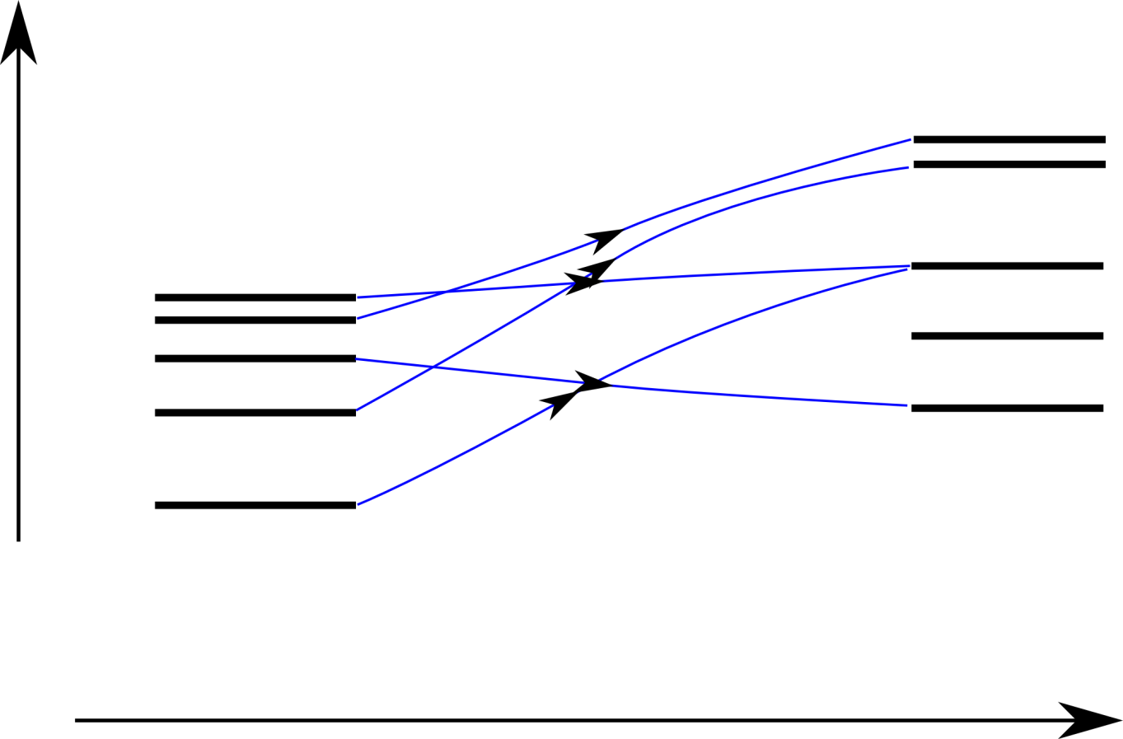
Adiabatic Quantum Computer – How does it work?
Encode objective function in ground state of quantum system
Initial system groundstate simple and implementable
Energy levels
Energy
Fast transition
Initial system
Final system
Time
Notes:
Cite Farhi

Slide 7
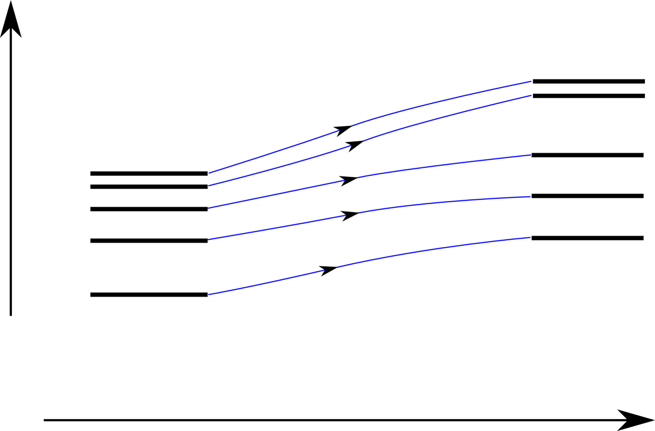
Adiabatic Quantum Computer – How does it work?
Sufficiently slow (adiabatic) transition to final system
Lowest energy gap $ΔE$determines runtime
Energy levels
Energy
$$ΔE$$
Slow transition
Initial system
Final system
Time
Notes:
Cite Farhi

Slide 8
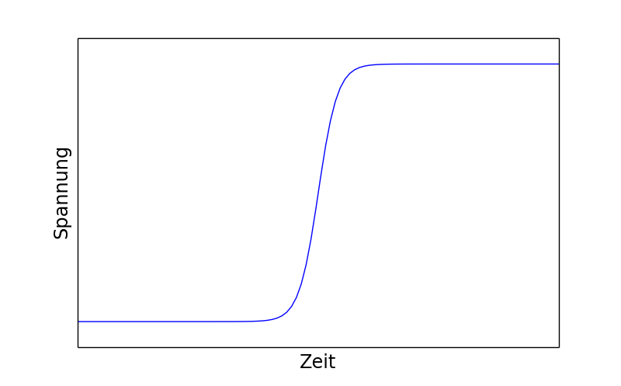
Quantum Bits – Two Level Quantum Systems
Classical bits
Quantumbits (Qubits)
Voltage
State is Superposition of „0“ und „1“
$$\left|\left.φ\right\rangle \right.=a\left|\left.0\right\rangle \right.+b\left|\left.1\right\rangle \right.$$
Measurement changes the state
Observe „0“ with probability ${{\left|a\right|}^{2} }^{ }$
$$ \left|\left.φ\right\rangle \right.=\left|\left.0\right\rangle \right.$$
Observe „1“ with probability ${{\left|b\right|}^{2} }^{ }$
$$ \left|\left.φ\right\rangle \right.=\left|\left.1\right\rangle \right.$$
Multiple Qubits ${\left|\left.χ\right\rangle \right.}_{12}$ = $\left|{\left.ψ\right\rangle }_{1}\right. ⨂{\left|\left.φ\right\rangle \right.}_{2}$
e.g. ${\left|\left.χ\right\rangle \right.}_{12}$ = $\left|{\left.0\right\rangle }_{1}\right. ⨂{\left|\left.1\right\rangle \right.}_{2}$
1
0
Notes:
Bild übersetzten

Slide 9
Adiabatic Optimisation Procedure
0
1
0
1
0
1
0
1
0
0
1
1
0
1
0
1
1
0
All qubits in „mixed state“
Solution
0
1
= $\frac{1}{√2} ( | 0〉+|1〉)$
1
= $|1〉$
Farhi et. al., Quantum Computation by Adiabatic Evolution (2001)

Slide 10
Why use an Adiabatic Quantum Computer?
QUBO / Ising is NP-hard
Quantum speed-up assumed but subject to discussion
(Defining and detecting quantum speedup, Rønnow et. al., Science 345, 1695, (2014))
Map other NP-hard problems to QUBO/Ising
(Ising Formulations of many NP problems, A. Lucas, Frontiers in Physics (2014))

Slide 11
Hardware limitations on a D-Wave device
$$H_{i}$$
Unit cell with 8 Qubits
an 2 partitions
8x8 Unit cells on D-Wave On chip
⇒ 512 Qubits
Range of strenghts $H_{i}$ and couplings $J_{ij}$ limited and subject to uncertainties
$$J_{ij}$$

Slide 12
Hardware limitations on a D-Wave device
Not all Qubits are connected
How to realise complete graphs?
Solution:
Connection via other qubits
Representation of a logical qubit with several physical qubits

Slide 13
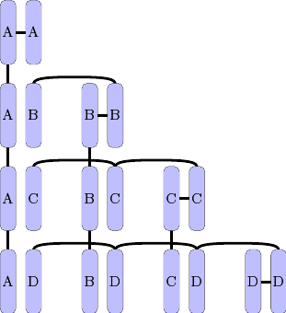
Overcome connectivity limitation
Rule for implementing a complete graph onto the D-Wave hardware:
Source: D-Wave Sys. Simulator Software Documentation

Slide 14
Maximum Clique problem - Example
1
Find largest complete subgraph
2
3
4
5
6
7
8
9
10

Slide 15
Maximum Clique problem - Example
2
3
1
4
10
5
9
6
8
7

Slide 16
Clique problem as QUBO
$$−1$$
$$−1$$
Set negative strength at all nodes, e.g. $H_{i}=−1$
Penalise all edges of graph complement with positive couplings, e.g. $J_{ij}=+10$
Edges of the graph itself can be activated without penalty,
2
3
$$H_{i}=−1$$
1
$$+10$$
4
10
5
$$−1$$
9
6
$$−1$$
$$−1$$
$E(s_{1},s_{2}$,…, $s_{n}$) = $\sum_{i}{H_{i}s_{i}}$ + $\sum_{ij}{{J_{ij}s}_{i}s_{j}}$
8
7
$$−1$$
$$−1$$

Slide 17
Cliquen Problem on D-Wave Device
1 logical qubit $→$ 4 physical qubits
5
5
5
5
-7
-7
-7
-1
1
2
3
4
5
6
7
8
9
10

Slide 18
Reduce Number of Qubits by Clique Problem
Improvement by hand: Reduce physical qubits from 40 $→$ 15
In general: Embed maximal clique to hardware by scheme

Slide 19
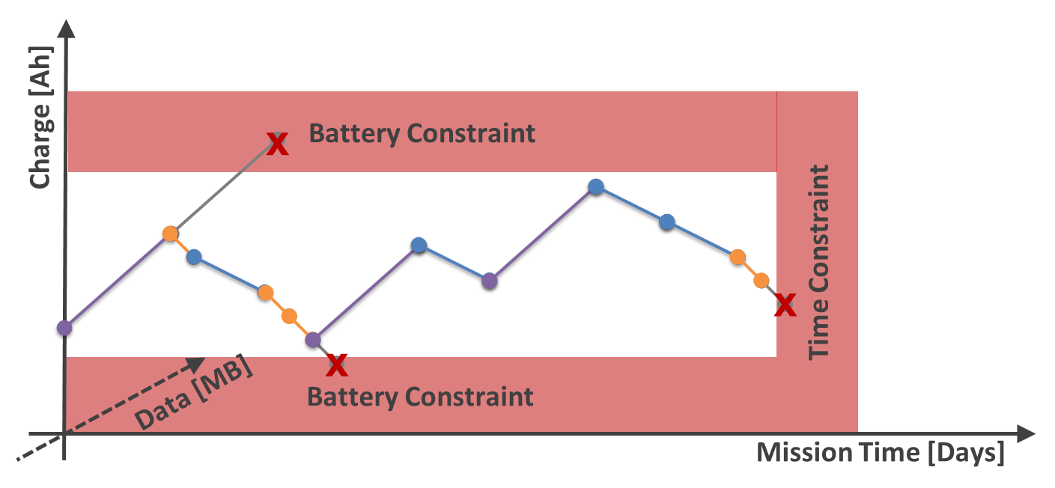
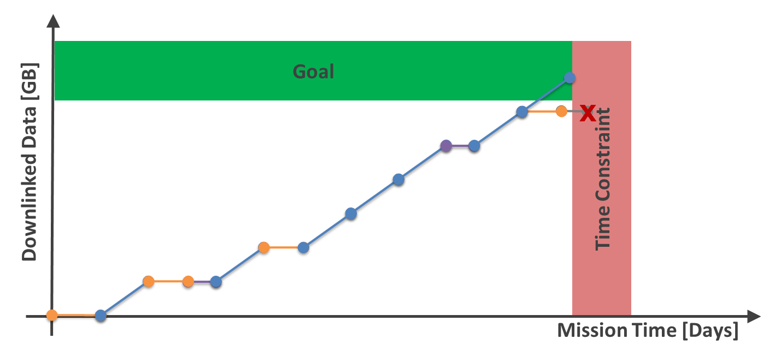
Outlook – Applicability to satellite scheduding
Objective: Maximal data downlink
Constraints:
Battery
Experiment (Obtain data)
Schaus et. al. A Continuous Verification Process in Concurrent Engineering. AIAA Space 2013

Slide 20
Outlook
What kind of problems can be converted to QUBO?
Combine conventional algorithms with AQC (hybrid approach)
Investigate scaling behaviour

